Slide 1
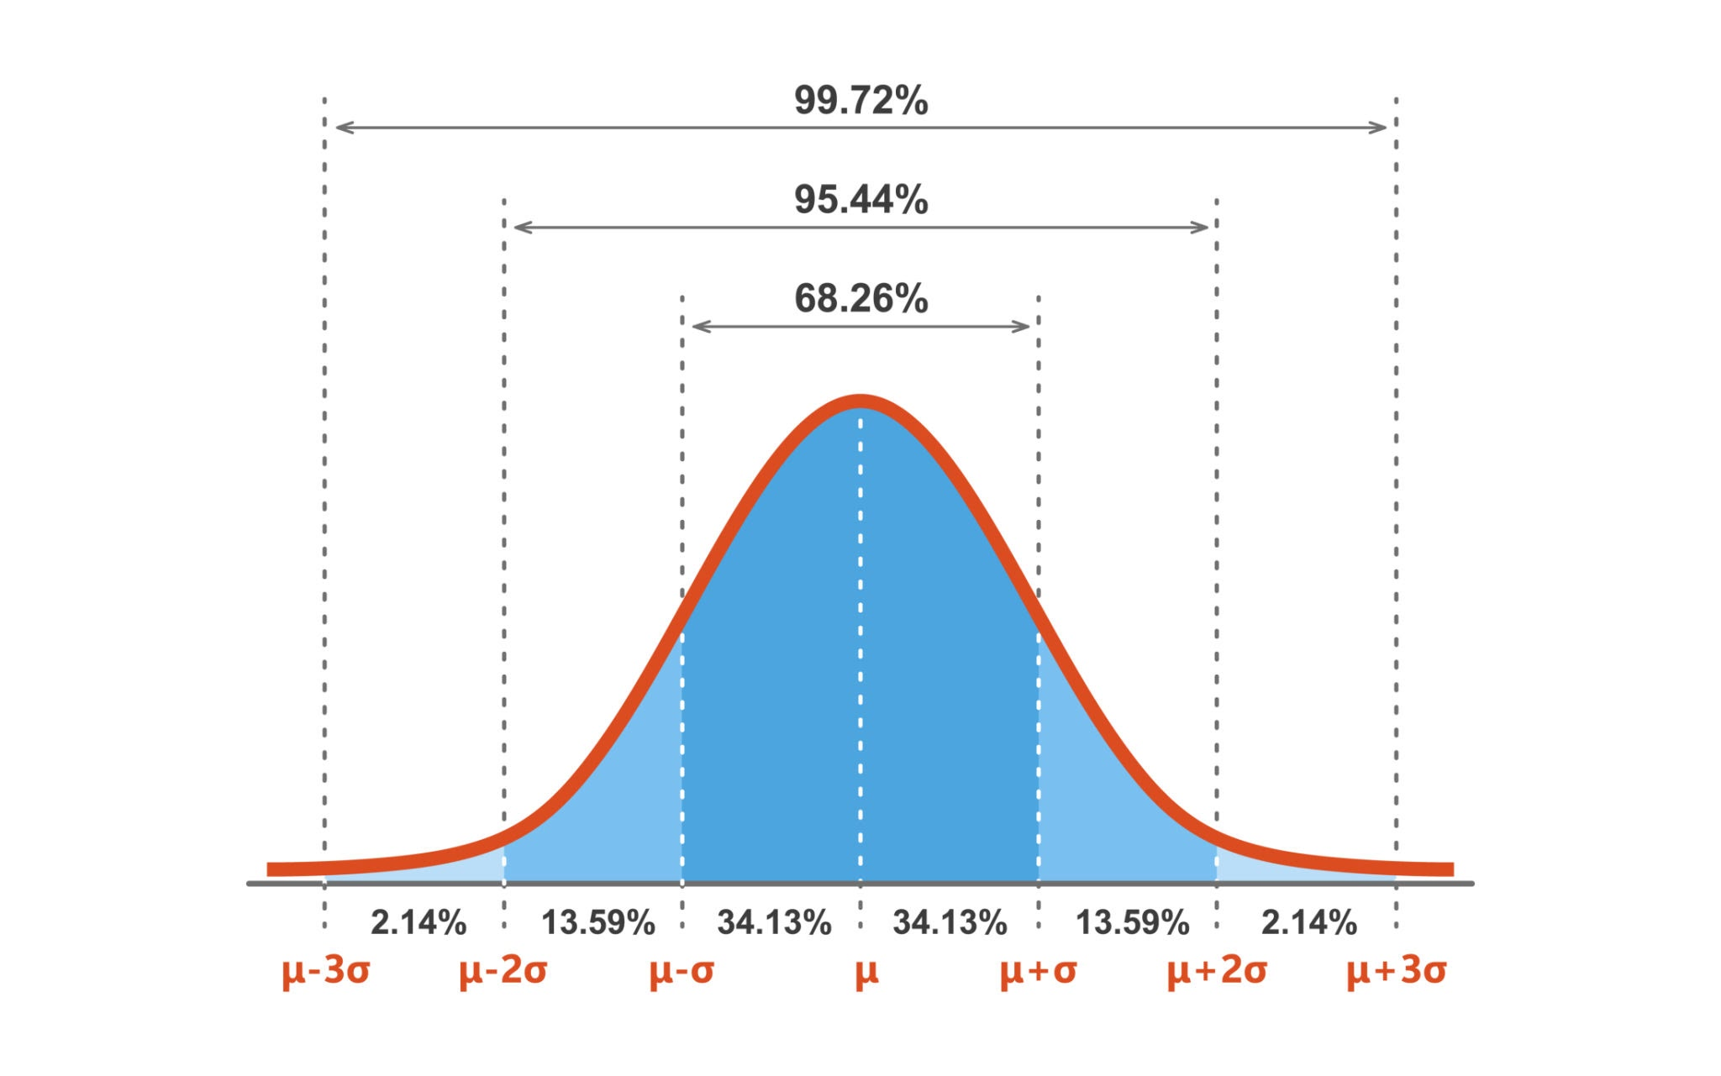
Método de Montecarlo

Slide 2
Adición
Ejemplo de generación
aleatoria de valores
Total Dimension =
12 ⁺¹ -1 + 12 ⁺² -3 = 24 ⁺³ -4
Dimensión 1 Diemnsión 2 Resultado
11.9888 mm + 11.4002 mm = 23.3890 mm
12.0792 mm + 11.5062 mm = 23.5854 mm
11.7967 mm + 10.7901 mm = 22.5868 mm
12.1302 mm + 11.6459 mm = 23.7761 mm
12.1101 mm + 11.0504 mm = 23.1605 mm
11.8141 mm + 11.6003 mm = 23.4143 mm
12.1218 mm + 11.1080 mm = 23.2297 mm
11.8287 mm + 11.6764 mm = 23.5051 mm
12.0501 mm + 11.5025 mm = 23.5526 mm
11.7606 mm + 11.7964 mm = 23.5570 mm
12 ⁺¹ -1
12 ⁺² -3
24 ⁺³ -4

Slide 3
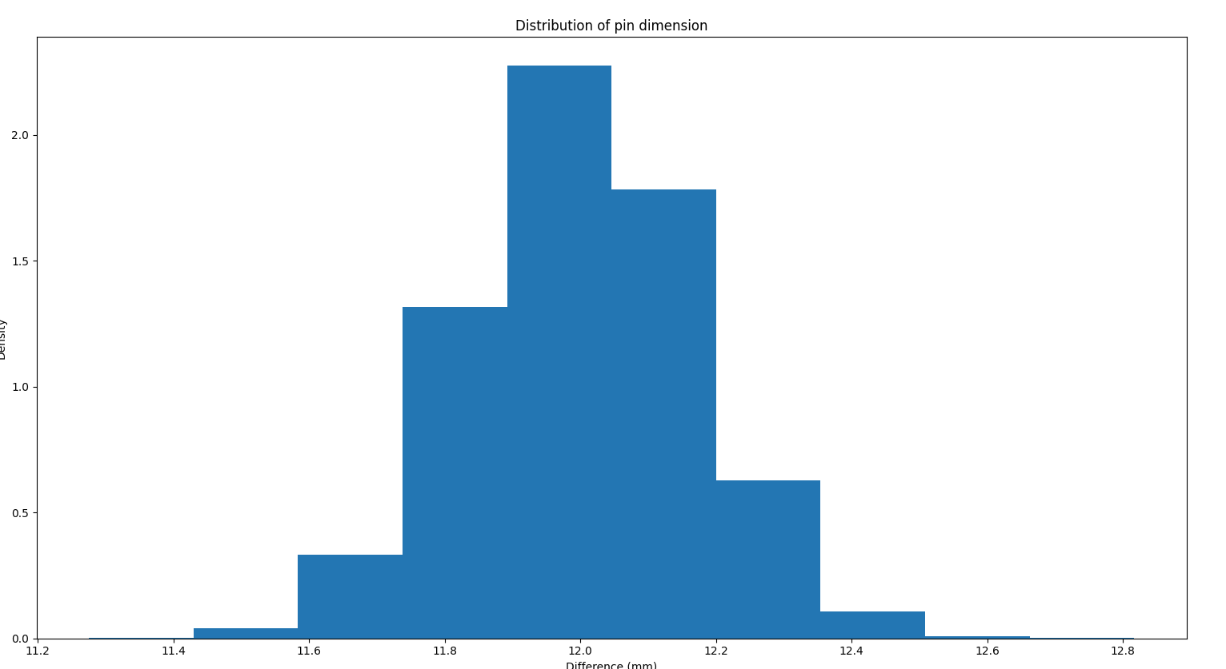
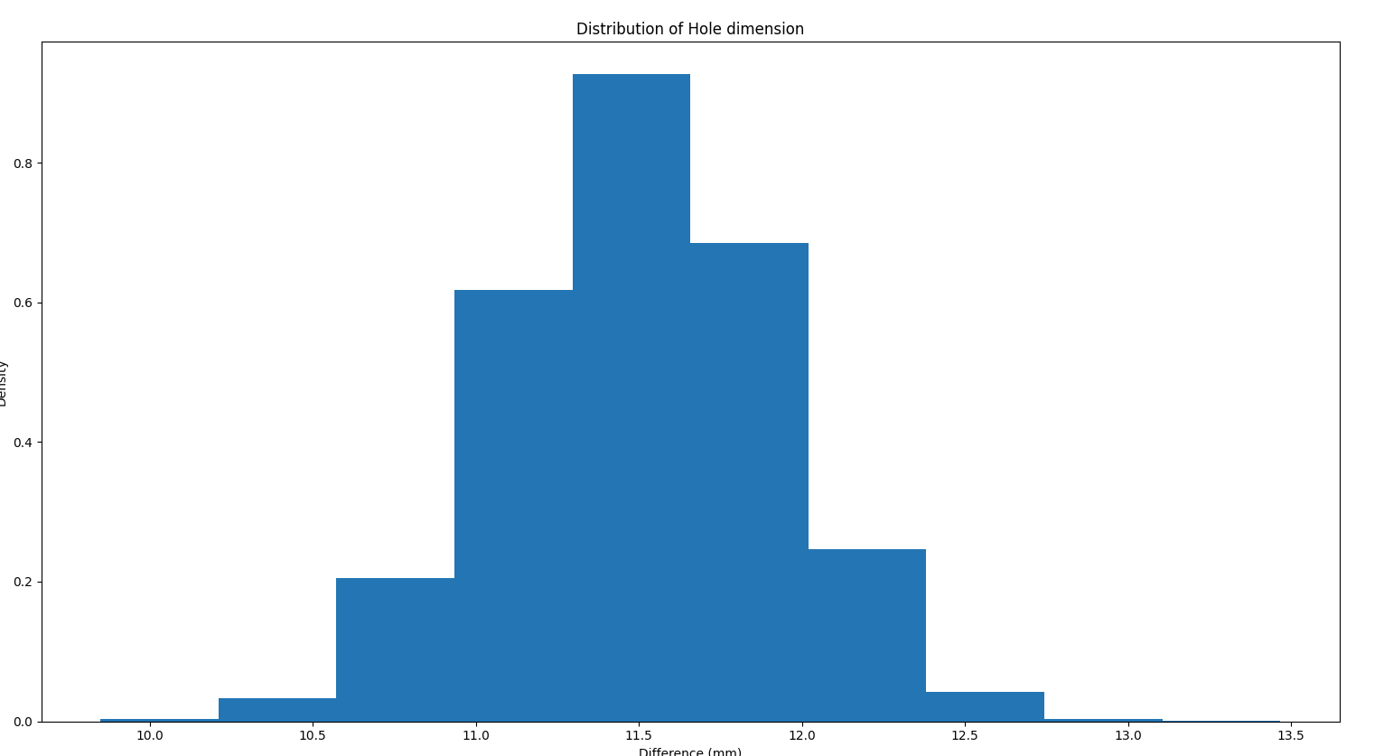
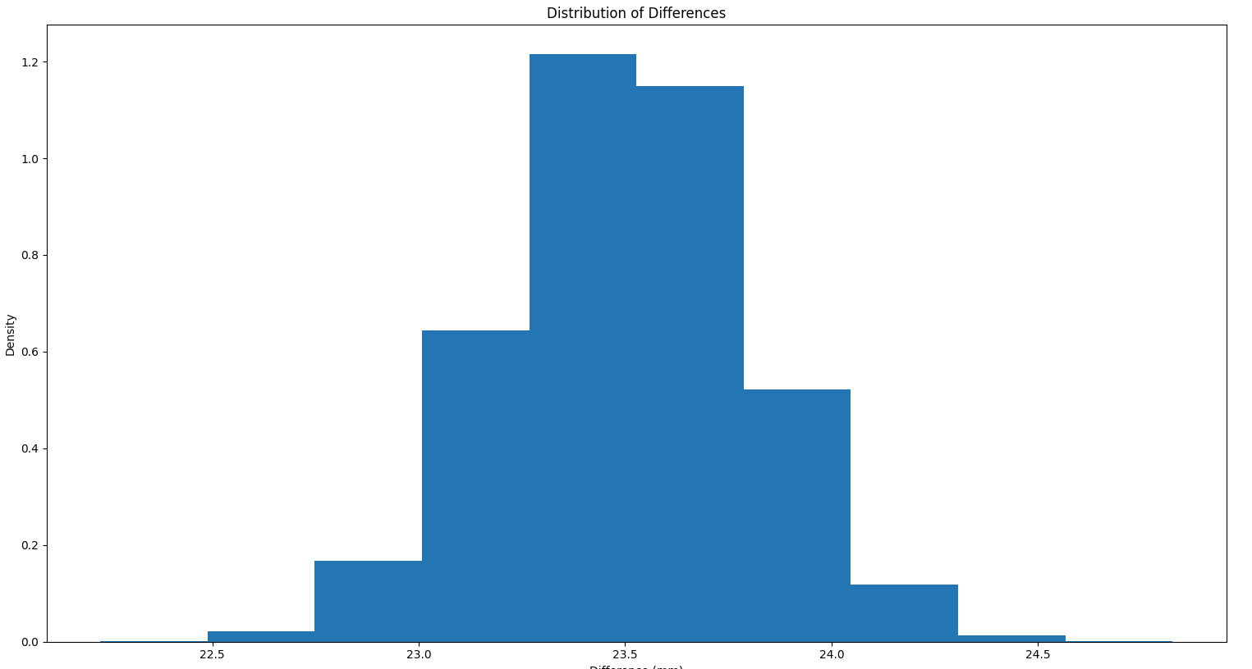
Adición

Slide 4
Resta
GAP = 12 ⁺²-1 – 10⁺¹-1 = 2 ⁺³-2
10 ⁺¹ -1
Agujero Pin Resultado
12.4013 - 10.1610 = 2.2403 mm
12.4618 - 10.0422 = 2.4196 mm
12.7374 - 9.8586 = 2.8788 mm
12.4705 - 10.0815 = 2.3889 mm
12.5313 - 9.9371 = 2.5942 mm
12.4115 - 10.0713 = 2.3402 mm
12.1490 - 10.1215 = 2.0274 mm
12.3812 - 9.9832 = 2.3979 mm
12.3237 - 9.8718 = 2.4520 mm
12.3452 - 9.8871 = 2.4581 mm
GAP
12 ⁺² -1

Slide 5
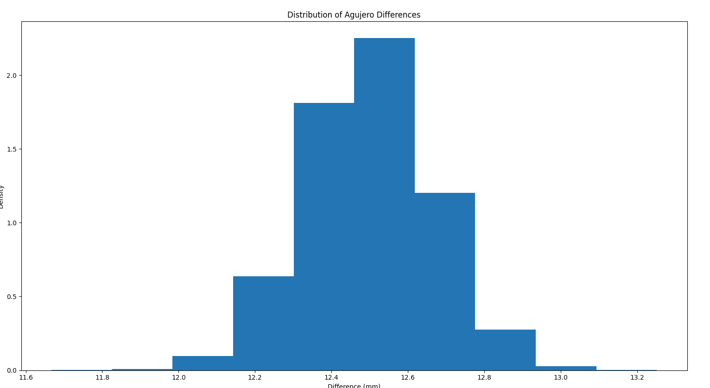
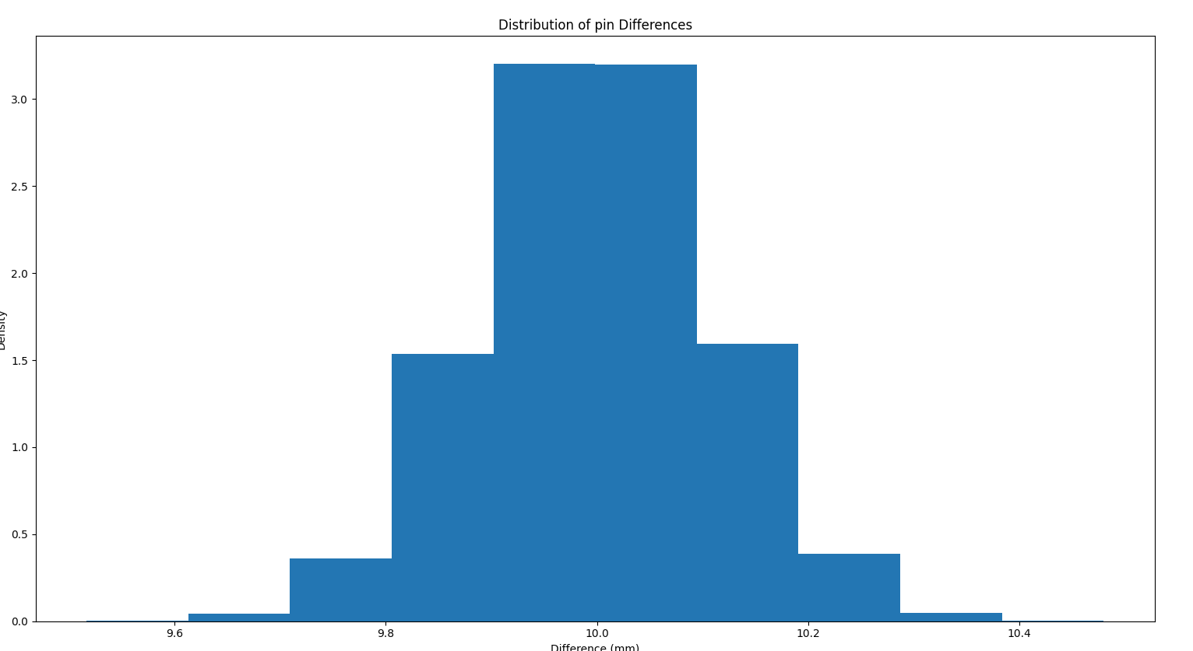
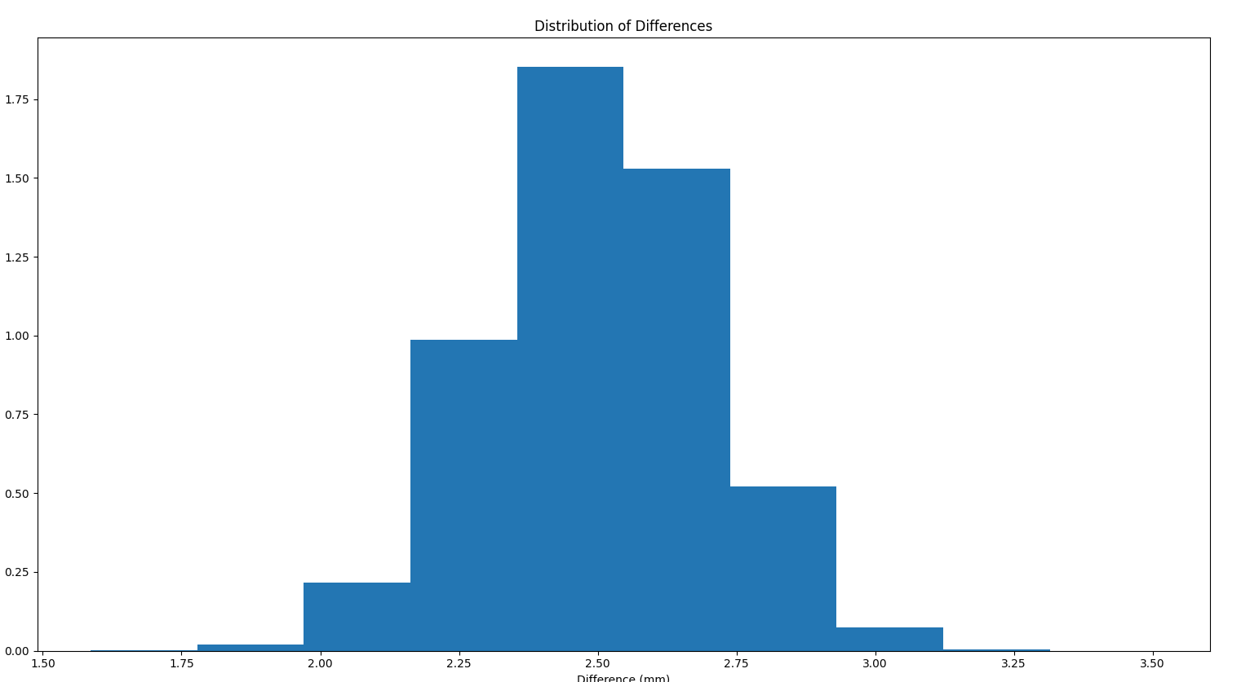
Resta

Slide 6
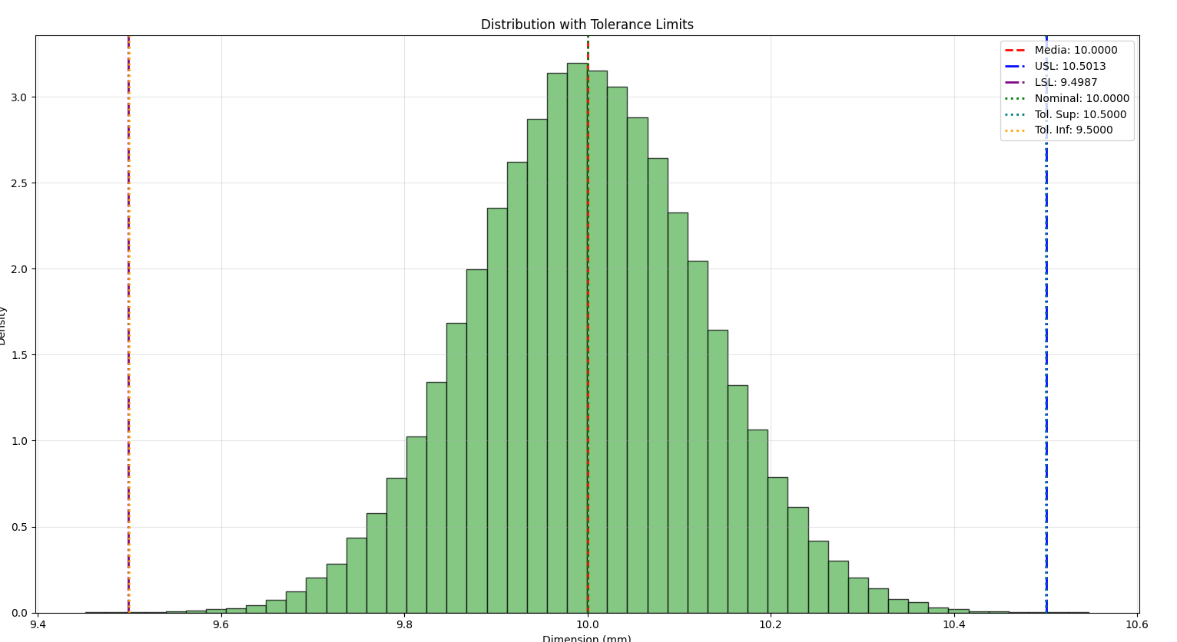

Slide 7
? ^{+?} -?
5 ⁺¹ -0.75
3.5 ^{+0.3} -0.1
1 ^{+0.5} -0.25
4 ^{+0.1} -0.2
24 ⁺³ -4
Total Dimension = 24 ⁺³ -4 - 5 ⁺¹ -0.75 - 4 ^{+0.1} -0.2 - 3.5 ^{+0.3} -0.1=
24 ⁺³ -4 - (5 ⁺¹ -0.75 + 4 ^{+0.1} -0.2 + 3.5 ^{+0.3} -0.1)=
24 ⁺³ -4 – 12.5^{+1.4} -1.05=
Total Dimension = 11.5^{+4.05}-5.4

Slide 8
