Slide 1
Lab 5: Firewalls & NATs
Learning iptables

Slide 2
Firewalls & NATs
Goals:
  Explore different firewall rule configurations using iptables
  Configure network address translation (NAT) on a given topology
  Learn how to implement a port forwarding mechanism

Slide 3
Evaluation
Where
  Lab 5: Firewalls & NATs on Moodle (already opened)
Submission due
  Thursday, 16 December, 23h59
Assessment due
  Sunday, 19 December, 23h59

Slide 4
Firewalls & NATs
Firewall & iptables
  Firewall: mechanism that controls incoming and outgoing network traffic according to configured security rules
  Iptables: a Linux utility that allows the definition and configuration of IP packet filter rules on a network host
iptables -I INPUT -p tcp -j DROP
“Drop all incoming tcp packets.”

Slide 5
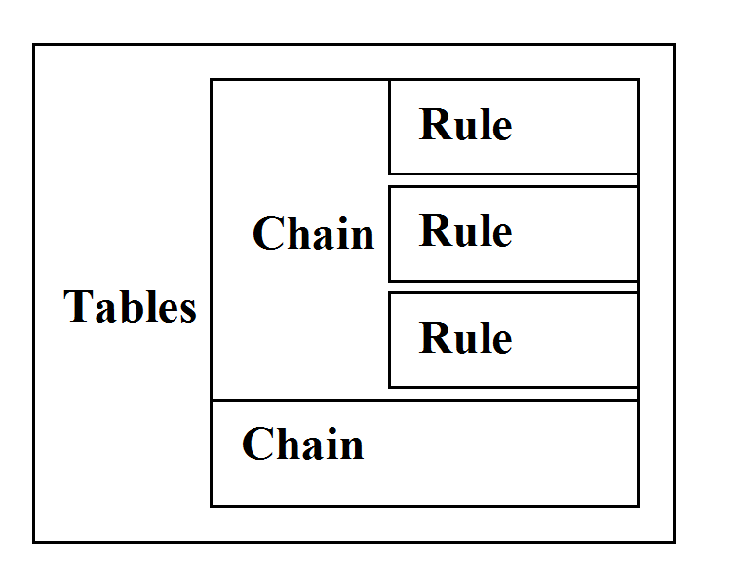
Firewalls & NATs
Iptables - Structure
  Iptables are divided into various tables
  Each table is composed of several rule chains
  Each rule will be used to match a given packet

Slide 6
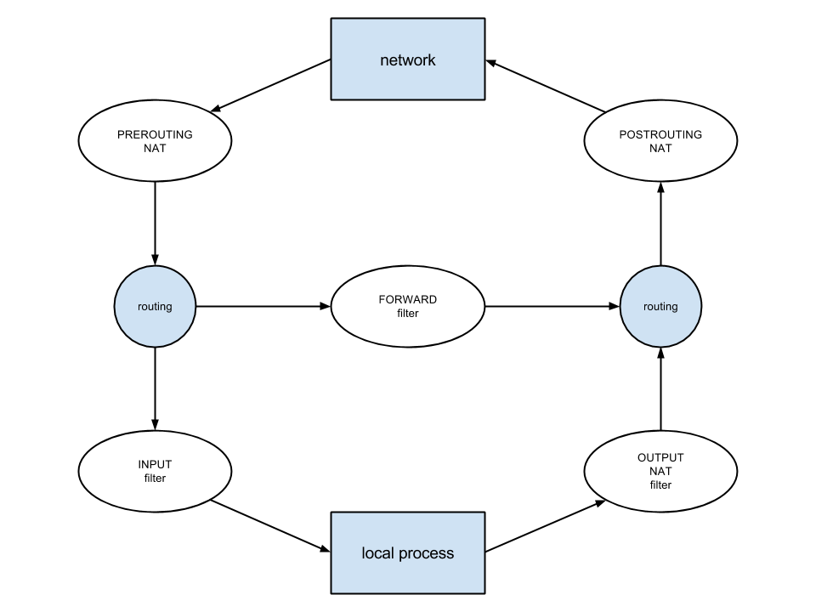
Firewalls & NATs
Iptables – Packet Flow
  Packets are processed by sequentially traversing the various rules in each applying chain, and certain rules may cause a packet to jump to another chain
  Besides the predefined chains, user-defined chains can also be configured

Slide 7
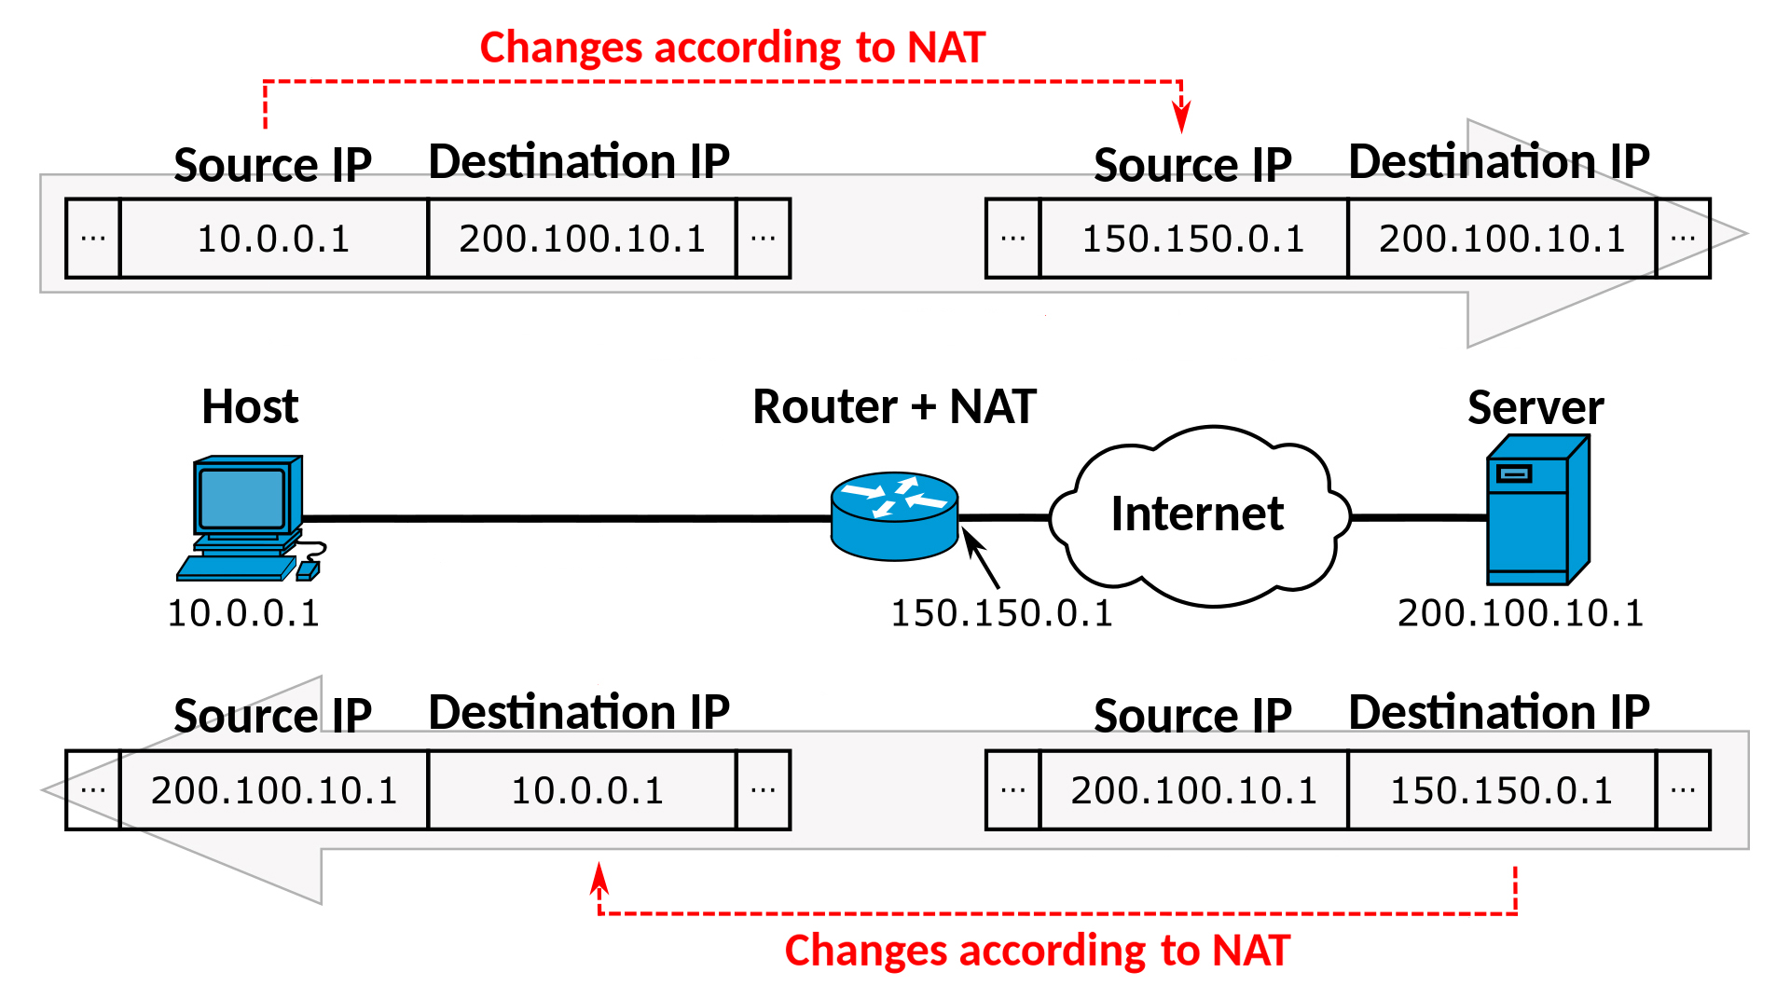
Firewalls & NATs
Network Address Translation (NAT)
  The process of rewriting the source or destination IP address of a packet traversing a network
  In iptables, a built-in NAT table allows the configuration of both Source NAT (SNAT) and Destination NAT (DNAT) rules
    PREROUTING chain
    POSTROUTING chain

Slide 8
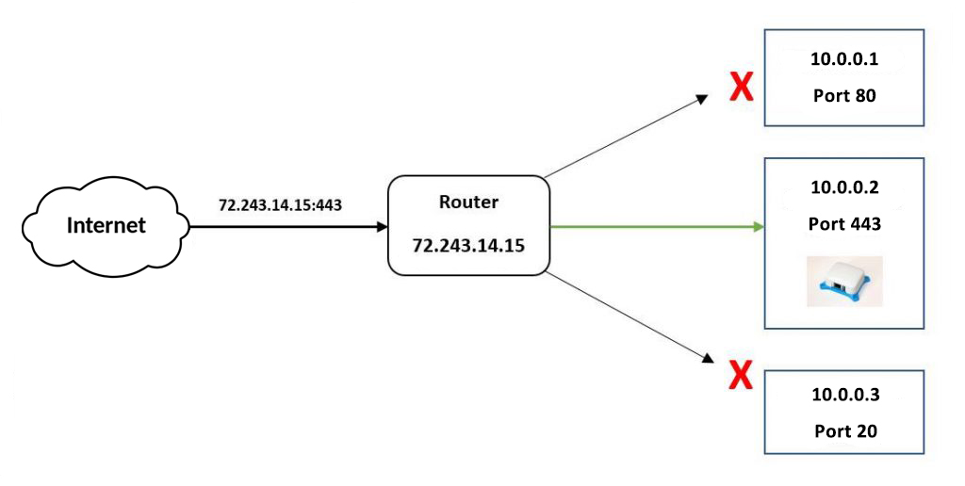
Firewalls & NATs
Port forwarding
  The process of forwarding traffic for a specific port to another host
  Considered a NAT operation, as it modifies a packet’s destination as it traverses the network

