Slide 1
Rell basics
Downloads and asimple application

Slide 2
Introduction to Rell
Rell is a programming language that makes it possible to combine the features of the relational database and blockchain
With Rell the developer can create a database and put it into the cromia platform.
The Rell-syntax is interpreted down into Kotlin/SQL

Slide 3
Download PostgreSql
First we need to have PostgreSql as the database manager
Go to https://www.postgresql.org/download/ and download the latest version.
Make sure that pgAdmin is installed alongside postgresql since we will be using pgAdmin in this tutorial, if you are familiar with postgresql this step will be optional

Slide 4
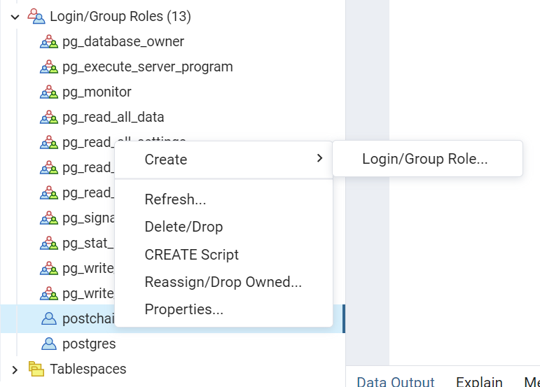
Create postchain role in postgres(optional)
Click on Login/Group -> Create
-> Login/Group Role

Slide 5
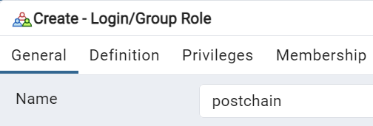
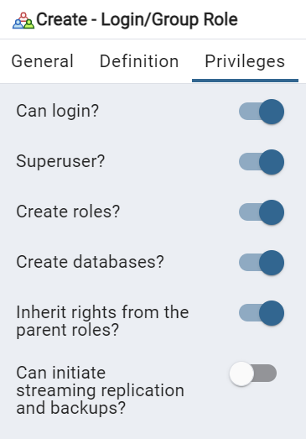
Give postchain privileges and in the definitions tab,
Set the password to anything to your liking.
The default in rell projects is ‘postchain’

Slide 6
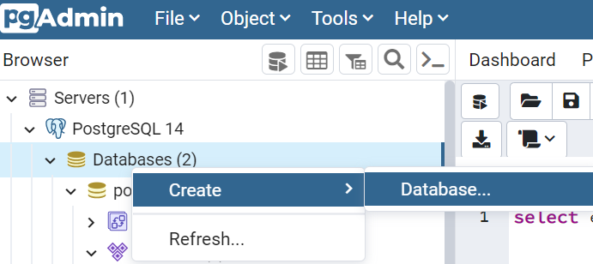
Create a Database in pgAdmin
Select Databases -> Create -> Database

Slide 7
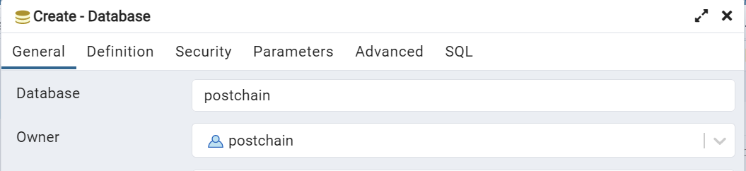
Creating a Database in pgAdmin
If you have created the postchain
Role, set it to the owner of the
new database.
Click save and your
database should be up and
running

Slide 8
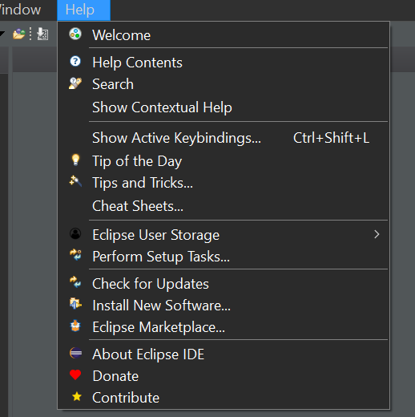
In Eclipse
Go to the Help tab
Click on : Install new software

Slide 9
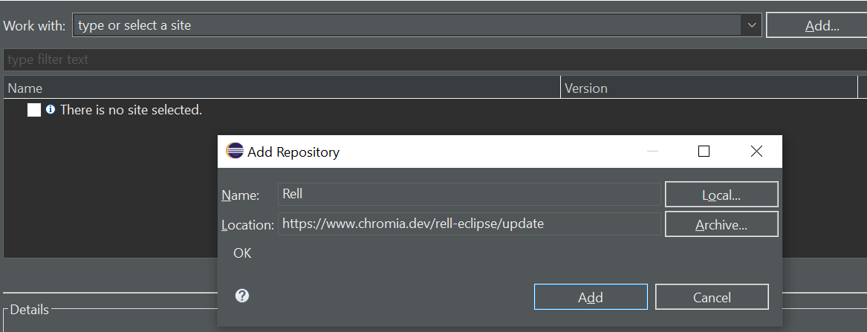
Add Rell Plugin
3. Click on Add
4. Have Rell as the name and https://www.chromia.dev/rell-eclipse/update as location and add.
Check the box next to Rell, then click on next and finish.

Slide 10
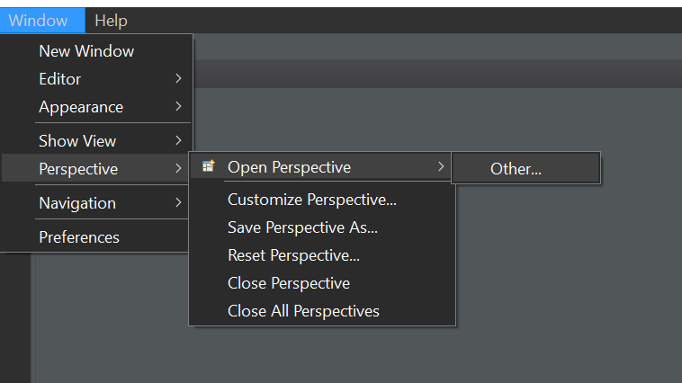
Changing to a Rell perspective
Go to window → perspective →open Perspective → other

Slide 11
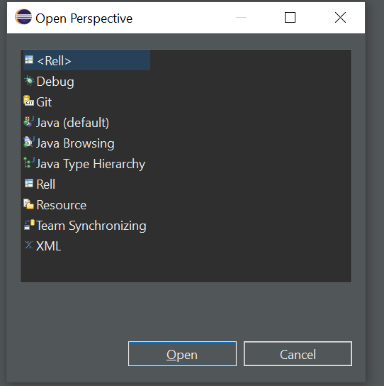
Select Rell and open

Slide 12
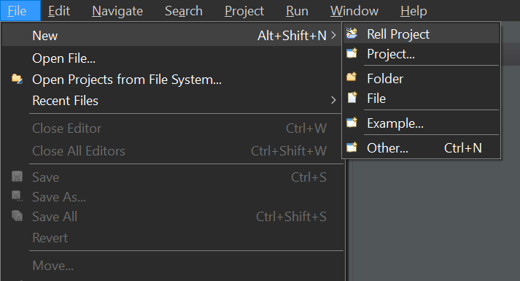
Open a Rell project
Now we can open a Rell project

Slide 13
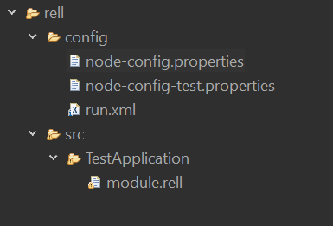
Config properties
In the node-config.properties file,
you can change the user logging into the
Postgres database and what port the
client will listen to.

Slide 14
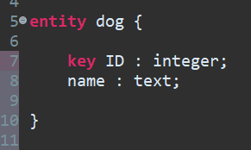
Entity
In Rell, an Entity is the data model we use in the database
The key identifier means that the attribute is unique for each instance of the entity.

Slide 15
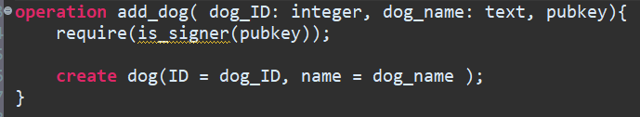
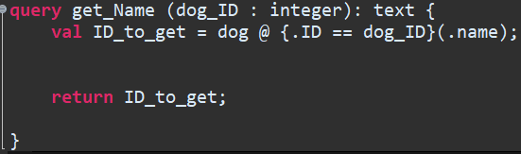
Operations and queries
operation is used when we want to modify data in the database
query is used when we want to retrieve data from the database

Slide 16
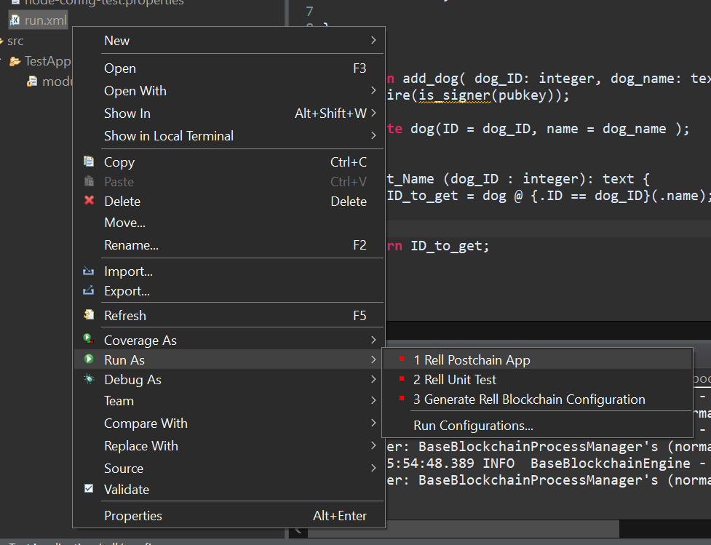
Running the Rell program
Right click on the run.xml file in your eclipse project, from there, choose
Run As -> Rell Postchain App
You now have a node up and running, now we will write a clientside program to communicate with it.

Slide 17
Clientside
Download the package ‘postchain-client’ using npm
With the command npm install ‘postchain-client’
This also requires you to have node js installed

Slide 18
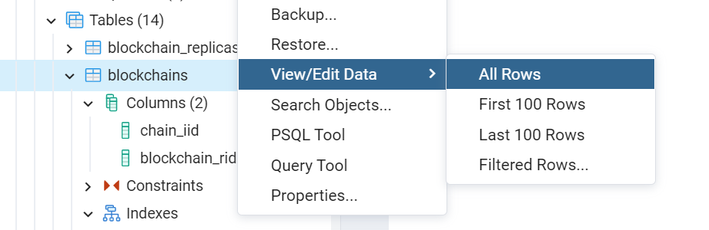
Finding the BRID
Now this next part will be to query our database inside pgadmin, we want to find the BRID to paste into our client, but to do that we have to find it in the database.
Start by going into the postchain database
in pgAdmin and from there select
schemas ->rell_app -> tables -> blockchains.
Right click on blockchains and select View/Edit Data ->
All Rows

Slide 19
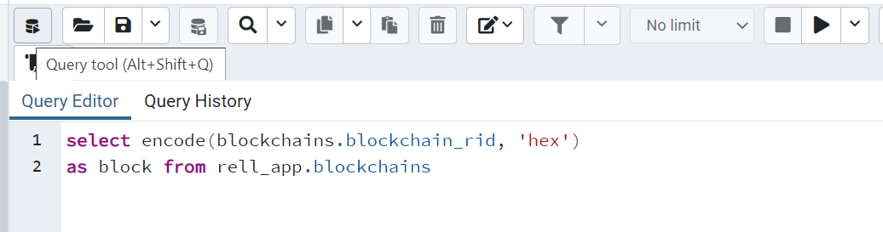
Finding the BRID
We will now click on the query tool and type in the following query:
Press the play button in the top right corner to perform the query, the BRID will be presented below the editor

Slide 20
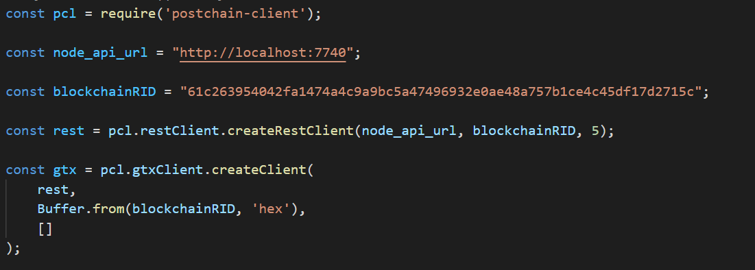
Connect client to database
Open a text editor for javascript and put this piece of code in the beginning of the file to connect to the database. Replace the blockchainRID with the BRID you received from the task in the previous slide.

Slide 21
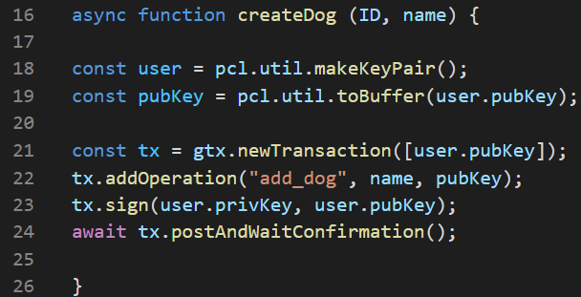
Calling on operation add_dog in the client
All operations require that we sign the transaction, we therefore create a key pair.
With (general transaction client) gtx we create a new transaction which we later sign when we are finished with the operations.

Slide 22
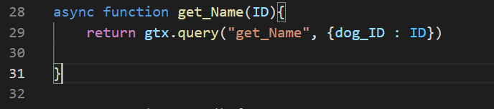
Calling on query get_Name in the client
When we call on query in the client we have to define which parameter in the client that corresponds to the parameter in the rell query

Slide 23
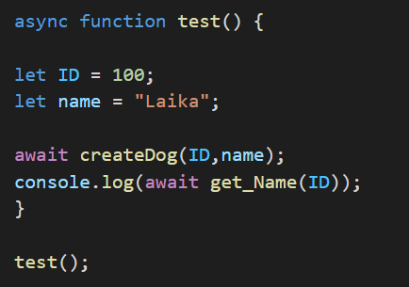
Use the created functions
We can now run the program with this simple implementation.

