Slide 1
Lesson 2
UIScrollView ,UITableView,UICollectionView, Layered Stack, Vertical Stack, Horizontal Stack.

Slide 2
UIScrollView
A view that allows the scrolling and zooming of its contained views.

Slide 3
Open a project
file:///Users/yernur/Desktop/OneLab2023/Lesson2/FirstScrollView/FirstScrollView.xcodeproj/
Iphone 14 pro simulator: FirstScrollView

Slide 4
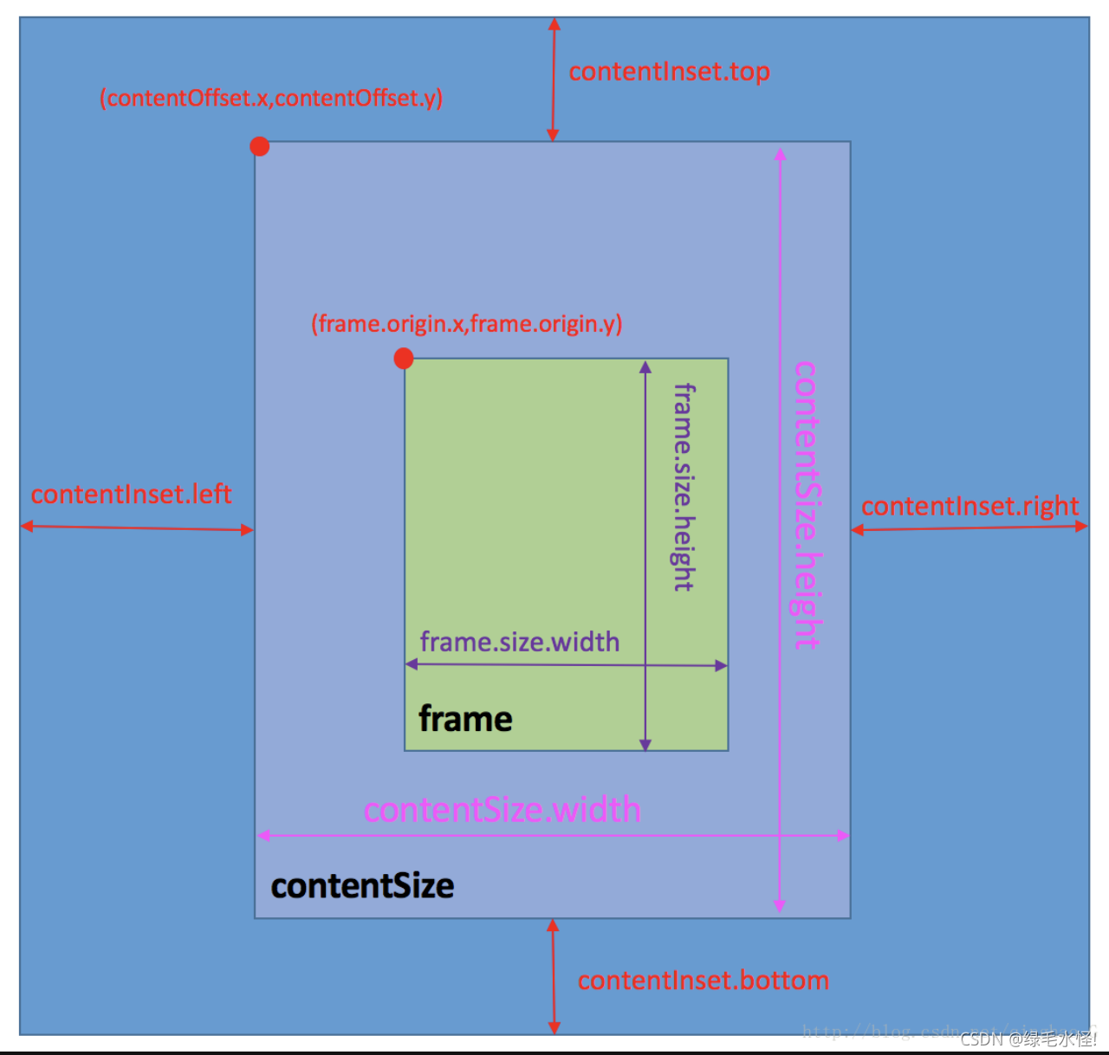

Slide 5
Open a project
file:///Users/yernur/Desktop/OneLab2023/Lesson2/ScrollViewProject/ScrollViewProject.xcodeproj/
Iphone 14 pro simulator: ScrollViewProject

Slide 6
UITableView
A view that presents data using rows in a single column.

Slide 7
Open a project
file:///Users/yernur/Desktop/OneLab2023/Lesson2/TableAndCollectionView/TableAndCollectionView.xcodeproj/
Iphone 14 pro simulator: TableAndCollectionView

Slide 8
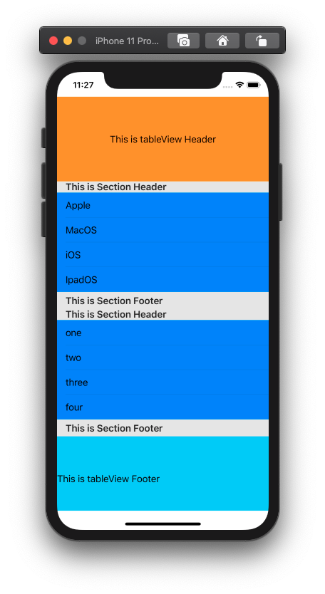

Slide 9
UICollectionView
An object that manages an ordered collection of data items and presents them using customizable layouts.

Slide 10
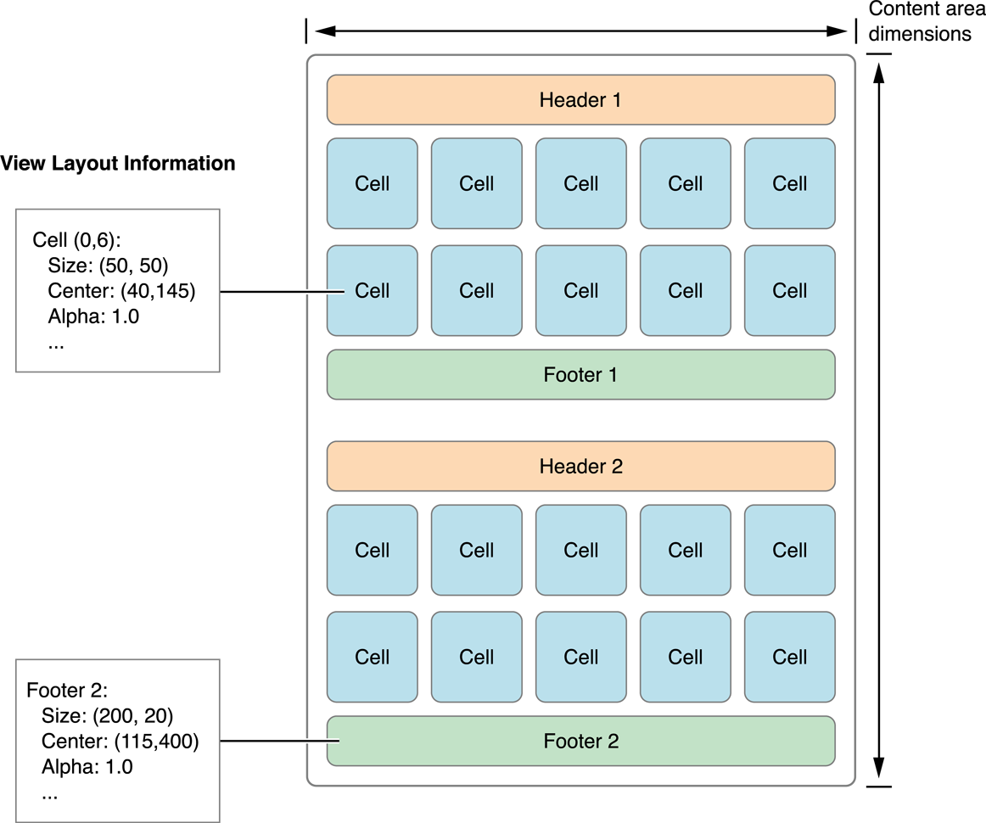

Slide 11
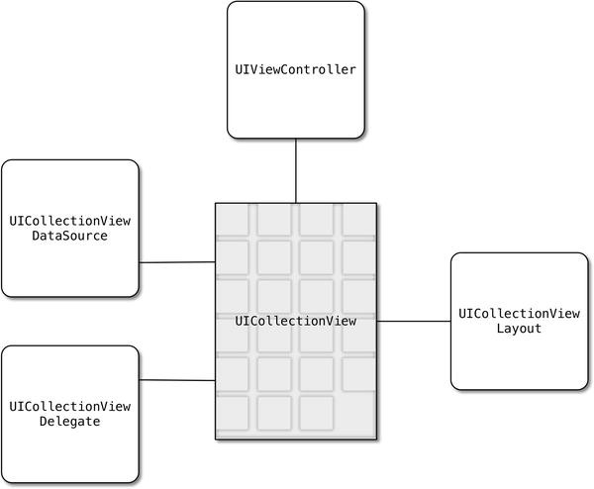

Slide 12
Open a project
file:///Users/yernur/Desktop/OneLab2023/Lesson2/TableAndCollectionView/TableAndCollectionView.xcodeproj/
Iphone 14 pro simulator: TableAndCollectionView

Slide 13
Projects
ZapisDemoVIP
NewsApp
Finder

Slide 14
UIScrollView, UITableView,UICollectionView, Layered Stack, Vertical Stack, Horizontal Stack.

Slide 15
SwiftUI
Declare the user interface and behavior for your app on every platform.
SwiftUI provides views, controls, and layout structures for declaring your app’s user interface. The framework provides event handlers for delivering taps, gestures, and other types of input to your app, and tools to manage the flow of data from your app’s models down to the views and controls that users see and interact with.
https://developer.apple.com/documentation/swiftui

Slide 16
Open a project
file:///Users/yernur/Desktop/OneLab2023/Lesson2/WheaterAppProject/WheaterAppProject.xcodeproj/

Slide 17
H/w
1 screen uiscrollview, tableView, collectionView, swiftUI

Slide 18
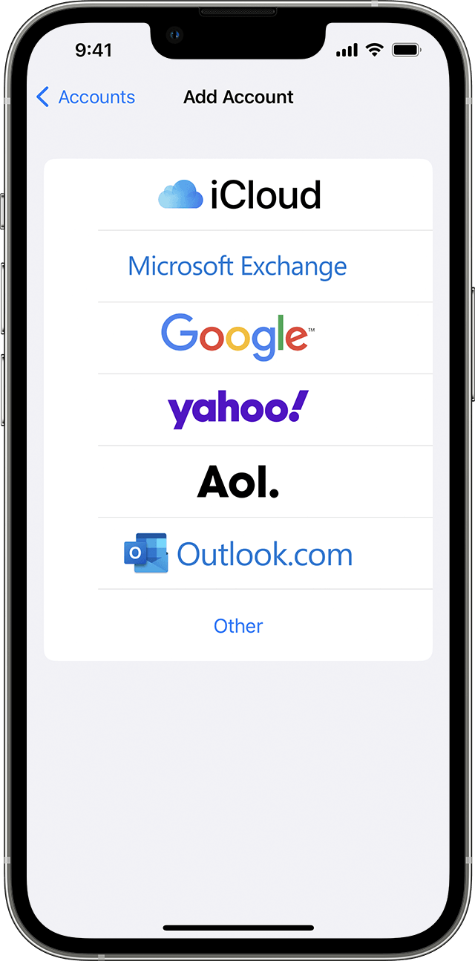
uiscrollview

Slide 19
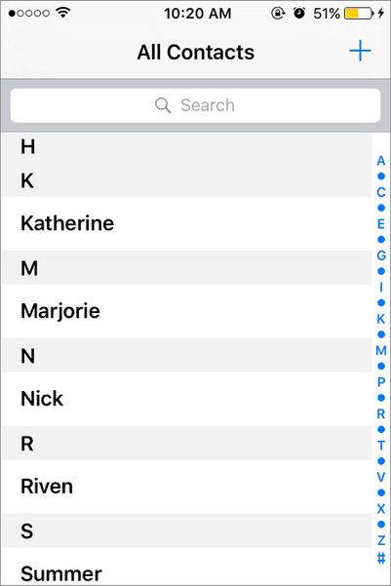
UITableview

Slide 20
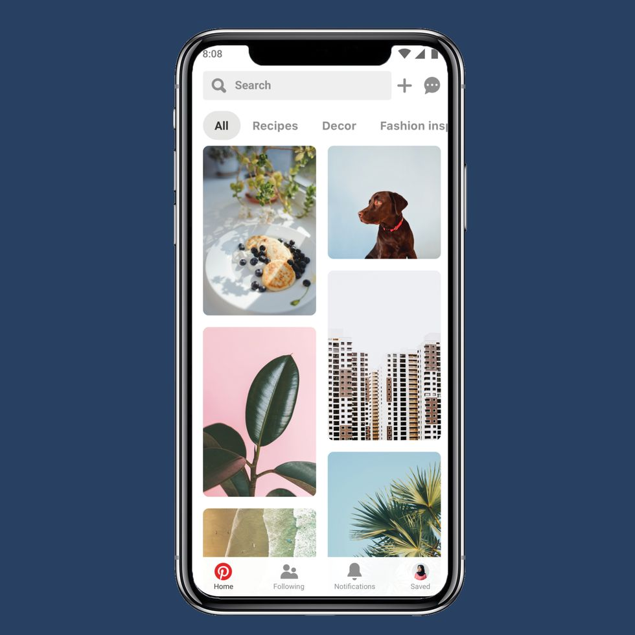
UICollectionView

Slide 21
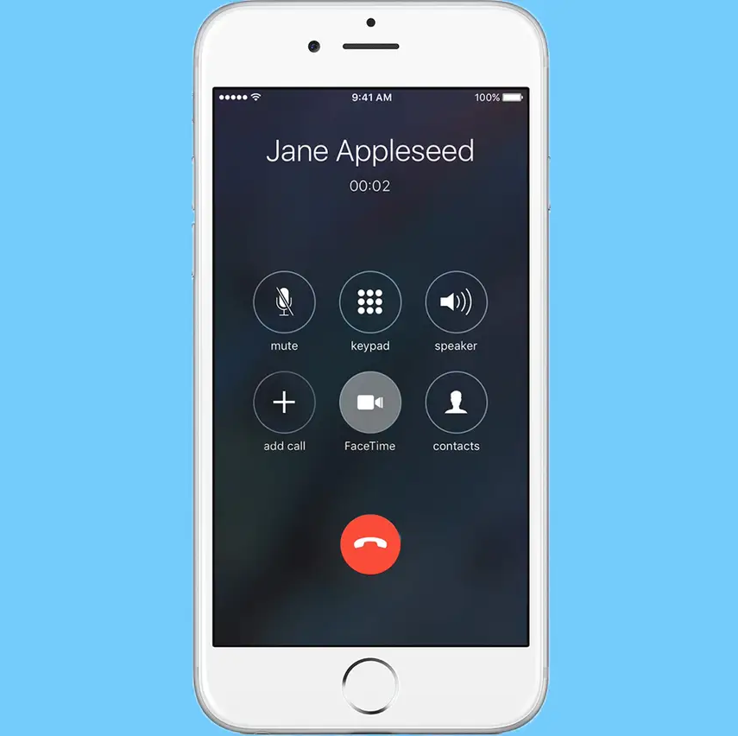
swiftui

