Slide 1
1 Lesson

Slide 2
Foundation, UIApplication, UIViewController, Autolayout, Content hugging & content resistance, Priority of constraints, UIStackView, SnapKit.

Slide 3
Import Foundation
https://developer.apple.com/documentation/foundation Access essential data types, collections, and operating-system services to define the base layer of functionality for your app.

Slide 4
Foundation
Fundamentals
App Support
Files and Data Persistence
Networking
Low-Level Utilities
Structures
Enumerations

Slide 5
file:///Users/yernur/Documents/OneLabPlayground.playground/

Slide 6
Break 5 -10 min

Slide 7
Foundation, UIApplication, UIViewController, Autolayout, Content hugging & content resistance, Priority of constraints, IUStackView, SnapKit.

Slide 8
https://developer.apple.com/documentation/uikit/uiapplication/

Slide 9
medium uiapplication link

Slide 10
Scene Delegate after ios 13
https://habr.com/ru/company/simbirsoft/blog/646687/

Slide 11
LyfeCycles(App, ViewControllers, View)
LifeCycle
Open a project

Slide 12
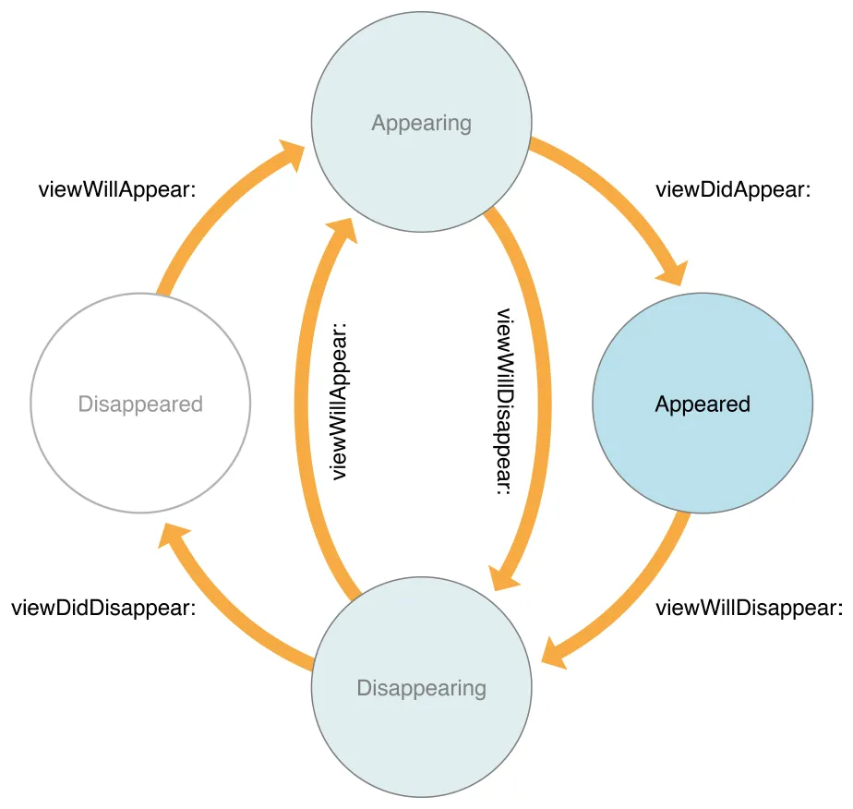

Slide 13
https://www.vadimbulavin.com/view-auto-layout-life-cycle/

Slide 14
ViewControllers and View relationships

Slide 15
Autolayout, Content hugging & content resistance/comparisson

Slide 16
https://habr.com/ru/post/690940/

Slide 17
CocoaPods
https://cocoapods.org/

Slide 18
SnapKit
Open a project

