Slide 1
阻抗测试规则
By Gorgeous

Slide 2
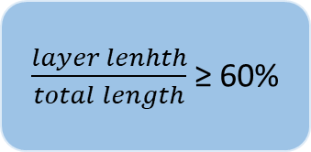
Brd
diff
single
Sorted by w/s
Sorted by w
Sorted by layer
Sorted by layer
$\frac{layer lenhth}{total length}$ ≥ 60%
output

