Slide 1
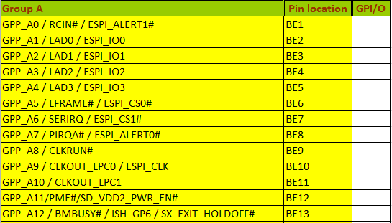
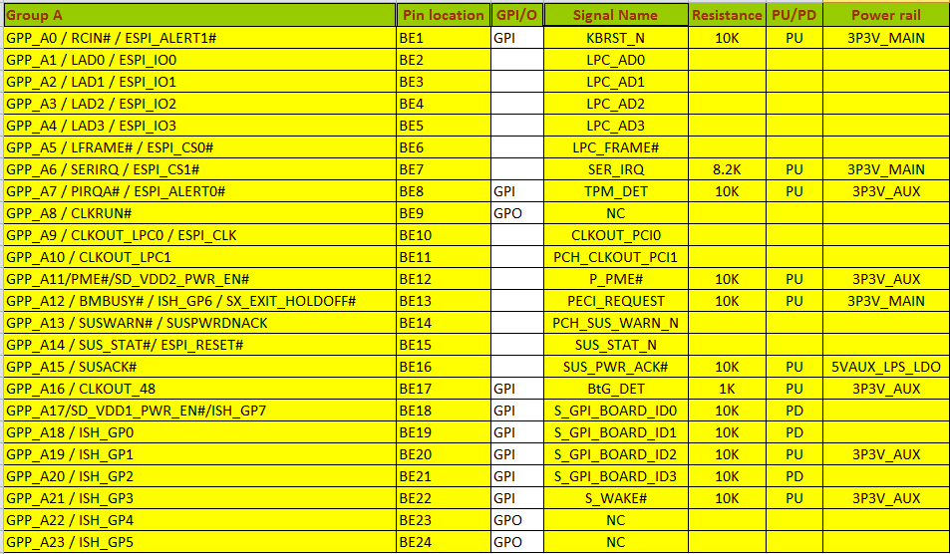
To generate GPIO table
1
2
3
Rule1:<Example 1>
1.Based on DSN search all of “GPP” title and list all of group order (A,B,C…etc)
2.List all of Pin location
3. Created a column named ”GPI/O”
Rule2:<Example 2>
1.Create the signal name /Resistance /PU /PD /Power rail /remark
Check all of components from the path of net.
Compare the path only one resistance to one power rail or to GND →if not need to show “fail”.
If capture both PU and PD , then show “check”
Lock all of column , except GPI/O item .
2.Based on GPI and GPO column to identity all of status
If define to GPI need to check the below rule
If check this is PU, then check Resistance and Power rail , 3 item need have value ,
If check this is PD, then need to check Resistance need have value, but not power rail.
4.Compare with last version for signal name /Resistance /PU /PD /Power rail , add a item for GPI/O item.
Provide completely DSN file
To generate standard format
<Rule 1 >
<Example 1>
Define GPI or GPO base on each platform
1
2
3
Create completely information and compare
<Rule 2 >
Engineer operation
Auto-tool operation
<Example 2>

Slide 2
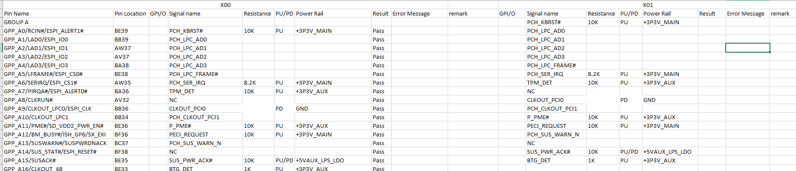
Compare GPIO table
Rule1:<Example 1>
1.Compare with last version for signal name /Resistance /PU /PD /Power rail , add a item for GPI/O item.
Check all of item need to same with last version .
If different need to show up the result “fail ” else is “pass”
Provide completely DSN file
Compare with last version of GPIO table
<Rule 1 >
Re-check GPI or GPO
Create completely information and compare
<Rule 2 >
<Example 1>

