Slide 1
User Guide Of Schematic Comparison Tool
By Gorgeous

Slide 2
User guide outline
Software limitations
Software directory structure
Software operation flow
Software result description

Slide 3
Software limitations
First of all, this is a semi-finished product, more functions will be completed after the information is complete.
Due to the limited information provided by EE, current tools can only compare two pages of schematic at a time. And because the power line naming rules are uncertain, errors may occur when judging the power line.
Sorry for any inconvenience.

Slide 4
Software directory structure
dsn_comparison_tool_trial
Input
Common
Three .dat file
One .exp file
Manufacturer Information Form
Foxconn
Three .dat file
One .exp file
Correspondence_between_pins.xlsx
Output
Result.xlsx
Correspondence_between_pins.xlsx
Schematic_comparison_tool.exe
The files marked in green are those that require user input.
The files marked in red are automatically generated by the software.

Slide 5
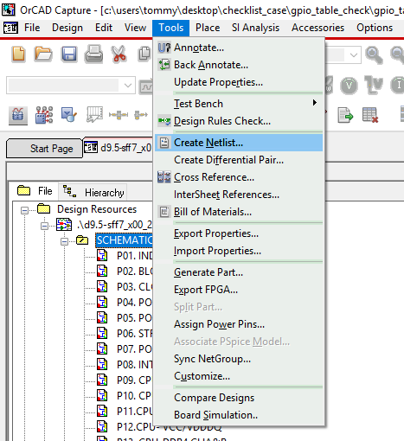
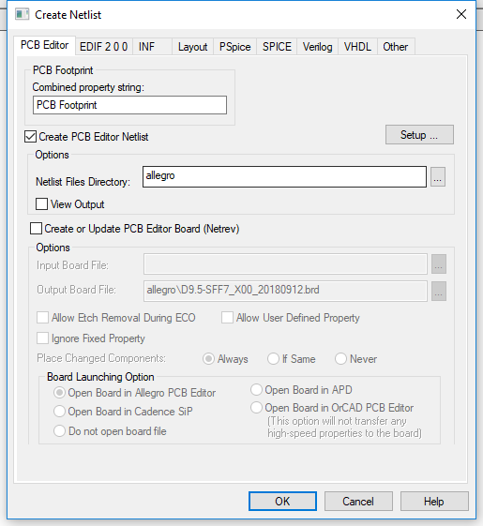
Software operation flow
Step One:
The user exports three .dat files and one .exp file from the OrCAD Capture.
a. Tools -> Create Netlist… -> OK (export three .dat files)

Slide 6
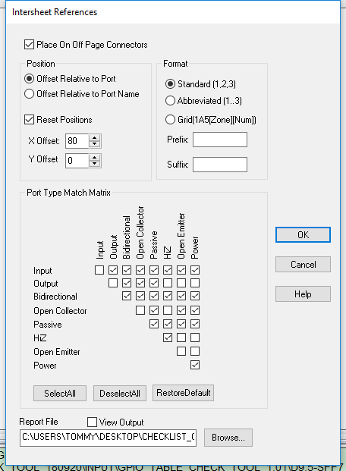
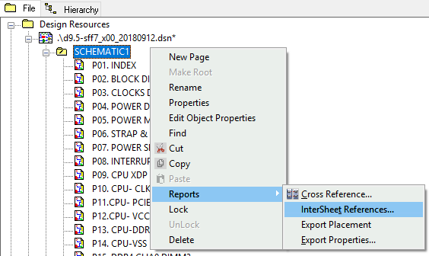
Software operation flow
Step One:
The user exports three .dat files and one .exp file from the OrCAD Capture.
b. Reports -> InterSheet References… -> OK -> OK
(export one .exp file)

Slide 7
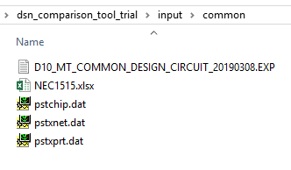
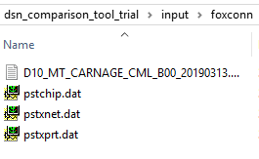
Software operation flow
Step Two:
Put the generated files into two folders, common and foxconn.
Put the Manufacturer relationship table into the common folder.

Slide 8
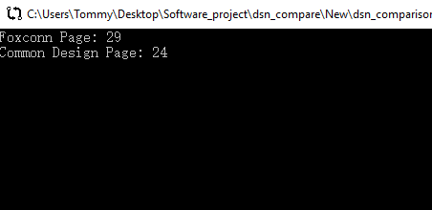
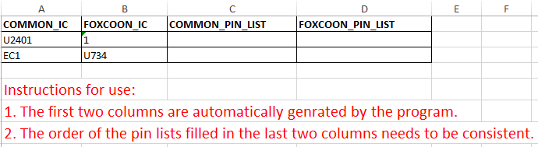
Software operation flow
Step Three:
a. Double click on the schematic_comparison_tool.exe file.
b. Enter the number of pages to compare in the window then press Enter.
c. Wait for the program to finish running (the window disappears to indicate
the end of the run)
d. The program will automatically generate the Correspondence_between_pins.xlsx
form in the output folder.(Users should fill the Correspondence_between_pins.xlsx)

Slide 9
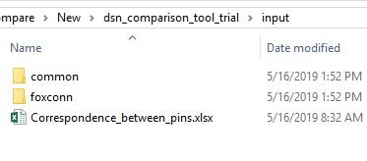
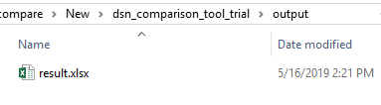
Software operation flow
Step Four:
a. Put the filled completed form into the input folder.
(Do not change the name of Correspondence_between_pins.xlsx)
b. Double click on the schematic_comparison_tool.exe file.
c. Enter the number of pages to compare in the window then press Enter.
d. The software generated result.xlsx in the output folder is the final result.

Slide 10
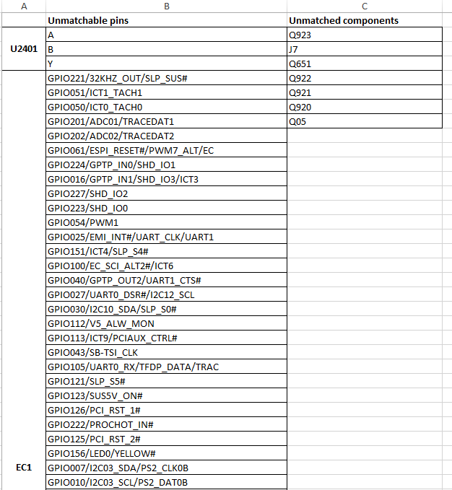
Software result description
The Unmatched components column shows the components in foxconn design that are not matched with the common design.
The Unmatchable pins column shows the pins that do not match the traces of the components in the foxconn design that match the common design.

Slide 11
Please contact me if you have any questions.
UC : gorgeous.jc.gong@foxconn.net.
Telephone Extension : 567-63812.

