Slide 1
A Fully Bayesian Approach to Unsupervised Part-of-Speech Tagging
Goldwater and Griffiths
Erol Özkan

Slide 2
Content
Part-of-Speech Tagging
Goldwater and Griffiths
Results
Conclusion

Slide 3
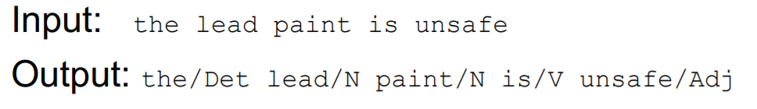
Part-of-Speech Tagging
We are given some observation(s) and our job is to determine which of a set of classes it belongs to.
Assign a sequence of part-of-speech tags.

Slide 4

Part-of-Speech Tagging
Considering all possible tag sequences, we want to choose most probable one, given the observation sequence.

Slide 5
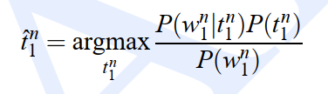

Maximum Likelihood Estimation
We choose the tag sequence for which this product is greatest.

Slide 6
Goldwater and Griffiths
They introduce a Fully Bayesian approach for POS tagging.
This Bayesian approach greatly improves the results.
  Integrates over all possible parameter values.
    Ensures that the learned structure will have high probability over a range of possible parameters,
    Permits the use of priors favoring the sparse distributions.
They say their method is 14% better than MLE.

Slide 7
Related Work
POS disambiguation;
  Merialdo (1994): MLE - trigram hidden Markov model (HMM).
  Banko and Moore, 2004: HMM imporved with some smoothing techniques.
  Smith and Eisner, 2005: a discriminative model rather than an HMM

Slide 8


Goldwater and Griffiths - MLE
In standard MLE approach, the goal is to assign appropriate values to the latent variables.
First, select values for the model parameters.
  then choose the most probable latent variable.
Latent variable assignment based on model parameters.
Notes:
step
w: observed variables
θ: model parameters
t: latent variables (the hidden structure).

Slide 9

Goldwater and Griffiths
This notation identify a distribution over latent variables directly, without ever fixing particular values for the model parameters.
The distribution over latent variables given the observed data is obtained by integrating over all possible values of θ.

Slide 10
Coin Example
There is a coin, which may be biased (t = 1) or fair (t = 0), each with probability .5.
  Let θ be the probability of heads. Biased: uniform distribution, otherwise θ = .5.
Flip the coin 10 times.
Determine whether the coin is biased.
  P(t|w, ˆθ) favors t = 1 for any sequence that does not contain exactly five heads

Slide 11
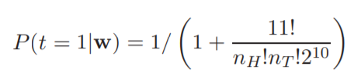
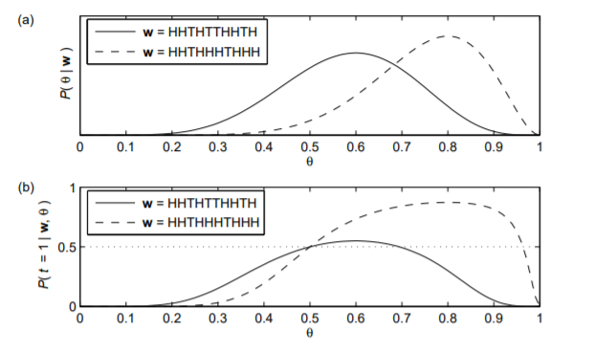
Goldwater and Griffiths
In contrast,using their Bayesian analysis show that applying Equation yields
It is significantly less than .5 when nH = 5, and only favors t = 1 for sequences where nH ≥ 8 or nH ≤ 2. This intuitively sensible prediction results from the fact that the Bayesian approach is sensitive to the robustness of a choice of t to the value of θ, as illustrated in Figure 1.

Slide 12
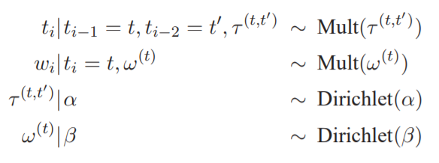
Goldwater and Griffiths
Their model has the structure of a standard trigram HMM, with the addition of symmetric Dirichlet priors over the transition and output distribution.
T: possible tags
τ (t,t′ ): transition distributions
ti and wi: ith tag and word

Slide 13
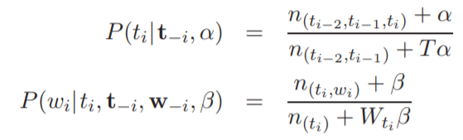
Goldwater and Griffiths
Under this model, Equation becomes;

Slide 14
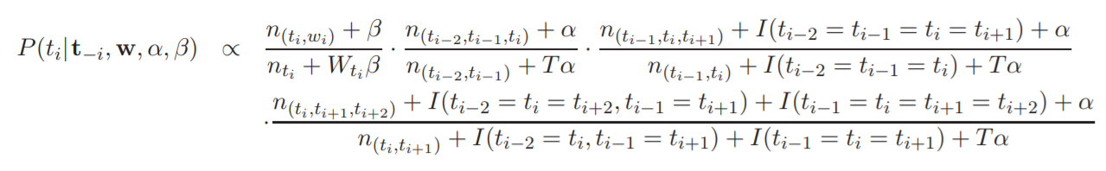
Inference
They use Gibbs sampling (Geman and Geman, 1984), a stochastic procedure that produces samples from the posterior distribution:
They treat the Gibbs sampler as a stochastic search procedure with the goal of identifying the MAP tag sequence.

Slide 15
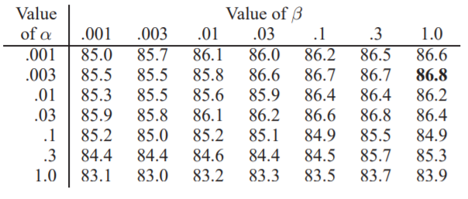
Results
They use a tag dictionary to constrain the possible parts of speech tags allowed for each word.
They use WSJ treebank. (24,000-word subset is used)
54.5% of the tokens in this corpus have at least two possible tags. The average number of tags per token being 2.3.
They varied the values of the hyperparameters α and β.
Notes:
and evaluated overall tagging accuracy.
Effect of α are stronger than the effects of β

Slide 16
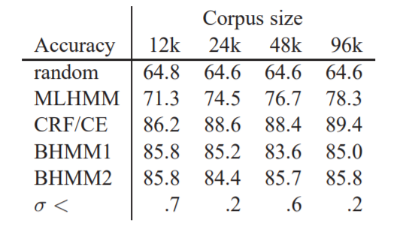
Results
They ran Gibbs sampling algorithm for 20,000 iterations over the entire data set.
Results are averaged over 5 runs.
BHMM: Bayesian HMM.
MLHMM: Viterbi decoding of an HMM trained using MLE by running EM to convergence.
CRF: Discriminative model.
BHMM1: uses a single value of β for all word classes.
BHMM2: uses a separate βj for each tag class j. (inference on the hyperparameters.)

Slide 17
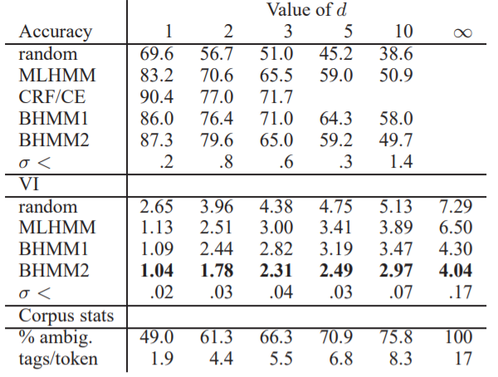
Results
  Determine the effects of reduced or absent dictionary information.
  Create several reduced dictionaries. Collapse 45 treebank tags to17.

Slide 18
Conclusion
Using Bayesian approach to POS tagging dramatically improves performance over MLE.
Integrating over possible parameter values leads to more robust solutions.
The Bayesian approach is particularly helpful when less data is available.

