Slide 1
CLINICAL DATA MANAGEMENT: E-CRF APPLICATIONS
CMP 652 - Next Generation Database Systems
Erol Özkan
erolozkan@outlook.com

Slide 2
Content
Clinical Data Management
High Quality Data
Collect High Quality Data
Standards and Guidelines
Processes
Roles and Responsibilities
CDM Tools
REDCap Demo

Slide 3

Clinical Data Management
CDM is the generation of high-quality, reliable, statistically robust data from clinical trials.
Generated data is useful from drug development to marketing.
It plays a very important role by helping to;
evaluating medicines,
finding answers to the research questions,
proving or disproving hypothesizes.

Slide 4

High Quality Data
Generated data should be;
complete,
accurate,
reliable,
error free,
processed correctly,
suitable for statistical analysis.
should have minimal or no misses.
Most importantly, generated data should have “acceptable level of variation”.
It should not affect the conclusion of the study on statistical analysis.

Slide 5

Collecting High Quality Data
Standards and Guidelines
There are regulatory standards for collection, cleaning, and management of data.
CFR, GCP, GCDMP, SDTMIG, CDASH…
Processes
There are various processes involved in CDM.
Roles and Responsibilities
Different team members actively involved in stages of CDM.
Tools
Clinical Data Management Systems (CDMS).

Slide 6
STANDARDS and GUIDELINES

Slide 7

CDM Guidelines and Standards
Industry relies on the data for evaluation of medicines.
CDM must provide high-quality data.
There is a need to follow good practices in CDM.
CDM has guidelines and standards that must be followed.
Some guidelines and standards introduced.
Code of Federal Regulations (CFR)
Good Clinical Data Management Practices (GCDMP)
The Study Data Tabulation Model Implementation Guide for Human Clinical Trials (SDTMIG)
The Clinical Data Acquisition Standards Harmonization (CDASH) standards
Good Clinical Practice (GCP)

Slide 8

Code of Federal Regulations (CFR)
The Code of Federal Regulations (CFR) is the general and permanent rules and regulations published in the Federal Register in USA [1].
It is divided into 50 titles, including;
Agriculture, Aliens and Nationality, Animals and Animal Products, Food and Drugs…
Example CFR Regulation - Title 21 CFR Part 11 [1]
Electronic records have to comply with CFR. Procedures and controls put in place to ensure the integrity, authenticity, and confidentiality of the data. It is applied to records that created, modified, maintained, archived, retrieved, or transmitted. Ensure accuracy, reliability, and consistency of data with the use of secure, computer-generated, time-stamped audit trail.
Code of Federal Regulations (CFR), CFR Title 21, Access Url: "https://www.fda.gov/media/75414/download", Last Access: May 2019.

Slide 9
Good Clinical Practice (GCP)
Good Clinical Practice (GCP) [1] is an international ethical and scientific quality standard for the performance of a clinical trial on medicinal products involving humans.
Describes the ethical and scientific aspects of a clinical trial and includes all aspects in CDM.
It is obligatory for the investigator to ensure;
accuracy,
legibility,
completeness
and timeliness
of the data.
Good Clinical Practice (GCP), Access Url: "https://www.ich.org/fileadmin/Public_Web_Site/ICH_Products/Guidelines/Efficacy/E6/E6_R1_Guideline.pdf", Last Access: May 2019.

Slide 10

Good Clinical Data Management Practices (GCDMP)
GCDMP is a document providing standards for CDM [1].
It covers the CDM process by highlighting standards and best practices.
Currently, it is the industry standards for CDM.
It is used as a guidance tool for clinical data managers when preparing for CDM training and education.
It was published by Society for Clinical Data Management (SCDM) in September 2000. It has undergone several revisions thereafter.
Some Subjects from GCDMP
Data Management Plan CRF Completion Guidelines Vendor Selection and Management Electronic Data Capture
Good Clinical Data Management Practices (GCDMP), Access Url: "https://www.mci-registrations.com/be-bruga/mci-registrations/scdm/files/gcdmp/en/2013/Full%20GCDMP%20Oct%202013.pdf", Last Access: May 2019.

Slide 11

SDTMIG and CDASH
Two more guides;
The Study Data Tabulation Model Implementation Guide for Human Clinical Trials (SDTMIG)
Describes the details of model and standard terminologies for the data [1].
It serves as a guide to the organization.
The Clinical Data Acquisition Standards Harmonization (CDASH) standards
Defines the basic standards for the collection of data in a clinical trial [2].
Clinical Data Interchange Standards Consortium (CDISC) is a non-profit organization, has developed standards to support acquisition, exchange, submission, and archival of clinical research data and metadata.
Good Clinical Data Management Practices (GCDMP), Access Url: "https://www.mci-registrations.com/be-bruga/mci-registrations/scdm/files/gcdmp/en/2013/Full%20GCDMP%20Oct%202013.pdf", Last Access: May 2019.
Study Data Tabulation Model (SDTMIG), Clinical Data Interchange Standards Consortium, Access Url: "https://www.cdisc.org/standards/foundational/sdtm", Last Access: May 2019.

Slide 12
Standards and Guidelines in Turkey
In Turkey, the process of collecting and managing clinical data is done in accordance with constitution law [1].
More specifically, data is managed and shared according to Article 56 of constitution law, Law No. 3359 with Article 8 of Law No. 663 [1].
In addition, a guide which was developed by ministry of health explains the best practices should be followed in clinical trials [2].
Furthermore, personal data protection law protects the privacy of the patient [3].
Kişisel sağlık verilerinin işlenmesi ve mahremiyetinin sağlanması hakkında yönetmelik, Regulation for clinical data in Turkey, http://www.resmigazete.gov.tr/eskiler/2017/11/20171124.htm, Last Access: May 2019.
Klinik kalite uygulama ve veri kalitesi iyileştirme rehberi (Clinical quality application and data quality improvement guide in Turkey), Access Url: "https://dosyamerkez.saglik.gov.tr/Eklenti/10942,klinik-kalite-uygulama-veri-kalitesi-2pdf.pdf", Last Access: May 2019.
Kişisel verilerin korunmasi kanunu (Privacy protection law in Turkey), Access Url: "https://www.mevzuat.gov.tr/MevzuatMetin/1.5.6698.pdf", Last Access: May 2019.

Slide 13
CDM PROCESSES
Notes:
The primary objective of CDM processes is to provide high-quality data.

Slide 14
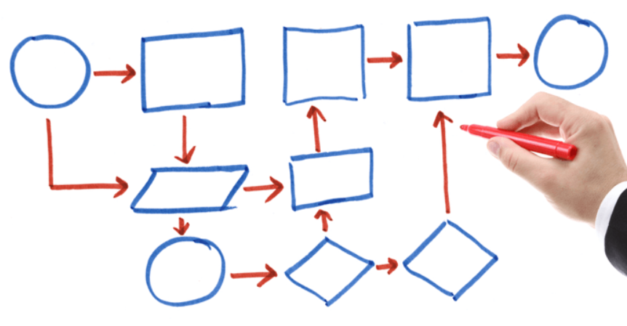
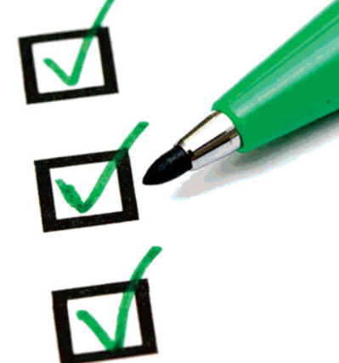
CDM Processes
CDM is designed to deliver an error-free, valid, and statistically sound data.
To meet this objective, there are various processes in CDM.
In CDM, a Data Management Plan (DMP) is developed.
It is a road map to handle the data.
It describes activities to be followed in the CDM.
Along with the DMP, a Data Validation Plan (DVP) is also developed.
Identifying the discrepancies in the data.
It contains edit-checks to be performed.
Some calculations are prepared to find discrepancies.

Slide 15
Processes in CDM
CRF Designing
CRF Annotation
Database Designing
Data Entry
Data Validation
Medical Coding
Database Locking
Discrepancy Management

Slide 16
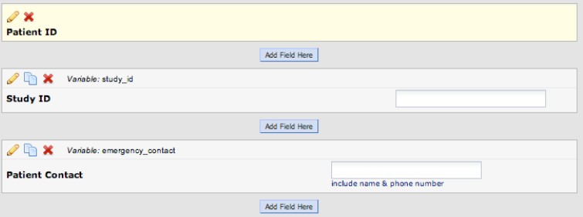
CRF Designing
As the first step, a Case Report Form (CRF) is designed.
CRF forms try to get input from the investigators.
To design the CRF forms, CDM personnel identifies;
the data items to be collected,
the frequency of collection with respect to the visit schedule in the trial.
Redcap, Access Url: "https://www.project-redcap.org/", Last Access: June 2019.

Slide 17
CRF Designing
These CRF forms should be concise, self-explanatory, and user-friendly.
The data fields should be
clearly defined,
consistent.
Redcap, Access Url: "https://www.project-redcap.org/", Last Access: June 2019.

Slide 18
CRF Annotation
Along with the CRF, the filling instructions are also provided.
Annotations try to get error-free data from investigators.
In questions with discrete value options all possible options may be coded with annotations.
Redcap, Access Url: "https://www.project-redcap.org/", Last Access: June 2019.

Slide 19
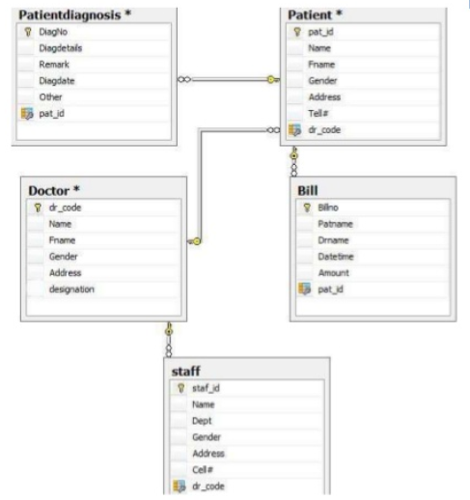
Database Design
Data is collected and stored in the database.
Databases are built to facilitate the CDM tasks to carry out.
In the database, details can be defined;
objectives,
intervals,
visits,
investigators,
sites,
patients…

Slide 20
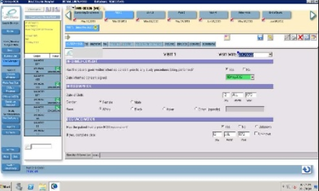
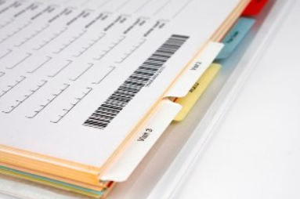
Data Collection
Data collection is done using the CRF.
CRF may exist in the form of a paper or an electronic version (e-CRF).
Paper CRF | e-CRF
Paper is to employed to collect the data. CRFs are filled up by the investigator according to guidelines. Data is translated to the database by means of data entry by individuals. | Data is entered directly at a site by investigator. Less chances of errors. Discrepancies are resolved faster. Reduced time to collect data.

Slide 21

CRF Tracking
The entries made in the CRF will be monitored for completeness.
CDM team tracks the retrieved CRFs and maintain their record.
CRFs are checked for missing pages, missing data, illegible data…
In case of a problem, a clarification is obtained from the investigator.
The Clinical Research Associate (CRA)

Slide 22
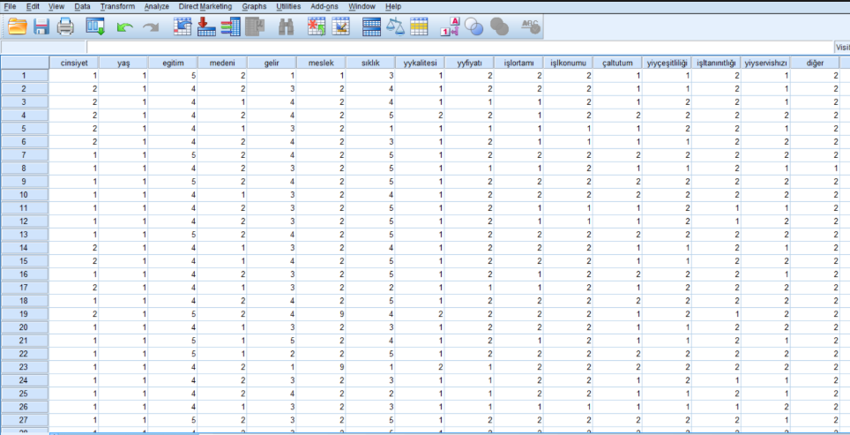

Data Entry
Data entry takes place according to the guidelines prepared along with the DMP.
This is applicable only in the case of paper CRF.
Usually, data entry is performed by two operators.
Lesser error rate,
Verification and reconciliation,
Identifying the transcription errors and discrepancies,
Cleaner database,
Better consistency.

Slide 23

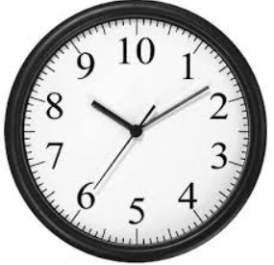
Data Validation
In data validation process, data is tested for validity.
Discrepancies are identified.
Discrepancy is defined as a data point that fails to pass a validation check.
Discrepancy may be due to inconsistent data, missing data, range checks, and deviations.
Check programs are written to identify the discrepancies.
For example, the age of the patient should be between 18 and 65 years.
If the condition becomes TRUE, a discrepancy is generated.
These discrepancies will be highlighted in the system.
Data Clarification Forms (DCFs) are generated.
In e-CRF based studies, data validation process is run frequently.

Slide 24

Discrepancy Management
Discrepancy management helps to clean the data for deviations.
The CDM team reviews all discrepancies at regular intervals to ensure that they have been resolved.
Discrepancy management process includes;
reviewing discrepancies,
investigating the reason,
resolving them with documentary proof or declaring them as irresolvable.
When a resolution is provided by the investigator, database will be updated.

Slide 25
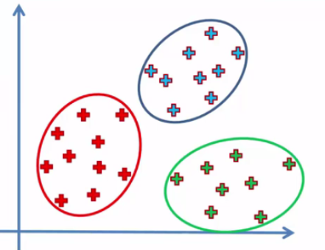
Medical Coding
Investigators may use different terms for the same events.
In this phase, medical terminologies in trials are identified and classified.
Medical coding helps to classify reported medical terms on the CRF in order to achieve data consistency and avoid unnecessary duplication.
This activity needs the knowledge of medical terminology, disease entities, drugs, pathological processes.
It also requires knowledge about the structure of electronic medical dictionaries for classifications.
For classification of events, medical dictionaries are used (MedDRA, WHODD).

Slide 26

Database Locking
After a proper quality check and assurance, final validations (checklist) are run and database is locked.
After locking;
Database cannot be changed. So all data management activities should have been completed prior to database lock.
But in case of a critical issue or for other important operational reasons, privileged users can modify the data.
Locking
Statistical Analysis
Data Extraction
Archival

Slide 27
TEAMS AND RESPONSIBILITIES
Notes:
The primary objective of CDM processes is to provide high-quality data.

Slide 28
Teams and Responsibilities
CDM requires a variety of roles and responsibilities.
Data manager | Supervises the CDM process. Prepares the DMP, approves the CDM procedures and all internal documents related to CDM activities.
Database programmer or designer | Performs the CRF annotation, creates the study database, enables data validation, designs data entry screens and performs edit checks using dummy data.
Medical coder | Codes variations such as adverse events and medical history.
Clinical data coordinator | Designs the CRF, prepares the filling instructions, develops discrepancy protocols.
Quality control associate | Checks the accuracy of data entry and performs data audits.
Data entry associate | Tracks the receipt of CRF pages and enters data into a database.

Slide 29
User Access
According to the roles and responsibilities, users has access limitation to
data entry,
medical coding,
database designing,
quality check.
This ensures that each user can access only the respective functionalities.
Also, software will record any change in the data for audit purposes.
the change made,
the user that made the change,
the time and date of change.

Slide 30
CMD Tools - CDMS

Slide 31

CMD Tools - CDMS
These tools are called Clinical Data Management Systems (CDMS).
These software applications helps for collection of high quality of data.
implementation of guidelines and standards,
maintain an audit trail,
provide easy identification and resolution of data discrepancies.
Many software tools are available for data management.
Governmental | Commercial | Open Source
E-nabız. | Redcap, OpenClinica, ClintrialWorks, Eclinical Suite, Macro, Oracle Clinical. | TrialDB, OpenCdms, Phosco.
Notes:
These software tools

Slide 32
REDCap
REDCap is a secure web application for building and managing online surveys and databases.
It can be used to collect any type of data (including 21 CFR Part 11, FISMA, and HIPAA-compliant environments)
It is developed by Vanderbilt University.
Advantages | Disadvantages
There is no need to know programming, No need to set up a database, Easy exports, Users are in control of their data, Daily backups, Basic support, Audit trail. | REDCap is a very robust tool but does have a learning curve. Some issues are reported that users make some mistakes using the software.
Notes:
These software tools

Slide 33
Other Tools
 | E-Nabız | Redcap | Open-Clinica | Clintrial-Works | Eclinical Suite | Macro | Oracle Clinical | TrialDB | Open-CDMS | Phosco
Commercial | X | √ | √ | √ | √ | √ | √ | X | X | X
Customizable CRF | X | √ | √ | X | √ | √ | √ | √ | √ | √
Data Entry | √ | √ | √ | √ | √ | √ | √ | √ | √ | ?
CFR Annotation | ? | √ | √ | ? | √ | √ | √ | √ | √ | √
Data Validation | ? | √ | √ | ? | √ | √ | √ | √ | √ | √
Visualization/Reporting | ? | √ | √ | √ | √ | √ | √ | √ | ? | ?
Data Import/Exports | ? | √ | √ | ? | √ | √ | √ | ? | √ | ?
Medical Coding | ? | ? | ? | ? | √ | √ | ? | √ | ? | ?
User Management | √ | √ | ? | √ | √ | √ | √ | √ | √ | ?
Query Management | ? | X | √ | √ | ? | ? | √ | ? | ? | ?
Audit Trail | ? | √ | √ | √ | √ | √ | √ | ? | √ | ?
E-mail Support | ? | √ | √ | ? | √ | √ | ? | ? | √ | ?
Skip Logic | ? | √ | ? | ? | ? | ? | ? | √ | ? | ?
Randomization | ? | X | √ | ? | ? | ? | √ | ? | √ | ?
Financial Management | X | X | X | √ | X | X | X | X | X | X
GCP Compliant | ? | ? | √ | ? | ? | ? | ? | ? | ? | ?
FISMA Compliant | ? | √ | √ | ? | ? | ? | ? | √ | ? | ?
CFR part 11 Compliant | ? | √ | √ | ? | √ | √ | √ | ? | ? | ?
HIPAA Compliant | ? | √ | √ | ? | √ | ? | √ | ? | ? | √
Operating Systems | Owned By Government | Linux, Unix, Windows, Mac | Linux, Windows | Cloud Based | ? | ? | Windows | ? | End Of Life | Java, End Of Life
Notes:
These software tools

Slide 34
Summary
There is a high demand for CDM.
Generation of high quality data is very important for CDM.
To generate high quality data in CDM, there are;
Standards and guidelines,
Processes,
Roles and responsibilities,
Tools.
Also, technological developments positively impacted CDM.
Future directions may be on the confidential collection and submission of subject data in clinical trials.

Slide 35

Questions and Answers

Slide 36
Acknowledgements
[1] Code of Federal Regulations, https://en.wikipedia.org/wiki/Code_of_Federal_Regulations, Last Access: April 2019
[2] Title 21 Code of Federal Regulations (21 CFR Part 11), Electronic Records; Electronic Signatures, Final Rule Published in the Federal Register, Last Access: April 2019
[3] Good Clinical Data Management Practices, https://www.scdm.org/publications/gcdmp/, Last Access: April 2019
[4] Krishnankutty B., Bellary S., Kumar N. B. R., Moodahadu L. S., Data management in clinical research: An overview, Indian J Pharmacol, 2012.
[5] Clinical Data Management, http://www.ofnisystems.com/information/, Last Access: April 2019
[6] Greenesab, R.A., Pappalardoab A.N., Marbleab C.W., Barnettab, G.O., Design and implementation of a clinical data management system, Computers and Biomedical Research, Volume 2, Issue 5, October 1969, Pages 469-485, 1969.
[7] Gazali, Kaur, S., Singh, I., Artificial intelligence based clinical data management systems: A review, Informatics in Medicine Unlocked, 2017.
[8] Lu, Z., Su, J., Clinical data management: Current status, challenges, and future directions from industry perspectives, Open Access Journal of Clinical Trials Dovepress, June 2010.
[9] Matkar, S., Gangawane A., An outline of data management in clinical research, International Journal of Clinical Trials, 2017.
[10] Manickavasakam, Sofia, H.N., Data Management in Clinical Research. Journal of Siddha, vol:2, Issue:1, page.no.60-66. 2. 60-66., 2009.

