Slide 1



Loan Risk Identification
Identification of risk factors involved with default loans &
The predicting models that could help investors avoid them
Executive Summary For Lending Club Investors
By Eran Schenker

Slide 2
Project Outline
Background & Business Question
Data Exploration & Preliminary Analysis
Baseline Modeling
Feature Engineering

Slide 3
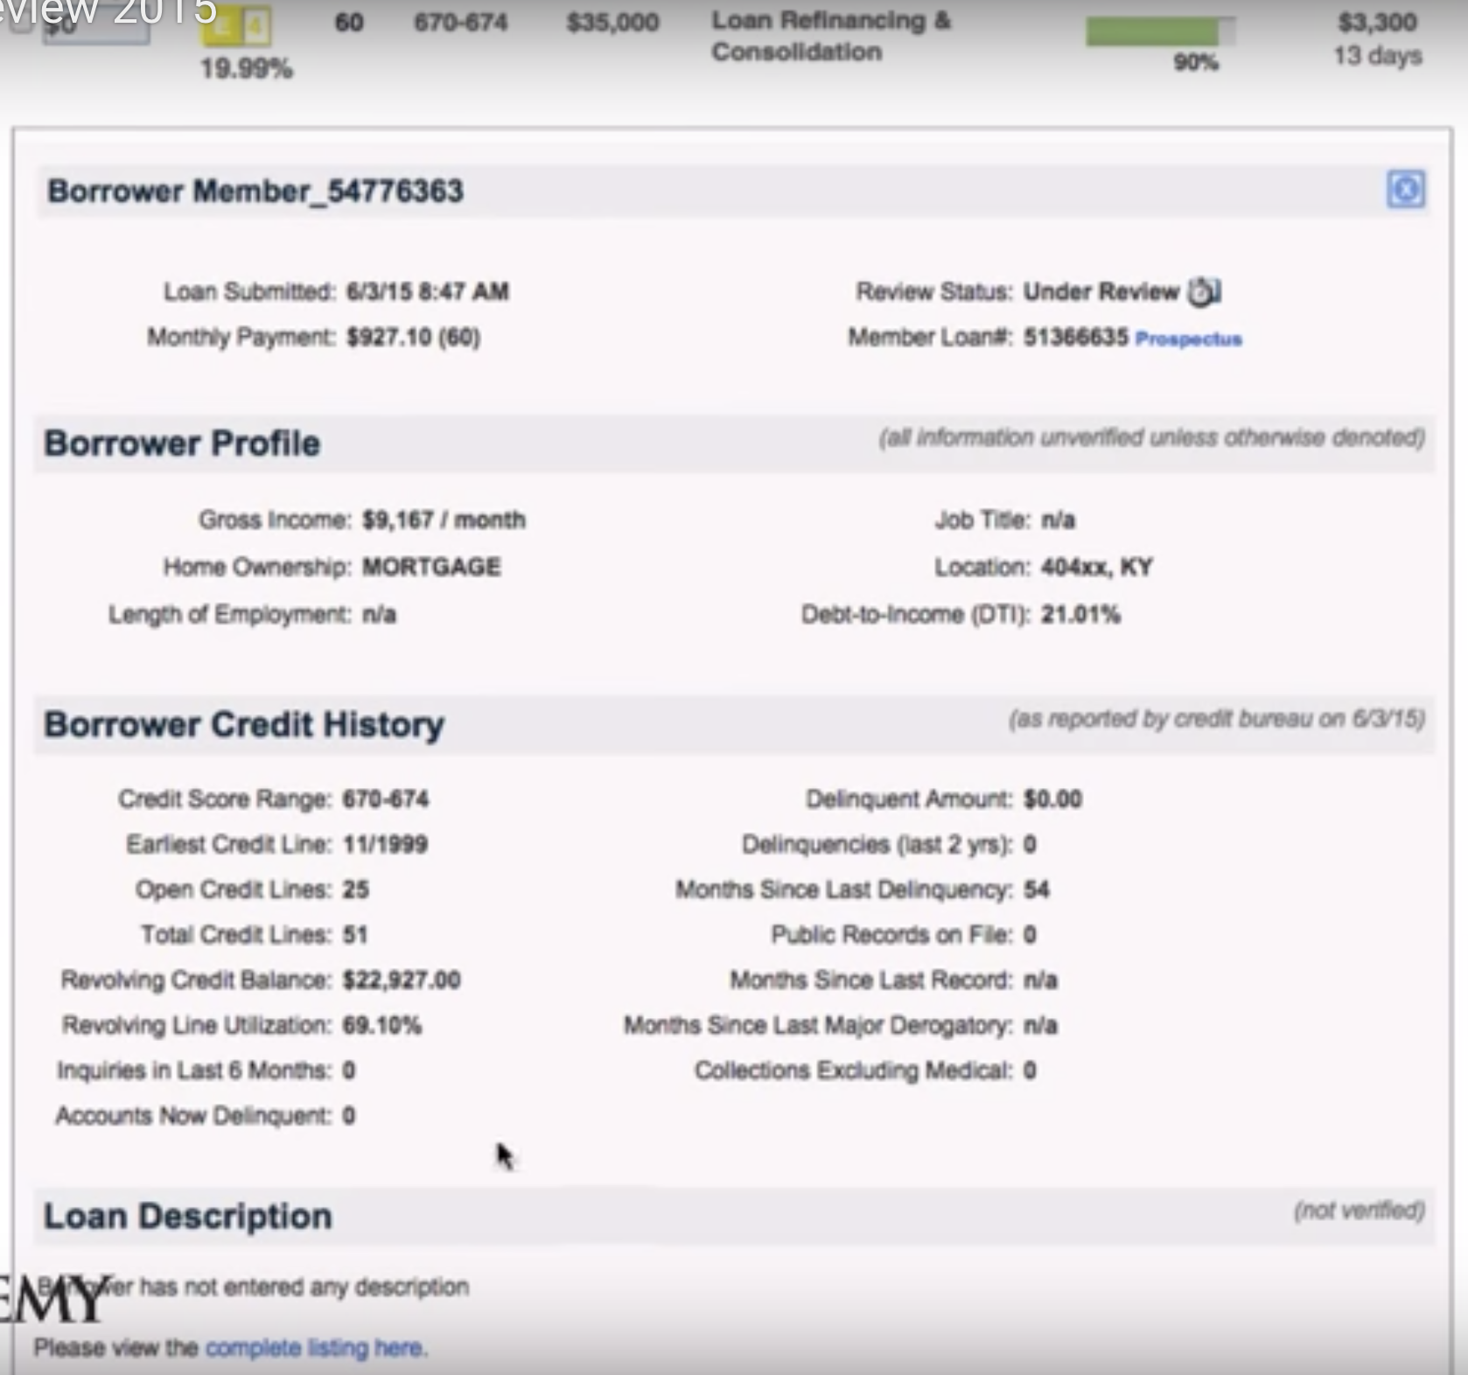
Background & Project Outline
Lending Club (LC)
The largest online loan platform ($10.9 B new loans -2018)
Peer-to-peer (P2P) lending site, directly connects borrowers and investors.
Value Proposition & Challenge:
“Cutting out the middleman” → opens possibilities for borrowers and investors
Exposes investors to the risk of unpaid loans → i.e. Default Loans.
Project outline:
Built a classification model based on data from LC website
Projects whether a loan in 2014 → Fully paid / Default loan
analysis used past loans only. The approach was to treat them as new loans, by ”turning back the clock” on the data by excluding any information that was sourced after the loan was initiated
Project goal:
Provide a predictive model and actionable insights on potentially risky loans for LendingClub investors, at the time they actually need it – before they decide on which loan to put the money on
Notes:
Lending Club (LC) is the largest online loan platform with $10.9 billions worth of new loans in FY2018
It is a peer-to-peer (P2P) lending website that directly connects borrowers and potential lenders/investors.
One of the biggest value propositions of LC, also holds within its potential risk: LC is “cutting off the middle man” and opens possibilities for borrowers and lenders and as such, it also exposes lenders to the risk of unpaid loans – i.e. Default Loan.
In this project we built a classification model based on data from LC website, that projects whether a Current loan (as of 2014) will most likely be Fully paid or does it hold a risk for a Default loan.
In the analysis we used only past loans, and in our approach we treated them as new loans offered, which necessitated ”turning back the clock” on the loans by excluding any data on the loan that was available only after it was issued
The goal is to give actionable insights and advice on loans, at the time when investors actually need it – before they decide on which loan to put the money on

Slide 4
Data Exploration and Preliminary Analysis
Defining the target – what is a “Default loan”?
The Dataset (161,231 unique loans) most are Current loans (~94%) whereas Fully paid are (4%) and the rest are in 5 more categories*
A search on LC website** gave the basis for our following assumption:
Since 75% of late (31-120 days) loans end up not fully paid, we aggregated them with Default group and Charged-off group to make up a diverse “bad loans” group we named “Default”
*Note: Our assumption is that using only a subset of the available data serves best the business goal we chose
Notes:
This meant that we needed to process the data further and use different metrics

Slide 5
Data Exploration and Preliminary Analysis
Our feature definition – A variable that is a available for investors on a loan before it is issued
Right:
Fields available
on LC website On
a loan for a 14 day
window, before
it is issued (or
discarded due to
lack of demand )
** https://www.lendingclub.com/info/demand-and-credit-profile.action
Notes:
This meant that we needed to process the data further and use different metrics

Slide 6
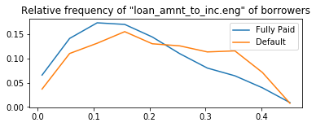
Data Exploration and Preliminary Analysis
Exploring dataset features
We hypothesized that borrowers with high loan amount relative to their income should have more difficulties in paying back their loan. We see evidence of that by exploring loan to income ratio:
Portion of borrowers
(relative frequency)
Loan Amount / Annual Income
Fully Paid: μ=﻿0.20, σ=0.1
Default: μ=﻿0.24, σ=0.11
Notes:
This meant that we needed to process the data further and use different metrics

Slide 7
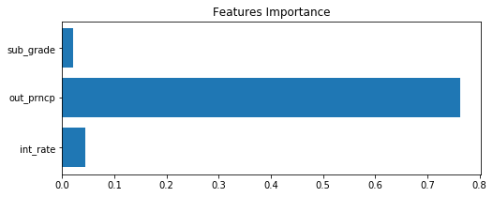
Data Exploration and Preliminary Analysis
Pinpoint features NOT to be used
Target-leaked features tend to be suspiciously strongly correlated with the target*, we therefore need to detect them, as done here by running a naïve model on the dataset and extracting the features importance
‘out_prncp’ is the remainder of borrowed amount that is still needed to be paid. By running a naïve model on the dataset that includes this feature we see how 75% of the prediction relies on this feature. Default loans by definition still have to be payed. whereas fully paid loans by definition have nothing sum left to be payed.
* Target leak - means that when deploying our model for prediction we wouldn't have the feature available to us because it is determined together with the target ( hence “target leak).
Notes:
This meant that we needed to process the data further and use different metrics

Slide 8
Baseline modeling
Classification with raw data:
Initial classification efforts with the raw dataset shows that the ability to detect Defaults (recall) is 0% (classifying every loan as fully paid)
This means that without feature engineering and class-balancing efforts (# of loans in each class) we can’t get a sufficiently sensitive classification*
*Note: we can use a target-leak feature in the dataset as a type of a “positive-control”. we’ve reached a 77% rate of detection with one such feature, showing a ballpark of expected detection capabilities.
Notes:
This due to the uncertainty in predicting complicated processes as defaults with a limited dataset,
Without enrichment (global factrs)
And also the target group has late loans that would not default in the end
Control if there is target leak

Slide 9
Feature Engineering
Selected Engineered Features:
log_ratio (annual inc / state median income)
Log Credit years
Months since last major derogatory
Principal
Home Ownership and Purpose
Grade & sub grade
Notes:
How shall we use location data?
zipcode is probably informative. it has just 3 digits (so with low resoulution). nevertheless we should engineer with longitude latitude converter or/and to enrich with census (translate zip to socio-economic level of neighborhood) this we'll leave for a later date.
Perhaps we can use state? it is less informative than zip, but we can quickly use a proxy such as median income per state in 2014 that is publicly available:
https://www.reinisfischer.com/median-household-income-us-state-2014

Slide 10
Feature Engineering
Selected Engineered Features:
log_ratio (annual inc / state median income)
Log Credit years
Months since last major derogatory
Principal
Home Ownership and Purpose
Grade & sub grade
How shall we use location data?
Both zip code and state should be informative
zip code has has 3 digits only (low resolution)
Ideally, if this project should continue we would engineer:
With longitude & latitude converter
Enrich with census data (translate zip to socio-economic data into categorical features )
State is less informative than zip, but we can quickly use
a proxy such as median income per state (in 2014*) that may show the socio-economical status of it’s the residents of this state
We also adjusted the annual income of borrowers to the state median to input their relative income which might be more informative
* https://www.reinisfischer.com/median-household-income-us-state-2014
Notes:
How shall we use location data?
zipcode is probably informative. it has just 3 digits (so with low resoulution). nevertheless we should engineer with longitude latitude converter or/and to enrich with census (translate zip to socio-economic level of neighborhood) this we'll leave for a later date.
Perhaps we can use state? it is less informative than zip, but we can quickly use a proxy such as median income per state in 2014 that is publicly available:
https://www.reinisfischer.com/median-household-income-us-state-2014

Slide 11
Feature Engineering
Selected Engineered Features:
log_ratio (annual inc / state median income)
Log Credit years
Months since last major derogatory
Principal
Home Ownership and Purpose
Grade & sub grade
How to add the credit longevity to the data?
Both Date of issue of loan & earliest credit line date could not be used as is
Subtracting earliest credit line date from issue date gives us the years a borrower has credit
Conducted log transformation (we assume that difference between 5 -10 years is more significant than 15-20 years)
Notes:
How shall we use location data?
zipcode is probably informative. it has just 3 digits (so with low resoulution). nevertheless we should engineer with longitude latitude converter or/and to enrich with census (translate zip to socio-economic level of neighborhood) this we'll leave for a later date.
Perhaps we can use state? it is less informative than zip, but we can quickly use a proxy such as median income per state in 2014 that is publicly available:
https://www.reinisfischer.com/median-household-income-us-state-2014

Slide 12
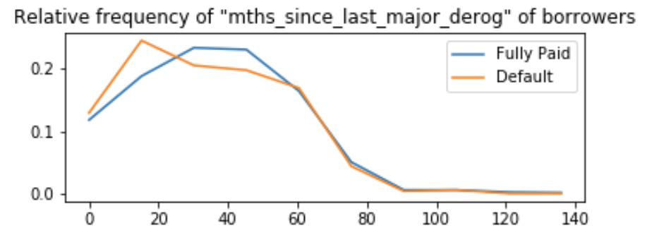
Feature Engineering
Selected Engineered Features:
log_ratio (annual inc / state median income)
Log Credit years
Months since last major derogatory
Principal
Home Ownership and Purpose
Grade & sub grade
How to add the credit longevity to the data?
Both Date of issue of loan & earliest credit line date could not be used as is
Subtracting earliest credit line date from issue date gives us the years a borrower has credit
Conducted log transformation (we assume that difference between 5 -10 years is more significant than 15-20 years)
Can a feature with mostly missing data be informative?
the data that is not missing seems informative up to 60 months mark
There is a intersection at 24 months mark where the relative frequency of a default loan diminishes further, while fully paid loans increases and continues to be high
Categorical transformation to ‘recent’ (<25) and ‘old’ (24 → 60) while the rest was categorized in ‘unknown’ group together with missing instances
Notes:
How shall we use location data?
zipcode is probably informative. it has just 3 digits (so with low resoulution). nevertheless we should engineer with longitude latitude converter or/and to enrich with census (translate zip to socio-economic level of neighborhood) this we'll leave for a later date.
Perhaps we can use state? it is less informative than zip, but we can quickly use a proxy such as median income per state in 2014 that is publicly available:
https://www.reinisfischer.com/median-household-income-us-state-2014

Slide 13
Feature Engineering
Selected Engineered Features:
log_ratio (annual inc / state median income)
Log Credit years
Months since last major derogatory
Principal
Home Ownership and Purpose
Grade & sub grade
Other selected feature transformations
Principal was calculated by installment – (interest rate*) installment. The rational was to isolate the monthly payment of the loan from credit aspects (the int rate which is partly depended on credit rating
Notes:
How shall we use location data?
zipcode is probably informative. it has just 3 digits (so with low resoulution). nevertheless we should engineer with longitude latitude converter or/and to enrich with census (translate zip to socio-economic level of neighborhood) this we'll leave for a later date.
Perhaps we can use state? it is less informative than zip, but we can quickly use a proxy such as median income per state in 2014 that is publicly available:
https://www.reinisfischer.com/median-household-income-us-state-2014

Slide 14
Feature Engineering
Selected Engineered Features:
log_ratio (annual inc / state median income)
Log Credit years
Months since last major derogatory
Principal
Home Ownership and Purpose
Grade & sub grade
Other selected feature transformations
Home ownership and purpose categories were expanded to “dummy” features
Grade & subgrade were transformed to numerical ranking
* Note: Additional features where transformed and engineered. The full list of features and their description is available in a separate document
Notes:
How shall we use location data?
zipcode is probably informative. it has just 3 digits (so with low resoulution). nevertheless we should engineer with longitude latitude converter or/and to enrich with census (translate zip to socio-economic level of neighborhood) this we'll leave for a later date.
Perhaps we can use state? it is less informative than zip, but we can quickly use a proxy such as median income per state in 2014 that is publicly available:
https://www.reinisfischer.com/median-household-income-us-state-2014

Slide 15
Building a Predictive Model
Assumption –
Lending Club investors would like to detect the highest number of risky loans possible, rather than avoid a false alarm (falsely identifying a default loan where in reality it is not)
This is because of the financial toll related to loans not payed back, as compared to the occasional investment miss-opportunity when mistakenly avoiding a loan because of false alarm
Method –
We ran several classification models (i.e. Logistic Regression, Random Forest (RF)) on the dataset to get initial idea about the predictive power of the models
Although RF showed inferior baseline performance as compared to logistic regression, RF is generally a more robust model*. So there is a better potential to improve its performance further
We chose AUCROC as a metric for performance due to its robustness**
Then we optimized the model depended on the prediction score we get (AUCROC score)
Finally we’ll set our recommendations based on several sensitive boundry we are able to provide
* Has more hyper parameters to tune. And can better cope with categorical features
** allows us to tune for the best model across all sensitivities and precisions
Missing feature selection methodology
Notes:
RF showed inferior baseline performance as compared to logistic regression 0.55 vs 0.63
5 fold CV

Slide 16
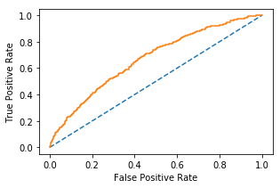
Building a Statistical Model for optimal risk detection
What is the performance of the model we are offering?
ROC curve in orange shows the range of different sensitivities we could choose from. Since we are interested in high sensitivity, we can choose a a high FP rate (e.g. around 0.6 will give us ~80% sensitivity).
 | Mean | STD
CV AUC score | 0.65 | 0.15
I’ve done gridearch and cross validation
Notes:
For WNV(-) cases, There is a 3 X lower chance if there is only one relatively cold day.
As opposed to 10 times lower for WNV(+) cases

Slide 17
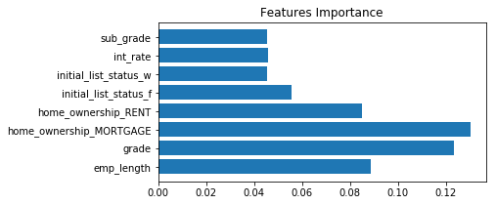
Summary of the Proposed Model and Final Recommendations
What the model is revealing to us about Default factors?
Credit score related features (grade, subgrade and int_rate) play an important role in the model, affirming that on average, credit score counts as expected (although it might put borrowers at risk in the first place due to higher monthly fees).
Even a stronger predictor is homeownership status, we suggest that the reason is that it defines more strictly the borrowers (renters and mortgage payers have high monthly payments)

Slide 18
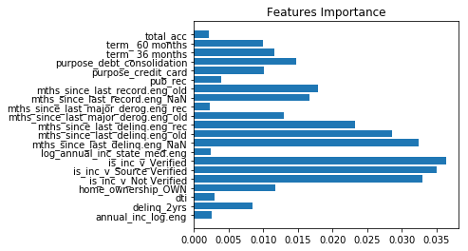
Summary of the Proposed Model and Final Recommendations
What the model is revealing to us about Default factors?
Whether income is verified is important
Negative credit history related features (e.g. months since last ‘delinq’, ‘last record’ and ‘major derog’ ) are also important Even though all of them suffered from significant missing data
A longer term might mean that borrowers with longer terms are the ones with difficulty of returning
Surprisingly log of annual income and dti are not as ”important” as hypothesized (and adjusting to median income of state might not add information)
Also surprisingly absent are the number of years of credit, and balance utility
Prediction ability isn’t necessarily depended on few important features, rather on multitude of features
that each might play a small part not be

Slide 19
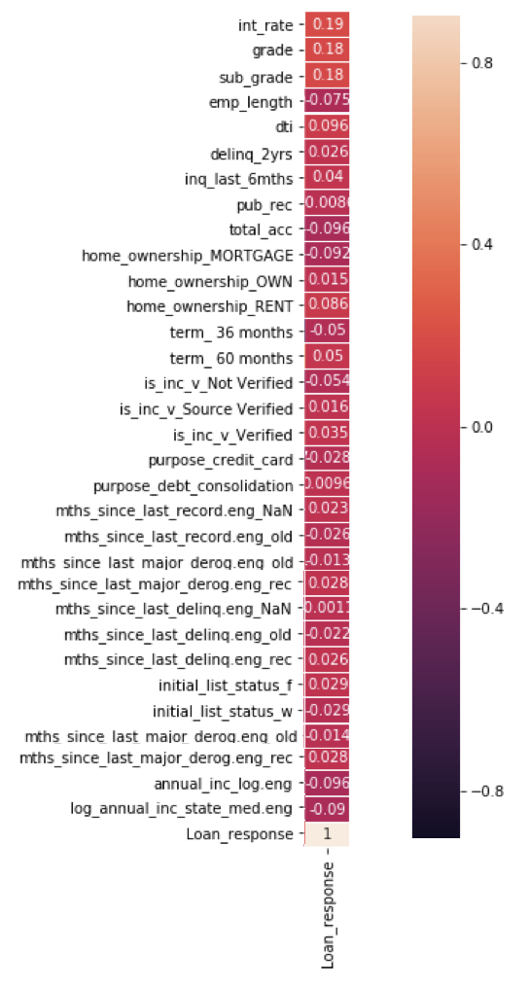
Summary of the Proposed Model and Final Recommendations
What the model is revealing to us about Default factors?
A heat-map of correlations can give a better sense of how these factors are linked to defaults

Slide 20
Summary of the Proposed Model and Final Recommendations
What the model is revealing to us about Default factors?
Summary of factors relationship to WNV:
(+++) strong positive relationship
(++) moderate positive relationship
(-) mild negative relationship
Factor | Related to Default
Low credit score / high interest / fractional loans * | +++
Income verified or source verified ² | ++
Recent ³ (or unknown): delinquency, major derogatory or record | +
Renting, owning home ¹ / debt consolidation / low annual income | +
Years of employment / whole loans | - - -
Mortgage | - -
Older: delinquency, major derogatory or record ³ / Term 60 | -
Interestingly renting and owning are related to risk while mortgage to de-risk (counter to our hypothesis), perhaps this group have higher credit scores (which allowed them to get a mortgage in the first place)
Income verification is related to default (counter intuitive) perhaps the verification is done only when there is a raised suspicion which understandably related to default
Negative financial history in the last 2 years is related to default whereas between 2 and 4 years is related to paid loans
* Note: It's Questionable whether this is an actionable insight. it’s possible that whole-loans are grabbed in one go because they are more appealing. So in P2P it’s probably easier to identify whether a loan is fractional ( cause it’s too late or too early to be whole)

Slide 21
Summary of the Proposed Model and Final Recommendations
Final conclusions and actionable recommendations for LendingClub investors
The sensitivity of the model we are offering to LendingClub investors ranges from identifying 60% to 80% of default loans
The desirable default identification rate is depended on the preferences of investors whether they are risk averse or risk takers
We offer 2 possible packages:
For risk-averse investors we offer the 80% default detection package. While this means that more than half (60%) of the loans that will be labeled by us as risky will end up to be perfectly safe loans, investors taking this package would enjoy lowering their risk to just 1.2% (from 6% according to the rate of default loans on Lending Club)
Alternatively, for risk taking investors we offer the 60% default detection package. Which means that 40% of the loans that will be labeled by us as risky will end up as safe, but investors taking this package would enjoy lowering their risk by almost half - from 6% to 3.6%
If investors would like to pick lower-risk loans manually (without using our packages) but still would like to benefit from our analysis, We recommend to follow these guidelines:
Take into consideration low credit cores first
whether the income or the income source are verified (as they are more related to default than not)
Lookout for negative credit history in the last 24 months. If it’s later than 24 months it’s even safer than loans with unknown history.
Counterintuitively owners of homes have higher risk than mortgage payers

Slide 22
Supplementary slides
The following pages are irrelevant as of now

Slide 23
Summary of the Proposed Model and Final Recommendations
Final actionable recommendations for Chicago Municipality and Department of Public Health
We suggest to take preemptive measures as well as spraying infested locations. Since June has the highest occurrences of WNV, whilst not being the hottest, driest and least windy, we could assume that the high occurrences are due to reactive measures to eradicate mosquitos been taken too late in the season (only after locations become infested).
We propose to invest efforts in prevention, starting from increasing awareness of the general population (e.g. to not leave exposed untreated water such as ponds and pools in their yard)
Additionally, since one specie (Culex Pipiens) stands out as a carrier with higher rates of WNV, We suggest to increase efforts in preventing the proliferation of this specie in particular. This could be done with more specific and environmentally friendly measures (e.g. "targeted biological mosquito control") which would make the process of lowering occurrences more efficient and less costly

Slide 24
Supplementary Slide - Project Discussion and Final Notes
AUC under the ROC curve is ~89% so the model is robust enough to allow flexible choice of thresholds ( choosing the most fitting recall vs precision rates)
The model is based on the assumption that the number of mosquitos is a valid info that could be collected and used for prediction. The model's performance would change if we exclude the ‘Number of Mosquitos’ feature. At that scenario we will use all other features to predict the number of mosquitos, and then use that prediction as a new feature in a new classification model, to make a new prediction for the WNV occurrences. We can expect the performance of this model to be lower.
The spray data was implemented with the hypothesis that recently sprayed sites would effect the occurrences of WNV. after EDA, occurrences seem to not vary (on average) and since the number of observations taken from recently sprayed sites were low (79), these observations were not excluded from the dataset with the rational that they would not effect the model's performance.
The data could be enriched further with publically available data, e.g. Implementing data on locations of exposed water reservoirs, lakes and other bodies of fresh water which might be correlated to increased mosquito population.
* All rights reserved to Eran Schenker
Features with anomalie:
revol_bal (no difference)
Grade with greatest default

Slide 25
Supplementary Slide - Project Discussion and Final Notes
AUC under the ROC curve is ~89% so the model is robust enough to allow flexible choice of thresholds ( choosing the most fitting recall vs precision rates)
The model is based on the assumption that the number of mosquitos is a valid info that could be collected and used for prediction. The model's performance would change if we exclude the ‘Number of Mosquitos’ feature. At that scenario we will use all other features to predict the number of mosquitos, and then use that prediction as a new feature in a new classification model, to make a new prediction for the WNV occurrences. We can expect the performance of this model to be lower.
The spray data was implemented with the hypothesis that recently sprayed sites would effect the occurrences of WNV. after EDA, occurrences seem to not vary (on average) and since the number of observations taken from recently sprayed sites were low (79), these observations were not excluded from the dataset with the rational that they would not effect the model's performance.
The data could be enriched further with publically available data, e.g. Implementing data on locations of exposed water reservoirs, lakes and other bodies of fresh water which might be correlated to increased mosquito population.
* All rights reserved to Eran Schenker

