Slide 1


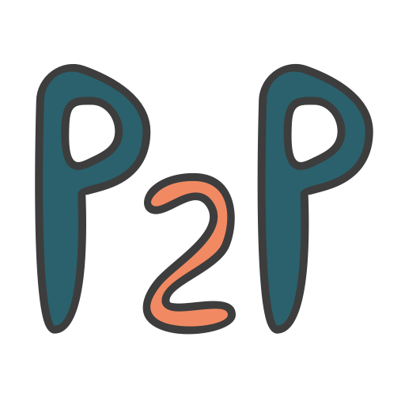
Loan Risk Identification
Identification of risk factors involved with default loans &
The predicting models that could help investors avoid them
Executive Summary For Lending Club Investors
By Eran Schenker
Notes:
Today I’ll present a data driven approach to help prevention and erradication of westnile virus in Chicago

Slide 2
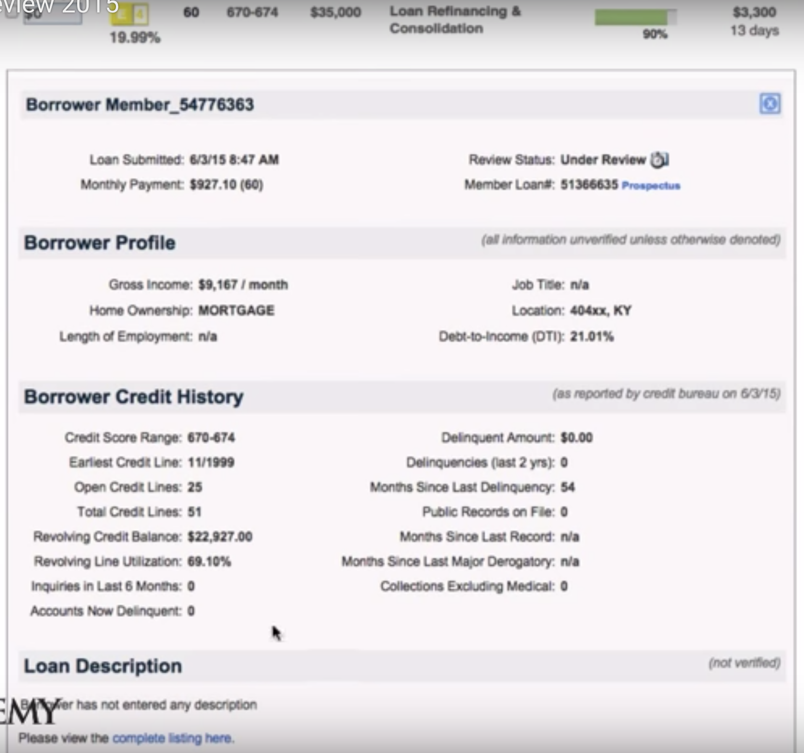
Introduction
Lending Club (LC)
The largest online loan platform ($10.9 B new loans -2018)
Peer-to-peer (P2P) lending site, directly connects borrowers and investors.
Value Proposition & Challenge:
“Cutting out the middleman” → opens possibilities for borrowers and investors
Exposes investors to the risk of unpaid loans → i.e. Default Loans.
Project outline:
Built-in classification model based on data from LC website
Projects whether a Current loan (2014) → Fully paid / Default loan
analysis used past loans only. The approach is to treat them as new loans, by ”turning back the clock” on the data by excluding information that was available only after the loan was initiated
Project goal:
Give actionable insights and advice on loans, at the time when investors actually need it – before they decide on which loan to put the money on
Notes:
Lending Club (LC) is the largest online loan platform with $10.9 billions worth of new loans in FY2018
It is a peer-to-peer (P2P) lending website that directly connects borrowers and potential lenders/investors.
One of the biggest value propositions of LC, also holds within its potential risk: LC is “cutting off the middle man” and opens possibilities for borrowers and lenders and as such, it also exposes lenders to the risk of unpaid loans – i.e. Default Loan.
In this project we built a classification model based on data from LC website, that projects whether a Current loan (as of 2014) will most likely be Fully paid or does it hold a risk for a Default loan.
In the analysis we used only past loans, and in our approach we treated them as new loans offered, which necessitated ”turning back the clock” on the loans by excluding any data on the loan that was available only after it was issued
The goal is to give actionable insights and advice on loans, at the time when investors actually need it – before they decide on which loan to put the money on

Slide 3
Is the data informative for default loans prediction?
Defining the target – what is a “Default loan”?
The Dataset (161,231 unique loans) most are Current loans (~94%) and Fully paid are (4%)
The rest are in 5 more categories*
A search on LC website** gave hint on the following assumption: Since 75% of late (31-120 days)
loans end up not fully paid, we aggregated them with Default group and Charged-off
group to make up a diverse “bad loans” group named Default
Defining the features – Variable that is a available for investors on a loan before it is issued
Fields available
on LC website
a loan for a 14
day Period
window before
it is issued
(or discarded due
to lack of demand )
*Note: although we are not using
the majority of the data, the assumption
Is that it is sufficient for the goals we set. Possibilities on how to use the rest of
the data would be brought later in the
presentation
** https://www.lendingclub.com/info/demand-and-credit-profile.action
Notes:
This meant that we needed to process the data further and use different metrics

Slide 4
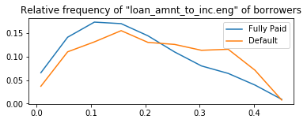
Is the data informative for default loans prediction?
Exploring dataset features
By exploring the Default occurrences vs credit rating, we could match the prior assessment of borrowers credit ability to actual credit ability on the subgrade
Borrowers with high loan amount relative to their income should have more difficulties in paying back their loan. We see evidence of that by exploring loan to income ratio.
bar plot of rel_freq
vs credit
Fully Paid: μ=﻿0.20, σ=0.1
Default: μ=﻿0.24, σ=0.11
Portion of borrowers
(relative frequency)
Loan Amount / Annual Income
Notes:
This meant that we needed to process the data further and use different metrics

Slide 5
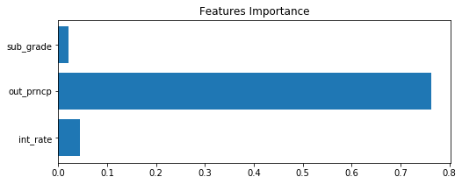
Is the data informative for default loans prediction?
Pinpoint features NOT to be used
Target-leaked features tend to be suspiciously strongly correlated with the target (meaning that when deploying our model for prediction we wouldn't have the feature available to us because it is determined together with the target ( hence “target leak).
‘out_prncp’ is the remainder of borrowed amount that is still needed to be paid. By running a naïve model on the dataset that includes this feature we see how 75% of the prediction relies on this feature. Default loans by definition still have to pay. whereas fully paid loans by definition have nothing left to pay.
Notes:
This meant that we needed to process the data further and use different metrics

Slide 6
Is the data informative for default loans prediction?
“Train” (main) Dataset
Features:
Train dataset has informative features ( e.g. number of mosquitos, species)
Assumption:
Baseline Prediction:
Initial classification efforts with the raw dataset shows that the ability to detect Defaults (recall) is 0% (classifying every loan as fully paid).
This means that without feature engineering and balancing efforts (# of loans in each class) we can’t get a sufficiently sensitive classification*
Note: By using a target-leaked feature in the dataset as a positive-control, we’ve reached a 77% rate of detection, showing that the best detection we can aspire to is still limited and will never be 100%
Notes:
This due to the uncertainty in predicting complicated processes as defaults with a limited dataset,
Without enrichment (global factrs)
And also the target group has late loans that would not default in the end

Slide 7
Are the datasets informative for prediction?
“Spray” (Supplementary) Dataset
Instances:
The Spray dataset’s low number of relevant instances (observations) and lack of significant relationship to WNV, deems it un-informative to our purpose to enrich the main “Train” dataset, so we can ignore it
“Weather” (Supplementary) Dataset
Features:
After conducting rigorous feature engineering, the newly engineered weather features became highly informative which provides strong prediction power for WNV cases
Notes:
Meaning less than 10% of the traps had spraying data
And out of these matches, spraying was not informative (doesn’t have a relationship with WNV)

Slide 8
Building a Statistical Model for optimal prediction of WNV
Assumption –
Chicago Municipality (CM) and CDPH Would like to detect the highest number of WNV cases possible, rather than avoid a false alarm (falsely detecting WNV where there isn’t).
This is because of the high cost related to undetected WNV cases (due to public health implications) as compared to the lower cost related to false alarm ( the cost which involves over-spraying).

Slide 9
Building a Statistical Model for optimal prediction of WNV
Assumption –
Chicago Municipality (CM) and CDPH Would like to detect the highest number of WNV cases possible, rather than avoid a false alarm (falsely detecting WNV where there isn’t).
This is because of the high cost related to undetected WNV cases (due to public health implications) as compared to the lower cost related to false alarm ( the cost which involves over-spraying).
Method –
We will run a classification model (Random Forest Classifier) to predict WNV cases
Then we’ll optimize the model depended on the prediction score we get (AUCROC score)
Finally we’ll set our recommendations based on the the most sensitive test we are able to provide, given a cost-benefit analysis (of undetected WNV vs over-Spraying)

Slide 10
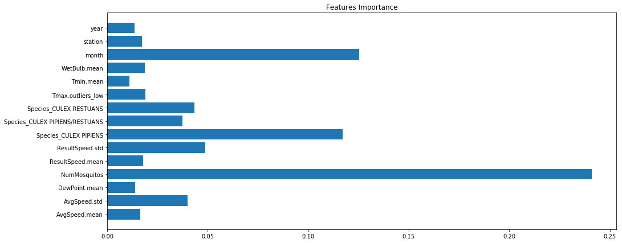
Summary of the Proposed Model and Final Recommendations
What the model is revealing to us about WNV factors?
8 out of 13 of the most important factors are engineered weather features
Not surprisingly, the most important factor is Number of Mosquitos
Whether the specie is CULEX_PIPIENS or not is important, as well as which month it is (e.g. peak of summer)
Weather factors include wind speed (most important probably due to strong winds effecting mosquito activity)
Next in importance are humidity factors (i.e. wetbulb & dewpoint)
A significantly cold day during otherwise stable 2 weeks is important (probably because it interrupts mosquito/virus activity)
Some years have more cases of WNV than other years (probably due to specifically cold/hot years)
0 0.05 0.10 0.15 0.20 0.25 0.30

Slide 11
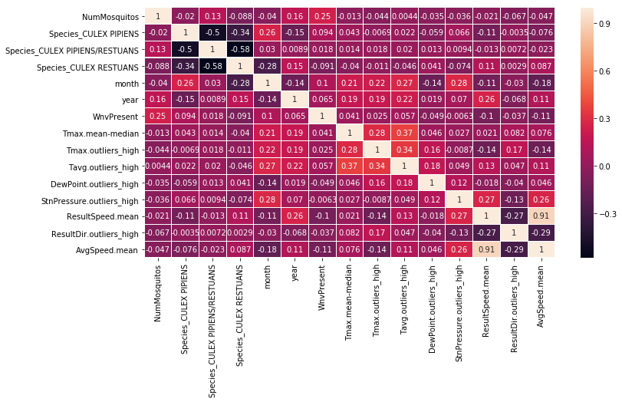
Summary of the Proposed Model and Final Recommendations
What the model is revealing to us about WNV factors?
A heatmap of correlations can give a better sense of how these factors are linked to WNV.
All factors involving wind have negative correlation with WNV response i.e.
more WINDY -> Less WNV.
Although a small effect, when we look at Dewpoint, we see that the
more HUMID -> Less WNV
(which is aligned with known facts about WNV which prefers dry conditions)
“Culex_Pipiens” specie is the most indicative of WNV response i.e.
more Culex_Pipiens -> more WNV,
and “Culex Restuans” is indicative of NO-WNV response i.e.
more “Culex Restuans” -> less WNV

Slide 12
Summary of the Proposed Model and Final Recommendations
What the model is revealing to us about WNV factors?
Summary of factors relationship to WNV:
(+++) strong positive relationship
(++) moderate positive relationship
(-) mild negative relationship
Factor | Related to WNV
Number of Mosquitos | +++
CULEX_PIPIENS (specie) | ++
Month | ++
High Temperatures | +
CULEX_RESTUANS (specie) | -
Wind | -
Humidity | -

Slide 13
Summary of the Proposed Model and Final Recommendations
Final actionable recommendations for Chicago Municipality and Department of Public Health
The sensitivity of the model we are offering ranges from detecting 60% to detecting 100% of WNV cases
Depended on the cost of false alarm (e.g. spraying areas that are not infested), we could offer the right package for Chicago Municipality and CDPH purposes.
We offer 2 possible packages:
If it’s affordable to “over-spray” 4 times the number of necessary spraying (i.e. only 1 out of 5 spraying efforts are justifiable), we predict eradication of 90% of WNV of occurrences in Chicago (lowering its rate from 5% to 0.5%).
Alternatively If it’s affordable to “over-spray” only 2.5 times (i.e. 2 out of 5 spraying efforts are justifiable), then we predict eradication of 60% of WNV occurrences (lowering its rate from 5% to 2%).
We recommend to take into consideration the inhabitants population density of the areas in order to asses the importance of eradicating the mosquitos. This could provide important clues about the right choice of over-spraying and WNV detection rate discussed previously.

Slide 14
Summary of the Proposed Model and Final Recommendations
Final actionable recommendations for Chicago Municipality and Department of Public Health
We suggest to take preemptive measures as well as spraying infested locations. Since June has the highest occurrences of WNV, whilst not being the hottest, driest and least windy, we could assume that the high occurrences are due to reactive measures to eradicate mosquitos been taken too late in the season (only after locations become infested).
We propose to invest efforts in prevention, starting from increasing awareness of the general population (e.g. to not leave exposed untreated water such as ponds and pools in their yard)
Additionally, since one specie (Culex Pipiens) stands out as a carrier with higher rates of WNV, We suggest to increase efforts in preventing the proliferation of this specie in particular. This could be done with more specific and environmentally friendly measures (e.g. "targeted biological mosquito control") which would make the process of lowering occurrences more efficient and less costly

Slide 15
Supplementary Slide - Project Discussion and Final Notes
AUC under the ROC curve is ~89% so the model is robust enough to allow flexible choice of thresholds ( choosing the most fitting recall vs precision rates)
The model is based on the assumption that the number of mosquitos is a valid info that could be collected and used for prediction. The model's performance would change if we exclude the ‘Number of Mosquitos’ feature. At that scenario we will use all other features to predict the number of mosquitos, and then use that prediction as a new feature in a new classification model, to make a new prediction for the WNV occurrences. We can expect the performance of this model to be lower.
The spray data was implemented with the hypothesis that recently sprayed sites would effect the occurrences of WNV. after EDA, occurrences seem to not vary (on average) and since the number of observations taken from recently sprayed sites were low (79), these observations were not excluded from the dataset with the rational that they would not effect the model's performance.
The data could be enriched further with publically available data, e.g. Implementing data on locations of exposed water reservoirs, lakes and other bodies of fresh water which might be correlated to increased mosquito population.
* All rights reserved to Eran Schenker

