Slide 1
POC of Classification of Health Status from Medical and Prescription Drug Usage
By Eran Schenker

Slide 2
Project Overview
Background & challenge
POC Outline (Part 1)
POC Outline (Part 2)
Model
Results
Intuition for Features Importance
Possible Post-POC Steps

Slide 3
Background & Challenge
The Need
Profiling health status of health insurance members is essential and has several drivers:
Detect members that are not receiving required medical care
Identify unusual care patterns that could convey health risk
Value Proposition
By addressing the profiling need, the insurer could anticipate issues and thus manage and possibly intervene to change members’ outcomes for the better
Challenge
Different datasets are sometimes channeled from several different providers
Each dataset holds only partial information about a member
Inferring health status of a member by using 2 different datasets is challenging
How to achieve meaningful results on health status from several datasets
Tasks Performed
Defined health status of members and defined the level of the analysis ( a member per a certain time period) from medical diagnosis data
Hypothesized and implemented a model that learns how to classify this health status by using prescription drug utilization data
Notes:
Task Performed (short, elaboration next slide..)
Emphasize business achievements – definitition of health status ( and avoid ML lingo for now), and level of investigation – member per period.
as is

Slide 4
Proof of Concept (PART 1)
Background
In the claims dataset there are more then 70,000 ICD-10 diagnoses codes which are not hierarchical and therefore could not be used directly for classification purposes
These codes are taxonomized into 18 “ccs_1_desc” super categories
These could presumably provide a definition for the health status
However, since they are on the claim level and not on the member level, members could have thousands of different combinations of super categories (which still won’t be informative enough) so a shift towards a more robust characterization was needed
Rationale
A generalized and actionable definition of health status was chosen - the wellbeing of the member.
Since the 18 groups are not hierarchical (could not provide a simple mapping of a member’s wellbeing) the decision was to build a risk score for wellbeing built on the following assumptions:
The more diverse the diagnosis profile of a member is (more groups), the higher the risk is for this member’s wellbeing.
The more total medical records a member has, the higher the risk for this member’s wellbeing
Notes:
Background point 2:
More robust solution is needed since, a member could have several health status, so up 18 categories, which means thousands of classes due to all combinations.
And even so it could be not informative enough ( inside Diseases of the nervous system there could be Alzheimer and carpal tunnel ).
Rationale point1
This differs from the health status example that was provided in the task (“Member xyz had cancer and a broken leg”), with the objective to provide a more robust and statistically useful characterization of health status*
Rationale point2
Why not use 70,000 codes? (To tackle the Alzeheimer carparal tunnel) because number of codes not necessarily means more serious and can introduce a lot of noise fractures could have many more codes, than cancer biopsy that has one code. So the groups might be doing a good job of generalizing. ( this might be a work of ( Subject Matter Expert)
So decision was towards a risk score – that allows to compare members wellbeing ( explained next slide)
Pros - easy to compare members
Possible to subset into risk groups (and concentrate on important population)
Cons – risk score is built on assumptions that is needed to be carefully validated

Slide 5
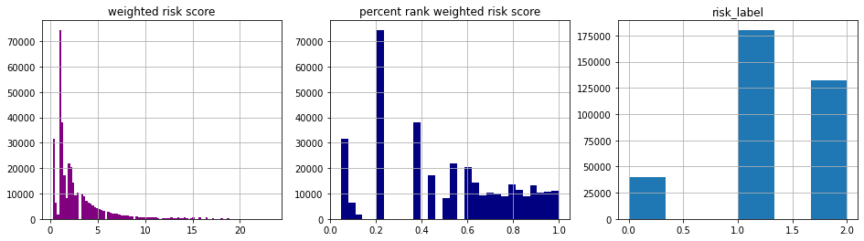
Proof of Concept (PART 1)
Implementation
Generate a risk score for each member:
A weighted average risk score was calculated: 0.75 X the count of unique ccs groups + 0.25 X the count of records, aggregated per member per year. *
Create 3 risk score groups ( according to risk score):
Members where classified into 3 groups: low, medium and high risk, according to the percentile of the risk score. The percentile cutoffs were chosen according to table A
______________________________________________________________________
table A
Class | Percentile
0 | Lower than .33
1 | Between .33 and .60
2 | Above .60
3 step transformation from weighted risk_score to risk_label
* Higher weight is given to count of unique ccs groups due to the presumed higher risk that it conveys.
* “ill defined” group and “unknown” group with no ccs mapping were excluded from count of unique groups calculation (used in the risk score)
Notes:
Implementation point1
One step before calculating the formula there was looking at the distribution:
Max count of records was ~=890 , (and max unique groups is ~18 ). So I capped the max count at 42 (which is 99% percentile).
If I had to build the risk score again I would do percentiles FIRST on #records and on unique #groups and then applying the weighted avg
Why labels?
Risk score doesn’t answer directly the question of wellbeing ( 50% risk score means?) so risk groups makes more sense ( are you at risk or not?)
- Important this just a baseline risk score so it might not be informative (e.g. 40 vs 60), there should be more iterations on what is the best weight and other aspects. So classes would avoid this
- regression of # drugs to # diagnosis is not straightforward

Slide 6
Proof of Concept (PART 2)
Goal: Classify health status of members (defined previously as wellbeing i.e. the risk group) by using prescription drug utilization data
The solution proposed: predict the risk group of a member at the beginning of each calendar year for the rest of the year, by looking at the member’s data from past calendar years.
The resolution of the model: The prescription drug data will be summarized (aggregated ) by calendar year per member
Notes:
Why aggregated per year? – the assumption is that we would like to asses member’s health status for a long rather than short period of time. A monthly aggregation was considered but that would lead to added seasonal information that can cause noise (member A in January and in August would have variance) so a year was chosen for simplicity ( for the scope of this project). Another reason was that it is more actionable since health plans are designed calendar year health plans should meet member needs for a calendar year*
*“When health insurance companies price their insurance premiums and design their plans, they do so based on a calendar year.”
The assumption is that the analysis is not on new members that joined mid year. If there are new members in the data - the way to tackle it is to aggregate annualy from the members 1st visit (so not on calendar years)
Sum of categories instead on one hot encoding

Slide 7
Proof of Concept (PART 2)
Background
Prescription drug utilization data consist of more than 20,000 drugs
Drugs are taxonomized into 94 drug categories (highest super category)
Variables in the dataset are limited “drug categories” “drug_class” and “drug_group”, so feature engineering is crucial
Rationale
94 different drug categories and the number of records per member is at the basis of engineering the following features:
”Count_distinct_drug_types” - more diverse number of drug categories a member has (more groups), the higher the likelihood that a member suffers from more than one condition.
“Count_Prescriptions” - The more prescriptions a member has, the higher is the risk for this member’s wellbeing
94 indicator features (e.g. “drug_category_analgesics – opioids” ) indicates if a member had a prescription for a specific category (Some drug categories are more related to severe medical conditions than others)
Count drug type features – counts number of prescriptions a member got for a specific drug category
“count_prescribed_months” - The total number of months that a member received at least one prescription. Can convey chronic diseases, that may ( or may not ) be correlated to severity of condition and member’s wellbeing
“STD_monthly_count_prescriptions” - Low variance of number of prescriptions per month can convey chronic conditions, whereas High Variance can convey acute condition
“Quaterly_proportion_prescriptions” – quarterly count of prescriptions divided by total number of prescriptions (for the member). 4 features for every Q. Rational - seasonal peak in Q1 to Q4 in relation to Q2 and Q3 can be correlated to flu related conditions for the member and be negatively correlated to the member’s wellbeing
Notes:
Why aggregated per year? – the assumption is that we would like to asses member’s health status for a long rather than short period of time. A monthly aggregation was considered but that would lead to added seasonal information that can cause noise (member A in January and in August would have variance) so a year was chosen for simplicity ( for the scope of this project). Another reason was that it is more actionable since health plans are designed calendar year health plans should meet member needs for a calendar year*
*“When health insurance companies price their insurance premiums and design their plans, they do so based on a calendar year.”
The assumption is that the analysis is not on new members that joined mid year. If there are new members in the data - the way to tackle it is to aggregate annualy from the members 1st visit (so not on calendar years)
Sum of categories instead on one hot encoding

Slide 8
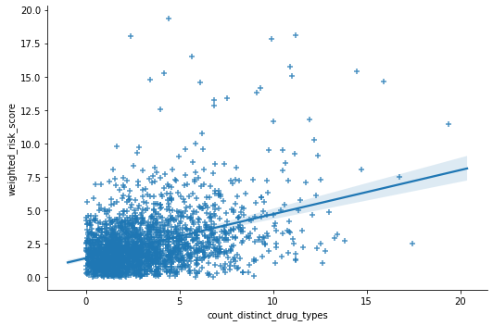
Model
Steps and assumptions prior to modeling –
Validating that some features have some correlation to the target variable (figure on the right)
We prefer to tune our model for higher recall (than precision) for class 2 due to the cost of falsely classifying a member as “low risk” where they should be classified as “high risk”
Modeling steps
Built train set on calendar years 2016, 2017 and test set on 2018
Ran classification model ( Random Forest Classifier (RFC)) on the dataset to get baseline initial results
RFC was chosen due to its robustness with sparse data (due to 94 indicator features), its robust tuning capabilities and relative interpretability ( with features importance application)
“count_distinct_drug_types” feature is correlated with the “weighted risk score” which the risk_label is based on
Notes:
How would you tune the RF model?
Max_ features Select a range of Max_ features rule of thumb sqrt ( # features ) sqrt ( 100 ) # allows to the model to test alternative features and not fix to a couple of dominant features.
n_estimators: # number of trees used (many would not lead to overfitting since it’s ensemble, every new tree is a new model..) it’s just a matter of calc , storage performance
max_depth: granularity, how far down the tree goes – more depth = more complexity of model higher sensitivity to small features
min_samples_split: similar to depth as it controls whether a feature could be used in the tree ( if it has enough info to split a node) smaller -> more depth..
What I Used: 'n_estimators':500,'min_samples_split':4,'max_features':30,'max_depth’:5
Merge bullets 2 and 3 on sensitivity ( use recall)

Slide 9
Results
Classification Model Results –
Results ( on the right ) show low accuracy, (class 0 was undetected), yet sensitivity of high risk group (class 2) had the best values (0.72)
With this imbalanced performance across the classes, tuning the thresholds to improve class 0 metrics would undoubtedly hinder the metrics of class 2*, therefore other measures should be taken to improve performance
precision recall f1-score support
0 0.00 0.00 0.00 3995
1 0.70 0.58 0.63 26802
2 0.44 0.72 0.54 13531
accuracy 0.57 44328
macro avg 0.38 0.43 0.39 44328
weighted avg 0.56 0.57 0.55 44328
Next steps to improve performance of model
Risk score level:
Calculate percentiles on risk factors first, and only then calculating weighted avg of risk score
Use lower level of ccs categories to refine the risk score (more specific)
Implement more assumptions to the risk score ( mapping of severity of diagnoses)
Label transformation - classify different number of classes (more than just 3)
Feature engineering level:
Implement features 4-7 (from page 7 yet to be implemented) and add more
Consider segmentation of members (e.g. members with chronic conditions) according to prescription activity or drug mapping, then run independent analyses on the different segments
Model level – tuning parameters of RFC, feature selection, different classifiers
Sampling level – cross validation
* AUC score and ROC were not implemented due to these reasons

Slide 10
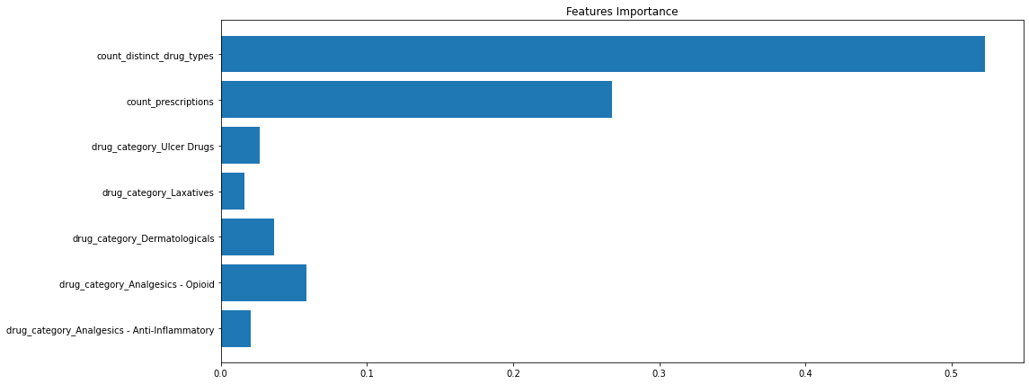
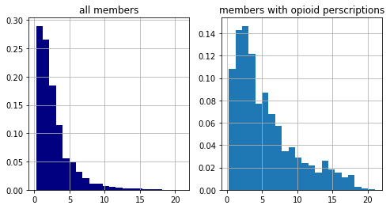
Intuition for Features Importance
2 dominant features are apparent. These are the engineered features 1 and 2 ( discussed on page 7)
“Drug_category_analgesics - Opioid” has the highest importance from the indicator features. An explanation could be that it treats a common symptom - pain that is related to numerous health conditions as could be seen with the shift to higher risk scores for that group (histograms on the right )
Relative frequency of weighted risk score

Slide 11
Possible Post-POC Steps
(Once model performance improved)
Target risk members found by the model
Conduct error analysis. The objective is to investigate the misclassified members. The significance in some occasions could be:
Identifying misalignment in drug prescriptions due to human error
Identifying members who do not utilize their medications
Identifying other errors due to misalignment between providers
All of which are “good” errors. By contradicting the model and its assumptions, they drive an opportunity to intervene and change outcomes for members for the better

