Slide 1
NBA GAME PREDICTION · WIDE & DEEP NEURAL NET
Can a model
hang with Vegas?
A leakage-free Wide & Deep network predicts NBA games from pre-tip-off box-score form — and lands within a few points of the sharpest betting markets on earth.
63%
66–68%
vs
THIS MODEL
LAS VEGAS
Eron Pano
MS Data Science · Regis University
Notes:
Open with the framing question. A deep model calls NBA games at 63% from nothing but pre-game box-score averages. Whether that's good depends entirely on the benchmark. The benchmark is Las Vegas, which sits at 66-68%. So the whole talk is: can we hang with Vegas?

Slide 2
01 · THE QUESTION
Is 63% good? Depends what you stack it against.
63%
66–68%
THIS MODEL — held-out test seasons
LAS VEGAS — closing market line
Pre-game team form only. No injuries, no lineups, no betting signal. Trained on 2015–21, judged on games it had never seen.
Rooms full of quants, insider injury news, sharp money moving billions. The most accurate public NBA forecast that exists.
A few points apart — that gap is the whole story.
Notes:
The single number 63% means nothing in isolation. Against a coin flip it's modest; against the sharpest markets on earth it's remarkable. We measure it against Vegas, the practical ceiling. The gap is only a few points, and the rest of the talk explains why that gap exists and why it closes honestly.

Slide 3
02 · THE PROBLEM
Single-game prediction is deceptively hard
54.4%
~67%
1 game
Home-win base rate
Las Vegas ceiling
All variance, no mercy
The naive floor: just pick the home team.
The practical upper bound on public forecasts.
Shot luck, foul trouble, late-game noise — unforecastable.
A useful model has to climb from the 54% floor toward the 67% ceiling — and resist the temptation to cheat past it.
Notes:
Three numbers frame the difficulty. The floor is 54.4% — always pick home. The ceiling is Vegas at ~67%. And any single game carries huge irreducible randomness. The model has to find real signal between floor and ceiling without manufacturing fake signal from the future, which is the leakage trap on the next slide.

Slide 4
03 · THE DATA
Ten seasons, rebuilt to respect time
11,876
64
10
13.5k
games
leakage-free features
seasons (2015–25)
model parameters
1
2
3
4
›
›
›
NBA Stats API
One row / game
Rolling L5 & L10 form
Time-based split
LeagueGameFinder, 10 seasons
home vs away, from MATCHUP
shift(1) — no peeking ahead
train · validation · test by season
Notes:
The pipeline is the unglamorous part that makes everything valid. Pull ten seasons from the NBA API, reshape to one row per game, engineer rolling last-5 and last-10 form with a one-game shift so a game never sees itself, then split by season — train on the past, test on the future. 11,876 games, 64 features, a compact 13.5k-parameter model.

Slide 5
04 · THE CORE FINDING
An 87% model was lying. Fixing it gave 63%.
87–88%
62.9%
The lesson
On temporal data, a score that looks too good is a symptom — not a success.
LEAKED
HONEST
›
Two features secretly encoded the result:
• cumulative season win% — a proxy for final standings
• head-to-head win% with |r| = 0.83 to the outcome
Rebuilt time-safe:
• season win% removed; bounded L5/L10 windows only
• H2H recomputed as a shifted mean → |r| = 0.08
• audit: every feature |r| < 0.40
The right reaction to 90% here is suspicion: which feature is encoding the answer?
Notes:
This is the heart of the project. The first model scored 87-88% and I almost celebrated. Instead I asked what was too good. Two features were leaking: cumulative season win percentage, basically the final standings, and a head-to-head rate computed without respecting time, correlating 0.83 with the outcome. Rebuilding both to be time-safe dropped the score to an honest 62.9%. The transferable lesson: on temporal data, suspiciously high accuracy is a red flag, not a trophy.

Slide 6
05 · THE MODEL
Wide & Deep: memorize and generalize
WIDE · linear branch
memorizes direct signals (16 units)
64 features
›
›
P(home
win)
rolling form
DEEP · learns interactions
96 → 48 → 24, ReLU + BatchNorm
dropout 0.5 / 0.4 / 0.3
~13,500 parameters · Adam, weight-decay 2e-3 · early stopping (best @ epoch 6) · heavy dropout keeps it pinned at the ceiling, not past it
Notes:
The architecture is Wide & Deep, from the Google recommender paper. The wide branch is linear and memorizes direct signals like form differentials. The deep branch — 96 to 48 to 24 with batch norm and heavy dropout — learns interactions like rest combined with opponent strength. They fuse into one probability. It's deliberately small, 13.5k parameters, with aggressive regularization, because the job is to reach the ceiling, not overfit past it.

Slide 7
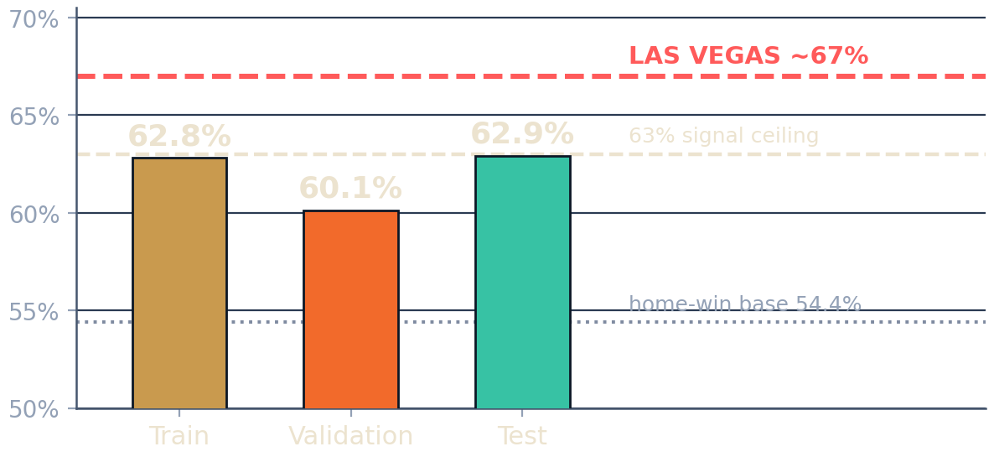
06 · RESULTS
Every split lands at the ceiling — just shy of Vegas
62.9%
Test acc
0.676
Test ROC-AUC
62.8%
Train acc
~4 pts
Gap to Vegas
Notes:
Here are the results against the two reference lines. Test accuracy 62.9%, ROC-AUC 0.676. Train is 62.8% — within a tenth of a point of test, so no overfitting. Every split clears the 54% floor and sits right at the 63% ceiling, about four points under the Vegas line. That four-point gap is exactly the injury and lineup information Vegas has and we don't.

Slide 8
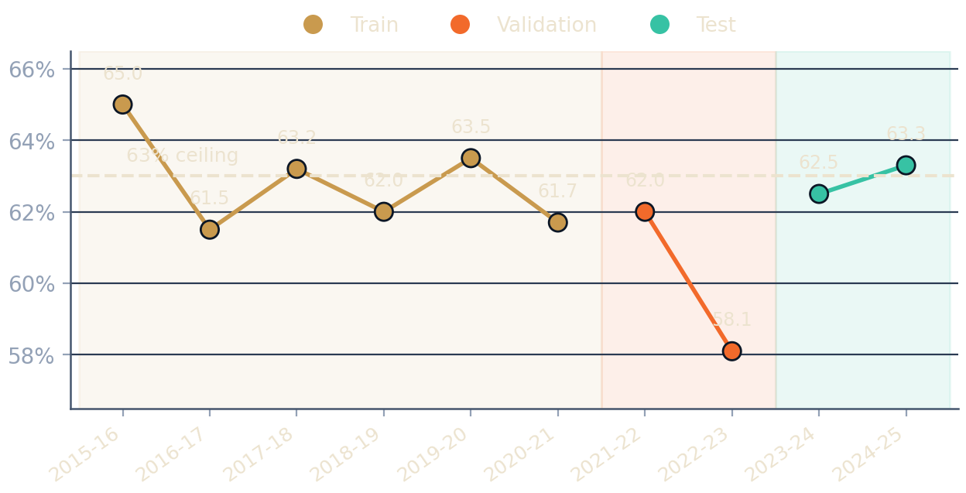
07 · STABILITY
Accuracy holds season to season
Train ≈ Test
The held-out 2023–24 and 2024–25 seasons score right alongside the training seasons. The model generalizes to years it never saw rather than memorizing the past.
Notes:
Stability check. Each point is one season's accuracy, shaded by split. The held-out test seasons on the right sit right alongside the training seasons on the left — no cliff at the boundary. The one soft spot is 2022-23 validation at 58%, a genuinely noisy season, but the trend is flat around the ceiling. That's generalization, not memorization.

Slide 9
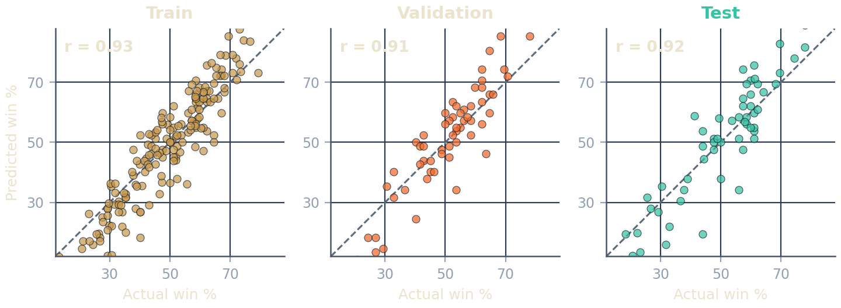
08 · CALIBRATION
Predicted win% tracks reality
Each point is one team-season. Hugging the diagonal means the model's projected record matches what teams actually did — and it holds on the unseen test seasons (r = 0.92).
Notes:
Beyond per-game accuracy, do the team-level projections make sense? Each dot is a team-season: actual win percentage on the x-axis, predicted on the y. Points hug the diagonal in all three splits, with correlations above 0.91 — and crucially 0.92 on the held-out test seasons. The model isn't just barely beating a coin flip; its team rankings are well calibrated.

Slide 10
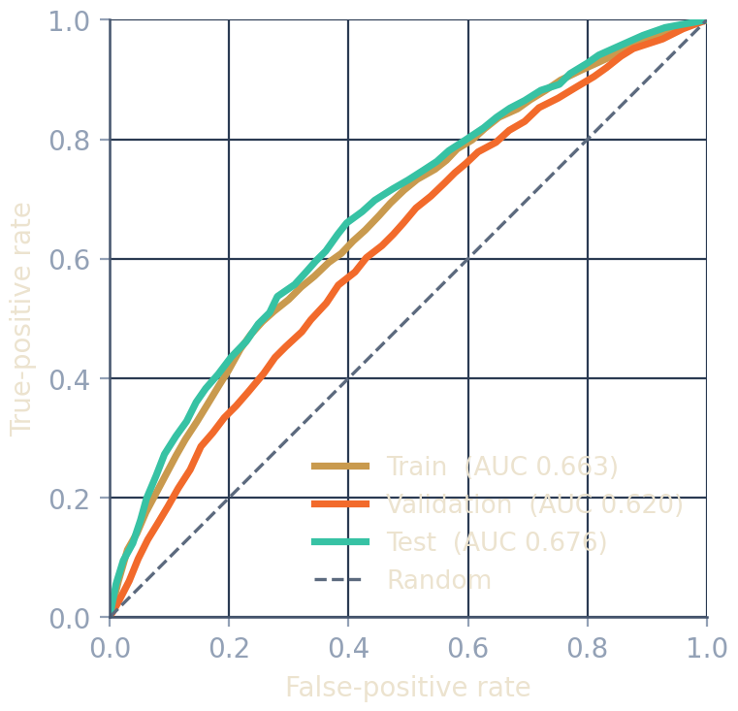
09 · RANKING POWER
Well above chance in every split
Test AUC 0.676
Best of the three splits — performance does not decay on unseen data.
Train AUC 0.663
Close to test: the model is not memorizing.
Validation AUC 0.620
The noisy 2022–23 season pulls this down slightly.
Notes:
ROC curves confirm the model ranks games far better than chance. All three curves bow well above the diagonal. Test AUC is 0.676, actually the strongest split, with train at 0.663 right beside it. Validation is a touch lower at 0.620, dragged by that noisy 2022-23 season. The pattern is consistent: real, bounded predictive signal.

Slide 11
10 · WHY 63% IS THE CEILING
Three reasons 63% is exactly right
THE WALL
THE LEAK TEST
THE FIT
63% is the real limit
A high score is a red flag
Train ≈ Test
Bigger, deeper, less-regularized models did not move the number. That's the signal ceiling of the data, not a tuning failure.
If this returned 90%, the right response is suspicion. Honest features cap out near the market — anything above means leakage.
62.8% train vs 62.9% test, within a tenth of a point. The model generalizes; dropout and weight decay keep it honest.
Notes:
So why call 63% the ceiling rather than a disappointment? Three reasons. One: pushing the model harder didn't help — that's the data's signal limit. Two: a high score would be a red flag, because honest features cap near the market. Three: train and test agree within a tenth of a point, so it genuinely generalizes. 63% isn't where we stopped trying; it's where the honest signal runs out.

Slide 12
THE ANSWER
Yes — a model can hang with Vegas.
A leakage-free Wide & Deep network reaches 62.9% on unseen seasons — a few points under the ~67% market line, with the gap fully explained by the injury and lineup information Vegas prices in and the model deliberately omits.
›
Real contribution Diagnosing and removing temporal leakage — not chasing a vanity number.
›
Honest by design 62.9% that survives deployment beats a brittle 90% that collapses.
›
Next Sequence models, injury & lineup data, and calibration against closing lines.
Court Vision · Eron Pano · MS Data Science, Regis University
Notes:
To close: the answer is a qualified yes. 62.9% on unseen seasons, a few points under Vegas, and that gap is exactly the information we chose not to use. But the real contribution isn't the number — it's the discipline of finding and removing leakage. An honest 63% that survives deployment beats a brittle 90% that doesn't. Next steps: sequence models, injury and lineup data, and benchmarking calibrated probabilities against closing betting lines. Thank you.

