Slide 1

Homework 2:
Kernel Density Estimation
AUTORI:
Francesco Faillace
Lorenzo Maria Pennelli
Eros Pinzani

Slide 2


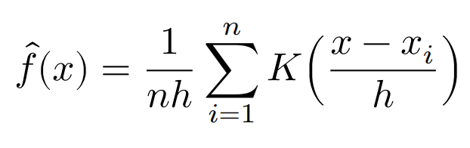
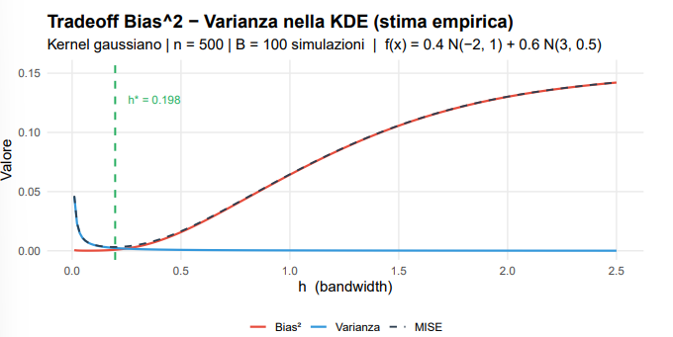
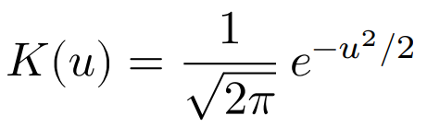
Accenni Teorici
Formula KDE
Kernel Gaussiano
Grafico MISE: Tradeoff Varianza-Bias²
2/5

Slide 3
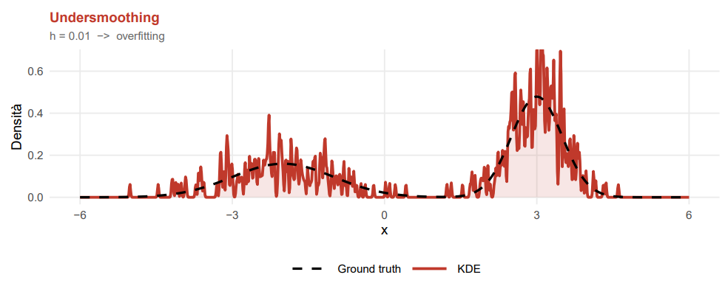
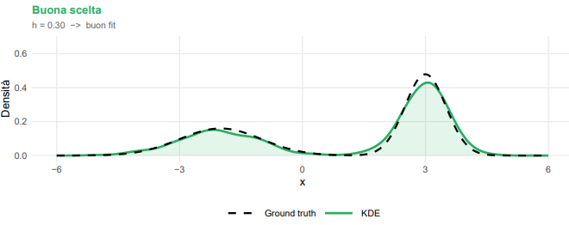
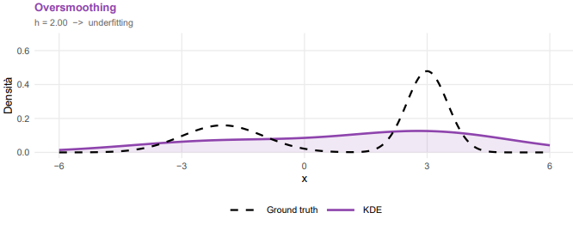
L’importanza della bandwidth (h)
Data Generating Process
f(x) = 0.4 N(-2, 1) + 0.6 N(3, 0.5)
3/5

Slide 4
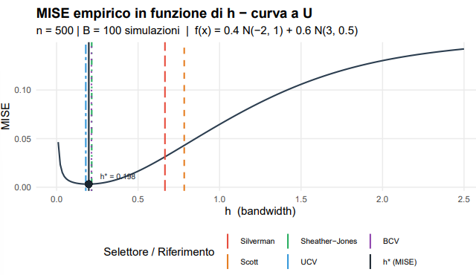
Ulteriori casi di studio
Metodo | h | MISE
h* | 0.1977 | 0.003214
UCV | 0.1793 | 0.003245
BCV | 0.2142 | 0.003292
Sheather-Jones | 0.2156 | 0.003302
Silverman | 0.6650 | 0.031295
Scott | 0.7832 | 0.043037
MISE empirico in funzione di h
4/5

Slide 5
References
A Tutorial on Kernel Density Estimation and Recent Advances (Yen-Chi Chen)
Kernel Density Estimator explained step by step (Medium.com)
Claude per aiuto sul codice
5/5

