Slide 1

REINFORCEMENT LEARNING FOR DYNAMIC MEMORY ALLOCATION
PRESENTED BY
ARNAB MANDAL
2310110428
AM483
CSE
SURYANSH ROHIL
2310110314
SR738
CSE
ACCESSIBLE AT
HTTPS://GITHUB.COM/EROS483/RL_MEMORY_ALLOCATION

Slide 2

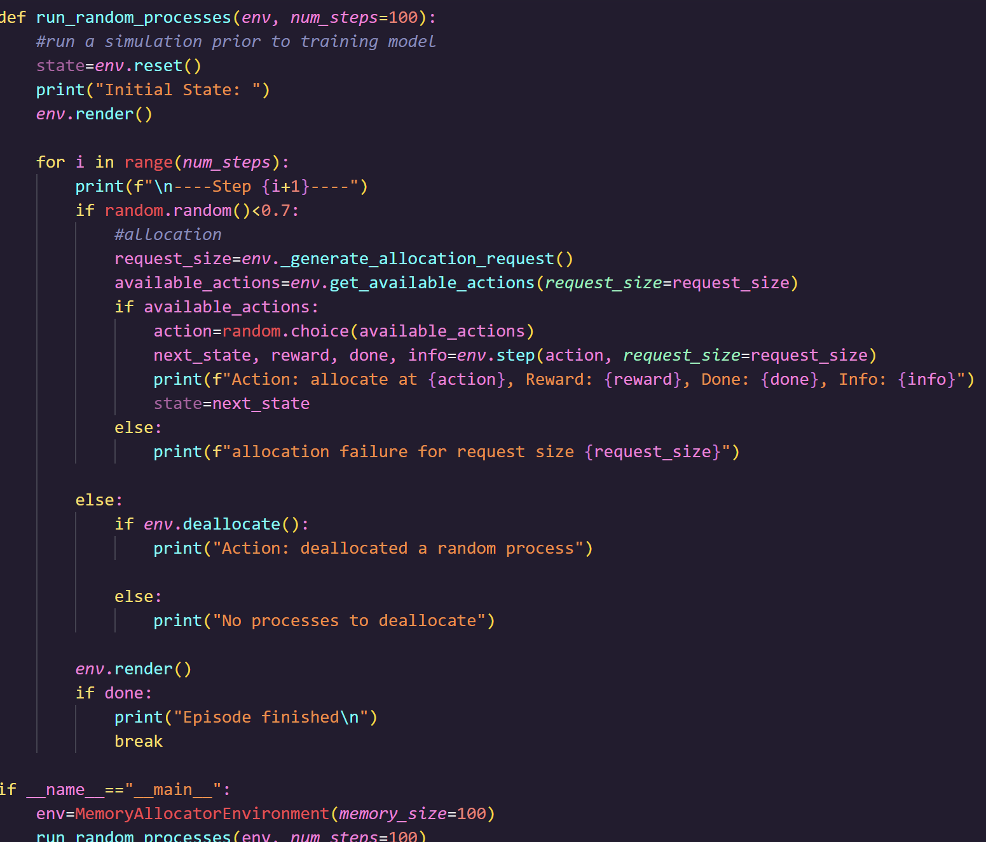
Introduction
The project attempts to solve existing memory allocation problems via the use of a reinforcement learning agent.
The agent used is a DQN agent, i.e a Deep Q-Network agent, which learns from its decisions to eventually make the most rewarding decisions possible.
Rewards are given to the agents based on
Successful allocations
Successful allocations, but with a high degree of fragmentation
Unsuccessful allocations
Then the agent is trained over 1000 steps
The agent is then evaluated against process size inputs and degree of fragmentation
Project Contribution
Suryansh was responsible for:
Creating the:
first fit
second fit
worst fit
best fit algorithms
Determining the degree of fragmentation
Looking into other forms of evaluation for our algorithm
Arnab was responsible for:
Creating a memory allocation environment, i.e, an agentic environment
Determining a reward-based algorithm
Training the RL agent
Hyperparametrizing training functions to improve efficiency

Slide 3
Reinforcement Learning for Dynamic Memory Allocation
Authors: Arisrei Lim, Abhiram Maddukuri
Key contribution: Selection of RL agent
Literature Review
Learning-Based System Optimisation in Memory-Constrained Environments
Authors: Research on AI-driven optimisation
Key contribution: Hyperparametrization of agent
Benchmarking RL-based Memory Allocation with Classical Approaches
Authors: Comparative studies in system memory optimisation
Key contribution: Ideas on quantitative analysis of model

Slide 4
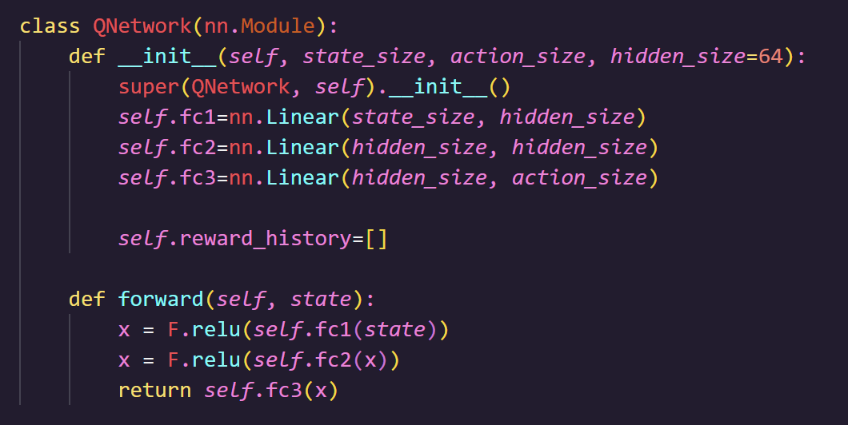
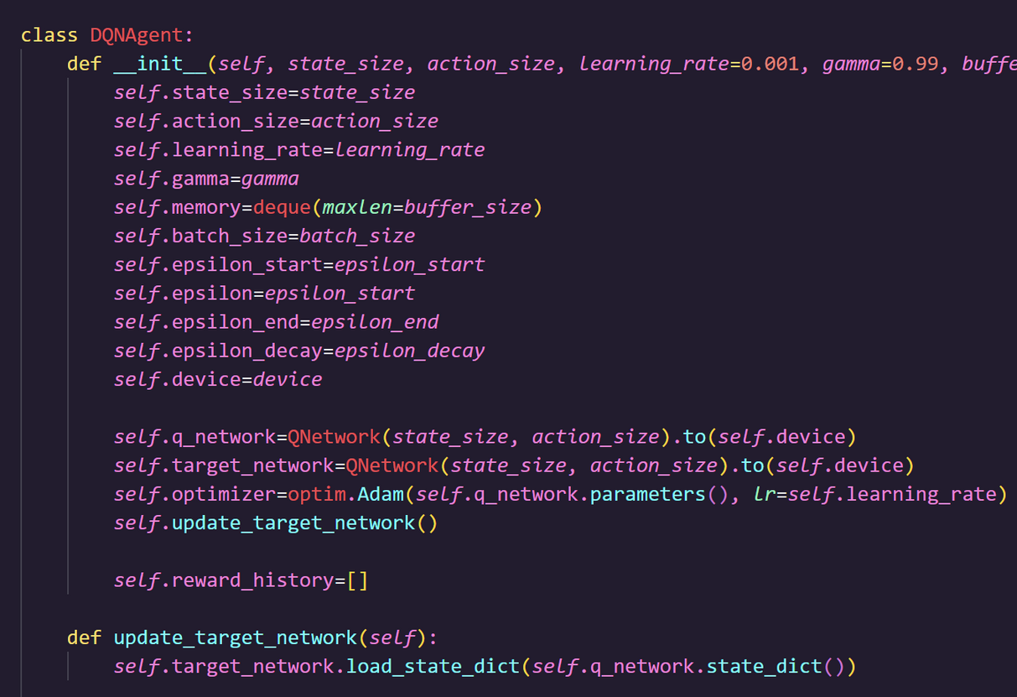
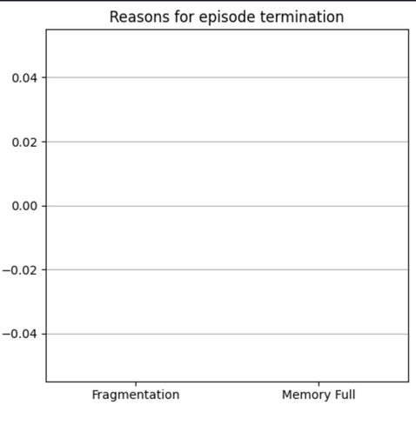
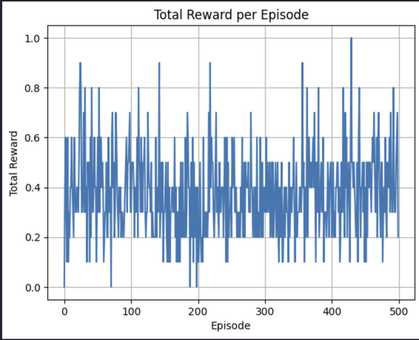
Proposed Solution
Using Python as the programming language of our choice, we trained a reinforcement model based on processes of random sizes.
We represented memory as a numpy array of 0s, with 0s being replaced by the process ID that is allocated to that block of memory.
We leveraged a DQN agent, as was suggested in previous publications, working inside a QNN and training it over 1000 episodes.
We then customised a memory filled with ‘holes’ so as to best stimulate a real-life scenario. This memory was then passed to the existing 4 algorithms and our trained agent.
User-defined processes would be subjected to each algorithm, and after allocation, the memory was once again rendered to observe differences between each algorithm.
A definition to determine the degree of external fragmentation was created, and the same was measured for each algorithm.
The results for all of the above were uploaded on the above-mentioned website, creating a simple front-end leveraging Streamlit.

Slide 5
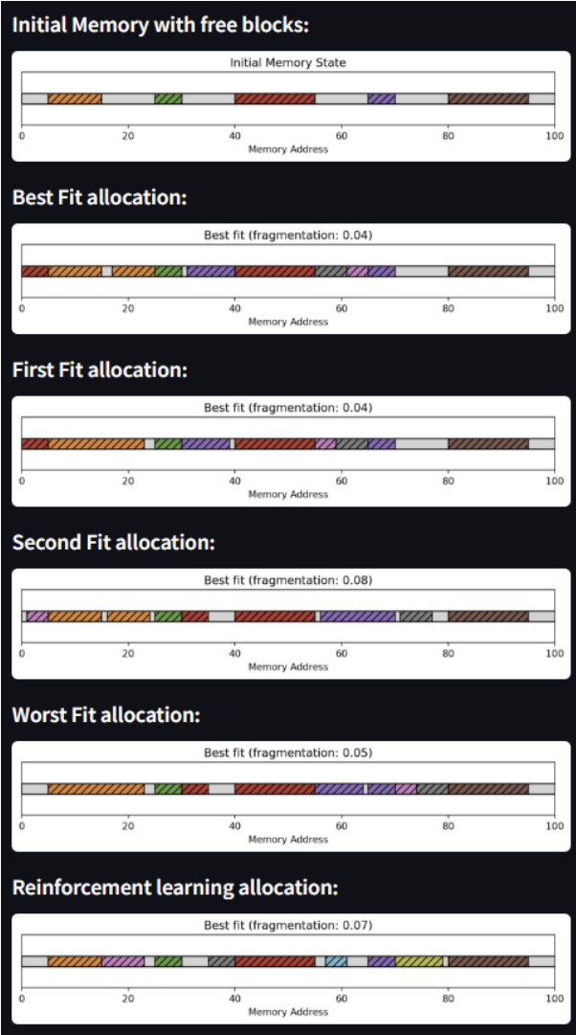
RESULTS
Results
The reinforcement learning algorithm typically led to the maximum number of successful memory allocations.
Conversely, the RL algorithm typically had one of the higher fragmentation rates compared to the remaining algorithms.
Overall, the best-fit algorithm consistently had the least fragmentation degree.
And analysis
Analysis
Best-fit algorithm remains undisputably the most efficient at avoiding fragmentation
The RL allocation agent did poorly in comparison to all other algorithms
This is most likely due to insufficient computing resources for proper and complete training
Lack of realtime process data also served as a barrier to proper allocation

Slide 6
Conclusion
The results of Reinforcement learning show strong potential for its use as a memory allocation algorithm.
However, resource limitations led to insufficient training of the agent used, and the model was established.
Ideally, with far larger training episodes, fragmentation could be further reduced in comparison to the other allocation methods while retaining the rate of allocation of processes.
Other limitations experienced include a lack of real-life data to use as training samples, which hinders the training process significantly.
A more robust form of comparison between each algorithm needs to be developed and explored as well.
Despite our promising results, we acknowledge existing limitations in the thoroughness and scale of our benchmark, challenges in the practicality of system-level implementation, and overall drawbacks of using hand-engineered simulators.

Slide 7
References
1) Reinforcement Learning for Dynamic Memory Allocation Authors: Arisrei Lim, Abhiram Maddukuri
2) RL-based Memory Management Optimisation
Authors: Various recent research groups
3) Learning-Based System Optimisation in Memory-Constrained Environments.
Authors: Research on AI-driven optimisation
4) Benchmarking RL-based Memory Allocation with Classical Approaches.
Authors: Comparative studies in system memory optimization

