Slide 1

Fractachain
FIRST RWA MARKET IN ARGENTINA BUILT ON STELLAR

Slide 2
Connecting Argentine Businesses to Capital Markets

Slide 3
HIGH FINANCING COSTS
Small and medium-sized businesses struggle to raise capital because accessing capital markets is prohibitively expensive and bureaucratic. With Fractachain, we solve that.
USD 30k–60k
Bond Issuance or IPO
USD 100k–300k
Bond Issuance
USD 400k–800k
IPO
With Fractachain
Traditional Market

Slide 4
TOKENIZATION WITHOUT A SECONDARY MARKET SIMPLY DOESN'T WORK
While multiple closed-loop solutions exist, they do not solve the fundamental need for exchange. Our objective goes beyond providing RWA technology: we are establishing Argentina's first regulated RWA trading venue.
Democratizing investment in promising businesses not yet ready for traditional capital markets. Making investing truly accessible to everyone.

Slide 5
What We Do
Issuance We guide businesses through digital public offerings — bonds and shares — under the CNV tokenization regime, generating revenue through listing and structuring fees.
Trading Our secondary market lets investors buy and sell those securities 24/7, with compliance rules enforced on-chain, monetized via a small transaction fee per trade.

Slide 6
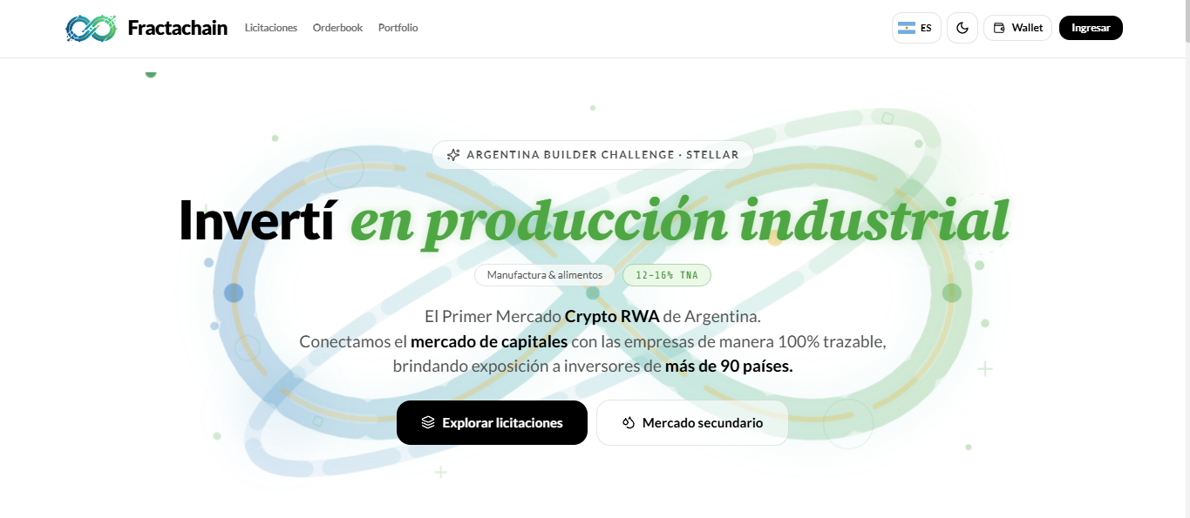
LIVE ON STELLAR TESTNET
https://fractachain.up.railway.app/

Slide 7
COMPLIANCE ENFORCED IN CODE
The CNV tokenization regime expressly permits digital issuance of shares, bonds (ONs) and financial trusts. We operate inside the regime, not around it.
  Ley 26.831 + Ley 27.440: capital markets and SME financing framework
  RG 1069/25 + RG 1081/25: tokenization of shares, ONs and trusts is already legal
  RG 1150/26: extends tokenization to SME low-impact offerings, sandbox until Dec 2027
  RG 1058/25: PSAV registry, custody and AML requirements
  Ley 9643 + Civil Code: warrants and production forwards

Slide 8
Next Steps
PHASE 1 — CORE INFRASTRUCTURE (LIVE / CURRENT)
24/7 Primary & Secondary Trading 24/7 on-chain issuance and secondary market trading for tokenized shares and corporate bonds under CNV compliance.
PHASE 2 — MERVAL TOKENIZATION & CUSTODY
24/7 Traditional Equities Compliant custody and tokenization of Merval blue-chip stocks for continuous trading and fractional shares.
PSAV registration and partnership with a licensed ALyC.

Slide 9
PHASE 3 — DERIVATIVES & ADVANCED STRUCTURED PRODUCTS
Foreign Investor Exposure Direct access for investors across 90+ countries under unified CNV compliance
Decentralized Forwards & Warrants Standardized hedging and forward contracts to manage volatility and hedge market positions.
Commodity-Backed Financing & Escrow Loans and forwards backed by production (wine, grain, dairy) using warrants under Law 9643

Slide 10
Built on Stellar
Soroban smart contracts: issuance factory, offering and stock vault (deployed on testnet)
Compliance in code: only KYC-verified wallets can hold the tokens (AUTH_REQUIRED)
Secondary market on Stellar's built-in DEX (SDEX)
Payments in USDC and XLM
Roadmap: fiat on/off-ramps via Stellar anchors: investors in 90+ countries.

Slide 11
Built on Stellar
Custodial wallet or self-custody with Freighter (wallet login via SEP-53)
Built to integrate with: Caja de Valores · BYMA · Matba Rofex · Anclap · Alfred Pay · MoneyGram · Circle CCTP
Order book 24/7, settlement in under 4 seconds, and on-chain takeover rules (OPA at 50%, squeeze-out at 95%), same rules as a traditional market

Slide 12
Go-To-Market
1. Issuers first. We target Argentine SMEs (small and medium-sized enterprises) that want to raise capital through a bond (ON) or shares, but can't afford the traditional market. We reach them through business chambers, SME associations, accountants and financial advisors.
2. They bring their own investors. A company looking for financing usually already has potential investors. What it lacks is the infrastructure, the technology and the regulatory know-how. We provide all of it.
3. One success unlocks the rest. Our first listing gives us the credibility to attract the next issuers.

Slide 13
Go-To-Market
4. A virtuous cycle. Investors who come for one issuance stay for the next ones, because they already know how the platform works. More issuers bring more investors, and more investors attract more issuers. We also add ALyCs/brokers as a distribution channel.
5. No crypto knowledge needed. Blockchain runs behind the scenes. Users trade like on a normal broker, with an order book, prices and a portfolio, and never deal with wallets or tokens unless they want to.
First milestone. One pilot issuance with an anchor company

Slide 14
Traditional Market Rules
+
=
DeFi
Fractachain
Clear Rules
Custody
Safety
High Liquidity
Global Access
24/7 Trading

Slide 15
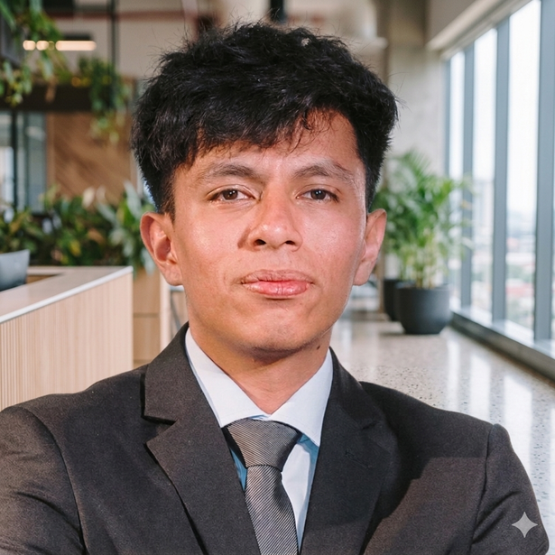
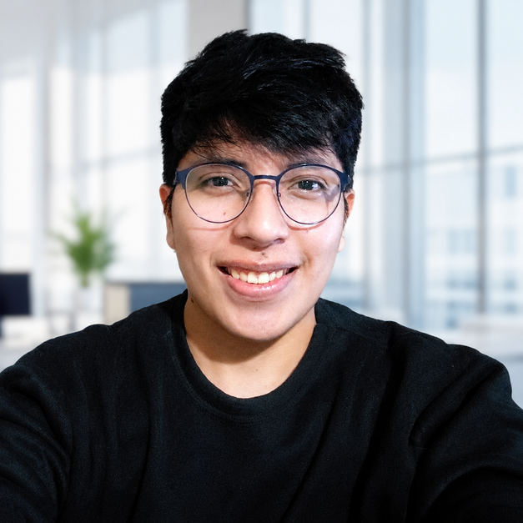
Team
EROS PUCA
CHOCOBAR ANTONIO
CEO & Founder
diamantitos.com.ar
Tec. Systems Analyst
Software Developer

