Slide 1
SMART IRRIGATION SYSTEM
NAME | REG. NUMBER
LESKANGA, DORCAS | 2018-04-02456
MTURI, GABRIEL B. | 2018-04-01677
SUPERVISOR: DR. WILFRED SENYONI

Slide 2
INTRODUCTION
Smart Irrigation System is an microcontroller based system that capture status of the farm by using sensors and control status of the farm by using text message with aid of GSM technology. Text message is the most used way of communication which is also reliable and cheap, this project will be accomplished by the use of GSM technology which is the heart of all cellular networks used by mobile devices.

Slide 3
PROBLEM STATEMENT
There has been a rapid growth of technology and smart systems all over the world, one of the developed smart systems is the smart irrigation system where by people controls their system automatically with a use of internet.
There is unavailability of reliable internet services in developing countries such as Tanzania especially in rural area where the most agricultural activities take place.
This makes it impossible to access the smart systems for those who lives in these areas. The rural area people cannot benefit from these smart systems due to this problem.

Slide 4
OBJECTIVES
Main objective:
The main objective of this project is to use the normal text messages to notify and control the smart irrigation system. Normal text messages are the most accessible and reliable way of communication used in developing countries especially in rural areas. With the help of GSM anyone with any type of a phone will be able to control the smart farm system.
Specific objectives
Capturing, gathering and analyzing data from the farm.
To integrate a temperature and humidity sensor, soil moisture and PH sensors that will be able to sense the temperature, humidity, moisture and PH of the soil respectively then sends notifications to the microcontroller
To build a centralized microcontroller which is programed to receive input signals of multiple sensors of the field and generate an output that drives the relays of the circuitries.

Slide 5
OBJECTIVES
Designing the hardware and software part of the system
To create a web based application that will store the records about the farm progress
Integrating the Global System for Message communication (GSM) in order to manage the normal text messages.
Testing the system using different test cases
To make a system that is understandable and easy to be used by farmers.

Slide 6
SIGNIFICANCE OF THE PROJECT
Save cost
Save time
Yielding better crops

Slide 7
SCOPE AND LIMITATION
Scope:
Can be used in rural areas
Main mode of control is done by mobile phone(feature phone)
Limitation:
It can not be used in areas experiencing low network signal
It will be used in areas which experience low amount of rainfall

Slide 8
LITERATURE REVIEW
Automated Irrigation system using solar power in Bangladesh
Design and implementation of an Automatic irrigation system in Nigeria
Sensor-based Automatic Irrigation System
Sensor Based Automatic Irrigation Management System
Smart agriculture to measure humidity, temperature, moisture, Ph. And nutrients values of soil using IoT
Plant moisture and Ph. sensing alarm using 8051
Automatic plant watering system

Slide 9
METHODOLOGY
This system is developed using a waterfall model where by one step will be accomplished after another, next process will start after the previous one has been completed. It is summarized as shown below:
- Requirement gathering and analysis
- Design and Simulation
- Circuit implementation and testing
- Integration and testing
- Deployment
- Maintenance

Slide 10
REQUIREMENT ANALYSIS
System requirements divided into three categories as follows,
Monitoring Unit: Involves all components used to monitor status of the farm and they include,
Moisture Sensor
Temperature and Humidity Sensor
Control Unit : Involves devices used for controlling purpose
Arduino MEGA
GSM module
Relay
Notification Unit: For providing notification to the user
Buzzer
Lcd display
GSM module

Slide 11
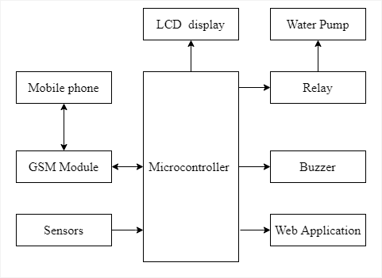

System Design High-level overview

Slide 12
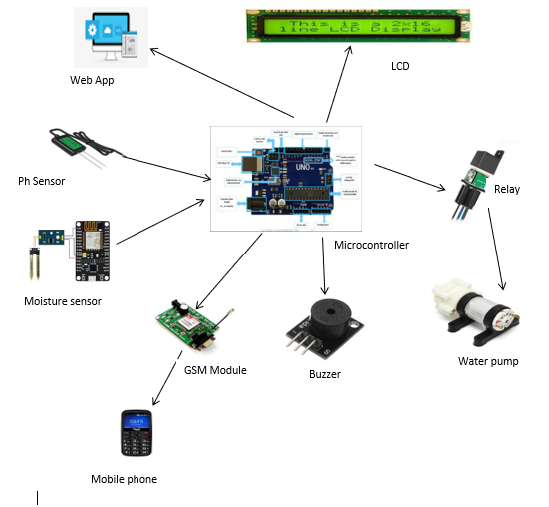
Components Interconnection_1

Slide 13
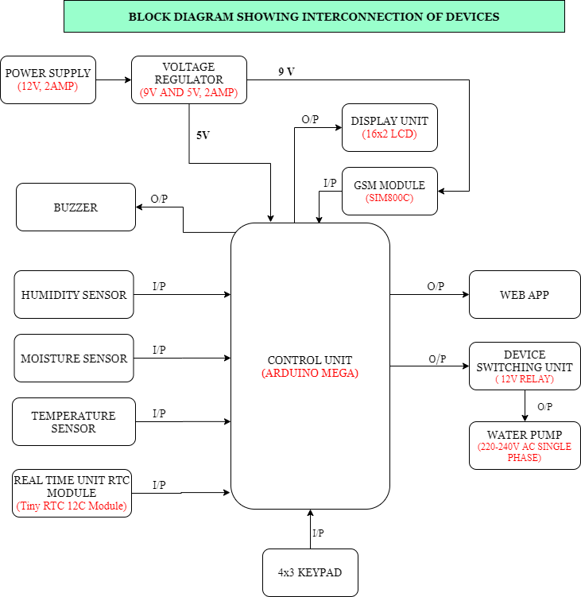
Components Interconnection_2

Slide 14
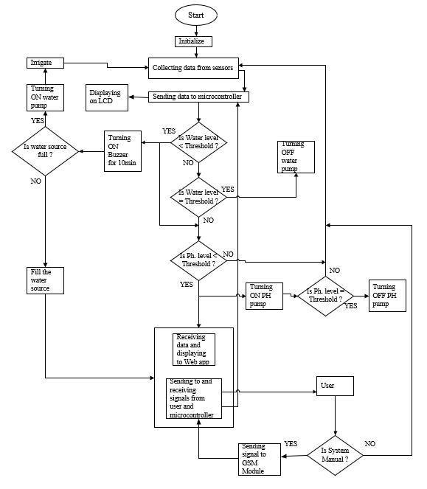
System Flowchart

Slide 15
Conclusion
To achieve effective monitoring and control of farm parameters especially for the farmer who lives far away from his/her far, farmer should use this system for getting notification of what happened in the farm and control some parameters when soil moisture is decreased beyond certain level.

Slide 16
Recommendation
The project has been developed and some modules are functioning properly. However, it can be improved and modified so that it can be employed in more advanced and better application but also store data. For future improvement, the program and input circuit can be modified so that it can control many other features as possible. Therefore, We encourage the government and private sectors to use this system in agriculture both for small scale and large scale specifically Irrigation type agriculture and those sited in rural areas.

Slide 17
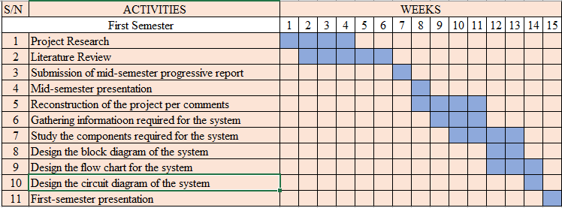
Timeline

Slide 18
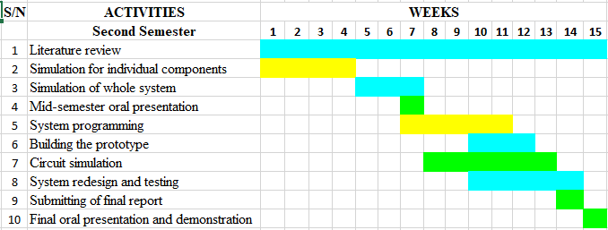
Timeline

Slide 19
Budget
ITEM | COST
Microcontroller (Arduino) | 35,000/=
Moisture Sensor | 13,500/=
Relay | 15,000/=
Buzzer | 1500/=
GSM | 40,000/=
Water Pump | 20,000/=
LCD Display | 30,000/=
Other Components | 52,800/=
Voucher | 45,000/=
Transportation | 32,000/=
TOTAL | 284,800/=

Slide 20
THANK YOU!

