Slide 1
Meta Ad Performance Analysis Dashboard
Capstone Project Evaluation Presentation
Digital Marketing Analytics | Power BI

Slide 2
Project Overview
Meta Ad Performance Dashboard built using Power BI
  Analyzes Facebook & Instagram campaigns
  Tracks marketing funnel metrics (Reach → Click → Purchase)
  Supports ROI-driven marketing decisions
Notes:
Explain how digital advertising requires measurable KPIs and centralized dashboards.

Slide 3
Problem Statement
Multiple campaigns generate large, complex datasets
  Manual analysis is inefficient and time-consuming
  Difficult to compare platforms and campaign effectiveness
  Need interactive dashboard for real-time insights

Slide 4
Business Objectives
Monitor impressions, clicks, engagements, purchases
  Evaluate CTR, Engagement Rate, Conversion Rate
  Analyze demographic and geographic patterns
  Optimize budget allocation for better ROI

Slide 5
Key Performance Indicators
Impressions – Total ad reach
  Clicks – User interest
  CTR = Clicks / Impressions × 100
  Engagement Rate = Engagements / Impressions × 100
  Conversion Rate = Purchases / Clicks × 100
  Purchase Rate = Purchases / Impressions × 100

Slide 6
Dashboard Architecture
KPI Section (Top Summary Metrics)
  Demographic Analysis (Gender & Age)
  Geographic Analysis (Country Map)
  Time Trends (Monthly, Weekly, Hourly)
  Ad Type Performance Matrix
  Interactive Filters & Dynamic Measures

Slide 7
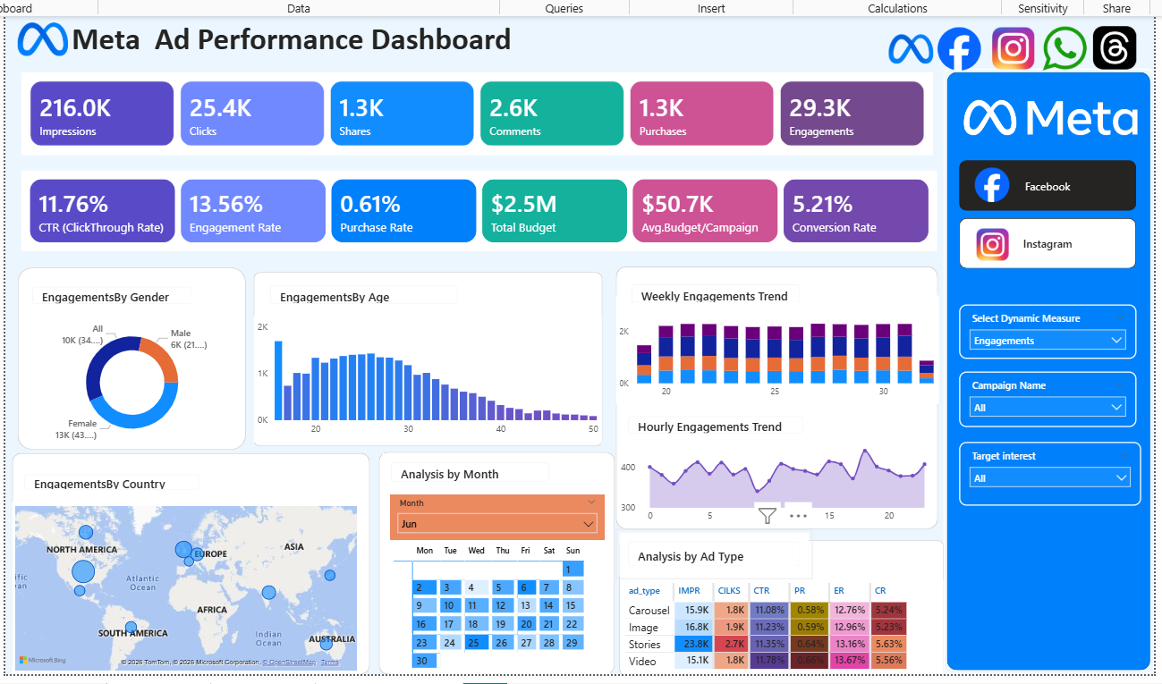
Facebook Campaign Performance View

Slide 8
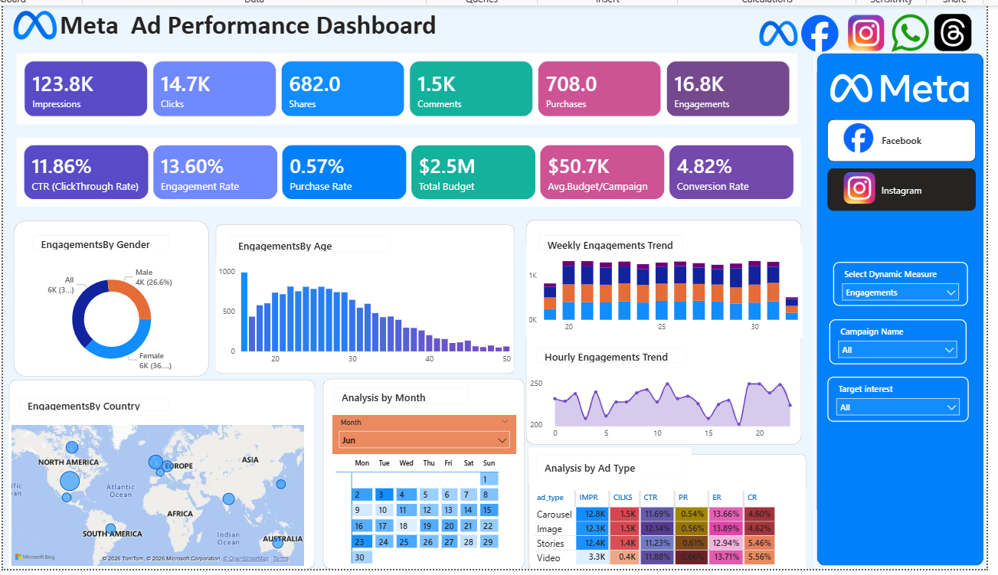
Instagram Campaign Performance View

Slide 9
Platform Comparison Insights
Facebook shows higher overall reach and conversions
  Instagram demonstrates stronger engagement rates
  CTR remains competitive across both platforms
  Platform selection depends on campaign objective

Slide 10
Key Insights from Analysis
Video & Story ads outperform static formats
  Young audience (18–30) drives higher engagement
  Funnel drop-offs observed between clicks & purchases
  Evening hours show peak engagement activity

Slide 11
Strategic Recommendations
Increase investment in high-performing ad formats
  Optimize landing pages to reduce funnel leakage
  Retarget engaged users for better conversions
  Schedule ads during peak engagement hours
  Allocate budget based on ROI-driven insights

Slide 12
Challenges & Learning Outcomes
Data cleaning and transformation using Power Query
  KPI creation using DAX formulas
  Designing user-friendly dashboard layout
  Understanding real-world marketing funnel analytics

Slide 13
Conclusion
Developed a fully interactive Meta Ad Performance Dashboard
  Enabled campaign monitoring and performance comparison
  Supported data-driven marketing decisions
  Demonstrated practical Power BI & analytics expertise

