Slide 1
Chapter 10
INHERITANCE

Slide 2
Chapter Goals
To learn about inheritance
To implement subclasses that inherit and override superclass methods
To understand the concept of polymorphism

Slide 3
Contents
Inheritance Hierarchies
Implementing Subclasses
Calling the Superclass constructor
Overriding Methods
Polymorphism
Application: A geometric shape hierarchy

Slide 4
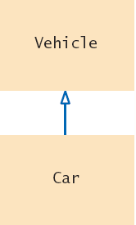
Inheritance Hierarchies
In object-oriented programming, inheritance is a relationship between:
  A superclass: a more generalized class
  A subclass: a more specialized class
The subclass ‘inherits’ data (variables) and behavior (methods) from the superclass

Slide 5
A Vehicle Class Hierarchy
General
Specialized
More Specific

Slide 6
The Substitution Principle
Since the subclass Car “is-a” Vehicle
  Car shares common traits with Vehicle
  You can substitute a Car object in an algorithm that expects a Vehicle object
myCar = Car(. . .)
processVehicle(myCar)
is-a
The ‘is-a’ relationship is represented by an arrow in a class diagram and means that the subclass can behave as an object of the superclass.

Slide 7
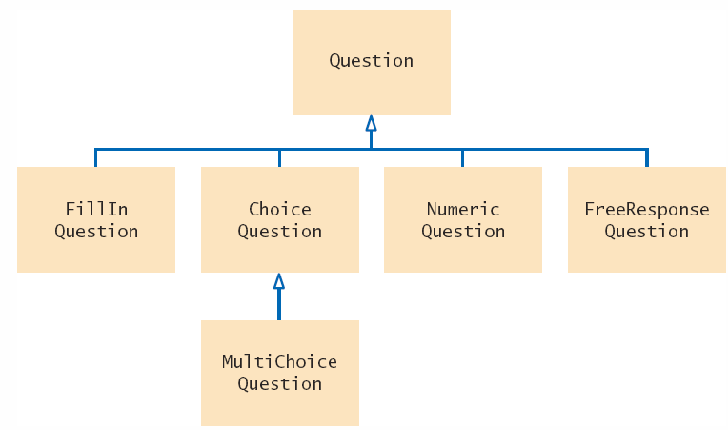
Quiz Question Hierarchy
There are different types of quiz questions:
  1) Fill-in-the-blank
  2) Single answer choice
  3) Multiple answer choice
  4) Numeric answer
  5) Free Response
The ‘root’ of the hierarchy is shown at the top.
A question can:
  Display its text
  Check for correct answer

Slide 8
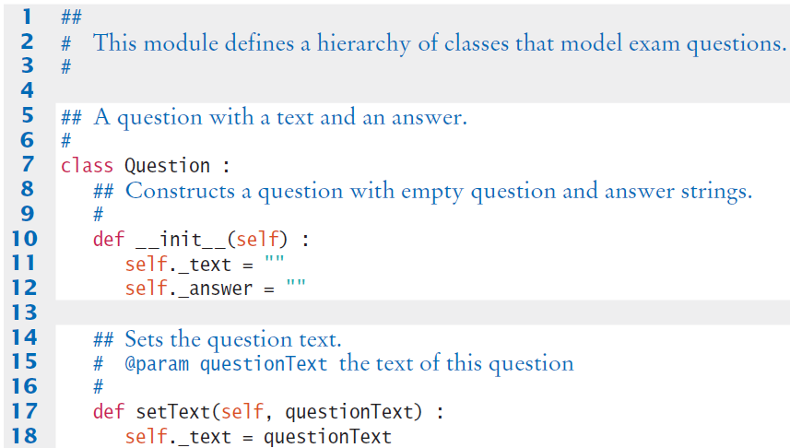
Questions.py
The class Question is the ‘root’ of the hierarchy, also known as the superclass
Only handles Strings
No support for:
  Numeric answers
  Multiple answer choice

Slide 9
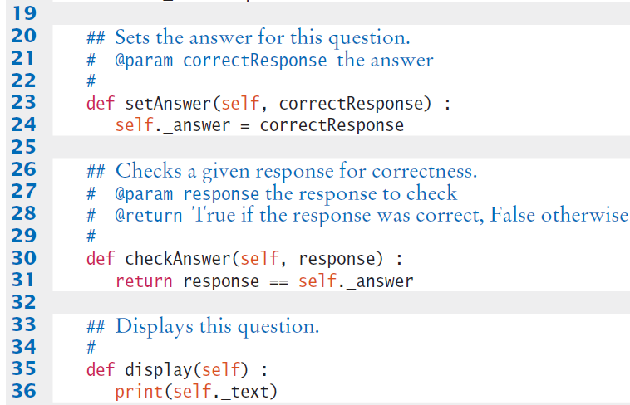
Questions.py

Slide 10
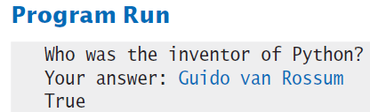
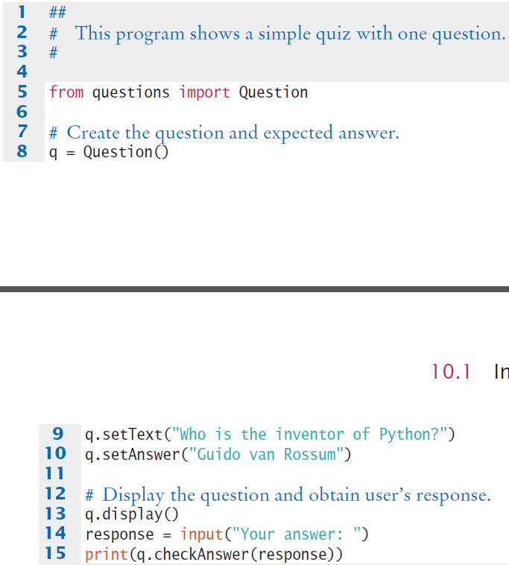
Questions.py
Creates an object of the Question class and uses methods.

Slide 11
Programming Tip
Use a Single Class for Variation in Values, Inheritance for Variation in Behavior
  If two vehicles only vary by fuel efficiency, use an instance variable for the variation, not inheritance
  If two vehicles behave differently,
  use inheritance
# Car instance variable
milesPerGallon
Be careful not to over-use inheritance

Slide 12
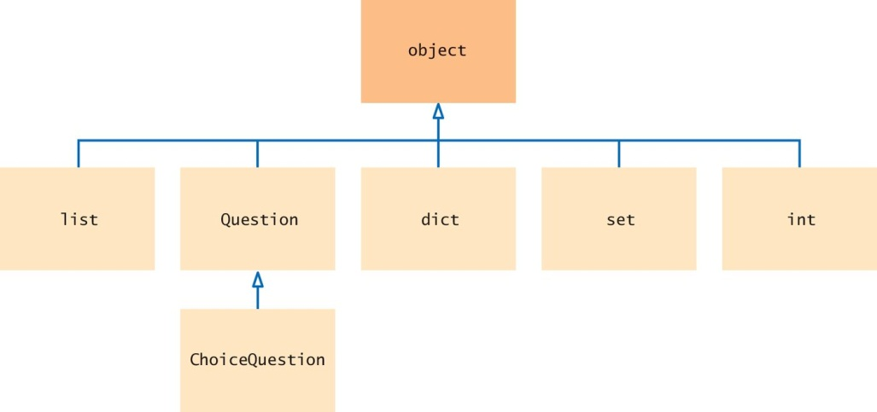
The Cosmic Superclass: object
In Python, every class that is declared without an explicit superclass automatically extends the class object

Slide 13
Inheriting from the Superclass
Subclasses inherit from the superclass:
  All methods, unless the subclass overrides the method
  All instance variables
The Subclass can
  Add new instance variables
  Add new methods
  Change the implementation of inherited methods
Form a subclass by specifying what is different from the superclass.

Slide 14
Overriding Superclass Methods
Can you re-use any methods of the Question class?
  Inherited methods perform exactly the same
  If you need to change how a method works:
    Write a new more specialized method in the subclass
    Use the same method name as the superclass method you want to replace:
      It must take all of the same parameters
      This will override the superclass method
      The new method will be invoked with the same method name when it is called on a subclass object
A subclass can override a method of the superclass by providing a new implementation.

Slide 15
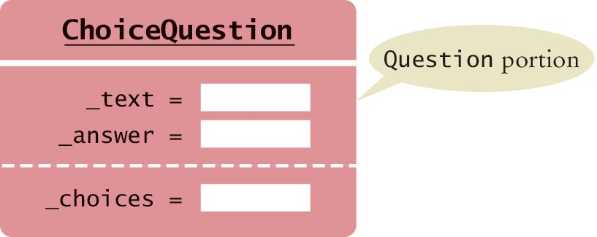
Planning the Subclass
Pass the name of the superclass Question as part of the definition of the subclass
  Inherits text and answer variables
  Add new instance variable choices
class ChoiceQuestion(Question):
# The subclass has its own constructor.
def _ _init_ _(self) :
. . .
# This instance variable is added to the subclass.
self._choices = []
# This method is added to the subclass
def addChoice(self, choice, correct) :
. . .
# This method overrides a method from the superclass
def void display(self) :
. . .

Slide 16
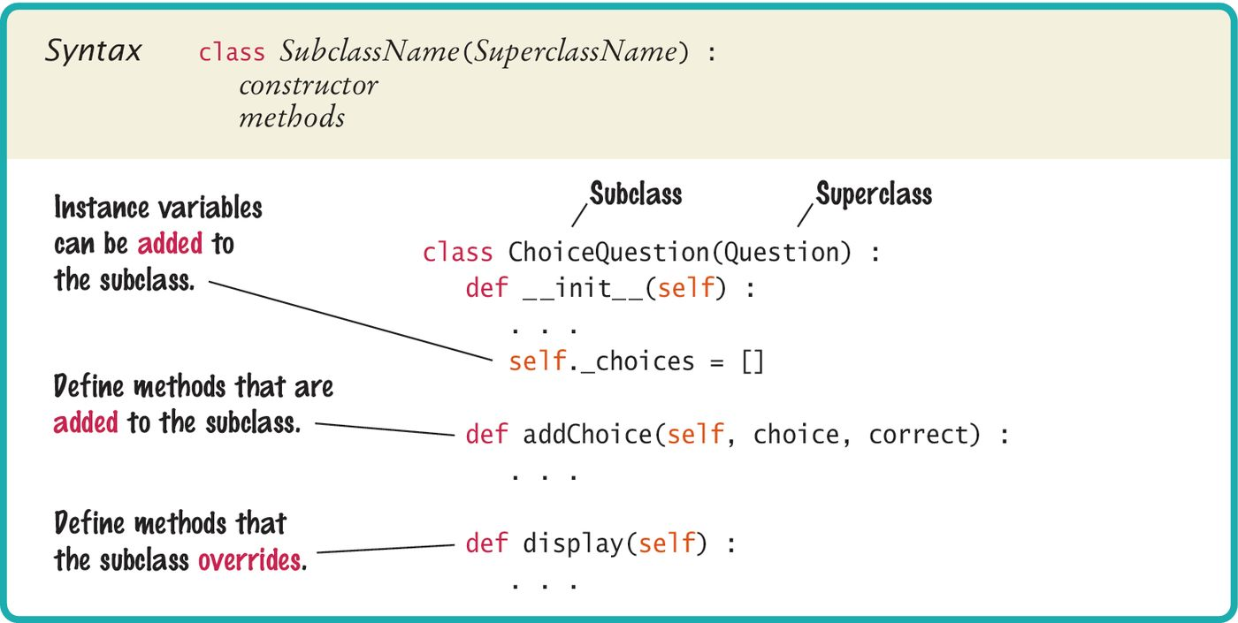
Syntax 10.1: Subclass Definition
The class name inside parentheses in the class header denotes inheritance.

Slide 17
Implementing AddChoice()
The method will receive three parameters
  As usual for a class method the self parameter is required
  The text for the choice
  A Boolean denoting if it is the correct choice or not
It appends the text as a _choice, sets choice number to the _answer and calls the inherited setAnswer() method:
def addChoice(self, choice, correct) :
self._choices.append(choice)
if correct :
# Convert the length of the list to a string.
choiceString = str(len(self._choices))
self.setAnswer(choiceString)

Slide 18
10.3 Calling the Superclass Constructor (1)
A subclass constructor can only define the instance variables of the subclass.
But the superclass instance variables also need to be defined.
The superclass is responsible for defining its own instance variables.
Because this is done within its constructor, the constructor of the subclass must explicitly call the superclass constructor.
  To distinguish between super- and sub- class constructor use the super() function in place of the self reference when calling the constructor:
class ChoiceQuestion(Question) :
def _ _init_ _(self) :
super()._ _init_ _()
self._choices = []

Slide 19
10.3 Calling the Superclass Constructor (2)
The superclass constructor should be called before the subclass defines its own instance variables.
If a superclass constructor requires arguments, you must provide those arguments to the _ _init_ _() method.
class ChoiceQuestion(Question) :
def _ _init_ _(self, questionText) :
super()._ _init_ _(questionText)
self._choices = []

Slide 20
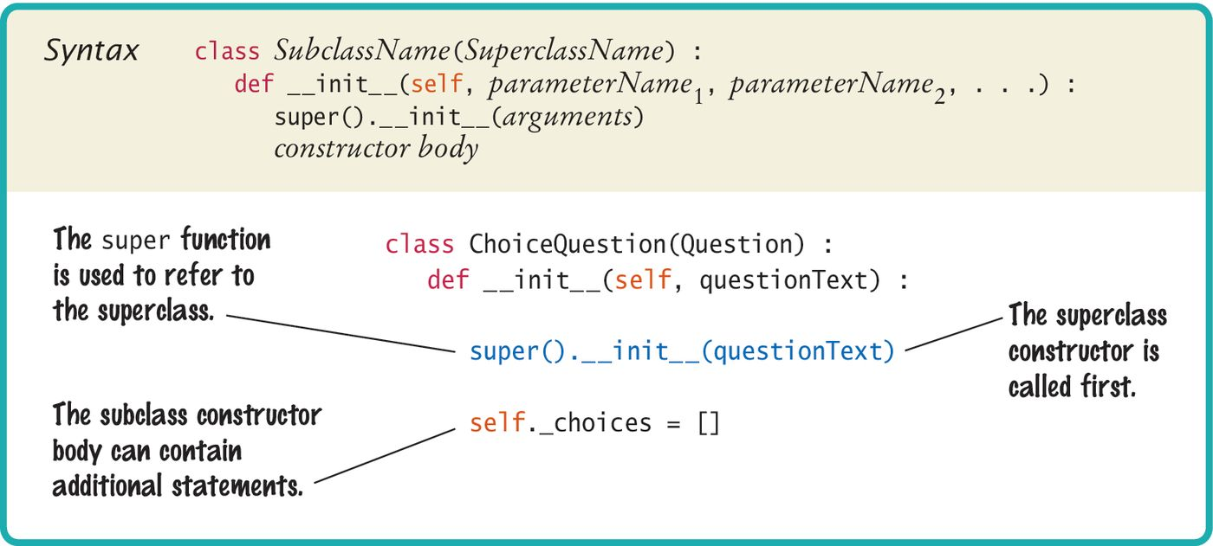
Syntax 10.2: Subclass Constructor

Slide 21
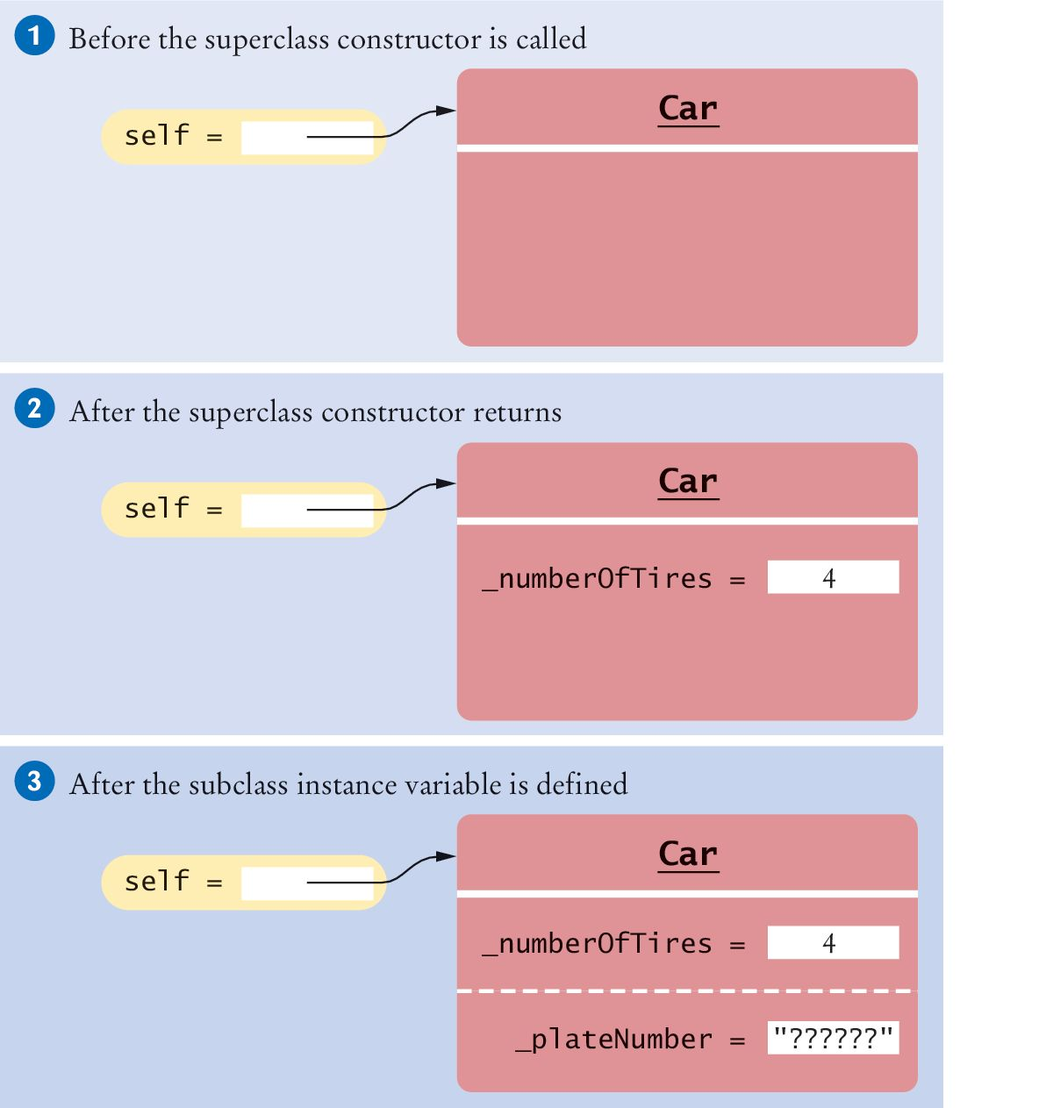
Example: Superclass Constructor (1)
Suppose we have defined a Vehicle class and the constructor which requires an argument:
class Vehicle :
def _ _init_ _(self, numberOfTires) :
self._numberOfTires = numberOfTires
. . .
We can extend the Vehicle class by defining a Car subclass
class Car(Vehicle) :
def _ _init_ _(self) : # 1

Slide 22
Example: Superclass Constructor (2)
Now as the subclass is defined, the parts of the object are added as attributes to the object:
# Call the superclass constructor to define its
# instance variable.
super()._ _init_ _(4) # 2
# This instance variable is added by the subclass.
self._plateNumber = "??????" # 3

Slide 23
10.4 Overriding Methods
The ChoiceQuestion class needs a display() method that overrides the display() method of the Question class
They are two different method implementations
The two methods named display are:
  Question display()
    Displays the text of the private attribute of class Question
  ChoiceQuestion display()
    Overrides Question display method
    Displays the instance variable text String
    Displays the list of choices which is an attribute of ChoiceQuestion

Slide 24
Tasks Needed for Display(): 1
Display the question text.
Display the answer choices.
  The second part is easy because the answer choices are an instance variable of the subclass.
class ChoiceQuestion(Question) :
. . .
def display(self) :
# Display the question text.
. . .
# Display the answer choices.
for i in range(len(self._choices()) :
choiceNumber = i + 1
print("%d: %s" % (choiceNumber,
self._choices[i]))

Slide 25
Tasks Needed for Display(): 2
Display the question text.
Display the answer choices.
  The first part is trickier!
    You can’t access the text variable of the superclass directly because it is private.
    Call the display() method of the superclass, using the super() function:
def display(self) :
# Display the question text.
super().display() # OK
# Display the answer choices.

Slide 26
Tasks Needed for Display(): 3
Display the question text.
Display the answer choices.
  The first part is trickier! (Continued)
    If you use the self reference instead of the super() function, then the method will not work as intended.
def display(self) :
# Display the question text.
self.display()
# Error—invokes display() of ChoiceQuestion.
. . .

Slide 27
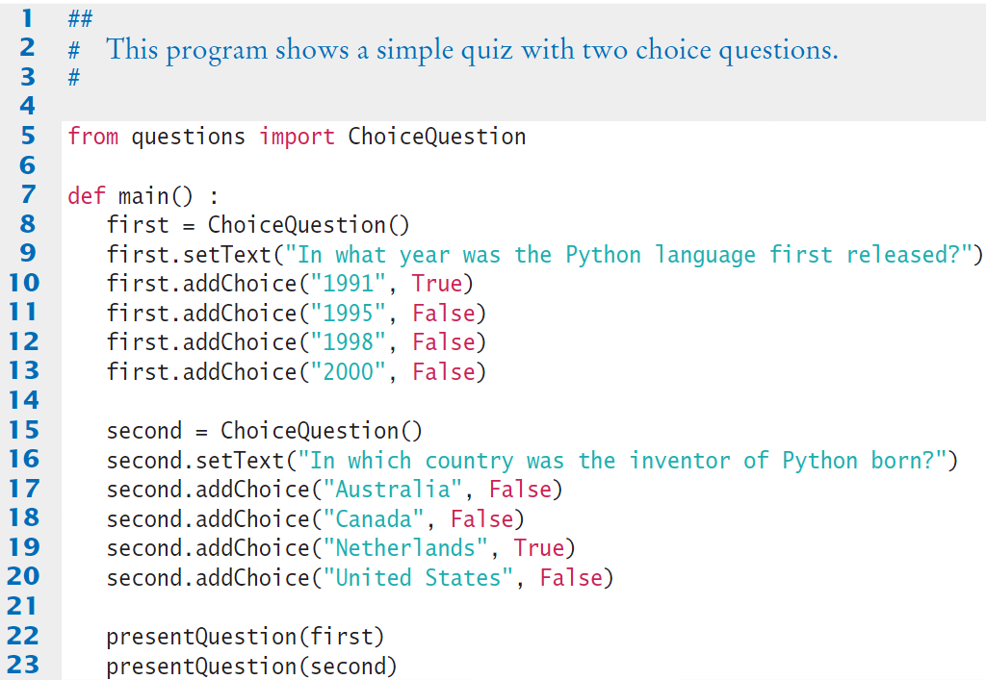
Questiondemo2.py (1)
Creates two objects of the ChoiceQuestion class, uses new addChoice() method.
Calls presentQuestion() - next page

Slide 28
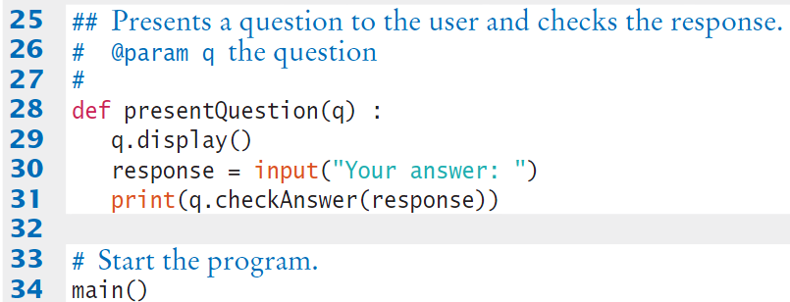
Questiondemo2.py (2)
Uses ChoiceQuestion (subclass) display() method.

Slide 29
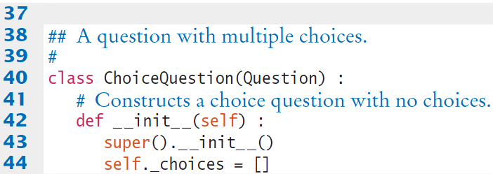
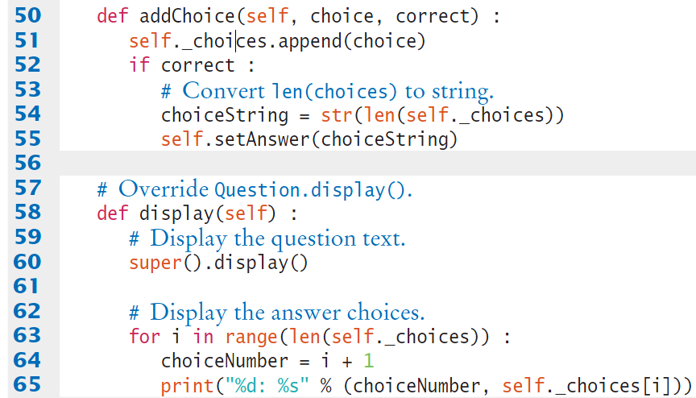
Questions.py (1)
Inherits from Question class.
New addChoice() method.

Slide 30
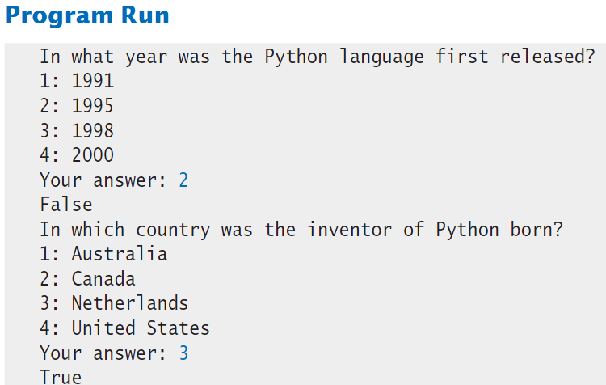
Questions.py (2)
Overridden display() method.

Slide 31

Common Error 10.2 (1)
Extending the functionality of a superclass method but forgetting to call the super() method.
For example, to compute the salary of a manager, get the salary of the underlying Employee object and add a bonus:
class Manager(Employee) :
. . .
def getSalary(self) :
base = self.getSalary()
# Error: should be super().getSalary()
return base + self._bonus
  Here self refers to an object of type Manager and there is a getSalary() method in the Manager class.

Slide 32
Common Error 10.2 (2)
Whenever you call a superclass method from a subclass method with the same name, be sure to use the super() function in place of the self reference.
class Manager(Employee) :
. . .
def getSalary(self) :
base = super().getSalary()
return base + self._bonus

Slide 33
10.5 Polymorphism
QuestionDemo2 passed two ChoiceQuestion objects to the presentQuestion() method
  Can we write a presentQuestion() method that displays both Question and ChoiceQuestion types?
  With inheritance, this goal is very easy to realize!
  In order to present a question to the user, we need not know the exact type of the question.
  We just display the question and check whether the user supplied the correct answer.
def presentQuestion(q) :
q.display()
response = input("Your answer: ")
print(q.checkAnswer(response))

Slide 34
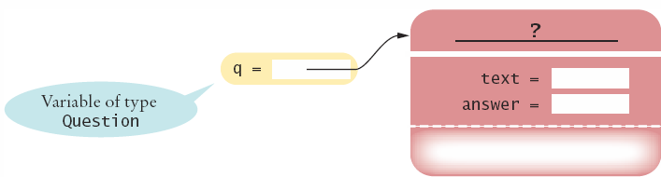
Which Display() method was called?
presentQuestion() simply calls the display() method of whatever type is passed:
def presentQuestion(q) :
q.display()
. . .
If passed an object of the Question class:
  Question display()
If passed an object of the ChoiceQuestion class:
  ChoiceQuestion display()
The variable q does not know the type of object to which it refers:
_
_
  display()

Slide 35
Why Does This Work?
As discussed in Section 10.1, we can substitute a subclass object whenever a superclass object is expected:
second = ChoiceQuestion()
presentQuestion(second) # OK to pass a ChoiceQuestion
Note however you cannot substitute a superclass object when a subclass object is expected.
  An AttributeError exception will be raised.
  The parent class has fewer capabilities than the child class (you cannot invoke a method on an object that has not been defined by that object’s class).

Slide 36
Polymorphism Benefits
In Python, method calls are always determined by the type of the actual object, not the type of the variable containing the object reference
  This is called dynamic method lookup
  Dynamic method lookup allows us to treat objects of different classes in a uniform way
This feature is called polymorphism
We ask multiple objects to carry out a task, and each object does so in its own way
Polymorphism makes programs easily extensible

Slide 37
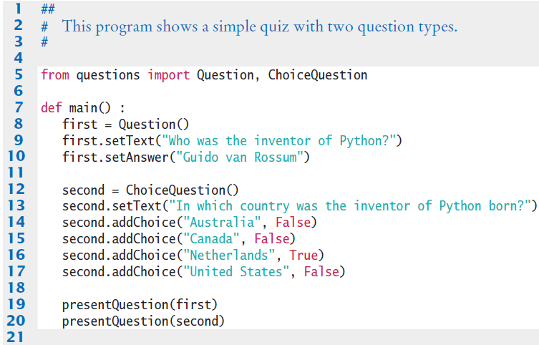
Questiondemo3.py (1)
Creates an object of the Question class
Creates an object of the ChoiceQuestion class, uses new addChoice() method.
Calls presentQuestion() - next page - passed both types of objects.

Slide 38
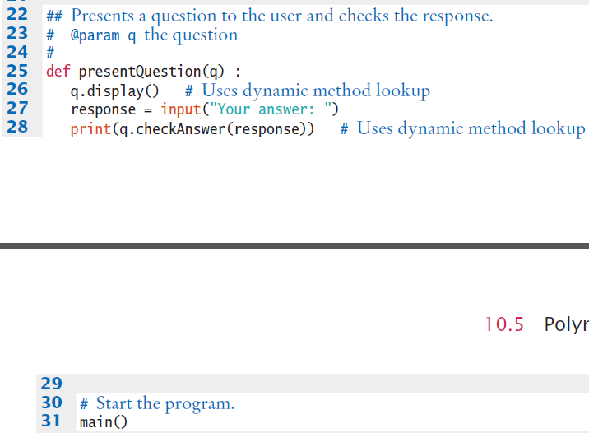
Questiondemo3.py (2)
Receives a parameter of the super-class type
Uses appropriate display method.

Slide 39
Special Topic 10.2
Subclasses and Instances:
  You learned that the isinstance() function can be used to determine if an object is an instance of a specific class.
  But the isinstance() function can also be used to determine if an object is an instance of a subclass.
  For example, the function call:
isinstance(q, Question)
    will return True if q is an instance of the Question class or of any subclass that extends the Question class,
    otherwise, it returns False.

Slide 40
Use of Isinstance()
  A common use of the isinstance() function is to verify that the arguments passed to a function or method are of the correct type.
def presentQuestion(q) :
if not isintance(q, Question) :
raise TypeError("The argument is not a Question or
one of its subclasses.")

Slide 41
Special Topic 10.3
Dynamic Method Lookup
  Suppose we move the presentQuestion() method to inside the Question class and call it as follows:
cq = ChoiceQuestion()
cq.setText("In which country was the inventor of Python born?")
. . .
cq.presentQuestion()
def presentQuestion(self) :
self.display()
response = input("Your answer: ")
print(self.checkAnswer(response))
  Which display() and checkAnswer() methods will be called?

Slide 42
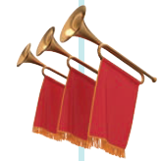
Dynamic Method Lookup
If you look at the code of the presentQuestion() method, you can see that these methods are executed on the self reference parameter.
  Because of dynamic method lookup, the ChoiceQuestion versions of the display() and checkAnswer() methods are called automatically.
  This happens even though the presentQuestion() method is declared in the Question class, which has no knowledge of the ChoiceQuestion class.
class Question :
def presentQuestion(self) :
self.display()
response = input("Your answer: ")
print(self.checkAnswer(response))

Slide 43
Special Topic 10.4
Abstract methods
  If it is desirable to force subclasses to override a method of a base class, you can declare a method as abstract.
  You can instantiate an object that has abstract methods
    But there will be an exception if the abstract method is called.
    It’s a tool to force programmers to create subclasses and it prevents the superclass from having unnecessary methods
    To create an abstract class you need to use methods in the Abstract Base Class (abc) module (covered in CIS 41B)
  In Python a method is is an abstract method when it raises a NotImplementedError exception as its only statement:
class Account :
. . .
def deductFees(self) :
raise NotImplementedError

Slide 44
Common Error 10.3
  It is not a good idea to use specific type tests in order to implement behavior that varies with each class:
if isinstance(q, ChoiceQuestion) : # Bad idea!
# Do the task the ChoiceQuestion way.
elif isinstance(q, Question) :
# Do the task the Question way.
  If a new class such as NumericQuestion is added, then you need to add another case to all places in the program that has a type test:
elif isinstance(q, NumericQuestion) : # high maintenance!
# Do the task the NumericQuestion way.
  Instead of using type tests in a hierarchy of classes, use polymorphism
  Declare a method doTheTask() in the superclass, override it in the subclasses, and simply call:
q.doTheTask()

Slide 45
Steps to Using Inheritance
As an example, we will consider a bank that offers customers the following account types:
  1) A savings account that earns interest. The interest compounds monthly and is based on the minimum monthly balance.
  2) A checking account that has no interest, gives you three free withdrawals per month, and charges a $1 transaction fee for each additional withdrawal.
The program will manage a set of accounts of both types
  It should be structured so that other account types can be added without affecting the main processing loop.
The menu: D)eposit W)ithdraw M)onth end Q)uit
  For deposits and withdrawals, query the account number and amount. Print the balance of the account after each transaction.
  In the “Month end” command, accumulate interest or clear the transaction counter, depending on the type of the bank account. Then print the balance of all accounts.

Slide 46
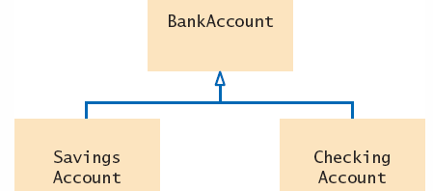
Steps to Using Inheritance
List the classes that are part of the hierarchy:
SavingsAccount and CheckingAccount
Organize the classes into an inheritance hierarchy based on the superclass BankAccount
Determine the common responsibilities.
  a. Write pseudocode for each task
  b. Find common tasks

Slide 47
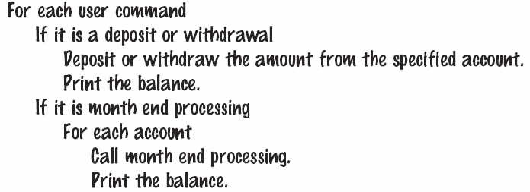
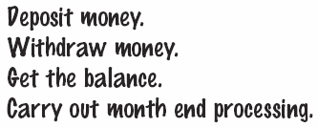
Using Inheritance: Pseudocode

Slide 48
Steps to Using Inheritance
Decide which methods should be overridden in subclasses.
  For each subclass and each of the common responsibilities, decide whether the behavior can be inherited or whether it needs to be overridden
Declare the public interface of each subclass.
  Typically, subclasses have responsibilities that are more specialized than those of the superclass.
  You also need to specify how the objects of the subclasses should be constructed.
Identify instance variables.
  List the instance variables for each class. Place instance variables that are common to all classes in the base of the hierarchy.
Implement constructors and methods.
Construct objects of different subclasses and process them.

Slide 49
10.6 Application
Creating a geometric shape class hierarchy
  To create complex scenes beyond the simple graphics introduced in Chapter 2, you may need a large number of shapes that vary in color, size, or location.
  Rather than calling the various methods again and again, it would be useful to have classes that model the various geometric shapes.
  Using shape classes, a programmer can create a shape object with specific characteristics, then use the same object to draw multiple instances of the shape with only minor changes.

Slide 50
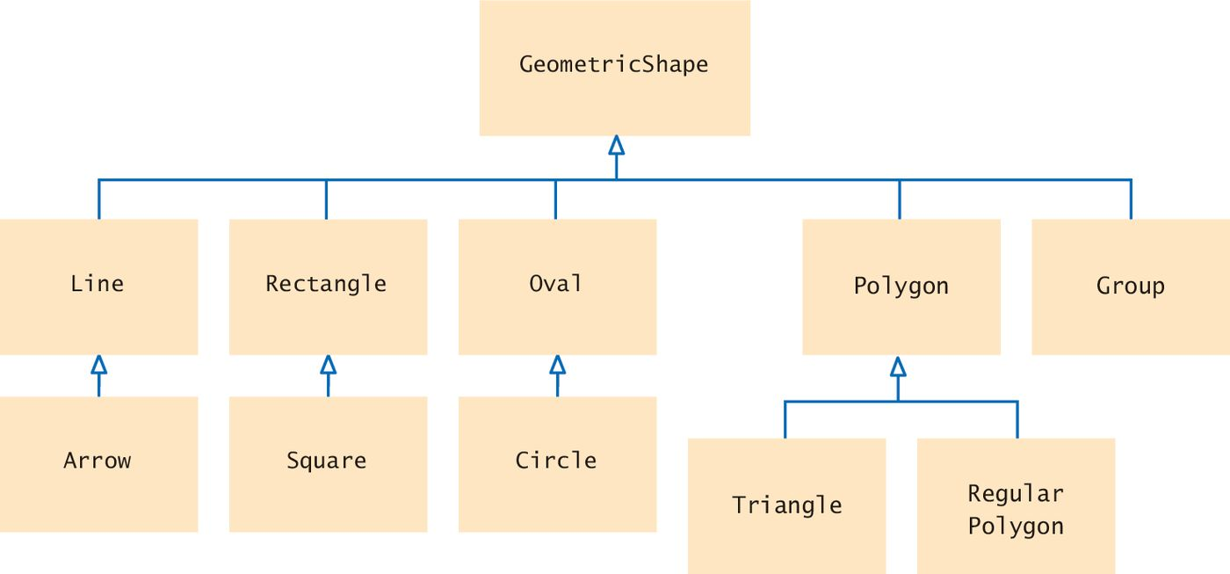
Inheritance Diagram of Geometric Shapes

Slide 51
The Base Class
The GeometricShape class should provide the functionality that is common among the various subclasses:
  Setting the colors used to draw the shape.
  Getting and setting the coordinates for the upper-left corner of a bounding box.
  Computing the width and height of the shape (or the bounding box used to define the shape).
  Drawing the shape on a canvas.
Due to the amount of variation between shapes all subclasses will have to override the draw() method.

Slide 52
Attributes of the Base Class
The instance variables _fill and _outline can store the fill and outline colors used by the shapes.
Coordinates of the top left hand corner of the bounding box for the shape can be stored in the instance variables _x and _y

Slide 53
Setting the Attributes
The constructor of the GeometricShape base class needs to define the common instance variables.
class GeometricShape :
## Construct a basic geometric shape.
# @param x the x-coordinate of the shape
# @param y the y-coordinate of the shape
def _ _init_ _(self, x, y) :
self._x = x
self._y = y
self._fill = None
self._outline = "black"

Slide 54
Accessor Methods
As expected they will return the values stored in the instance variables.
def getX(self) :
return self._x
def getY(self) :
return self._y
Because the getWidth() and getHeight() methods return zero they should be overridden by subclasses.
def getWidth(self) :
return 0
def getHeight(self) :
return 0

Slide 55
Mutator Methods
We define three mutator methods for setting the colors.
Two methods set the outline or fill color individually, and the third method sets both to the same color:
def setFill(self, color = None) :
self._fill = color
def setOutline(self, color = None) :
self._outline = color
def setColor(self, color) :
self._fill = color
self._outline = color

Slide 56
Other Methods
The move() method moves the shape by a given amount (x, y) coordinates.
def moveBy(self, dx, dy) :
self._x = self._x + dx
self._y = self._y + dy
As indicated earlier, the draw() method has to be overridden for each subclass’s specific shape but the common operation (setting the drawing colors) is included here.
def draw(self, canvas) :
canvas.setFill(self._fill)
canvas.setOutline(self._outline)

Slide 57
The Rectangle Class (1)
The Rectangle class inherits from GeometricShape.
The constructor passes the upper-left corner to the superclass and stores the width and height.
def _ _init_ _(self, x, y, width, height) :
super()._ _init_ _(x, y)
self._width = width
self._height = height

Slide 58
The Rectangle Class (2)
The draw method is overridden in the Rectangle subclass to include the call to the appropriate canvas method.
Accessors are overridden (from the ones that return zero).
def draw(self, canvas) :
super().draw(canvas) # Parent method sets colors
canvas.drawRect(self.getX(), self.getY(), self._width,
self._height)
def getWidth(self) :
return self._width
def getHeight(self) :
return self._height

Slide 59
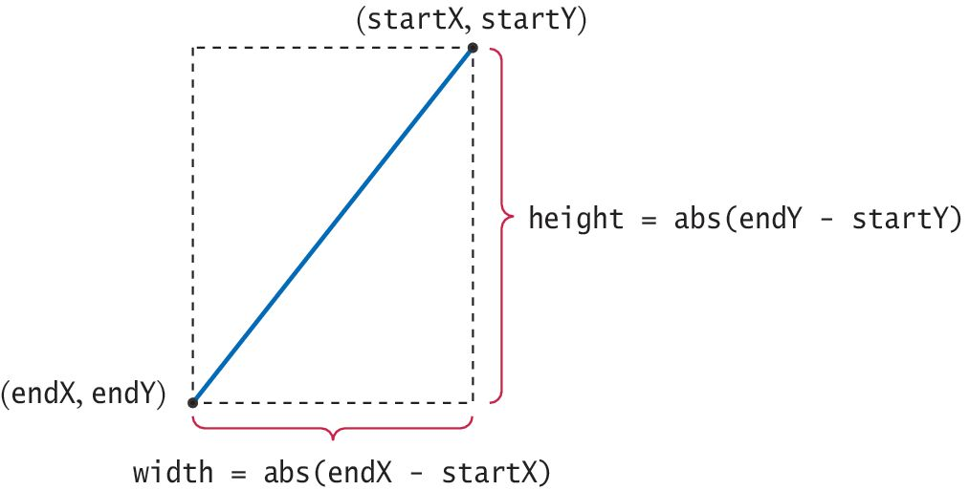
The Line Class (1)
A line is specified by its start and end points.
It is possible that neither of these points is the upper-left corner of the bounding box.
Instead, we need to compute the smaller of the x- and y-coordinates and pass those values to the superclass constructor.

Slide 60
The Line Class (2)
We also need to store the start and end points in instance variables because we need them to draw the line.
def _ _init_ _(self, x1, y1, x2, y2) :
super()._ _init_ _(min(x1, x2), min(y1, y2))
self._startX = x1
self._startY = y1
self._endX = x2
self._endY = y2

Slide 61
Line Class: Methods (1)
The width and height are the differences between the starting and ending x- and y-coordinates.
However, if the line isn’t sloping downward, we need to take the absolute values of the difference.
def getWidth(self) :
return abs(self._endX - self._startX)
def getHeight(self) :
return abs(self._endY - self._startY)

Slide 62
Line Class: Methods (2)
As noted the draw() method must be overridden
def draw(self, canvas) :
super().draw(canvas)
canvas.drawLine(self._startX, self._startY, self._endX, self._endY)
Also the moveBy() method must be overridden so that it adjusts the starting and ending points, in addition to the top-left corner.
def moveBy(self, dx, dy) :
super().moveBy(dx, dy)
self._startX = self._startX + dx
self._startY = self._startY + dy
self._endX = self._endX + dx
self._endY = self._endY + dy

Slide 63
Wrapper Class: Square
A wrapper class wraps or encapsulates the functionality of another class to provide a more convenient interface.
For example, we could draw a square using the Rectangle subclass.
  But it requires that we supply both the width and height.
  Because a square is a special case of a rectangle, we can define a Square subclass that extends, or wraps, the Rectangle class and only requires one value, the length of a side.
class Square(Rectangle) :
def _ _init_ _(self, x, y, size) :
super()._ _init_ _(x, y, size, size)

Slide 64
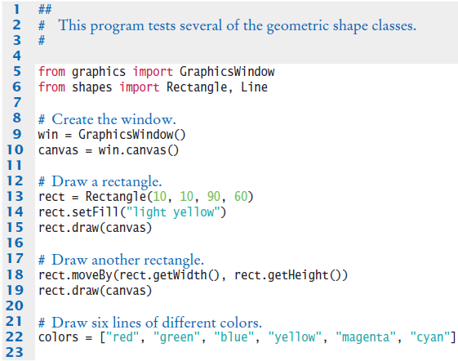
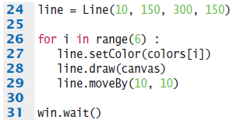
Testshapes.py

Slide 65
Groups of Shapes
The Group subclass does not actually draw a geometric shape.
Instead it can be used to group basic geometric shapes to create a complex shape.
  For example, suppose you construct a door using a rectangle, a circle for the doorknob, and a circle for the peep hole.
  The three components can be stored in a Group in which the individual shapes are defined relative to the position of the group.
  This allows the entire group to be moved to a different position without having to move each individual shape.

Slide 66
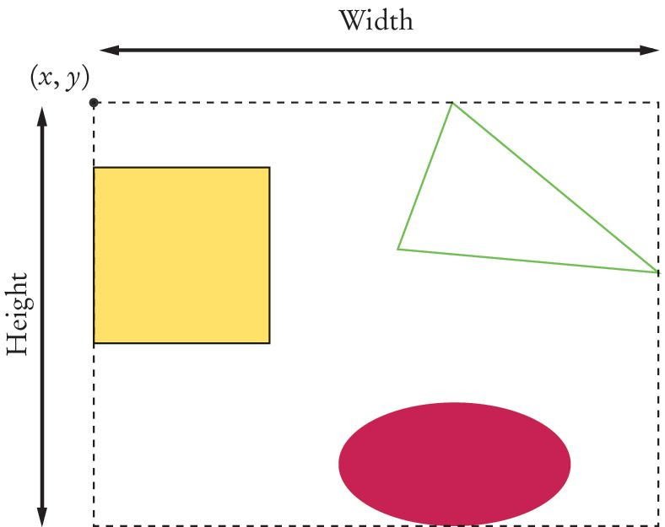
The Group Class
To create a Group, you provide the coordinates of the upper-left corner of its bounding box.
The class defines an instance variable that stores the shapes in a list.
As new shapes are added to a Group object, the width and height of the bounding box expands to enclose the new shapes.

Slide 67
Group Class Methods (1)
Create the group with its bounding box positioned at (x, y).
def _ _init_ _(self, x = 0, y = 0) :
super()._ _init_ _(x, y)
self._shapeList = []
Adding a shape to the group involves several steps.
  First, the shape has to be appended to the list:
def add(self, shape) :
self._shapeList.append(shape)

Slide 68
Group Class Methods (2)
  The individual shapes are positioned relative to the upper-left corner of the group’s bounding box.
  We must ensure that each shape is positioned below and to the right of this point. If it is not, it must be moved.
# Keep the shape within top and left edges of the
# bounding box.
if shape.getX() < 0 :
shape.moveBy(-shape.getX(), 0)
if shape.getY() < 0 :
shape.moveBy(0, -shape.getY())

Slide 69
Group Class Methods (3)
  The width of the group is determined by the rightmost extent of any of the group’s members.
  The rightmost extent of a shape is shape.getX() + shape.getWidth(). The following method computes the maximum of these extents.
def getWidth(self) :
width = 0
for shape in self._shapeList :
width = max(width, shape.getX() +
shape.getWidth())
return width

Slide 70
Group Class Methods (4)
  The height of the group (the bottommost extent) is computed in the same way as the width.
def getHeight(self) :
height = 0
for shape in self._shapeList :
height = max(height, shape.getY() +
shape.getHeight())
return height

Slide 71
Group Class Methods (5)
The entire group can be drawn on the canvas.
The shapes contained in the group are defined relative to the upper-left corner of its bounding box.
Before a shape can be drawn, it has to be moved to its position relative to the upper-left corner of the group’s bounding box.
def draw(self, canvas) :
for shape in self._shapeList :
shape.moveBy(self.getX(), self.getY())
shape.draw(canvas)
shape.moveBy(-self.getX(), -self.getY())

