Slide 1
AI Assignment 2
CS22B028 Johri Aniket Manish
CS22B024 Harshit Garg

Slide 2
DFBnB
Algorithm
This code implements the Depth-First Branch and Bound algorithm to find the shortest path in a grid. It explores paths using depth-first search while keeping track of the lowest cost found so far. Any path with a higher cost than the current best is pruned. A stack is used to manage paths, and visited states are tracked to avoid revisiting more expensive paths. The algorithm continues until it finds the goal or the time limit is reached.
Depth-First Branch and Bound
Heuristic Function
The algorithm uses the Manhattan distance as a heuristic, which calculates the total number of horizontal and vertical steps between the current state and the goal. This helps estimate how far a state is from the goal and guides the search more effectively. Successors are sorted based on this heuristic value before being explored, so paths that appear closer to the goal are tried first. Although the algorithm still guarantees optimality, using a heuristic improves speed by reducing the number of unnecessary paths explored.

Slide 3
2) IDA*
Algorithm
The code implements the IDA* algorithm to find the shortest path in a grid-based environment. It combines the depth-first search strategy with a cost threshold that gradually increases. In each iteration, the algorithm explores paths with a total estimated cost (g + h) not exceeding the current threshold. If no solution is found, the threshold is updated to the minimum cost that exceeded it. This continues until the goal is reached or time runs out. The algorithm returns the optimal path, the actions taken, and the time required.
Iterative Deepening A*
Heuristic Function
IDA* uses the Manhattan distance as a heuristic, which estimates the remaining cost from the current state to the goal by summing the horizontal and vertical distances. This heuristic helps prioritize paths that are likely to reach the goal sooner. By guiding the depth-first search with this estimate, IDA* avoids exploring inefficient paths and improves search performance while still guaranteeing an optimal solution.

Slide 4
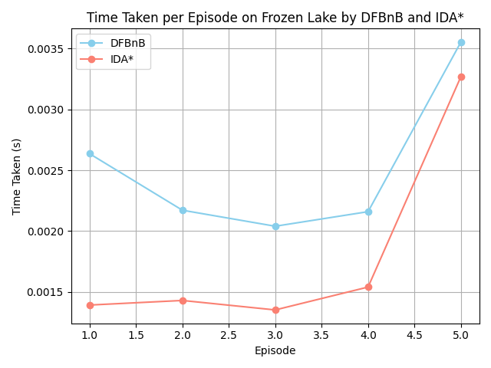
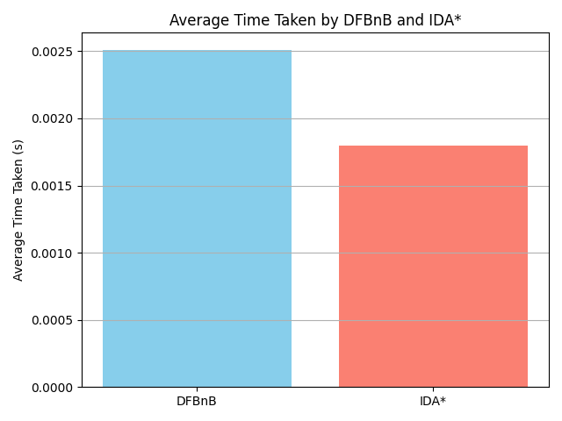
Performance Metrics

Slide 5
3) Hill Climbing
Algorithm
This code solves the Travelling Salesman Problem using the Hill Climbing algorithm. It begins with a random route connecting all the cities (nodes) and iteratively improves it by swapping two random cities. If the new route results in a shorter total distance, it is accepted. The process continues for a fixed number of iterations, and the best route found is tracked throughout. Visualizations are generated every few steps to show the path improvement, which are then compiled into a GIF showing the route optimization over time.
On Travelling Salesman Problem
Cost Function
The cost function used here is the total distance of the tour, calculated by summing the Euclidean distances between consecutive cities. The route is treated as a loop, so the last city connects back to the first. This helps the algorithm measure how good a solution is and guides the search toward shorter routes.

Slide 6
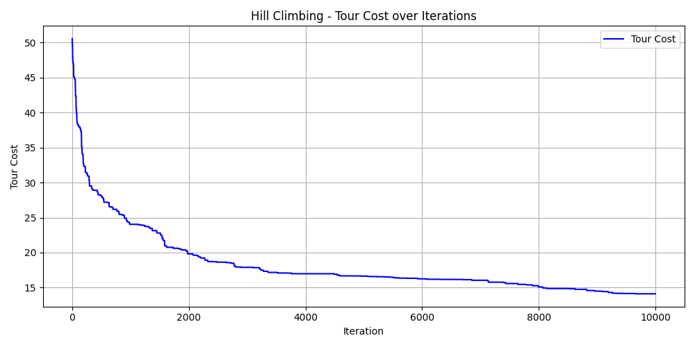
Performance Metrics
Initially, the cost drops rapidly, indicating that the algorithm quickly finds significantly better solutions. As the iterations progress, the rate of improvement slows down, and the cost gradually converges towards a near-optimal value. This typical behavior of hill climbing reflects its greedy nature—making local improvements until it reaches a local minimum

Slide 7
4) Simulated Annealing
Algorithm
Simulated Annealing is a probabilistic algorithm used here to solve the Travelling Salesman Problem. It starts with a random route and tries to improve it by randomly swapping two cities. Unlike Hill Climbing, it can accept worse solutions with a certain probability, allowing it to escape local minima. This probability depends on a temperature parameter, which decreases gradually over time. As the temperature lowers, the algorithm becomes more selective, accepting only better or slightly worse moves. This balance of exploration and exploitation helps it find a near-optimal path across many iterations.
On Travelling Salesman Problem
Heuristic Function
The cost function used is the total distance of the route, calculated using the Euclidean distance between consecutive cities, including the return to the starting point. At each step, the algorithm calculates this total distance to evaluate the quality of the current route. If the new route has a lower cost, it is accepted; otherwise, it might still be accepted based on a probability that decreases with the temperature. This approach allows Simulated Annealing to explore a wider range of solutions and avoid getting stuck in local optima, gradually guiding it toward a better overall tour.

Slide 8
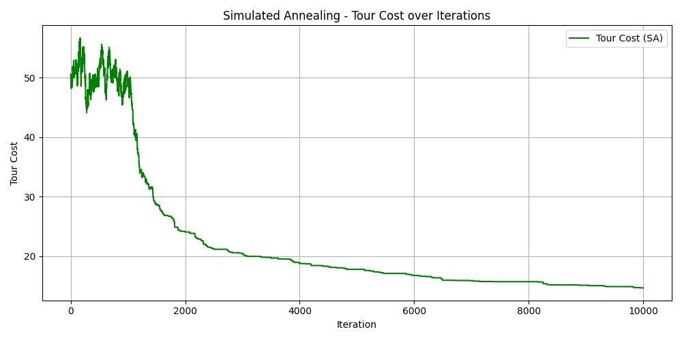
Performance Metrics
Initially, there is noticeable fluctuation in the tour cost, which is a characteristic feature of simulated annealing as it explores the solution space and occasionally accepts worse solutions to escape local minima. As the temperature decreases, the algorithm becomes more conservative, leading to a steady and consistent decline in tour cost. Eventually, the curve smooths out, converging towards a near-optimal solution with a final cost, showing the effectiveness of simulated annealing in balancing exploration and exploitation.

Slide 9
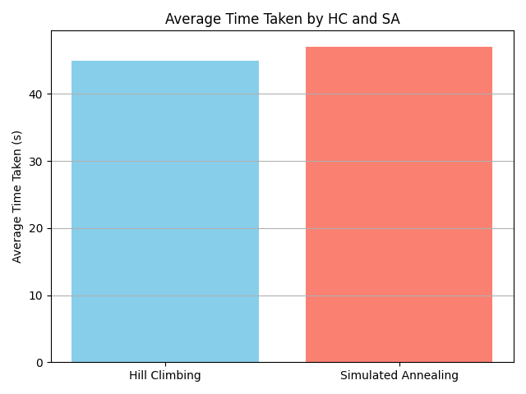
Hill Climb v/s Simulated Annealing
This difference is expected, as Simulated Annealing involves additional steps like probabilistic acceptance of worse solutions and temperature-based control, which introduce more computation per iteration. Despite being slower, Simulated Annealing offers better exploration capabilities, which can lead to improved solution quality in complex search spaces.

Slide 10
Conclusion
This project explored different search and optimization algorithms such as DFBnB, IDA*, Hill Climbing, and Simulated Annealing to solve pathfinding and TSP problems. Each algorithm uses different strategies—some focus on optimality, while others rely on heuristics for faster solutions. We observed how heuristic functions significantly impact the efficiency and accuracy of the search. Overall, these techniques highlight the trade-offs between optimal solutions and computational performance, helping us choose the right approach for different problem types.

