Slide 1


FindMate
Instant teammate matching and micro-lobby collaboration
CSE0613316 — Software Project Design and Development
Final Presentation · Autumn 2026
University of Information Technology and Sciences
1
Notes:
Slide 1 — Introduce your project: project name with logo, university name with logo, course code, title and semester.

Slide 2


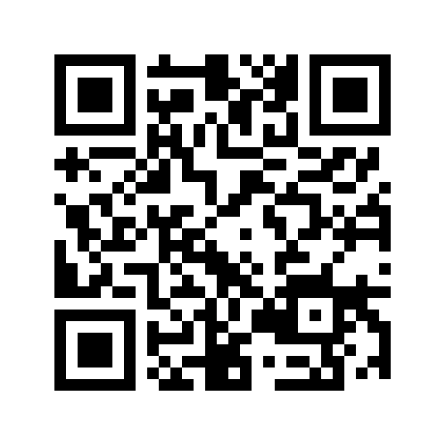
Our Team
AN
RB
Project link
Abu Nasim
Rimon Chandra Bhowmik
0432320005101033
Lead developer · Backend & testing
0432320005101001
UI/UX · QA & documentation
Live URL: findmate-psi.vercel.app
Github Repo : github.com/Error-Nasim/ Findmate
Course Instructor: Al Imtiaz, Associate Professor, Department of CSE, UITS
Notes:
Slide 2 — Team members (ID, name, role), course instructor, and repository and live product links. A QR code helps the audience open the product. A formal team name is optional.

Slide 3
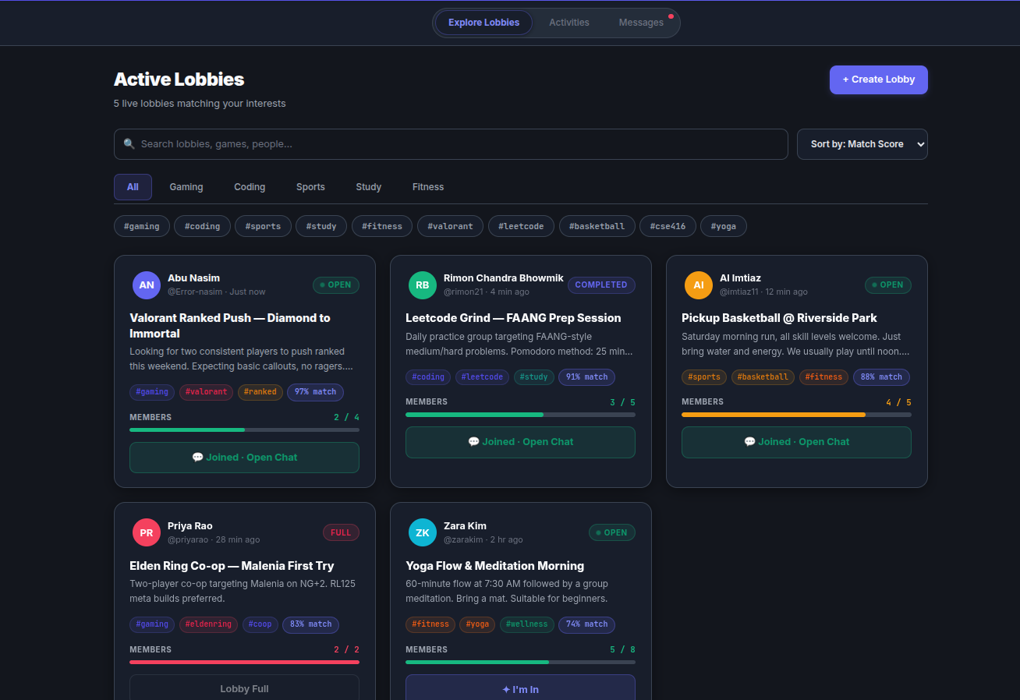
Problem and Motivation
A gamer needs one teammate tonight.
A forum post gets buried; a server is noisy.
Finding, vetting, and coordinating takes hours.
<2 min
Project goal for team assembly time
Notes:
Slide 3 — Tell the real-life problem as a short story. Who is affected and how? Give one statistic or real example. Storytelling is very effective; involve the audience.

Slide 4
Objectives
1
2
3
Match by activity, tags, and compatibility
Let hosts vet applicants with pitch notes
Enforce lobby capacity with transactions
4
5
6
Unlock squad chat after host approval
Reach at least 90% line coverage
Keep p95 API response below 250 ms
Notes:
Slide 4 — Goal of your project and 4 to 6 measurable objectives (problem with solution). You will check each objective again in the Results and Conclusion slides.

Slide 5
Existing Solutions and Our Difference
Feature | Discord | Reddit /r/lfg | FindMate
Structured lobbies | No | No | Yes
Compatibility score | No | No | Yes
Host pitch review | No | No | Yes
Squad chat after accept | Manual | No | Automatic
FindMate combines structured discovery, host vetting, and team chat in one focused flow.
Notes:
Slide 5 — Add 2 or 3 existing applications or systems and point out why your project is different. This shows you really studied the problem (CO5).

Slide 6
Key Requirements
Functional
Quality targets
Browse and filter open lobbies
Apply with a short pitch note
Hosts accept or reject applicants
Acceptance unlocks squad chat
p95 API under 250 ms
Secureauth and admin RBAC
Responsive, accessible interface
User story · acceptance
As a seeker, I find a fitting lobby.
Given an open lobby, when host accepts, then chat unlocks.
Notes:
Slide 6 — Key functional and non-functional requirements, and one or two user stories with acceptance criteria. Do not show the full SRS.

Slide 7
Methodology and Project Plan
Agile Scrum · seven 2-week sprints
W1–2
Problem & setup
On time
Short cycles fit a two-person team
Review progress at sprint boundaries
Integrate through peer review + CI
Track tasks and code in GitHub
W2–4
SRS, design, prototype
On time
W5–7
Build & integrate
On time
W8
Mid-term demo
On time
W9–11
Test, secure, document
On time
W12–14
Deploy & present
On time
Notes:
Slide 7 — SDLC model (Agile / Scrum / Kanban / Spiral) and 3 or 4 points on why you chose it; timeline or Gantt chart showing planned vs. actual; how tasks were tracked (GitHub Issues / Projects).

Slide 8
System Architecture and Technology Stack
PRESENTATION
React 19 · Vite 6 · Tailwind CSS
↓ REST API · JWT · RBAC
APPLICATION
Go 1.22+ · Gin services
↓ SQL · ACID transactions
DATA
PostgreSQL 16
Layer | Technology | Why
Presentation | React 19 · Vite 6 | Responsive SPA
Styling | Tailwind CSS 3 | Consistent UI
Application | Go 1.22+ · Gin | Compiled REST API
Data | PostgreSQL 16 | ACID capacity updates
Notes:
Slide 8 — One clear architecture diagram, and the technology used in each layer with the reason for choosing it.

Slide 9
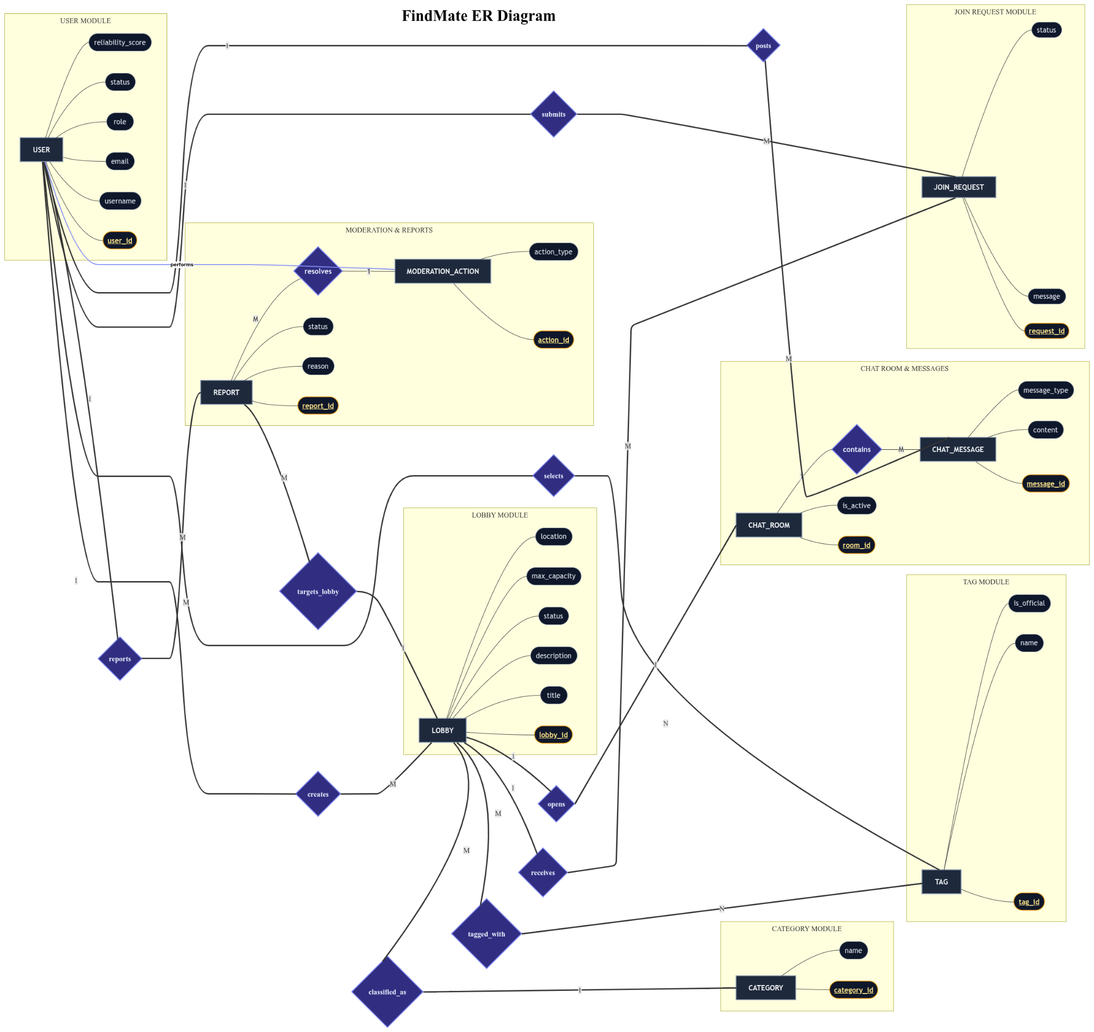
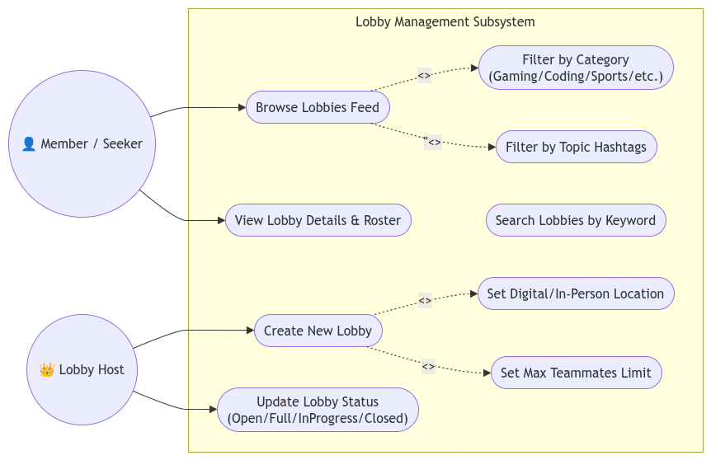
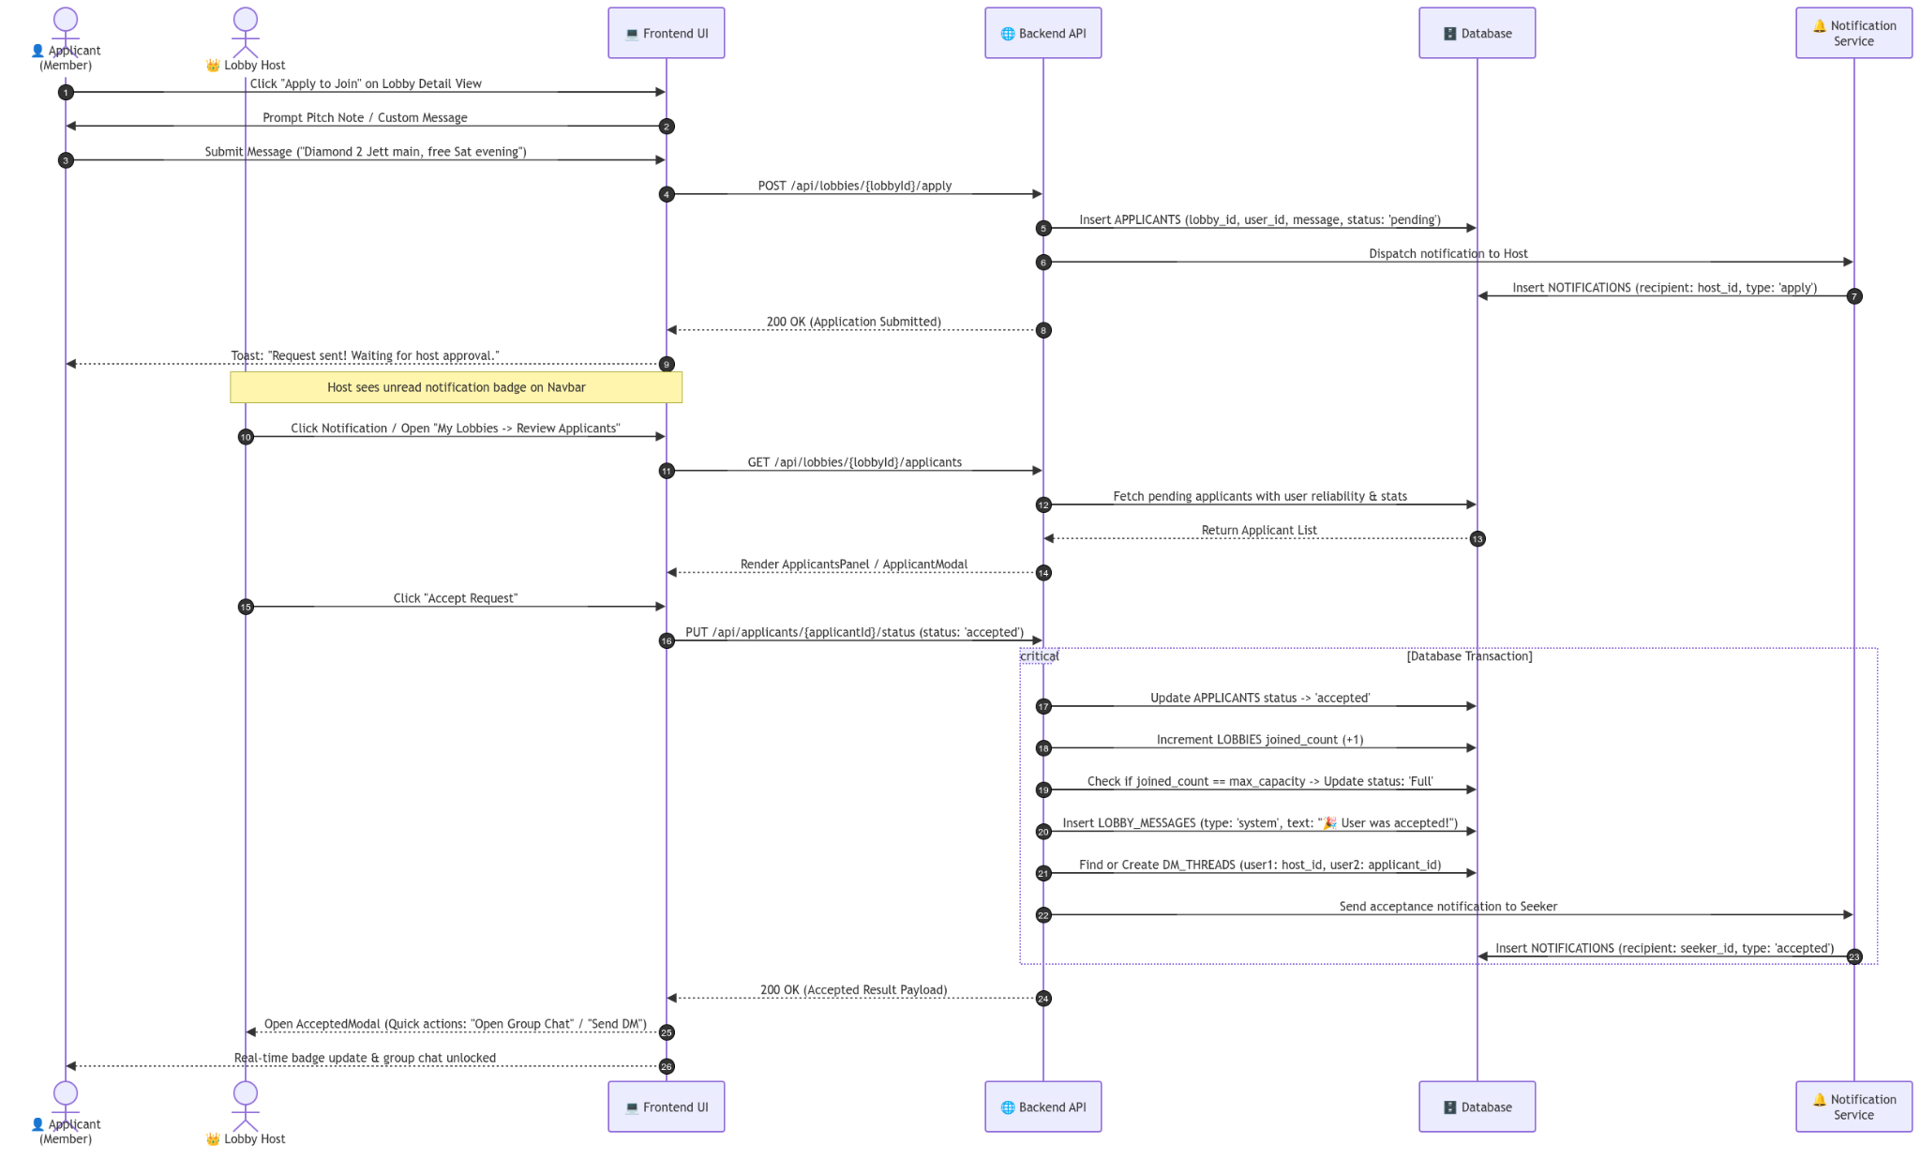
System Design
User roles
Data model
Pitch vetting flow
Notes:
Slide 9 — Use case diagram, ER diagram (database) and one class or sequence diagram for the key feature. Use 2 or 3 slides only; the rest is in the report. Diagrams must be readable from the back of the room: zoom in on what you explain.

Slide 10
Key Design Decisions
Decision | Alternatives | Reason / evidence
Go + Gin API | Node.js + Express | Compiled backend; Go test suite
PostgreSQL | MongoDB | ACID protects lobby capacity
React SPA | Next.js SSR | Fast client transitions; team fit
Notes:
Slide 10 — 2 or 3 important decisions, the alternatives you considered and why you chose this one (performance, cost, security, team skills). Expect the judges to ask you to defend one.

Slide 11
Live Demonstration
Live URL: findmate-psi.vercel.app · Release v1.0.0
1
2
3
4
5
Browse and filter lobbies
Open a lobby and review details
Apply with a concise pitch note
Host accepts from the review queue
Open squad chat and direct messages
Backup: screenshots follow the seeker-to-squad journey
Notes:
Slide 11 — Tell the audience you will demonstrate now. Use the deployed product, follow your script (3–4 minutes), and keep the backup video ready. Never code during the demo.

Slide 12
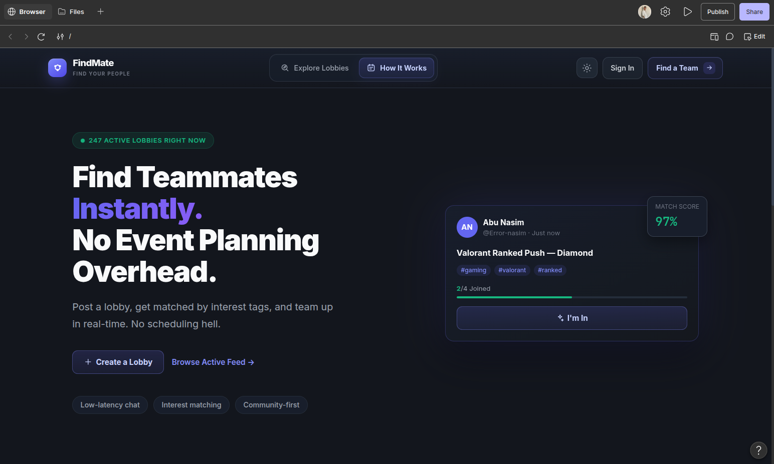
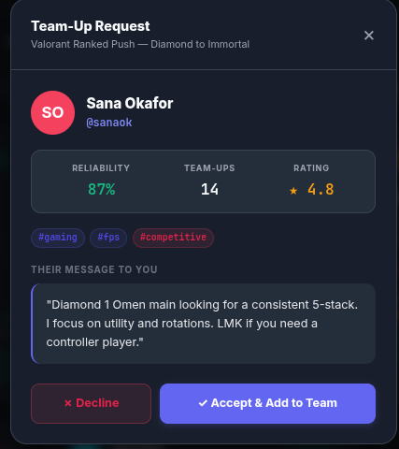
Product Walkthrough · Find a team
Landing page · Focused teammate search
Discover · Tags and compatibility scores
Host review · Pitch and reliability context
Notes:
Slide 12 — Every important UI must be on the slides as a backup. Use 4 to 6 slides of screenshots that follow the user journey: duplicate this slide as needed.

Slide 13
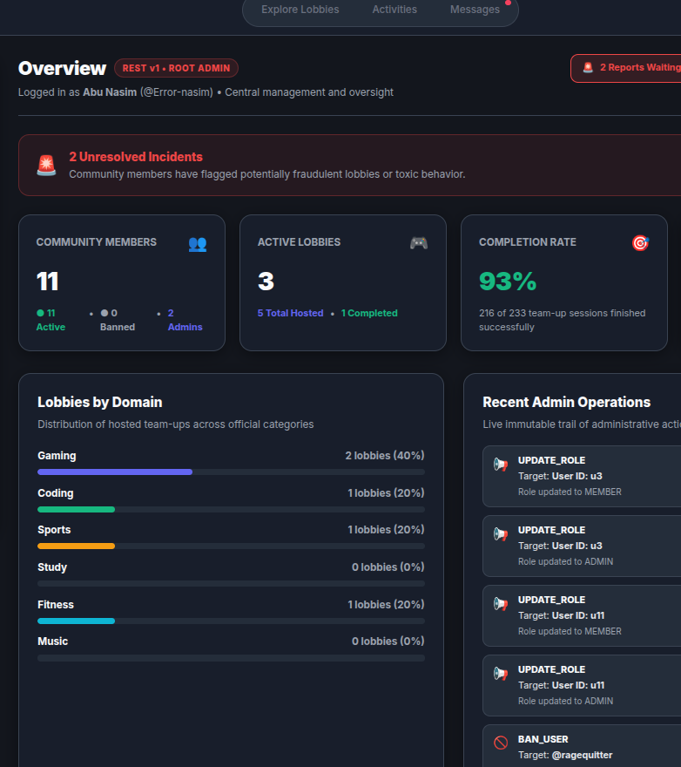
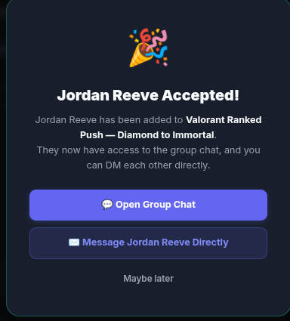
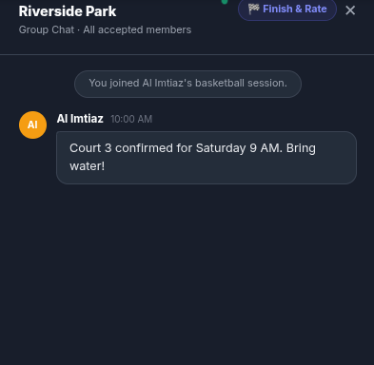
Product Walkthrough · From acceptance to safety
Acceptance · Squad access unlocked
Squad chat · Coordinate together
Admin · Reports and audit trail
Notes:
Slide 12 — Every important UI must be on the slides as a backup. Use 4 to 6 slides of screenshots that follow the user journey: duplicate this slide as needed.

Slide 14
Testing and Quality Assurance
31 / 31
99.00%
100%
4
Automated tests passed
Line coverage
SRS functional coverage
Findings fixed · 0 open S1/S2
Levels and tools
Bug story
Unit + integration + RBAC
End-to-end + Go backend
99% line · 87.85% branch
k6 · OWASP ZAP · GitHub Actions
Review caught an unparameterized SQL pattern. The team replaced it with parameterized queries and verified the tests.
Notes:
Slide 13 — Test levels and tools; key numbers (tests passed, code coverage, requirements covered); defects found and fixed by severity; one interesting bug: how you found it and how you fixed it (CO3).

Slide 15
Code Review, Security and Ethics
1
Review and scans
2
Secrets and data
3
Licences
Four findings fixed; no high/critical ZAP issues
Admin-only actions enforced server-side
Pitch notes capped at 280 characters
Passwords hashed with bcrypt; JWT over HTTPS
Profiles store bio and interest tags
Admin actions recorded in audit trail
React, Vite, Tailwind, Gin: MIT
PostgreSQL License; notices retained
Notes:
Slide 14 — Review and security-scan tools with the main findings you fixed; how passwords, secrets and personal data are protected; licences of the main libraries (CO8).

Slide 16
CI/CD and Deployment
Push / PR
Build
Test
Deploy
Release
Failing tests block release; GitHub Actions runs parallel jobs
CI tool | Hosting | Deployment | Release | Live URL
GitHub Actions | Free tier; provider Render | Rolling | v1.0.0 | findmate-psi.vercel.app
Notes:
Slide 15 — Pipeline diagram (build, test, deploy), hosting environment, release tag and live URL. Be ready to explain what happens when a test fails in CI.

Slide 17
Assistant Tools and Verification
Phase | Tool | Team designed first | Verification
UML | Draw.io | Entities and lifelines | Cross-checked with SRS
Implementation | GitHub Copilot | Routes and layout rules | Reviewed handlers / UI
Testing | Node V8 + ZAP | Test cases and scan scope | CI pass; findings triaged
When a tool draft was unsafe
A draft used an unparameterized SQL pattern. Review caught it; the team replaced it with parameterized queries and tested the fix.
Notes:
Slide 16 — Which tools you used in which phase, what you designed yourself first, and one example where a tool was wrong and how you caught it. This is 20% of the mark (defense of tool-use decisions).

Slide 18
Teamwork and Contribution
Abu Nasim
50%
Rimon Chandra Bhowmik
50%
Risks and responses
Capacity race → ACID transaction
Spam → pitch limit and reporting
Admin misuse → RBAC and audit log
Backend API, data model, pitch flow
Test suite and GitHub Actions
42 commits · 14 pull requests
Figma, React UI, Tailwind
Accessibility, security, load tests
38 commits · 12 pull requests
Notes:
Slide 17 — Who did what (modules, tests, documentation), contribution split, a summary of commits and pull requests, and the main risks you faced and how you handled them (CO7).

Slide 19
Results and Socio-economic Impact
Measured outcomes
Impact
Discovery and matchmaking
Delivered
Students, gamers, and hackathon teams
Target: reduce team assembly to under 2 minutes
Free-tier hosting; $0 reported cloud cost
Host vetting and team chat
Delivered
Accessibility score ≥90
96 / 100
p95 API <250 ms
188.4 ms
Notes:
Slide 18 — Which objectives were achieved and which were not, and how this project will change our system, society or business.

Slide 20
Limitations
No native voice or video calling
No financial tournament wagers
Responsive PWA; no native mobile binaries
These boundaries define the current release scope
Notes:
Slide 19 — This part is very important. Mention all of your limitations; do not hide anything. It will help you during the Q/A session.

Slide 21
Future Work
1
2
3
WebRTC voice in squad rooms
Reduce reliance on external voice links
Semantic matchmaking with embeddings
Improve fit beyond explicit tags
React Native and location matching
Support mobile and campus use cases
Notes:
Slide 20 — Mention all of your unfinished work. Think about the audience: what will they ask you to add? Add those to your future work. If a judge suggests an idea, agree and add it here.

Slide 22
Conclusion
Goal | Outcome
Lobby discovery + match scoring | Delivered
Host vetting + chat unlock | Delivered
Accessibility target ≥90 | 96 / 100 Lighthouse
p95 response target <250 ms | 188.4 ms measured
FindMate turns teammate search into a structured, tested journey from discovery to squad collaboration.
Notes:
Slide 21 — Relate all of your goals to the outcome of your project.

Slide 23
References
[1] R. S. Pressman and B. R. Maxim, Software Engineering, 9th ed., 2020.
[2] I. Sommerville, Software Engineering, 10th ed., 2015.
[3] GitHub, “GitHub Actions documentation,” docs.github.com/actions.
Notes:
Slide 22 — A few key references: standards, official documentation, books or research papers. Avoid ordinary web pages. Use IEEE style and keep them the same as in your report.

Slide 24
Thank You — Questions?
Scan this QR to use the website!
FindMate · CSE0613316 · Autumn 2026
Live URL: findmate-psi.vercel.app
Github Repository : https://github.com/Error-Nasim/Findmate
24
Notes:
Slide 23 — End with the repository and live product links so judges can open them during Q&A.

