Slide 1

DESIGN AND ANALYSIS OF ALGORITHMS
Group 18
IIT2019237 - Ishneet Sethi
IIT2019238 - Chandramani Kumar
IIT2019239 - Mrityunjaya Tiwari

Slide 2
Problem Statement
Given a gold mine of n*m dimensions. Each field in this mine contains a
positive integer which is the amount of gold in tons. Initially the miner is at
first column but can be at any row. He can move only (right->,right up
/,right down\) that is from a given cell, the miner can move to the cell
diagonally up towards the right or right or diagonally down towards the
right. Find out maximum amount of gold he can collect. Solve using
Dynamic programming.

Slide 3
APPROACH-1
Brute Force
Traversing each row of the first column for updating the max variable which stores the
maximum amount of gold collected after traversing through the matrix.
In each iteration of the loop, we recur thrice in the directions specified in the question i.e
right, right_up and right_down, through m-1 columns to get the maximum amount of gold
collected if started with that cell of the ﬁrst column.
In each iteration update the max variable if required.
Finally print the max amount gold collected.

Slide 4
ALGORITHM - 1
Pseudo Code
function maxm_Gold_amnt(R, C, row, col, matrix)
if (col == C+1 || row == 0 || row == R+1) then
return 0;
long long int right ← maxm_Gold_amnt(row,col+1)
long long int right_up ← maxm_Gold_amnt(row-1,col+1)
long long int right_down ← maxm_Gold_amnt(row+1,col+1)
return matrix[row][col] +
max( right, max(right_up, right_down))
function max(a,b)
if (a>b) then
return a
return a
function main()
srand(time(0))
get R and C
for i ← 1 to R do
for j ← 1 to C do
matrix[i][j] ← rand
for i ← 1 to R do
ans ← max(ans,
maxm_Gold_amnt(R,C,i,1,matrix))
print ans

Slide 5
APPROACH-II
Dynamic Programming
Traverse each row for the last column cells’ value and copy the given matrix value for those cells in the dp[][] matrix.
Traverse each row and column except the last one to store the maximum gold value in each cell of the dp[][] matrix.
Traverse each row of the first column to find the maximum among them.
Finally print the maximum value i.e, the maximum amount of gold collected after traversing through the matrix.

Slide 6
ALGORITHM-II Pseudo Code
else
long long int m ← max(dp[i+1][j+1],dp[i-1][j+1])
dp[i][j] ← matrix[i][j] + max(dp[i][j+1],m)
long long int maxm ← -1 for i ← 1 to R do
if ( dp[i][1] > maxm) then
maxm ← dp[i][1]
return maxm
function main( )
srand(time(0))
get R and C
for i ← 1 to R do
for j ← 1 to C do
matrix[i][j] ← rand
print maxm_Gold_amnt(R, C,matrix)
function max(a,b)
if (a>b) then
return a
return a
function maxm_Gold_amnt(R, C,matrix)
long long int dp[R][C] ← {0}
for i ← 1 to R do
dp[i][C] ← matrix[i][C]
for i ← C-1 to 1 do
for j ← 1 to R do
if (i ← 1) then
if ( i+1 <= R ) then
dp[i][j] ← matrix[i][j] + max(dp[i][j+1], dp[i+1][j+1])
else
dp[i][j] ← matrix[i][j] + dp[i][j+1]
else if ( i ← R) then
dp[i][j] ← matrix[i][j] + max(dp[i][j+1],dp[i-1][j+1])

Slide 7
ALGORITHM ANALYSIS for Algorithm 1
Time Complexity:
Let's suppose step 1 time complexity be T1
So, the Time complexity of the whole program
(T) = T1
Assuming 1 unit time for comparison and assignment.
Now, calculating T1 :
No of rows traversed = N
So, T1 = N*(T’)
where , T’ = Time complexity for recursive function
= width of the recursive tree
= 3^^{(m-1)}
Therefore the time complexity would be O(N*3^^{(M-1)}).
Space Complexity:
Our memory complexity is determined by the number of return statements because
each function call will be stored on the program stack. To generalize, a recursive function’s
memory complexity is O(recursion depth).Hence in this case space complexity would be O(M).

Slide 8
ALGORITHM ANALYSIS for Algorithm 2
Time Complexity :
Let's suppose step 1 time complexity be T1,
step 2 time complexity be T2 and that of step 3 be T3
So, the Time complexity of the whole program
(T)=T1+T2+T3
Now, calculating T1 :
No of rows traversed = N
=> T1 = O(N)
Now, calculating T2 :
No of rows traversed = N
No of columns traversed = M-1
So, T2 = O((N)*(M-1))
No of rows traversed = N
So, T3 = N
Hence, T = O(N) + O(N*(M-1)) + O(N)
` => T ~ O(N*M)
Time Complexity :
Best Case : O(N) when M=1
Worst Case : O(N*M)
Space Complexity :
Since we are creating a 2D matrix of the same size as of the original matrix, i.e N X M, so we are using N*M space .Hence, the space complexity of the algorithm 2 will be O(N*M).

Slide 9
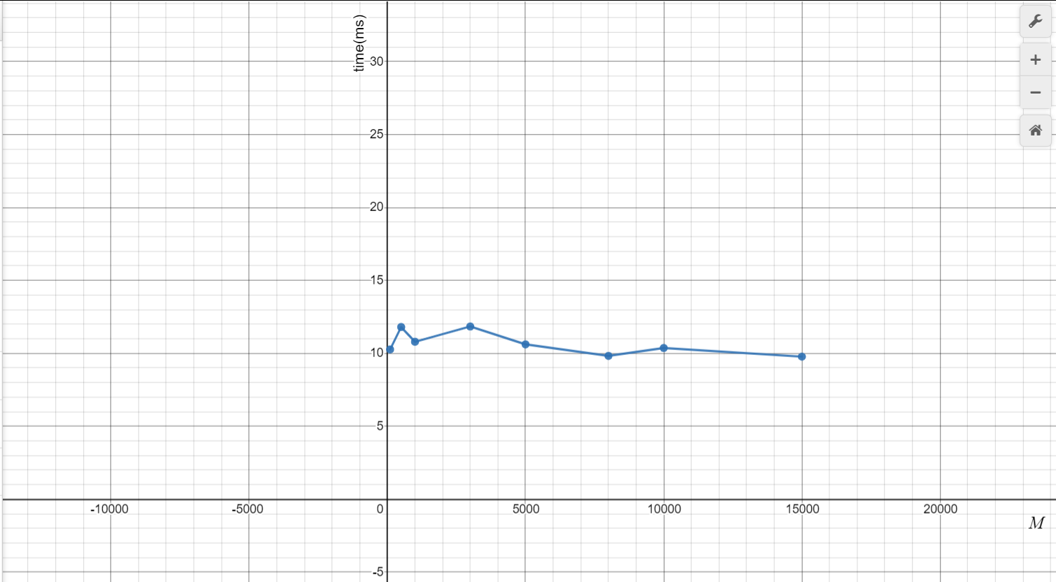
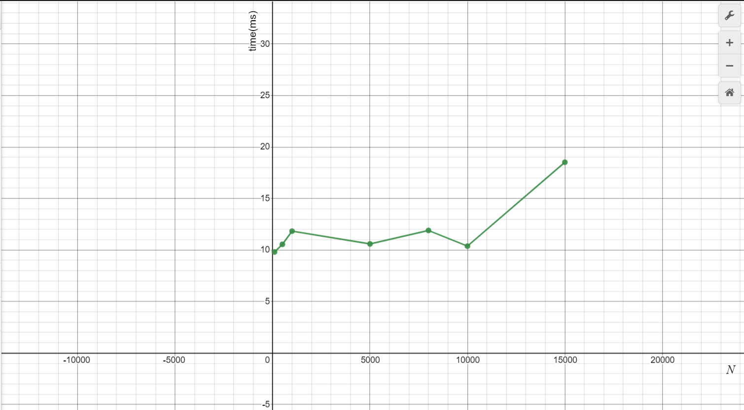
EXPERIMENTAL RESULT
i. Time complexity graph(Keeping N constant and M on X-axis )
i. Time complexity graph(Keeping M constant and N on X-axis )

Slide 10
Conclusion
The algorithms discussed in this paper can be used to ﬁnd the maximum amount of gold collected by a miner while starting from any cell of the ﬁrst column. traversing a matrix of N X M size whose each cell contains the amount of gold. In the matter of comparison between these two algorithms both approaches had the same space complexity. But, in Approach 1, time complexity would be higher as compared to Algorithm 2. So we can conclude that Dynamic Programming Solution i.e, the Algorithm 2 is optimal and efﬁcient.

