Slide 1





Slide 2



SUMMARY

Slide 3
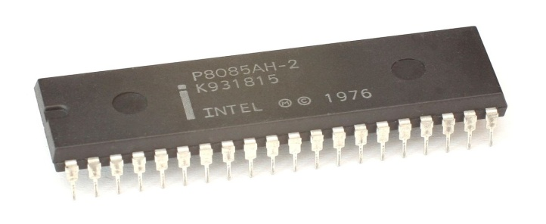
What is microprocessor
A microprocessor is a component that performs the instructions and tasks
involved in computer processing. In a computer system, the microprocessor
is the central unit that executes and manages the logical instructions passed
to it.

Slide 4
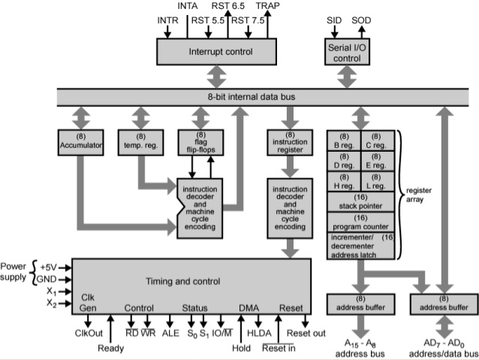
Architecture of 8085

Slide 5
INSTRUCTION SET OF 8085
An instruction is a binary pattern designed inside a microprocessor to perform a specific function.
The entire group of instructions that a microprocessor supports is called Instruction Set.
8085 has 246 instructions.
Each instruction is represented by an 8-bit binary value.
These 8-bits of binary value is called Op-Code or Instruction Byte.

Slide 6
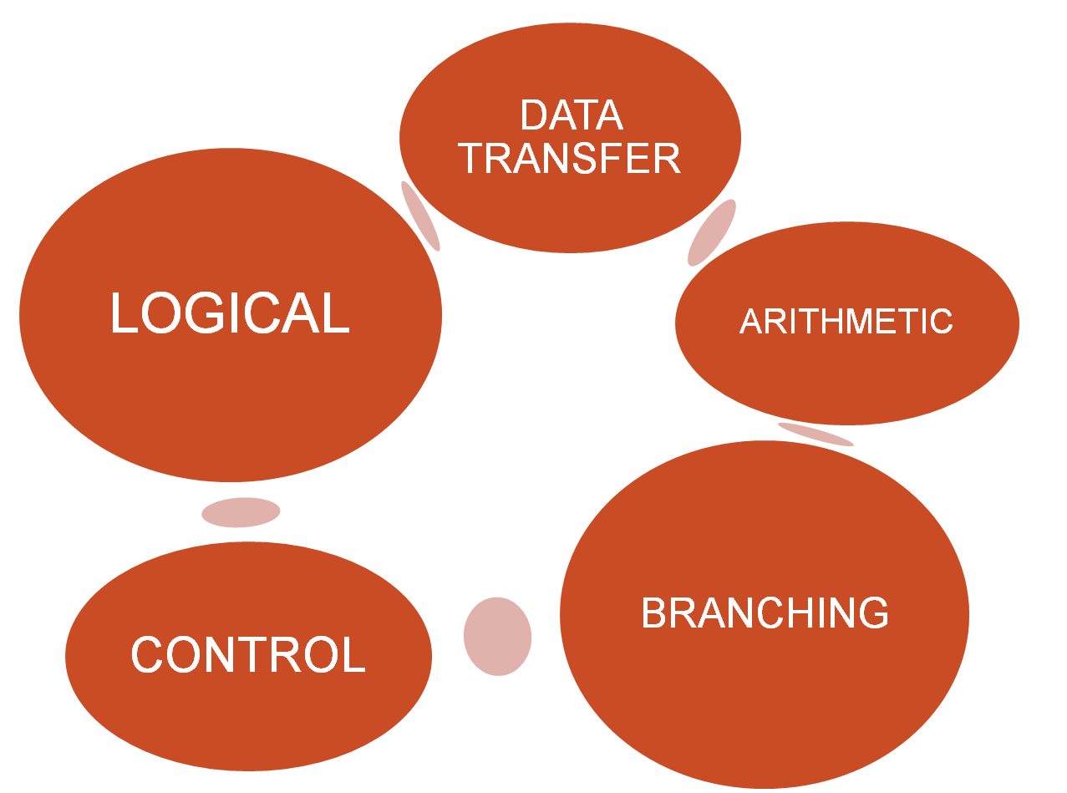
INSTRUCTION SET

Slide 7

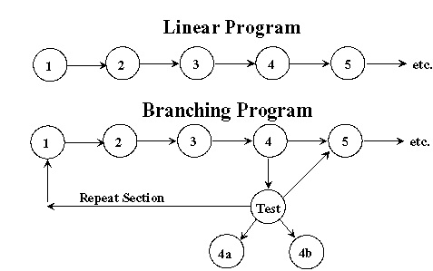
The branching instruction are the most powerful instruction because they allow the microprocessor to change the sequence of the program, either unconditionally or under certain condition.
These instruction are the key to the flexibility and versatility of a computer.
The microprocessor is a sequential machine ; it executes machine code from one memory location to the next.

Slide 8
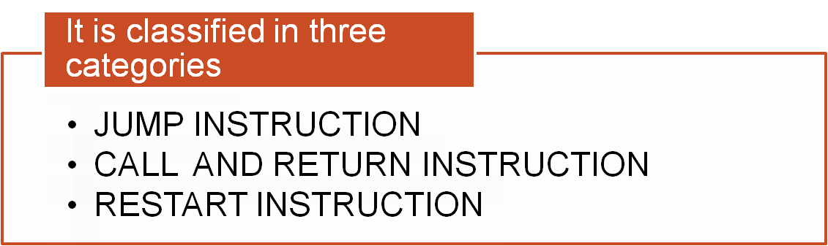

The program sequence is transferred to the memory location specified by the 16-bit address given in the operand.
Example: JMP 2034 H.

Slide 9

Opcode | Operand | Description
JMP | 16-bit address | Jump unconditionally
After this instruction the Program Counter is loaded with this
location and starts executing and the contents of PC are
loaded on Stack.
Flags Affected : No Flags are affected.
Addressing mode: Immediate.

Slide 10
ADDRESS | MNEMONIC | DESCRIPTION
8000 | MVI A , 05H | Move data 05 in A
8001
8002 | JMP (8007)H | Jump unconditionally to 8007
8003
8004
8005 | ADD A | Add A means A=A+A
8006 | MOV B,A | Move A in B
8007 | MVI B, 03H | Move 03H in B
8008 | ADD B | ADD B (A=A+B)

Slide 11
Jump Conditionally
Opcode | Operand | Description
Jx | 16-bit address | Jump conditionally
The program sequence is transferred to the memory location specified by the 16-bit address given in the operand based on the specified flag of the PSW.
Example: JZ 2034 H.

Slide 12
Opcode | Description | Status Flags
JC | Jump if Carry | CY = 1
JNC | Jump if No Carry | CY = 0
JP | Jump if Positive | S = 0
JM | Jump if Minus | S = 1
JZ | Jump if Zero | Z = 1
JNZ | Jump if No Zero | Z = 0
JPE | Jump if Parity Even | P = 1
JPO | Jump if Parity Odd | P = 0

Slide 13

Opcode | Operand | Description
CALL | 16-bit address | Call unconditionally
The program sequence is transferred to the memory location specified by the 16-bit address given in the operand.
Before the transfer, the address of the next instruction after CALL (the contents of the program counter) is pushed onto the stack.
Example: CALL 2034 H.

Slide 14
ADDRESS | MNEMONIC | DESCRIPTION
8000 | MVI A , 05H | Move data 05 in A
8001
8002 | CALL (8007)H | CALL unconditionally to 8007
8003
8004
8005 | ADD B
.. | .. | It return after it receive ret instruction to the next address
.. | ..
9001 | ADD A
9002 | MOV B ,A
9003 | RET
9004
9005

Slide 15
Call Conditionally
Opcode | Operand | Description
Cx | 16-bit address | Call conditionally
The program sequence is transferred to the memory location specified by the 16-bit address given in the operand based on the specified flag of the PSW.
Before the transfer, the address of the next instruction after the call (the contents of the program counter) is pushed onto the stack.
Example: CZ 2034 H.

Slide 16
Call Conditionally
Opcode | Description | Status Flags
CC | Call if Carry | CY = 1
CNC | Call if No Carry | CY = 0
CP | Call if Positive | S = 0
CM | Call if Minus | S = 1
CZ | Call if Zero | Z = 1
CNZ | Call if No Zero | Z = 0
CPE | Call if Parity Even | P = 1
CPO | Call if Parity Odd | P = 0

Slide 17
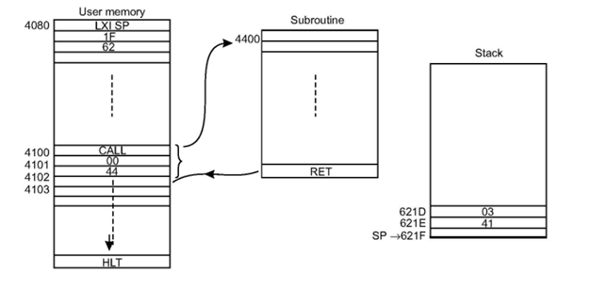

Slide 18
Return Unconditionally
Opcode | Operand | Description
RET | None | Return unconditionally
Return Conditionally
Opcode | Description | Status Flags
RC | Return if Carry | CY = 1
RNC | Return if No Carry | CY = 0
RP | Return if Positive | S = 0
RM | Return if Minus | S = 1
RZ | Return if Zero | Z = 1
RNZ | Return if No Zero | Z = 0
RPE | Return if Parity Even | P = 1
RPO | Return if Parity Odd | P = 0

Slide 19
RESTART
Opcode | Operand | Description
RST | 0 – 7 | Restart (Software Interrupts)
The RST instruction jumps the control to one of eight memory locations depending upon the number.
These are used as software instructions in a program to transfer program execution to one of the eight locations.
Example: RST 3.

Slide 20
Restart Address Table
Mnemonic | Binary Code |  |  |  |  |  |  |  | HEX Code | Call Location in Hex
 | D7 | D6 | D5 | D4 | D3 | D2 | D1 | D0
RST 0 | 1 | 1 | 0 | 0 | 0 | 1 | 1 | 1 | C7 | 0000
RST 1 | 1 | 1 | 0 | 0 | 1 | 1 | 1 | 1 | CF | 0008
RST 2 | 1 | 1 | 0 | 1 | 0 | 1 | 1 | 1 | D7 | 0010
RST 3 | 1 | 1 | 0 | 1 | 1 | 1 | 1 | 1 | DF | 0018
RST 4 | 1 | 1 | 1 | 0 | 0 | 1 | 1 | 1 | E7 | 0020
RST 5 | 1 | 1 | 1 | 0 | 1 | 1 | 1 | 1 | EF | 0028
RST 6 | 1 | 1 | 1 | 1 | 0 | 1 | 1 | 1 | F7 | 0030
RST 7 | 1 | 1 | 1 | 1 | 1 | 1 | 1 | 1 | FF | 0038

Slide 21
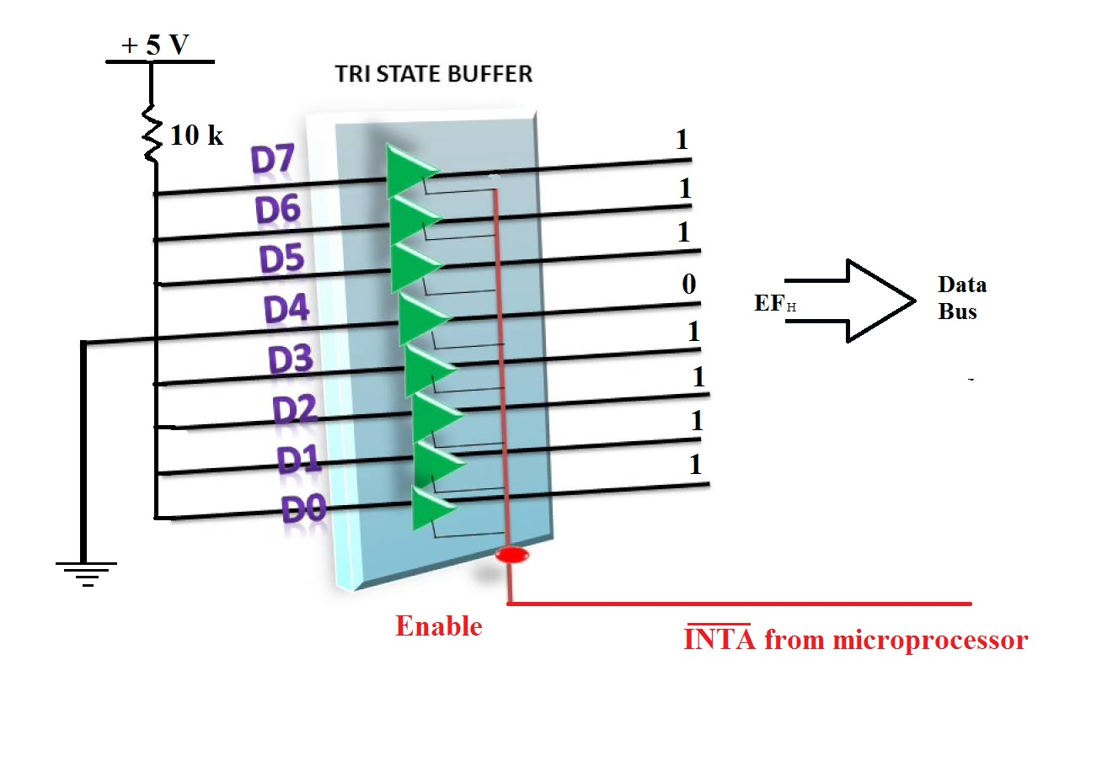
Circuit to Implement the instruction RST 5

Slide 22
CONCLUSION
A branch is an instruction in a computer program that can cause a computer to begin executing a different instruction sequence and thus deviate from its default behavior of executing instruction in order.
In high-level programming language branches usually take the form of conditional statement of various forms that encapsulate the instruction that will be executed if conditions are satisfied. Unconditional branch such as GOTO are used to unconditional jump
These Instruction are vary powerful and important instruction which gives us flexibility in organizing and reusing certain part again and again.

Slide 23


