Slide 1
University of Washington Kirsten Wind Tunnel Sidewall Balance Software
C.W. Lum, W. Hongjun, K. Ho, R. Slim, H. Stevens
Aircraft Icing and Aerodynamics Research Group, University of Washington
Function:
-Perform balance calibration.
-Done Once.
-Equivalent daily Bal Cal check for SWB?
-UWAL main data acquisition & control module
-Main balance only.
-Read tunnel q.
-LabView
-Will DeJang(?)
-UW owns the source code
-.EU file creates.
-Pressure
-Internal Balances
-AUX Data Aquision
The speed controller of the fan of wind tunnel. Operated by the staff.
FAN MOTORS
Other Sensors
Main Balance
Speed Controller
Fan Motors
Main Balance
TO-DO:
-Nomenclature
-Picture of SWB DAQ box.
-Will we use the triangle box or our own A/D box?
-Get an example .EU file from SWB and TCAM.
-Qi
AIARG Sidewall Balance Software
Main(Name?)
Static Pressure (?)
-Control pitching angle
-”(?)”
-What format is SWB output?
-Creates .EU files.
Pitch Control Motor
Level Cells
RS-232
Pitch Control Motor
Level Cells
KWT DAQ BOX
TO-DO
Plot
Triangle Box (KWT DAQ box)
SWB Laptop (Nathan)
SWB
UWAL Plotting
Can we interface here?
.EU Files
-(?)
-Apply Bal Cal Constants
-Final DR
-Wall Control
Network
Online
The Force

Slide 2
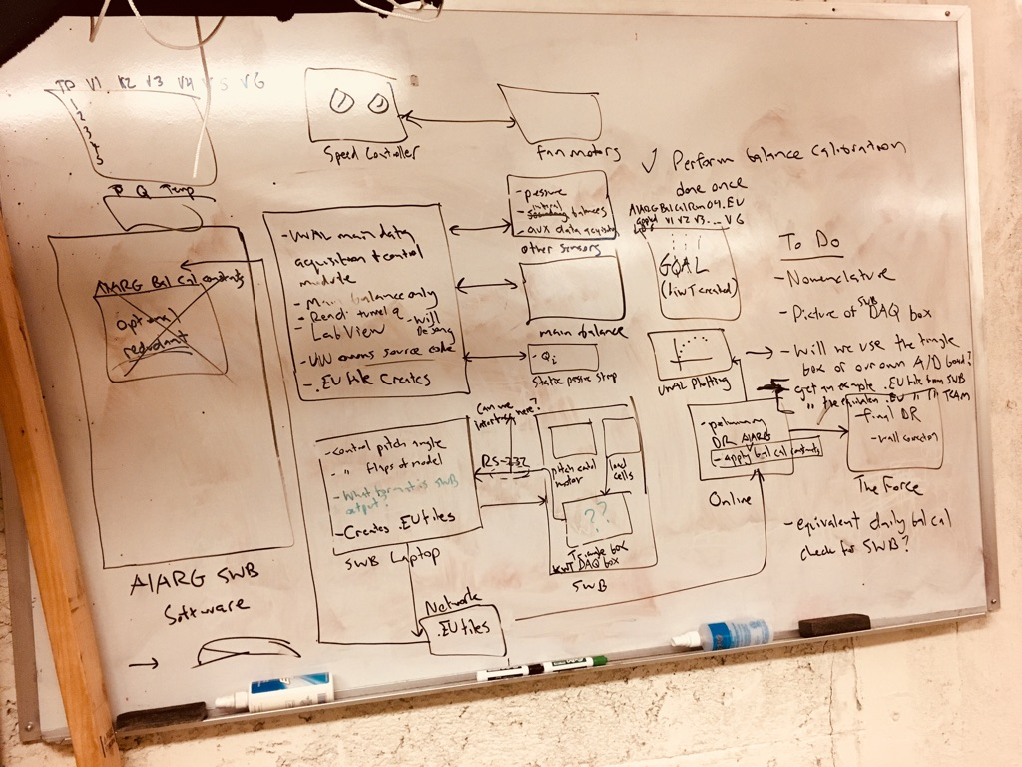

Slide 3
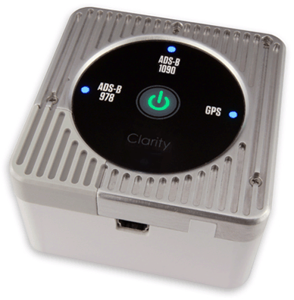
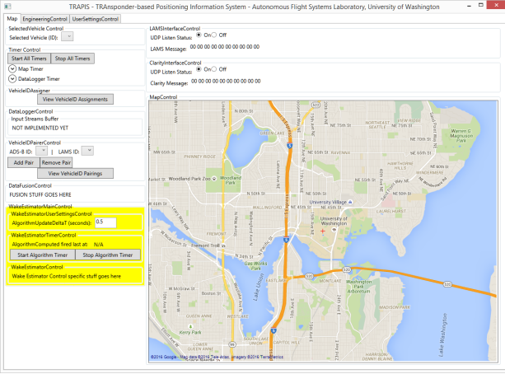
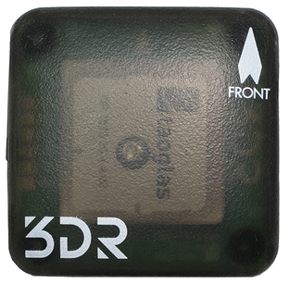
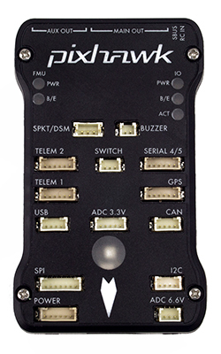
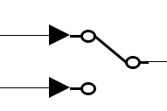
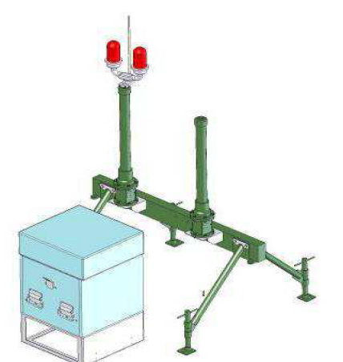


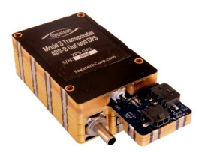
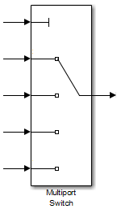
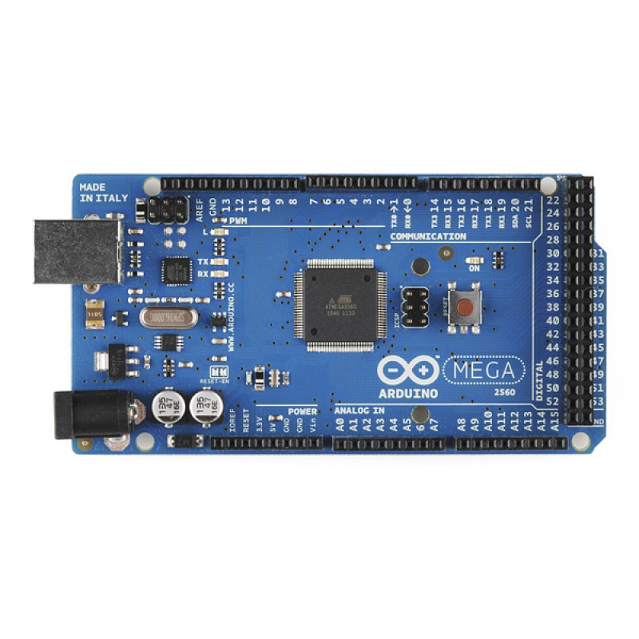

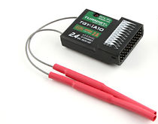
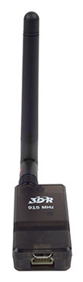
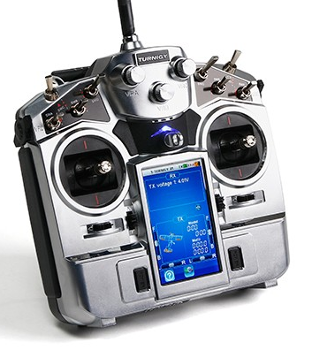
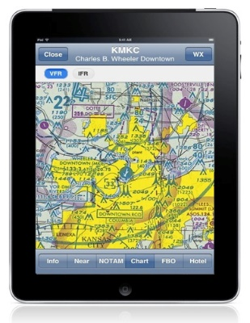
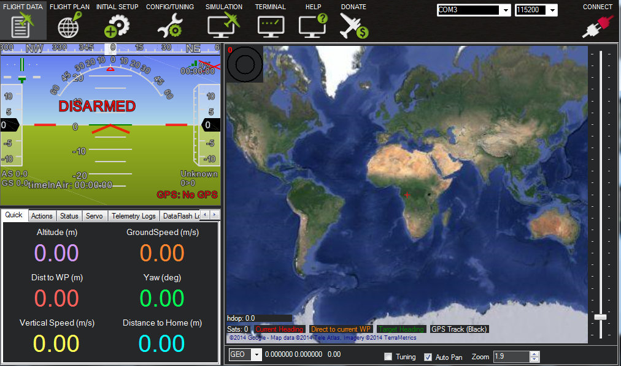
University of Washington Kirsten Wind Tunnel Sidewall Balance Software
C.W. Lum, W. Hongjun, K. Ho, R. Slim, H. Stevens
Aircraft Icing and Aerodynamics Research Group, University of Washington
Sagetech Clarity
Hosts a WiFi hotspot.
Decodes transponder outputs and translates to Clarity packets (clear text).
Broadcasts UDP data over port 4000 (IP address is unclear)
Clarity packet
(port 4000)
Drives
Pumps
Fan Pitch
Drives
Pumps
Fan Pitch
U.S.668
Human Operator
Solely used to feed GPS information to TRAPIS payload.
ADS-B In Receiver
Speed Controller
Interrogates transponder (on 1030 MHz) and receives response (on 1090 MHz)
CAT48 packet & CAT34 packet
(port 20550)
See \\JCATI2015\TechnicalDataPackage\ProjectVision\GPSDeniedProjectVision.pptx for additional information.
Running UW customized ArduPlane 3.8.0
U.S.1741
Decodes transponder outputs and translates to CAT48 messages.
UAV GPS signal
Discards UAV GPS signals and only uses TRAPIS position estimates for navigation.
TRAPIS Payload Pixhawk
Broadcasts UDP data over port 20550 (destination IP address is configurable)
TRAPIS 1.0
TRAPIS position estimate
Flight mode simply actuates a servos based on LLA.
GPS info
Emulate/output LAMS and Clarity packets.
Developed by UWAFSL.
Generates scenarios for lab testing.
WSMP (Washington Simple)
U.S. 1730
Select position information to output from TRAPIS.
Raw ADS-B can be used as a surrogate for LAMS during testing.
LAMS used for flight demo.
Filtered versions of signals can also be used.
Perform rudimentary waypoint navigation.
Use rudder to point aircraft in direction of next waypoint.
Running AFSL software to intercept GPS measurements.
Can pass, degrade, or deny GPS signals.
Controlled by GCS.
Sagetech XPS-TR
Reverts to Mode S transponder if GPS is lost.
Mux position estimates
WSTR (Washington Steer)
U.S. TBD
U.S.726, 727
Perform advanced waypoint navigation.
ANPC Local Area Multilateration System
U.S.1726
WADV (Washington Advanced)
U.S. TBD
U.S.668
TRAPISSimulator
U.S.1752, 1753
UW Customized GPS-Denied Flight Modes
U.S.1739
Arduino Mega 2560
ADS-B Out Transponder
Emulate LAMS functionality and outputs.
Position Estimate Selection Control
Future work will entail replacing ArduPlane GPS information so all flight modes operate using TRAPIS provided position estimates.
Receive commands from payload operator on ground.
Stock ArduPlane Flight Modes
Turnigy TGY-iA10 Receiver
U.S.1049
U.S.1725
Receive TRAPIS position estimates from GCS.
Flight Mode Selection
UAV Pixhawk
TRAPIS Payload
ANPC LAMS Simulator
Receive commands from remote PIC.
Select mode.
DataOutputController sends TRAPIS position estimates to Mission Planner using UDP (nominally using port 4005).
U.S.1724
U.S.1731
Turnigy TGY-iA10 Receiver
Mission Planner Interface
Data Telemetry Radio
UW TRAnsponder-based Position Information System (TRAPIS)
Flight Mode Selection
TRAPIS Payload Mode Selection
UAS
Chose flight mode via Turnigy TGY-i10.
Monitor ADS-B output via EFB.
Control TRAPIS payload via Turnigy TGY-i10.
TRAPIS Position Estimate via UDP connection
Maintain data telemetry link to UAS.
Modify to carry position estimates on the data telemetry link.
Remote PIC
Payload Operator
Responsible for rerouting position estimates from TRAPIS and uploading it to the UAS via the data telemetry link.
WGPS MAVLink Message
Data Telemetry Radio
U.S.1728, 1729
UW Customized Mission Planner
Ground Control Station
Legend
= See specified user
story for more information
U.S.XYZ

