Slide 1
Fix-it-Felix Script FAQ
Hongjun Wu
2021.3.3

Slide 2
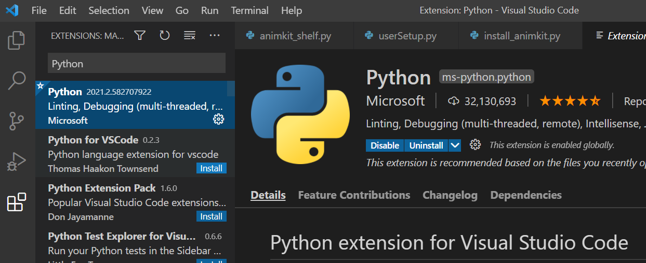

How to install AnimKit? (Windows)
Download the AnimKit package, Python, and VSCode.
Install Python plugin in VSCode by going to ↓ and install.
You should see a green play button on the right side of the window when you open install_animkit.py with VSCode (right click-open with VSCode)
Hit the play button.
You should see a log like this and AnimKit should be installed. Restart Maya to see if AnimKit shelf is there.

Slide 3
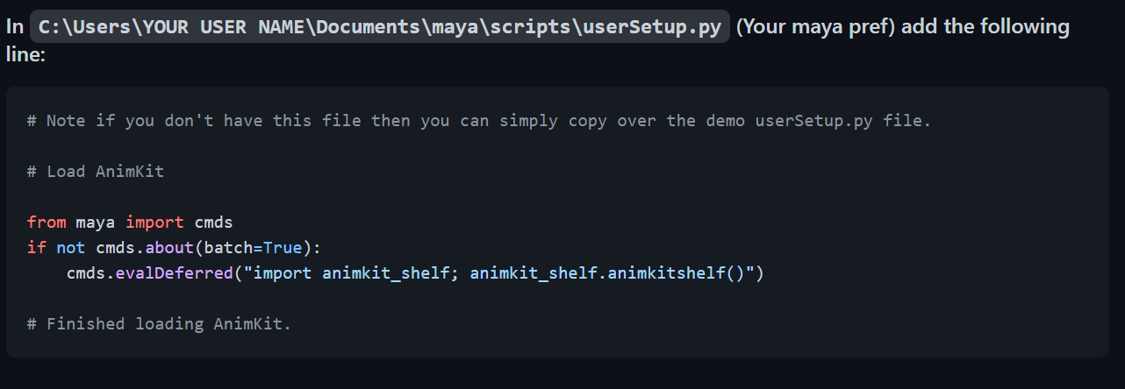
How to install AnimKit?,cont (Windows)
If you see this:
[⍻] [CHKDIR] WARNING: UserSetup file already exist at USER_SETUP , you may need to configure it manually.
Do this:

Slide 4

Fix-it-Felix
What:
A set of helpful little fixes that helps some pain.
When:
When things go wrong!!!
Full documentation + videos: README.md

Slide 5
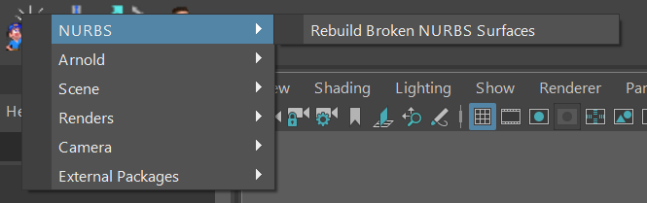
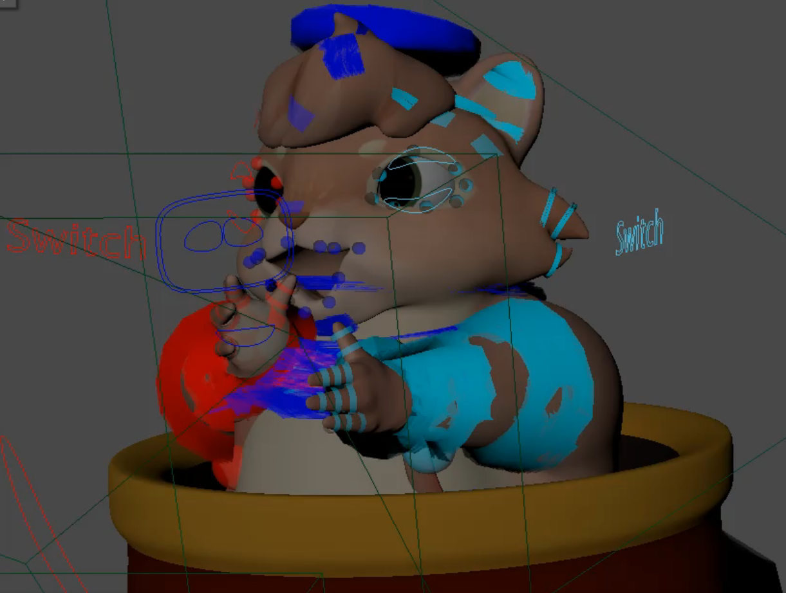
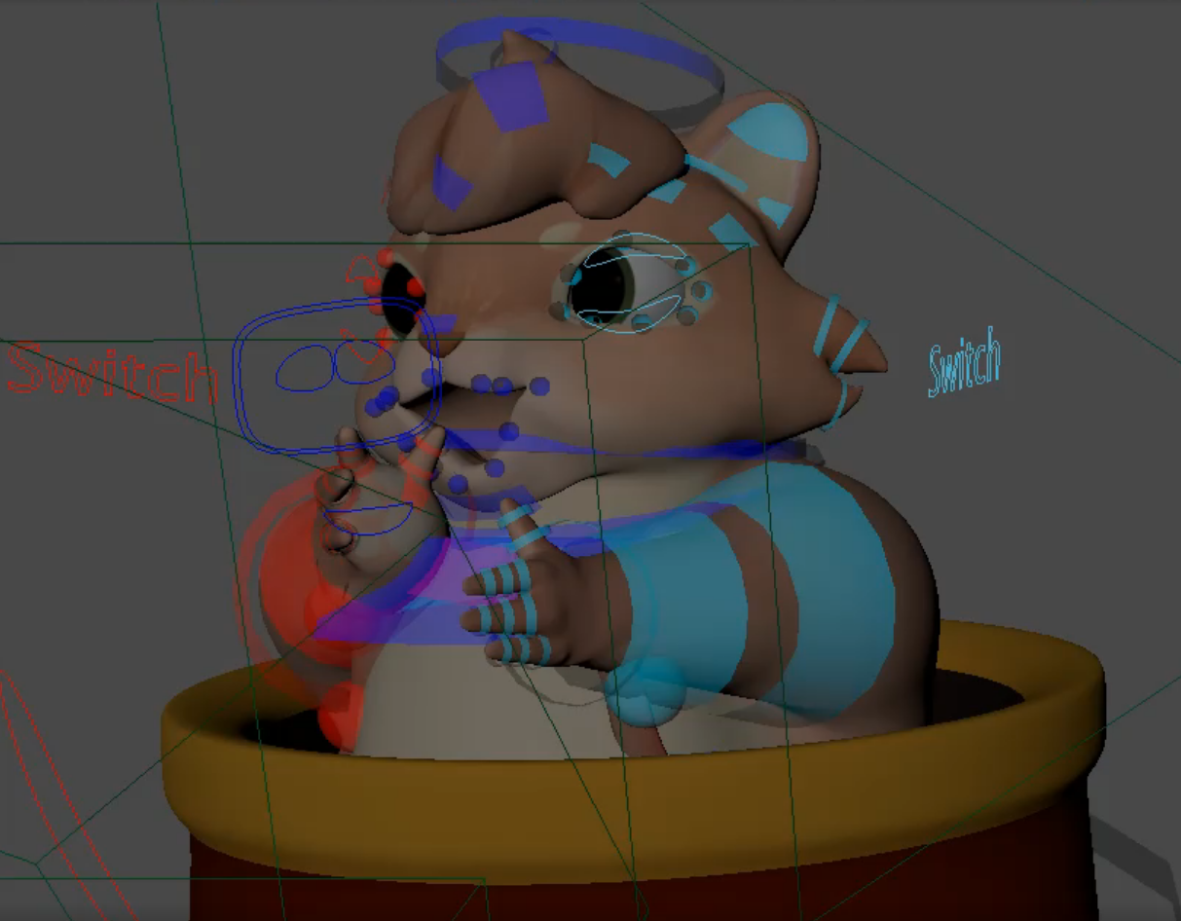
NURBS
Rebuild broken NURBS:
One Click!
Before & After:

Slide 6
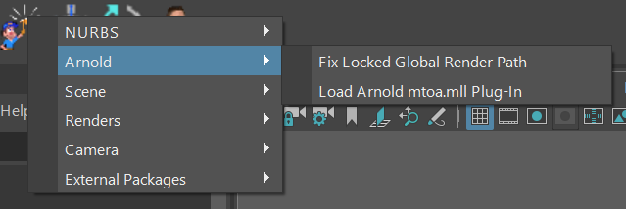
Arnold
Fix locked Global Render Path
Fix for some scenes’ render path being permanently locked to renders/defaultRenderLayer due to early buggy implementations of zoetrope. Newer scenes shouldn’t need it.
Load Arnold mtoa.mll Plug-In: Fairly straightforward.

Slide 7
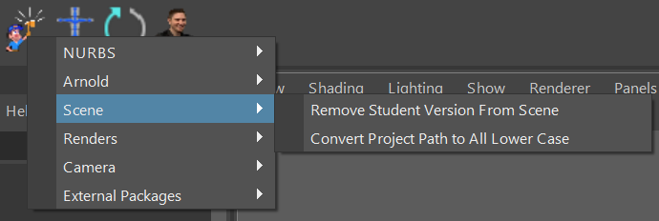
Scene
Remove Student Version From Scene:
Fairly straightforward, just follow directions.
Convert Project Path to All Lower Case:
An attempt to fix broken CSE lab file paths that throw error when sending scenes to the render farm.
Local(Windows): \\csenetid\CS\unix
Farm(Linux): \\csenetid\cs\unix\
PANIC!!!!

Slide 8
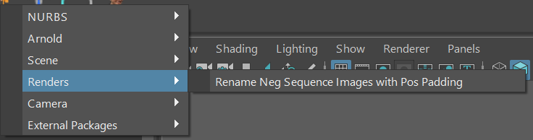
Renders
Rename Neg Images:
Rename all the frames rendered with a negative padding to a positive image sequence so After Effects/Premiere can recognize all the images rather than throwing the first 24 frames away.
Directions:
Step 1: Copy the folder where all the rendered images are stored at, paste it in the box for “Render Folder Path Override”
Step 2: Input “Rendered Scene Name” – Example: “seq_01_intro_0100”
Step 3: Change the start frame if it is not -24
Step 4: Change the end frame to whatever end frame is that scene.
Step 5: Change file format if it is not tif.
Step 6: Change padding is not 4 (0-24 -> Padding = 4)
Step 7: Hit start and done.

Slide 9
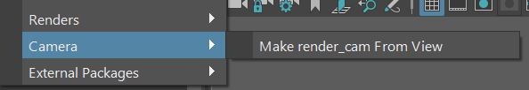
Camera
Pretty straight forward.

Slide 10
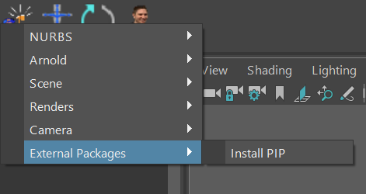
External Packages
Not working yet.

