Slide 1
Measuring Retail Store Sales Performance with SQL
Ersan Fernando Samjaya

Slide 2
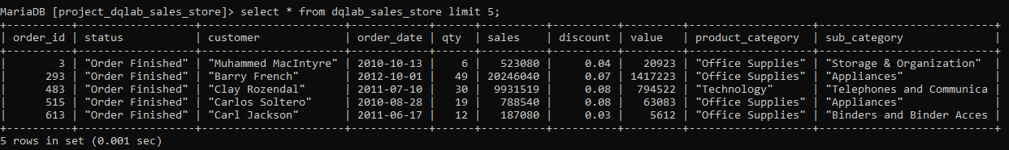
Project- Detail
The data is about dqlab sales store performance online
There 5.499 row data (all orders) with 10 columns data
The data contain customer name, sales performance, and order history from 2009-2012

Slide 3
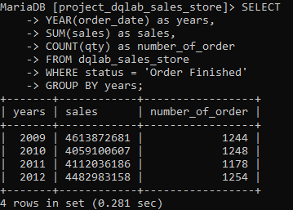
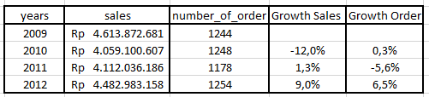
Overall Analysis
Objective: To monitor overall and key metrics in the company.
Knowing the overall performance can become a starting to dig deeper into another metrics
From the result that we have for overall performance, we can see that the growth since 2009 is not really significant. This mostly because the growth of our order is also not growth really great.
Sales in 2012 is even less than sales in 2009.
Formula for growth:
(sales 2012/ sales 2011) -1

Slide 4
Project Flowchart
By Sub Category
Burn Rate Analysis
Overall Analysis
Targeted Promotion
Based On Sales
Customer Analysis
Based On Customer
Customer Retention

Slide 5
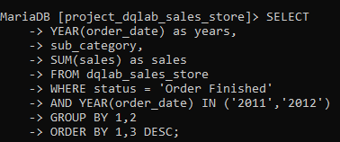
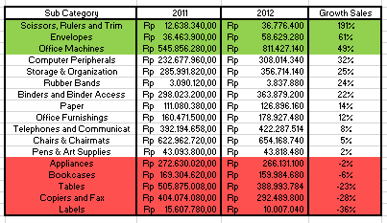
By Sub Category Product
The first step that we can use is to analyze current performance compared to past performance. In here we use 2011 and 2012 performance.
After knowing the overall performance, by subcategory we can see product category that have the best and worst performance.
This will allow business team to take an action for these category.

Slide 6
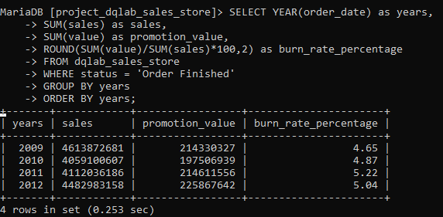
Burn Rate Analysis (1)
Objective: To know whether campaign that we have done so far is effective and efficient.
From the overall performance our hypothesis is that the campaign that we have done so far is not really effective.
By this analysis we can see there is something wrong, our burn rate is growing each year, however it doesn’t reflect into our sales.
It means that we spend so much money, but it fail to boost our sales.
Formula for Burn Rate:
(total discount/total sales)*100

Slide 7
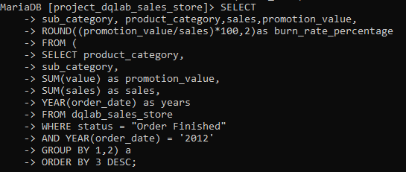
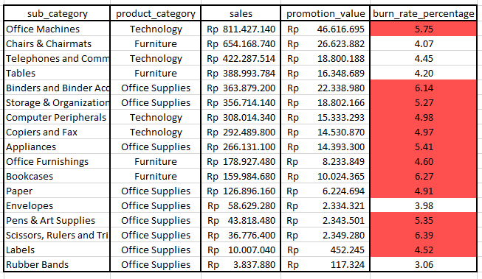
Burn Rate Analysis (2)
After seeing that our burn rate over years is keep increasing, next we want to look into the detail. Here we are using data for years 2012.
From these data, we can see the relation between money that we spent and total sales that we can generate.
Some with the highest burn rate are actually have a low sales.

Slide 8
Targeted Promotion
Let say we want to increase our sales but also keeping our burn rate low, then one way is doing targeted promotion.
Clustering customer based on their sales contribution (we can also add frequency of the transaction. This also related to minimum transaction that we can apply)
High Sales
High Trx
High Sales
Low Trx
Low Sales
High Trx
Low Sales
Low Trx
Clustering customer based on their sales’ contribution and their burn rate (This we can where we spend our money. Sometimes we spend our money but they didn’t actually bring a good sales for the store)

Slide 9
Project Flowchart
Overall Analysis
By Sub Category
Burn Rate Analysis
Targeted Promotion
Based On Sales
Customer Analysis
Based On Customer
Customer Retention

Slide 10
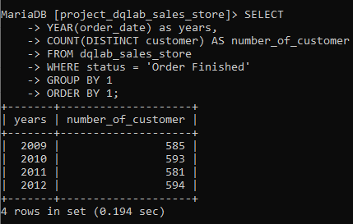
Customer Analysis
Objective: Seeing that our sales and number of order are not growing significantly, one of the hypothesis is that we don’t really get new customer or our retention rate is low.
As we can see, number of customer for each year is more or less the same.
From here we can dig deeper and do the analysis
Analyze based on new customer acquisition
Customer retention

Slide 11
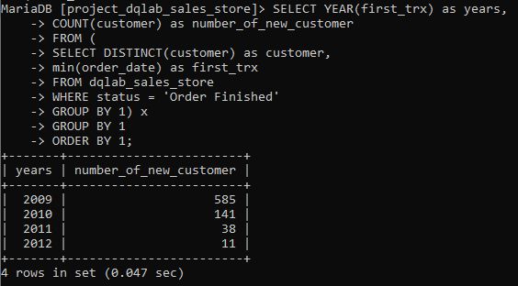
New Buyer Acquisition
Seeing that our customer is not really growing, first we will see how much new buyer that we get over the years
From the result we get that total of new customer that we get every year is decreasing significantly.

Slide 12
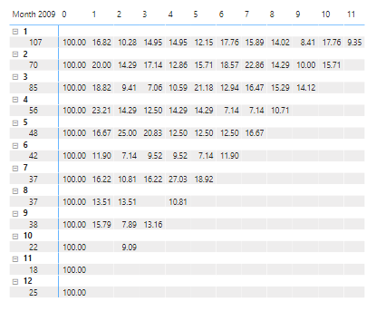
Customer Retention
To see customer retention, we usually use cohort analysis. With cohort analysis we can see how many of the customer come back and have transaction again after their first transaction.
In %

Slide 13
THANK YOU!!!

