Slide 1
Create AWS infrastructure using
Terraform

Slide 2
Demonstrate AWS
DevOps and Terraform
PIP Task - 1
By - Sandeep Kumar Patel
UST ID -213508

Slide 3
Prerequisite
Local Environment Setup
A .AWS Account
A. AWS CLI
B. Terraform .exc
C. Python
D. Tool for SSH Connection
E. Git Bash
F. VS Code Editor

Slide 4
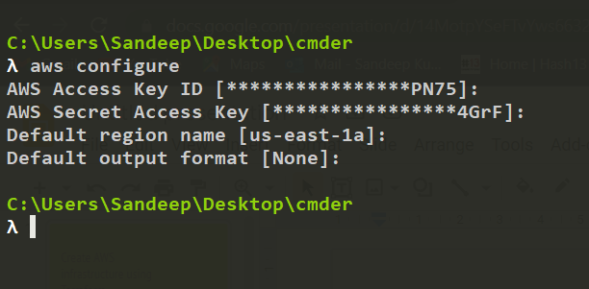
AWS Local Configure
To set up aws Access key and AWS Secret Key in local .aws profile
$ aws configure

Slide 5
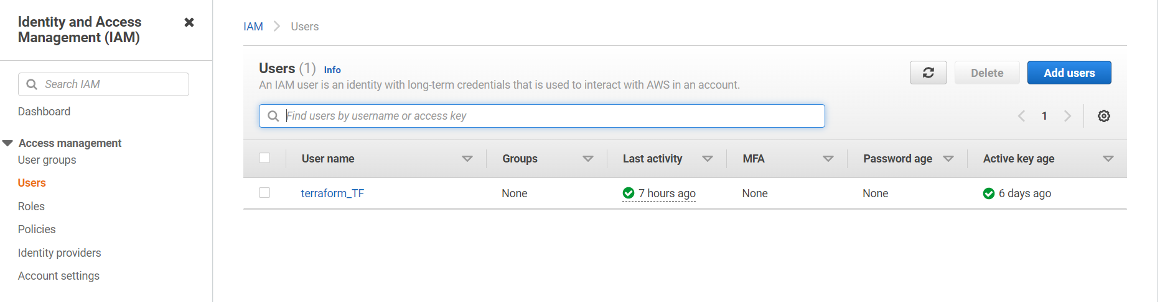
IAM User create
A.Create IAM user Name - terrafrom_TF
B. Attach policy -PowerUserAccess
C.Access key - Programmatic access

Slide 6
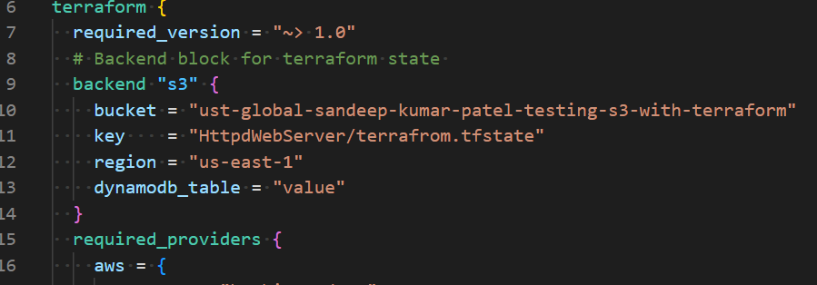
Terraform tfstate file store S3 and Dynamodb

Slide 7
List of Resources creating
Networking
VPC
Subnet
Internet Gateway
NAT Gateway
Elastic IP
Route Table
Route
2. Storage
A. EBS
B. S3

Slide 8
Continue….
3.Backup Storage
A . AWS Ebs Snapshot
4. EC2 Instance
A .AWS Instance
B.AWS Security Group
5. Null Resource
A.Local exec
B Remote exec
C.Data

Slide 9
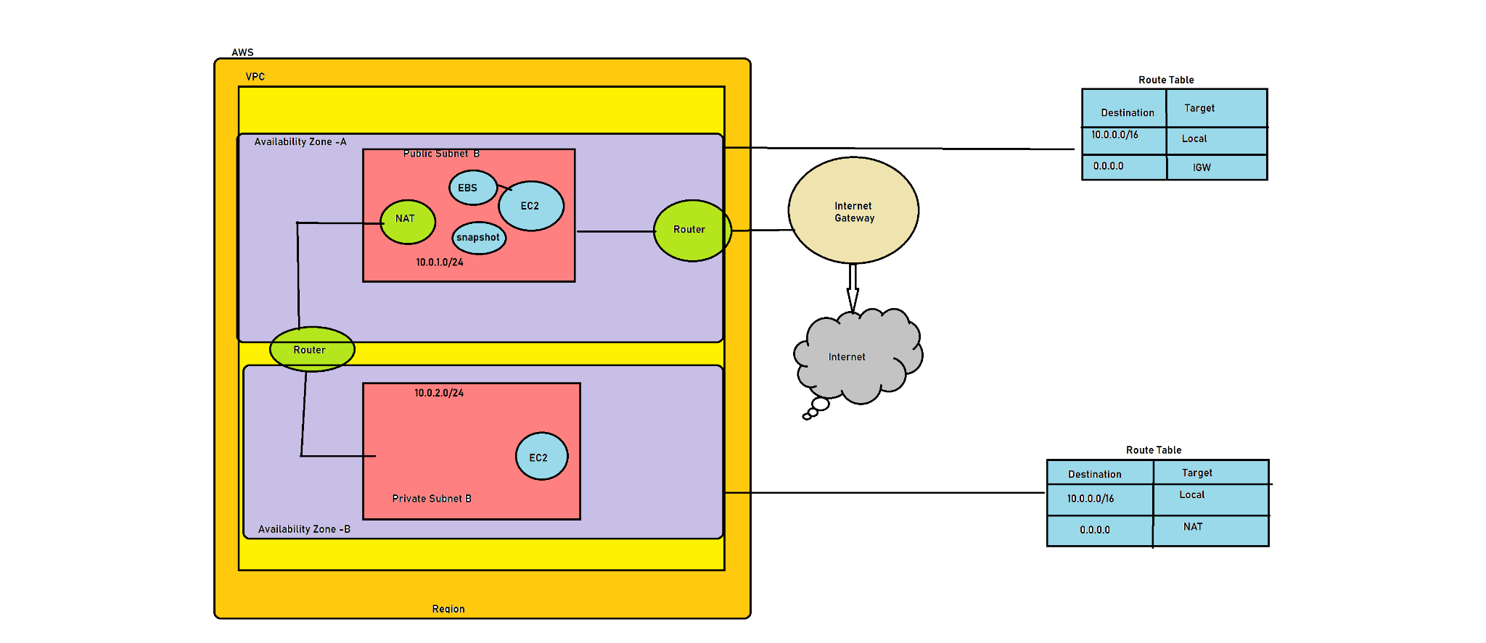
Architectural diagram

Slide 10
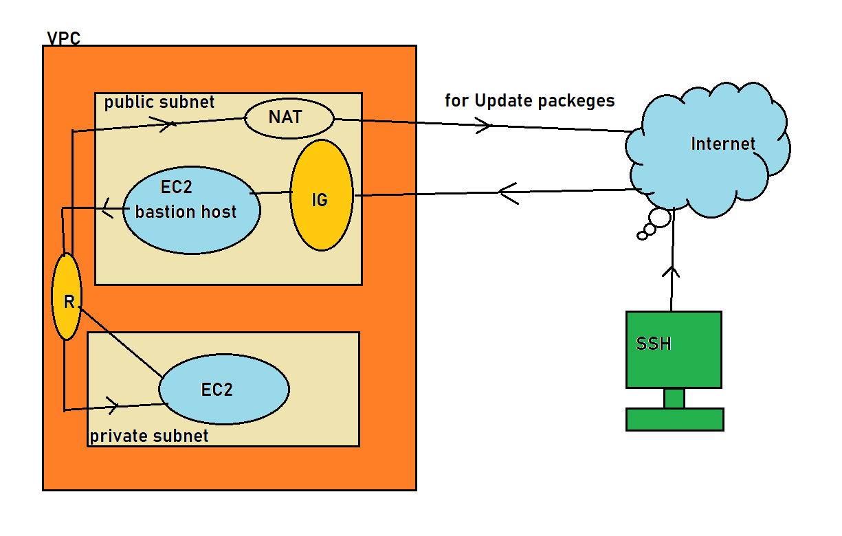
Architectural diagram jump box server(Bastion Host)

Slide 11
Terraform Command used
1. terraform init
2. terraform fmt
3. terraform validate
4. terraform plan
5. terraform apply
6. terraform destroy
7. terraform init -reconfigure

Slide 12
Terraform Command used for other env
Local env setup
A. terraform apply -auto-approve
B. terraform destroy -auto-approve
B. Test env setup
A. terraform apply -var-file=Env_Test.tfvars
C. Pro env Setup
A. terraform apply -var-file=Env_Pro.tfvars
D. Setup Both env
A. terraform apply -var-file=Env_Test.tfvars -var-file=Env_Pro.tfvars

Slide 13
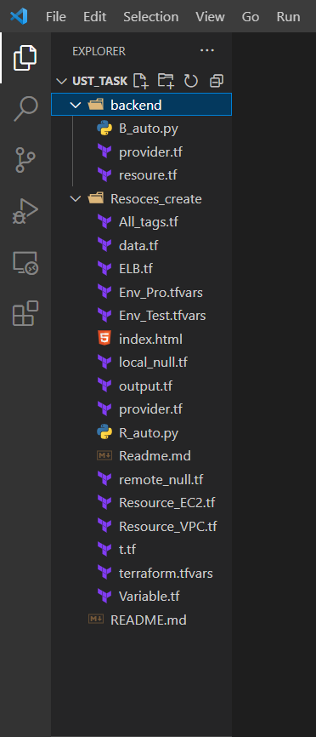
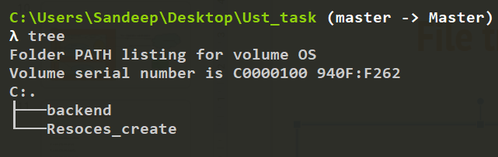
File tree

Slide 14
Action Plan

Slide 15
VPC Resources
1. Create VPC - Main VPC -Cidr-Block - ”10.0.0.0/16”
2. Create 2 Subnet
Public subnet Cidr-Block - “10.0.1.0/24”
Private subnet Cidr-Block -”10.0.2.0/24”
3. Create 2 Route Table and associate route table
4. Create aws nat gateway and update to route table
5. Create aws internet gateway and update route table
6. Create EIP and associate it IGW

Slide 16
Instances Resources
Create 3 EC2 instances
2 Httpd Web server for hosting pages
1 DB Server for DB Storage
Create EBS for Attached DB Server
Create Snapshot for backup drive

Slide 17
Null Resources
Create 3 Null Resources
Remote exec for install httpd web server
Data for the copy index page to /var/www/html path
Local exec for making inventory file to store IP for other tool like ansible other
Crate null resources for destroy time for other task

Slide 18
Other Activate
Other Activate this script we are used to create resource for dev env,test env ,
Prod env also to run below command
Local env setup
A. terraform apply -auto-approve
B. terraform destroy -auto-approve
B. Test env setup
A. terraform apply -var-file=Env_Test.tfvars
C. Pro env Setup
A. terraform apply -var-file=Env_Pro.tfvars
D. Setup Both env
A. terraform apply -var-file=Env_Test.tfvars -var-file=Env_Pro.tfvars

Slide 19
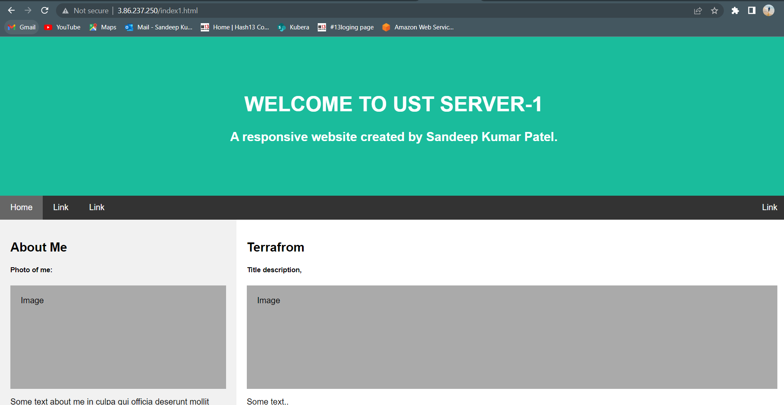
Output Server -1

Slide 20
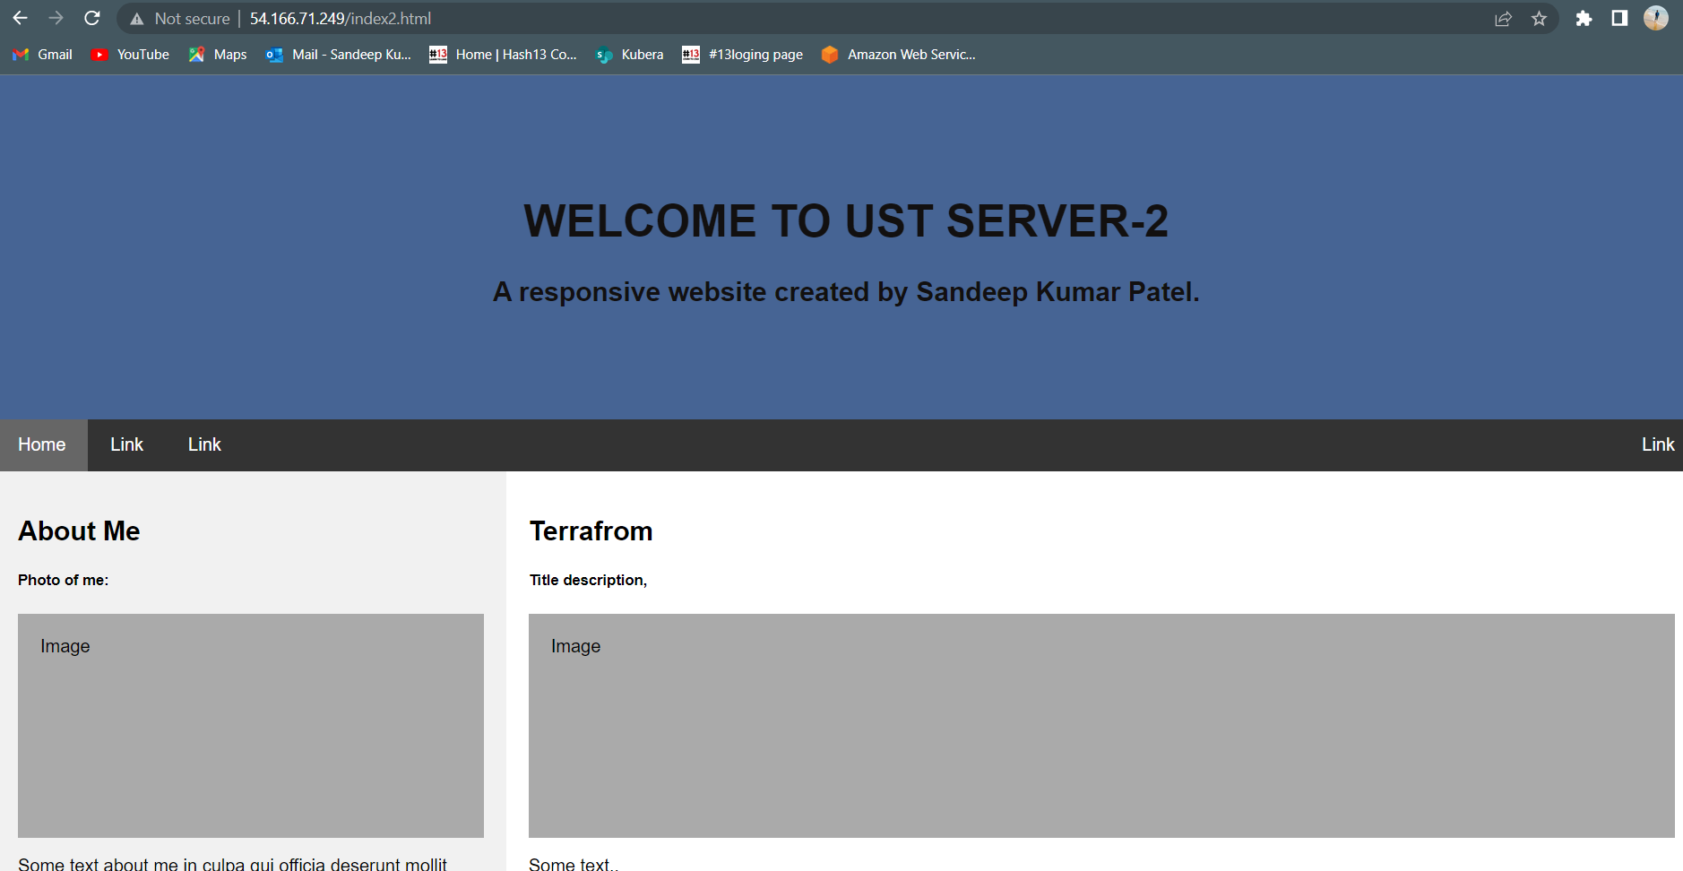
Output Server -2

Slide 21
Future Activity
In future this script modified used modul and add to based on requirement
Due to less time only this terraform.tf file create

Slide 22
Thank you for your time and ask any question ???

