Slide 1

PUBLIC SAFETY AND SECURITY
AEGIS

Slide 2
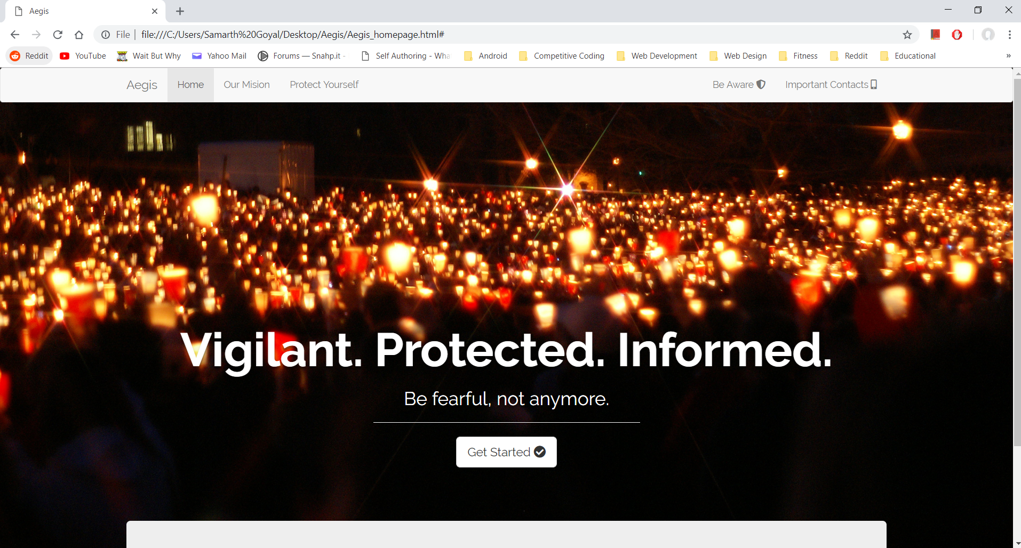
THEME/FEATURES
Aegis aims at making people responsible for their own safety in conjunction with public safety departments.
Location of all nearby hospitals, police stations, and fire departments.
Various helpline and official support contacts.
First-aid primer and self defense techniques with recommended self defense tools.
Companion app for one-tap emergency broadcast.

Slide 3
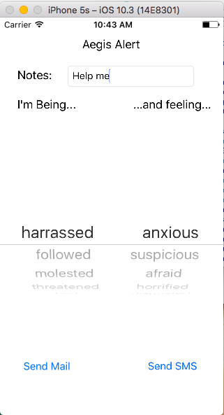
iOS Companion app
In development.
Select preset text from two picker views.
One-tap option to send mail/SMS.
Add additional notes.
Send current location (Future prospect).
Selling feature: ‘feeling’ mode highlights the level of urgency.

Slide 4

EMPOWERING THE PEOPLE
We aim to empower the public to be vigilant and informed about their own safety.

Slide 5

TOOLS AND TECHNOLOGIES USED
HTML
CSS
BOOTSTRAP
JAVASCRIPT
OBJECTIVE C (iOS)
WEB PLUGINS

Slide 6
FUTURE SCOPE/EXPANSION
Advertisements
Commitment
Self-defense tools: product placement
Hub for self-defense training centers
Android/iOS companion app with regular updates
Web-App Integration
FUTURE SCOPE/
EXPANSION
Process
Strategy
Local Implementation and Expansion
Locality based forums for reporting suspicious activities
Membership for premium features, with strategic advertisement to fund development.
Notes:
Download more templates from http://slidehunter.com/

Slide 7
THANK YOU!
EFFORTS AND CREDITS BY:
DIVYANSH SEHGAL
KARTIKEYA CHAUHAN
PARAG MITTAL
SAMARTH GOYAL
Notes:
Download more templates from http://slidehunter.com/

