Slide 1
8255 PPI
Programmable Peripheral Interface

Slide 2
Intel 8255 PPI
PPI – Programmable Peripheral Interface
It is an I/O port chip used for interfacing I/O devices with microprocessor
Very commonly used peripheral chip

Slide 3
About 8255
The 8255 is a popular interfacing component, that can interface any I/O device to a microprocessor.
It is used to interface to the keyboard and a parallel printer port in PCs (usually as part of an integrated chipset).
PPI has 24 pins for I/O that are programmable in groups of 12 pins and has three distinct modes of operation.

Slide 4
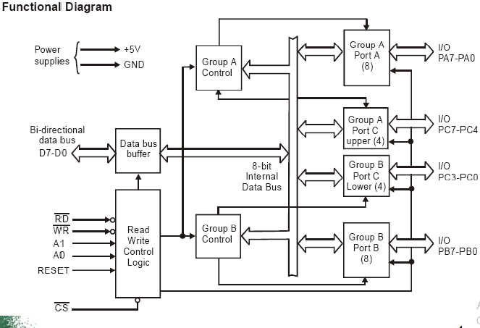

Slide 5
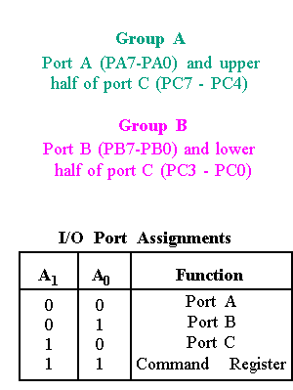
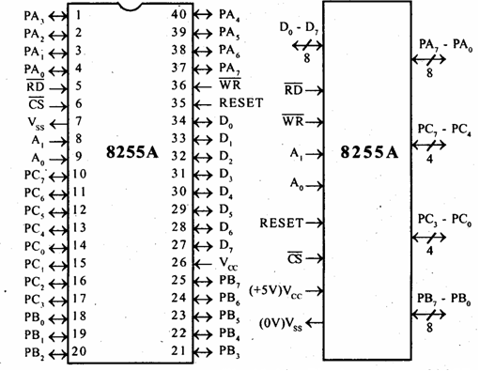
82C55 : Pin Layout

Slide 6
OPERATING MODES OF 8255PPI

Slide 7
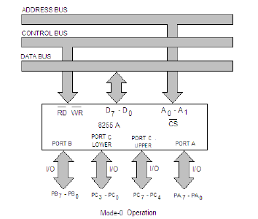
Mode 0

Slide 8
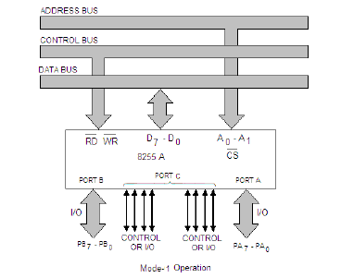
Mode 1

Slide 9
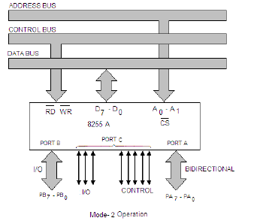
Mode 2

Slide 10
INITIALIZING THE 8255 PPI

Slide 11
Control Word
Mode definition Control Word
  Used to tell the device what modes you want to use
Bit Set/Reset Control Word
  Used when you want to set/reset the output pin of Port C
  Used when you want to enable the interrupt output signal for handshake data transfers

Slide 12
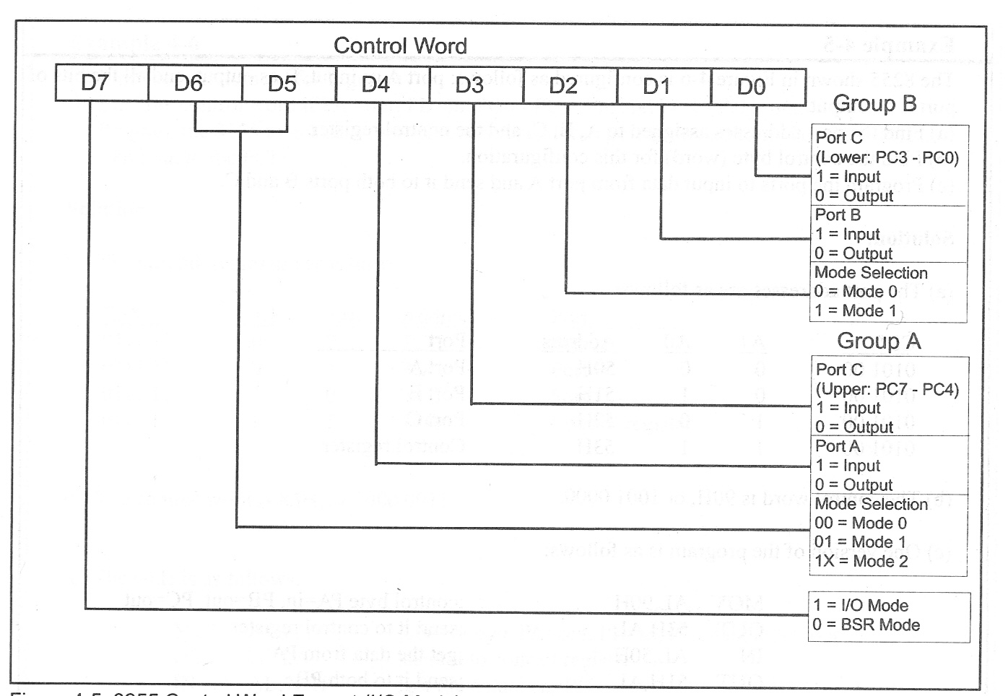
8255 Mode Set Control Word

Slide 13
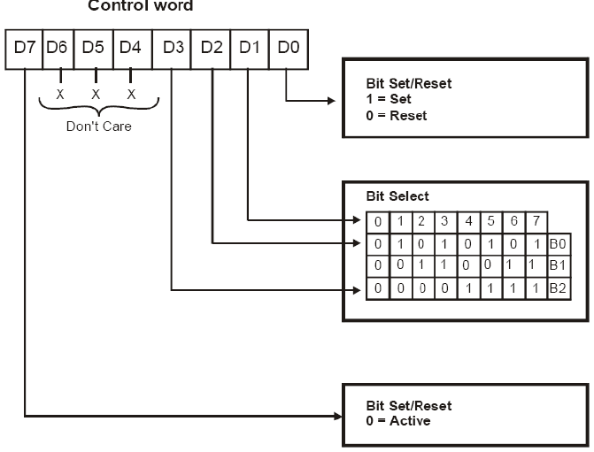
Port C Bit Set/Reset (BSR) Mode

Slide 14
Modes of operation
Modes of 8255 PPI
If D7 of control word is 0 then BSR mode
If D7 of control word is 1 then Parallel I/O mode
Parallel I/O mode
BSR Mode
(BIT SET RESET MODE)
Mode 0 Mode 1 Mode 2
Ports ABC Ports A B Port A
Port C

Slide 15
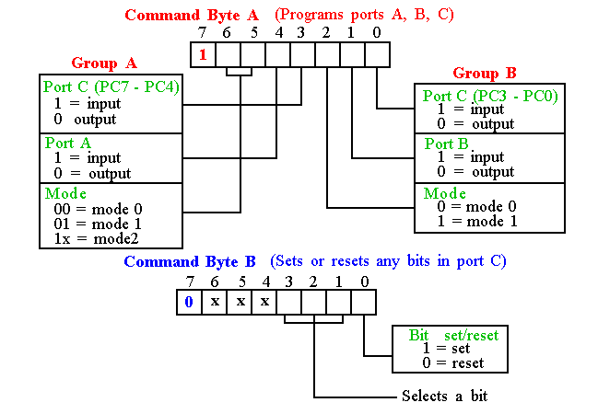
Programming 8255
8255 has three operation modes: mode 0, mode 1, and mode 2
11-<number>

Slide 16
Mode 0 (Basic Input/Output)
This functional configuration provides simple input and output operations for each of the three ports.
Data can be read or write by setting CWR respective bits
No “handshaking” is required, data is simply written to or read from a specified port.
16 different input/output configurations are available

Slide 17
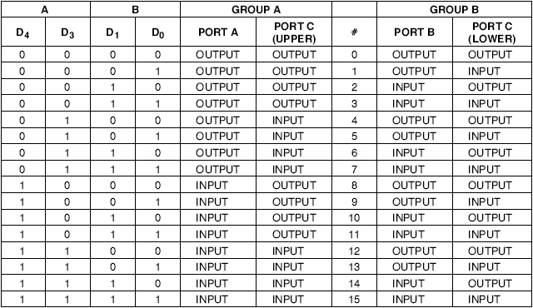
Mode 0 Port definition

Slide 18
Continued..
For example :
If D4 D3 D1 D0 =1010, then
PA=Input
PC up = output
PB = input
PC low = output

Slide 19
MODE 1 (Strobed Input/Output)
This functional configuration provides a means for transferring I/O data to or from a specified port in conjunction with strobes or “handshaking” signals.
In mode 1, Port A and Port B use the lines on Port C to generate or accept these “handshaking” signals

Slide 20
Continued…
Handshake signals used to give information to device
When an external device want to send data to 8086 via 8255 PPI, it will send data to 8255 and inform to it.
And 8255 generate a signal to indicate data present within 8255 called handshaking signal
When 8086 gets this signal , it will read data from 8255 port and get ready to accept new data

Slide 21
Mode 1 Basic functional Definitions
Two Groups (Group A and Group B).
Each group contains one 8-bit data port and one 4-bit control/data port.
The 8-bit data port can be either input or output Both inputs and outputs
The 4-bit port is used for control and status of the 8-bit data port.

Slide 22
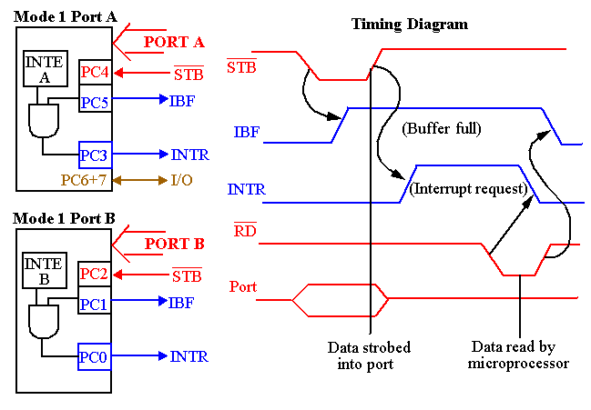
82C55: Mode 1 Strobed Input
Interrupt Enable
Input Buffer full
Interrupt Request
Signal definitions for Mode 1 Strobe Input

Slide 23
8255: Mode 2 Bi-directional Operation
This functional configuration provides a means for communicating with a peripheral device or structure on a single 8-bit bus for both transmitting and receiving data (bidirectional bus I/O).
“Handshaking” signals are provided to maintain proper bus flow discipline in a similar manner to MODE 1.
Interrupt generation and enable/disable functions are also available.

Slide 24
MODE 2 Basic Functional Definitions:
Used in Group A only.
One 8-bit, bi-directional bus port (Port A) and a 5-bit control port (Port C).
Both inputs and outputs are latched.
The 5-bit control port (Port C) is used for control and status for the 8-bit, bi-directional bus port (Port A).

Slide 25
82C55: Mode 2 Bi-directional Operation
INTR : Interrupt request is an output that requests an interrupt.
~OBF : Output Buffer Full is an output indicating that that output buffer contains data for the bi-directional bus.
~ACK : Acknowledge is an acknowledgement from 8255.
~STB : The strobe input loads data into the port A latch.

Slide 26
82C55: Mode 2 Bi-directional Operation
IBF : Input buffer full is an output indicating that the input latch contains information for the external bi-directional bus.
INTE : Interrupt enable are internal bits that enable the INTR pin. BIT PC6(INTE1) and PC4(INTE2).
PC2,PC1,PC0 : These port C pins are general-purpose I/O pins that are available for any purpose.

Slide 27
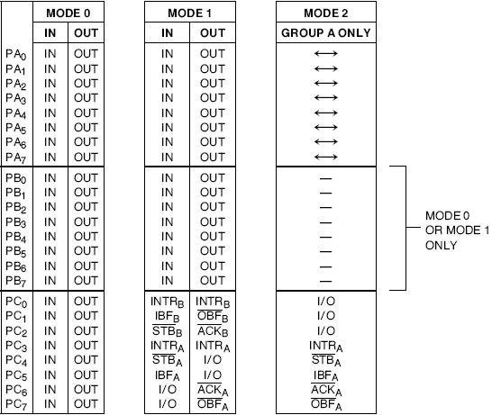
Mode definition summary

Slide 28
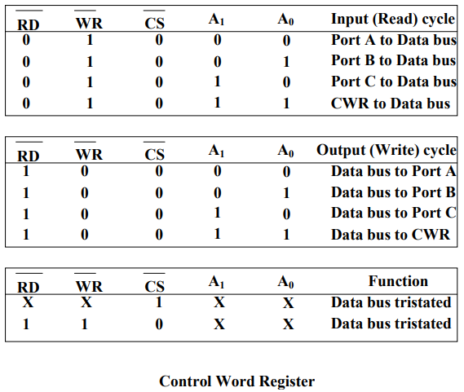
Let’s evaluate

Slide 29
Q&A
Write a set of instructions to set bit 4 of Port C. Assume the address of Port A is 10H.
Find the control word if PA = out, PB = in, PC0- PC3 = in, and PC4 - PC7 = out.
Write a program that gets data from port address 300H and sends it to port address 302H.

Slide 30
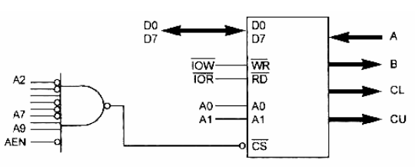
The 8255 shown in Figure is configured as follows: port A as input, B as output, and all the bits of port C as output.
(a) Find the port addresses assigned to A, B, C, and the control register.
(b) Find the control byte (word) for this configuration.

Slide 31
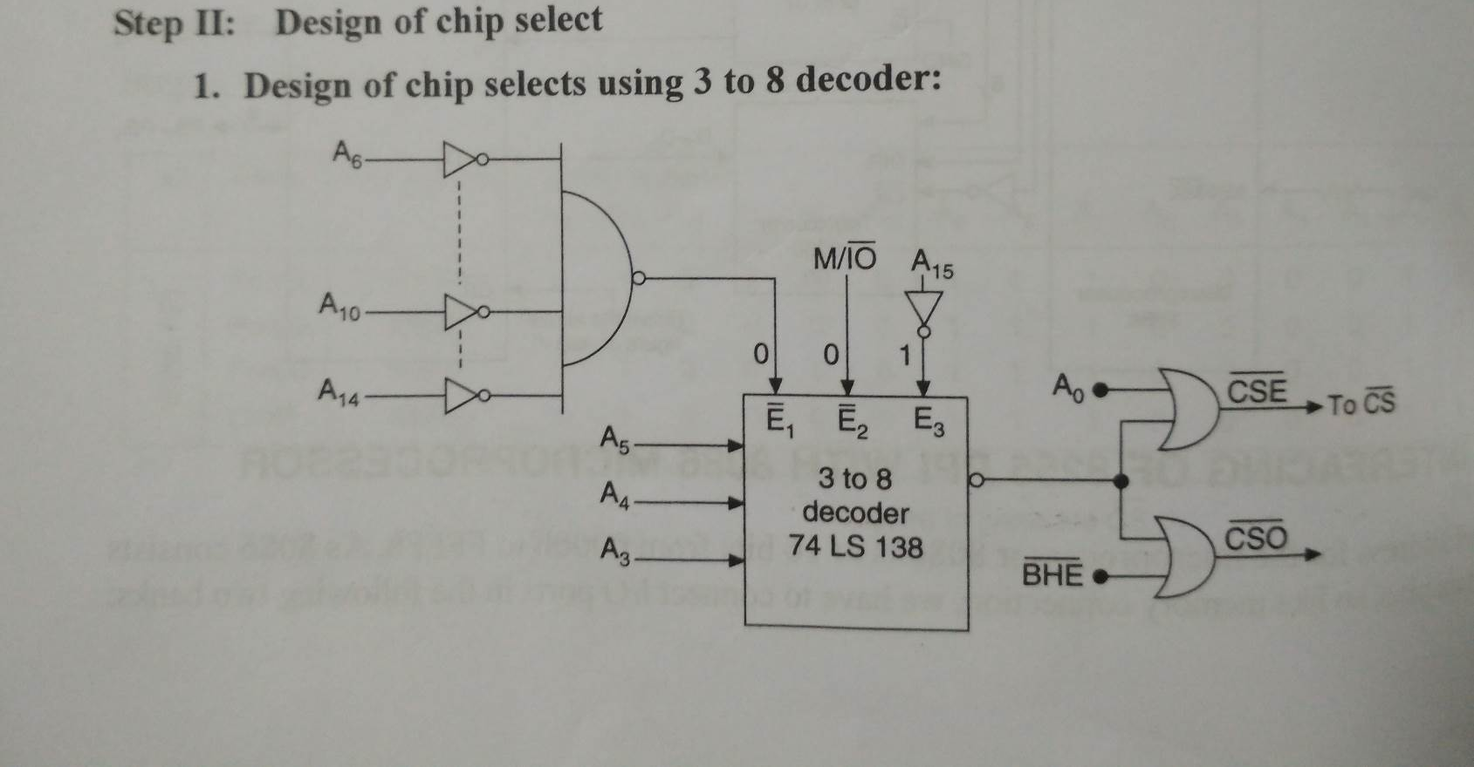
Interfacing 8255 with 8086

Slide 32
