Slide 1
🔒
Privacy-First Travel Platform
Affordable Adventures. Your Data Stays Yours.
Erson Kice | Capstone Project
GitHub: github.com/ErsonAus/Capstone

Slide 2
The Problem
Why does this project exist?
Current State
Desired State
• Booking.com, MakeMyTrip & others harvest user data aggressively
• Data used for targeted ads & personalised (inflated) pricing
• Cybernews confirmed apps collect far more data than necessary
• Users have little transparency or control over their information
• Travel costs continue to rise — affordability is a growing issue
• Full user control over personal data
• Transparent, plain-language privacy policies
• Competitive pricing with no data exploitation
• Accessible to all ages and technical abilities
• No equivalent platform currently exists in the market

Slide 3
Industry & Domain
Travel Technology × Data Privacy
Industry
Value Chain
Online travel booking platforms at the intersection of travel and data privacy.
Revenue via commissions, ads & subscriptions — this platform uses a privacy-safe subscription model.
Key Differentiator
Wider Relevance
Trust. Users return because their data is safe, not because of lock-in or dark patterns.
Privacy-first model applies to accommodation, transport, finance & digital inclusion initiatives.

Slide 4
Stakeholders
Who is this built for?
Primary Users — Travellers
Core Promise
• Internet-enabled travellers of all ages
• Young independent travellers seeking affordable options
• Older users booking family holidays
• Anyone wanting privacy without sacrificing ease-of-use
"Great prices,
easy to use,
and your data
stays yours."
Secondary Stakeholders — Service Providers & Advocates
• Airlines, hotels, and car hire companies listed on the platform
• Privacy advocates who may promote or endorse the service
• Benefit: access to a growing audience of privacy-conscious consumers
• Straightforward booking
• No data sold without consent
• All ages & abilities

Slide 5
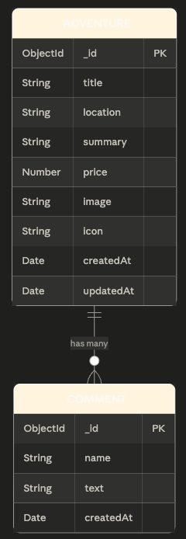
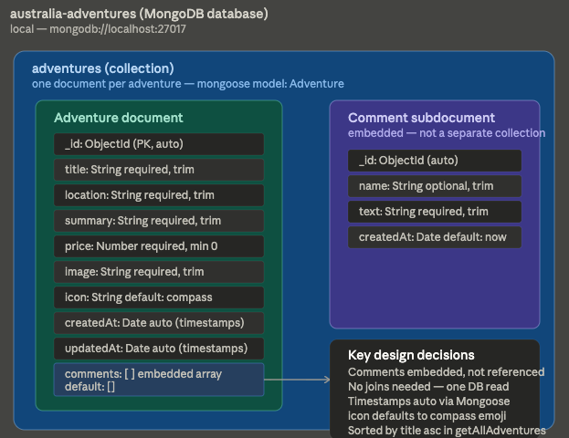
Data Structure
Current State
Desired State
• Booking.com, MakeMyTrip & others harvest user data aggressively
• Data used for targeted ads & personalised (inflated) pricing
• Cybernews confirmed apps collect far more data than necessary
• Users have little transparency or control over their information
• Travel costs continue to rise — affordability is a growing issue
• Full user control over personal data
• Transparent, plain-language privacy policies
• Competitive pricing with no data exploitation
• Accessible to all ages and technical abilities
• No equivalent platform currently exists in the market

Slide 6
User Stories
What users need to do
#
Story
Description
Priority
1
Privacy
Book holidays in a private, secure environment
High
2
Feedback
Leave feedback on holidays
High
3
Watch Videos
View other people's holiday videos if posted
Low
4
Create Account
Create an account to book holidays
Low
5
Add Adventure
Add an adventure for my holiday
High
6
List Holidays
See a list of available adventures
High
7
Edit Adventure
Edit booked adventures
High
8
Delete Adventure
Delete an adventure
High

Slide 7
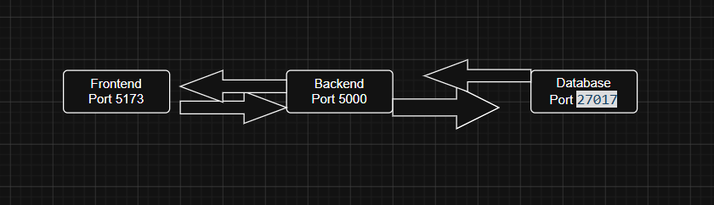
Architecture Diagram
System design overview
[ Insert Architecture Diagram Here ]
React Frontend → Express/Node.js API → MongoDB Database

Slide 8
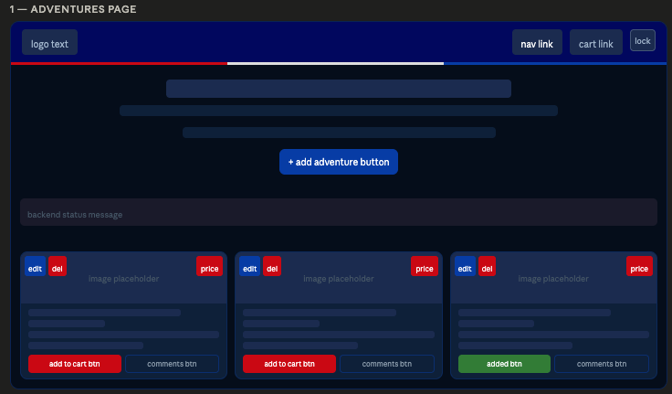
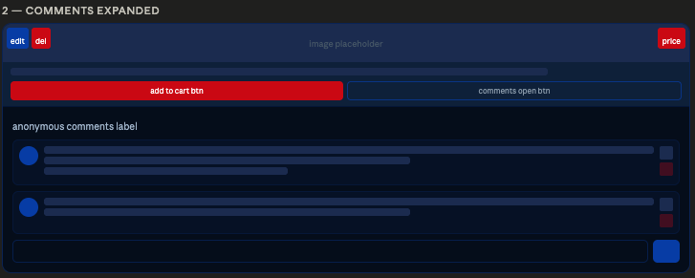
Wireframe Design
UI/UX — Figma
[ Insert Figma Wireframe Screenshot Here ]
Export from Figma: File → Export → PNG, then insert image above

Slide 9
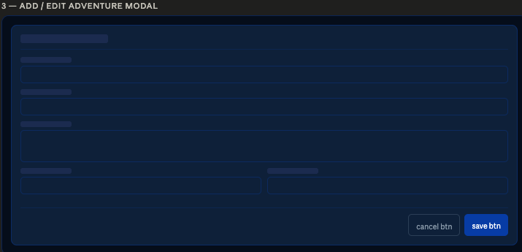

Wireframe Design
UI/UX — Figma
[ Insert Figma Wireframe Screenshot Here ]
Export from Figma: File → Export → PNG, then insert image above

Slide 10
Wireframe Design
UI/UX — Figma
[ Insert Figma Wireframe Screenshot Here ]
Export from Figma: File → Export → PNG, then insert image above

Slide 11
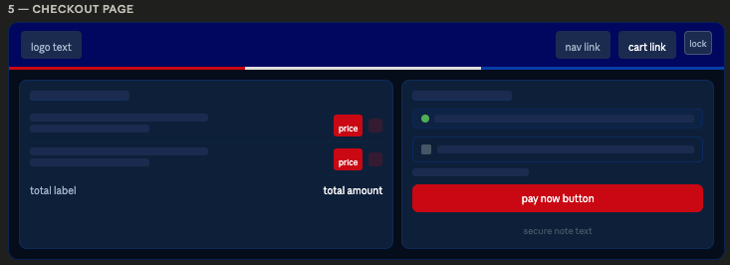
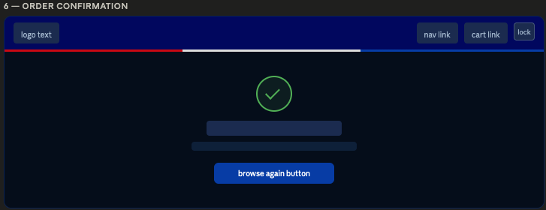
Wireframe Design
UI/UX — Figma
[ Insert Figma Wireframe Screenshot Here ]
Export from Figma: File → Export → PNG, then insert image above

Slide 12
Non-Functional Requirements
Performance, security & reliability
⚡ Performance
🔒 Security
Response as fast as possible
1,000 transactions per second at peak load
Secure login, encrypted personal data
Privacy-first data handling throughout
♿ Usability
🔧 Reliability
Easy to use for all ages
Intuitive interface requiring no technical expertise
100% uptime target, 24/7
Max 1 hour between failure recovery

Slide 13
Project Planning
10-day development sprint using GitHub
Mon 12
Tue 13
Wed 14
Thu 15
Fri 16
Sat 17
Sun 18
Mon 19
Tue 20
Wed 21
Research
Documentation
Backend
Backend Testing
Frontend
Frontend Testing
Database
DB Testing
Presentation
Final Testing
Researched existing travel platforms & project direction
Started project documentation
Built backend with JavaScript using MVC architecture
Tested backend, identified and fixed errors
Built React frontend
Tested frontend, fixed errors
Set up MongoDB database
Tested database, fixed errors
Created presentation
End-to-end testing of website & presentation

Slide 14
Testing Strategy
Jest & Thunder Client
Tools & Approach
Quality Assurance
• Jest — Unit, integration and automated testing
• Thunder Client — API endpoint testing
• Manual testing by hand across all features
• Code tested before each new feature added
• Comments added throughout for clarity
• Extensive research into existing travel platforms
• Each feature tested with principal software tools
• Edge cases handled by testing incrementally
• Code reviewed for readability with inline comments
• End-to-end testing on final day (Wed 21)

Slide 15
Implementation
Tech stack, deployment & outcome
Tech Stack
End-to-End Outcome
• Frontend: React.js with MUI components
• Backend: Node.js / Express.js (MVC pattern)
• Database: MongoDB
• Version Control: GitHub
• Testing: Jest + Thunder Client
• Deployment: Local (AWS EC2 + Docker out of scope)
The website is fully functional — helping users discover and book adventures while keeping their data private.
Out of Scope
• Adventure images/videos
• Other users' public feedback
• AWS EC2 / Docker deployment
• Dynamic low-price guarantees

Slide 16
Thank You
Privacy-First Travel Platform — Capstone Project
References & Resources
• GitHub Repository: github.com/ErsonAus/Capstone
• Libraries: React, MUI, Express.js, Mongoose, Jest, Nodemailer
• Database: MongoDB
• Tools: Thunder Client, GitHub, Figma
• Research: Cybernews travel app privacy investigation
Erson Kice | Capstone Project

