Slide 1

DSA210 TERM PROJECT
Ertuğrul Soydal
32175

Slide 2
What Is The Aim Of The Project?
As a university student, after lots of exam period, I have realized some significant changes in my life when exam dates are coming.Therefore; I want to look deeper to these changes. This project aims to analyze the correlation between sleep patterns, eating habits,study hour and exam dates based on my personal data.

Slide 3
What Is In The Dataset?
Date: Date of The Given Day
Wake-up Time: Waking up time in the given day
Sleeping Time: Sleeping time in the given day
Sleep Duration: Longness of the sleep (minute) in the given day
Number of Meal: Eaten meal number in the given day
Coffee Intake: Total drinking coffee in the given day (Small Size=1, Medium Size=2, Large Size=3)
Study Time: How long studied (minute) in the given day
Lecture Name and Exam Date: Lecture name(s) and closest exam date(s)

Slide 4
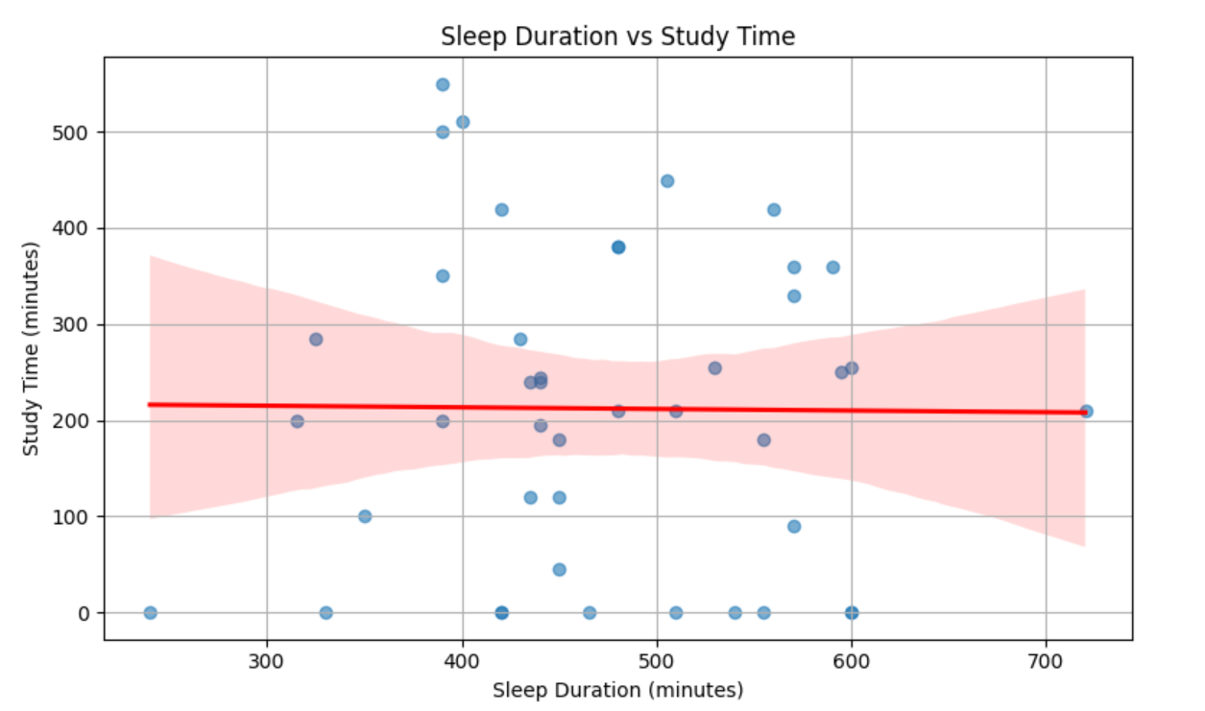
SLEEP DURATION VS STUDY TIME

Slide 5
Question: Does sleep duration significantly correlate with study time?
H₀: There is no significant correlation between sleep duration and study time.
H₁: There is a significant correlation between sleep duration and study time.

Slide 6
Pearson Correlation Hypothesis Test (95% Confidence Interval)
Pearson Correlation Coefficient: −0.010
P-value: 0.9495
Conclusion: Fail to reject H₀ → There is no significant correlation between sleep duration and study time.

Slide 7
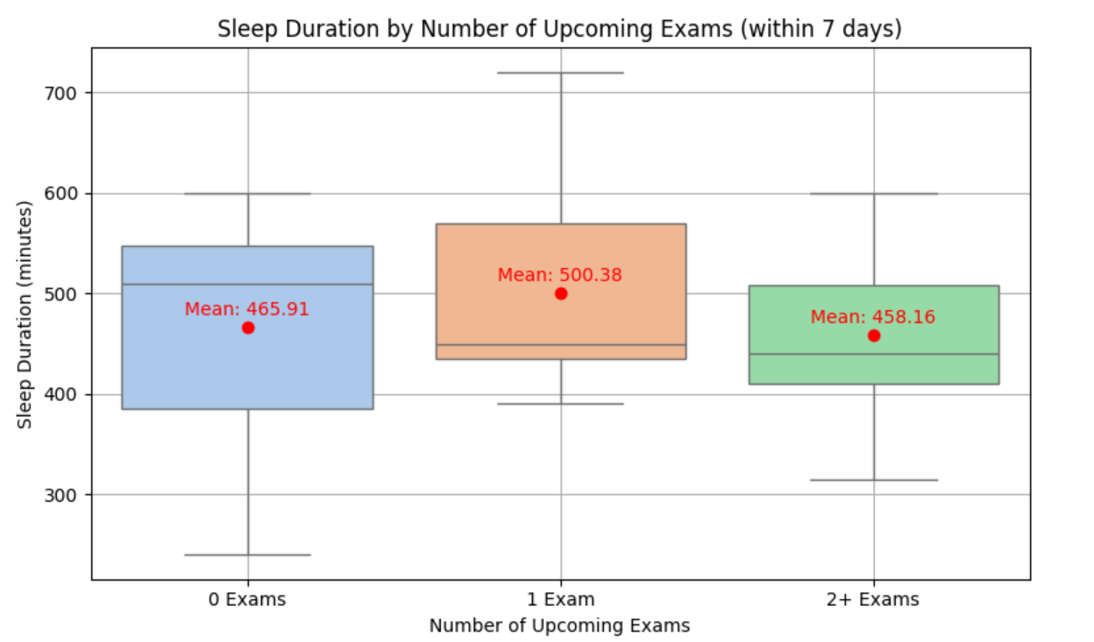
SLEEP DURATION VS UPCOMING EXAMS (IN 7 DAYS)

Slide 8
Question: Does number of exams in 7 days affect sleep duration?
H₀: There is no significant difference in average sleep duration between students with 0, 1, or 2+ upcoming exams.
H₁: At least one group differs significantly in average sleep duration.

Slide 9
One-Way ANOVA Hypothesis Test (95% Confidence Interval)
F-statistic: 0.779
P-value: 0.4658
Conclusion: Fail to reject H₀ → No significant difference in sleep duration between groups (0, 1, or 2+ upcoming exams).

Slide 10
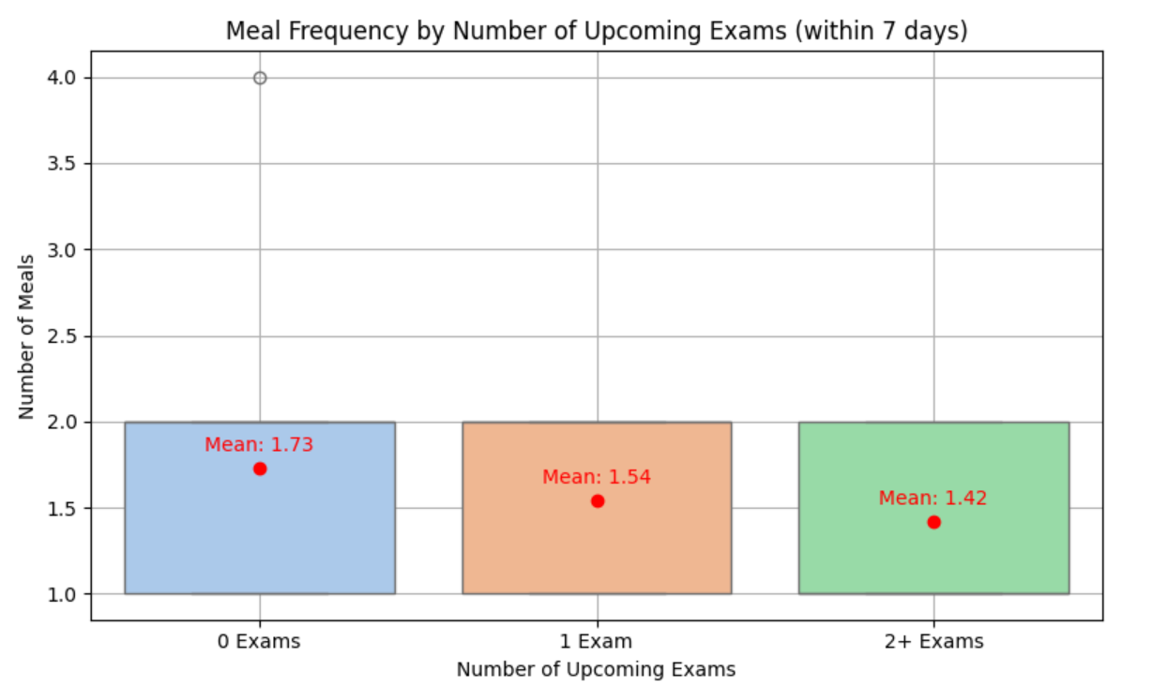
EATING HABITS VS UPCOMING EXAMS (IN 7 DAYS)

Slide 11
Question: Does the number of upcoming exams affect eating habits?
H₀: There is no significant difference in the number of meals among students with 0, 1, or 2+ upcoming exams.
H₁: At least one group differs significantly in the number of meals.

Slide 12
One-Way ANOVA Hypothesis Test (95%Confidence Interval)
F-statistic: 0.815
P-value: 0.4500
Conclusion: Fail to reject H₀ → No significant difference in eating habits between groups (0, 1, or 2+ upcoming exams).

Slide 13
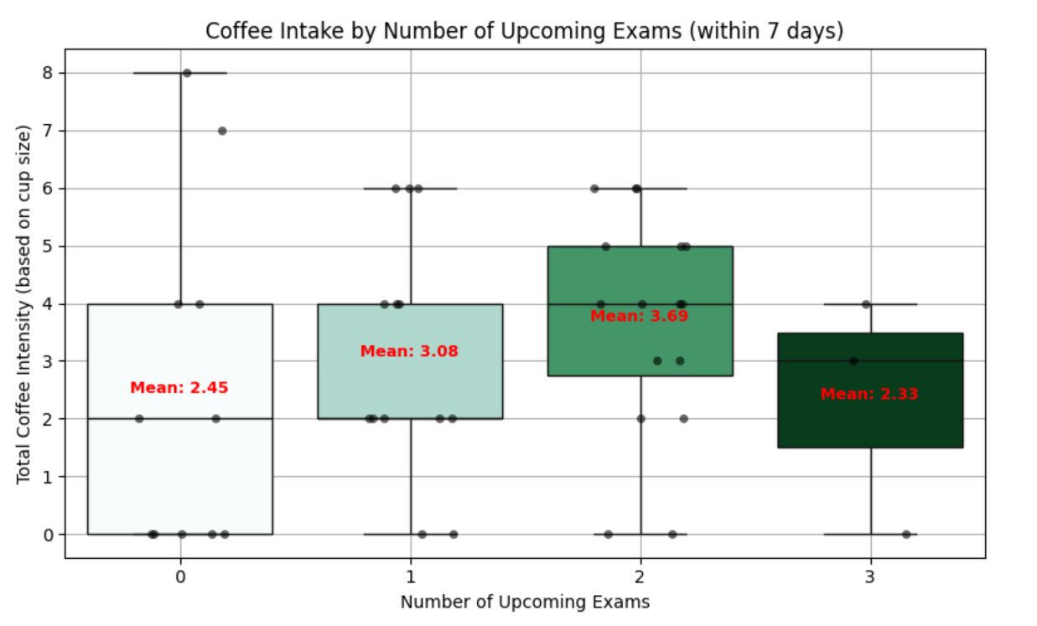
COFFEE INTAKE VS UPCOMING EXAMS (IN 7 DAYS)

Slide 14
Question: Does coffee intake significantly change depending on number of upcoming exams?
H₀: There is no significant correlation between number of upcoming exams and coffee intake.
H₁: There is a significant correlation between number of upcoming exams and coffee intake.

Slide 15
Pearson Correlation Hypothesis Test (95% Confidence Interval)
Pearson Correlation: 0.136
P-value: 0.3860
Conclusion: Fail to reject H₀ → No significant relationship between number of upcoming exams and coffee intake.

Slide 16
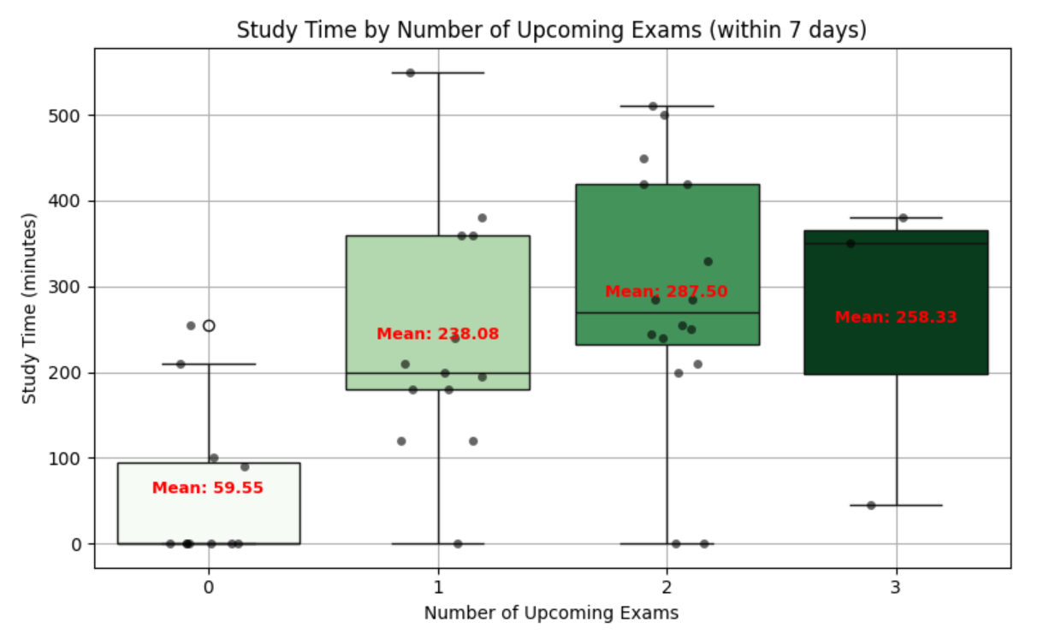
STUDYING HOURS VS NUMBER OF UPCOMING EXAMS (IN 7 DAYS)

Slide 17
Question: How much is the change in the studying hour depending on the active exams (within 7 days)?
H₀: There is no significant difference in average study time across groups.
H₁: At least one group differs significantly.

Slide 18
One-Way ANOVA Hypothesis Test (95%Confidence Interval)
F-statistic: 9.662
P-value: 0.0004
Conclusion: Reject H₀ → Number of upcoming exams significantly affects study time.

Slide 19
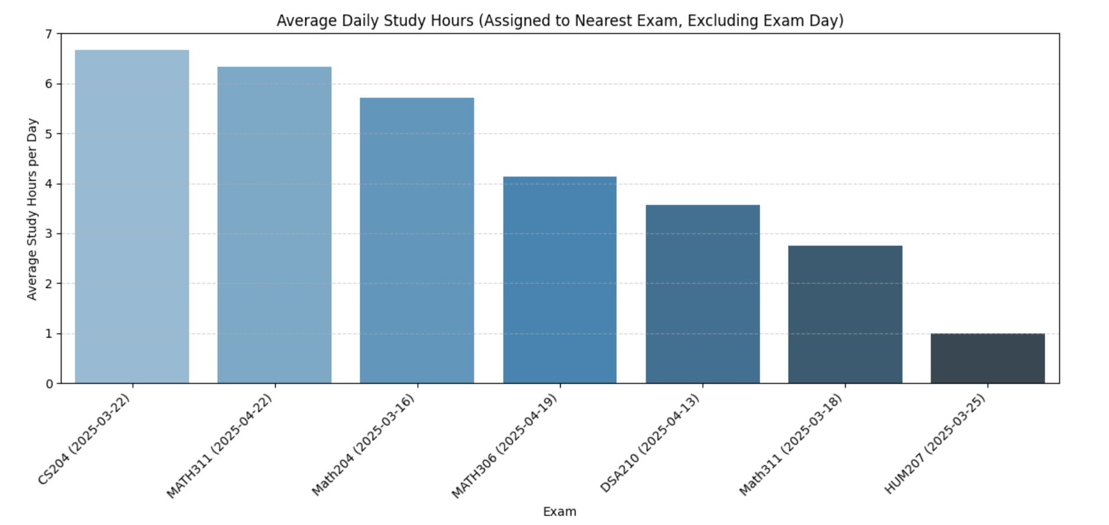
LECTURE NAME VS DAİLY AVERAGE STUDY HOUR

Slide 20
Question: Which exam affects studying hours most (based on average daily study hours)?
This question is answered by comparing the average daily study time associated with each exam (excluding exam days).

Slide 21
Comparison Based On Average Daily Study
Top 3 Exams with Highest Average Daily Study:
CS204 (2025-03-22):
→ Average Daily Study: 6.67 hrs/day
MATH311 (2025-04-22):
→ Average Daily Study: 6.33 hrs/day
Math204 (2025-03-16):
→ Average Daily Study: 5.71 hrs/day

Slide 22
Final Notes About The Presentation
The data is collected by Ertuğrul Soydal.
The designs and test parameters are decided by Ertuğrul Soydal.
Using appropriate test method and interpreting the results are also done by Ertuğrul Soydal.
In the visualization and hypothesis testing part, Chat-GPT assistance has taken in order to make visualization clearer and make test results more understandable.
This explanation is included to avoid any potential academic dishonesty.

