Slide 1
INFLUENCE OF EDUCATION
ON
FIREARM MORTALITY
Eru Poudel
MSc Computer Science and Technology – Ulster University
Module: COM745 Big Data And Infrastructure

Slide 2
Problem Statement
Seriousness of the firearm Mortality
Overlooked Factor
Firearm mortality remain a significant public health concern [1].
In the USA especially, gun death rates have affected the public health challenges [1].
However, research and public discourse have overlooked how educational attainment influences gun mortality risk.
Most existing studies focus on race, age, rurality and gun ownership rates [2].
Education level is rarely treated as the major factor [2].
Gap In the analysis
Recent links
According to Jha et. al. [3], the contribution of education to firearm mortality has yet to be studied although variations in education has been registered previously
Hamilton and Kposowa [4] found that higher education levels are associated with lower rates of firearm suicide and total gun deaths.

Slide 3
ABOUT DATASET
To address the lack of focus on education in gun death research and to directly compare education with firearm deaths, the dataset “Gun Deaths in America- CDC” [5] was used.
Following are the reasons for choosing the dataset:
Reasons | Description
Availability | Dataset is publicly available on Kaggle.
Cost | Free to access and use.
Domain Relevance | Covers Education and Firearm Mortality which facilitates a direct link between them.
Comparability | Allows direct comparison with previous studies that claims education level also affects firearm mortality rate.
Data Quality | Sourced from the CDC, ensuring high credibility.

Slide 4
DATASET PROPERTIES
Information about gun-related deaths in the United States.
Total number of rows: 100798
Total number of columns: 9
ATTRIBUTES:
INTENT OF DEATH:
EDUCATION LEVEL
Year of Death
Month of Death
Intent
Police Involvement
Gender Of The Victim
Age Of The Victim
Race Of The Victim
Place Of Shooting
Education Level
Suicide
Homicide
Accidental
Undetermined
Less Than High School
High School/General Educational Development
Some College
BA+

Slide 5
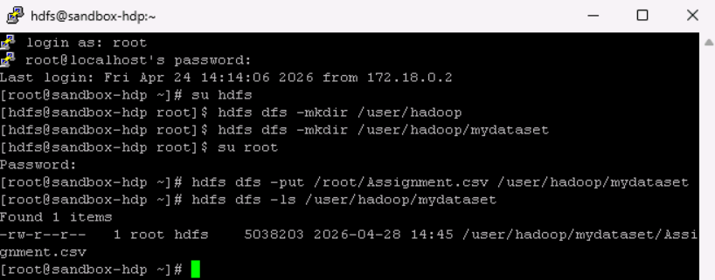
METHODOLOGY
Data Source:
Kaggle
CSV Dataset
HDFS Ingestion:
Hdfs dfs –put /user/Hadoop/mydataset
Hive:
Create Database
Create Table
HiveQL Analysis:
COUNT(*)
GROUP BY
WHERE IN
Visualization:
Apache Zeppelin
Graph Chart
Line Chart
Download Dataset from Kaggle
Upload CSV file to HDFS using PuTTY
Create Hive Database and Table
Execute HiveQL Queries
Visualize in Apache Zeppelin
Analyze Education Levels Against Firearm Mortality Rates
Fig. 1: Uploading dataset to HDFS using PuTTY

Slide 6
STORAGE LAYER (HDFS)
Dataset uploaded from local machine to Hadoop Distributed File System using PuTTY.
Copied the dataset from local machine using the path of the file.
Created directory as in Figure 1. to add the dataset in HDFS.
PuTTY is a free open-source terminal emulator and SSH client [6]. It was used to:
Connect to Hadoop environment.
Upload the dataset into HDFS.
Run Hive queries from command line.
Hadoop Distributed File System?
Hadoop Over Other Systems
HDFS is a distributed storage system that stores very large datasets across multiple machines and ensures high data access speed [7].
HDFS was used for its:
High Throughput: Optimized for batch processing jobs.
Scalability: Stores large volumes of data across distributed nodes.
Fault Tolerance: Data is replicated across nodes. Facilitates reliability in case of failures.
Ecosystem Integration: Easily integrates with Hive, which was used for querying and processing.
Not Schema Based: Data of any type can be stored.
GlusterFS: Works better as a general-purpose file server than dedicated storage layer in Hadoop.
QFS: Less commonly used and has smaller ecosystem than HDFS.
CephFS: Adds more complexity as it requires configuring multiple components.
Azure Data Lake: Requires extra login setup and adds more complexity.
Amazon S3: S3 is object storage and does not support true file system operations.
Google Cloud Storage: Requires cloud dependency and external login setup.

Slide 7
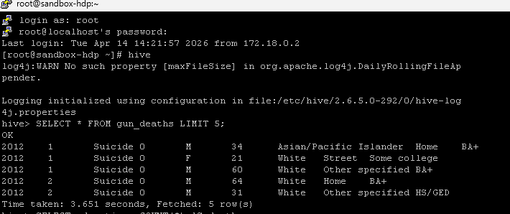
DATA PROCESSING WITH HIVE
Steps Performed:
Why Hive?
Created a database named cw2.
Defined a table “gun_deaths” inside the database, matching the 9 columns of the CDC dataset .
Loaded the data from the dataset into the Hive table.
Used SQL to explore the dataset. Ran SELECT * FROM gun_deaths LIMIT 5; to check column values and confirm data loaded correctly.
Performed queries to identify the education level with the highest number of deaths using GROUP BY education ORDER BY deaths DESC LIMIT 1 as shown in figure 3.
Counted number of gun deaths by suicide and homicide using COUNT(*) with WHERE intent IN (“Suicide”, ”Homicide”).
Performed additional queries like SELECT education, COUNT(*) AS death FROM gun_deaths GROUP BY education to analyze deaths across different educational levels.
Hive runs on top of HDFS and hence data stays in distributed storage.
Hive handles large rows smoothly and without performance issue.
Hive is also good at batch processing which resonates with this workload.
Hive uses SQL. There is no need to learn a new query language unlike Spark and Pig, which require more procedural code.
Hive integrates well with Zeppelin and BI tools while Pig has smaller ecosystem support. Spark needs additional Spark session configuration or cluster resource tuning.
Fig. 2: Query that shows first five rows of the table

Slide 8
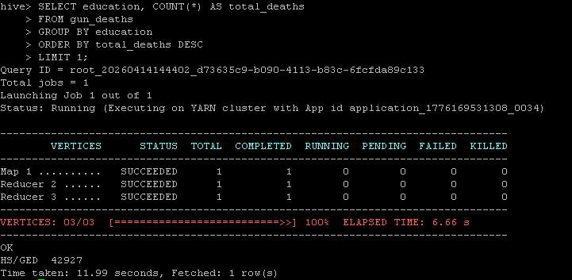
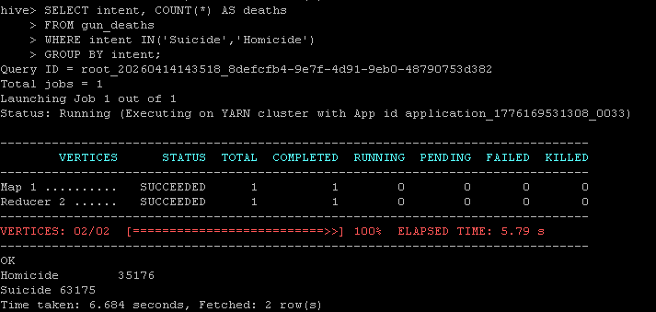
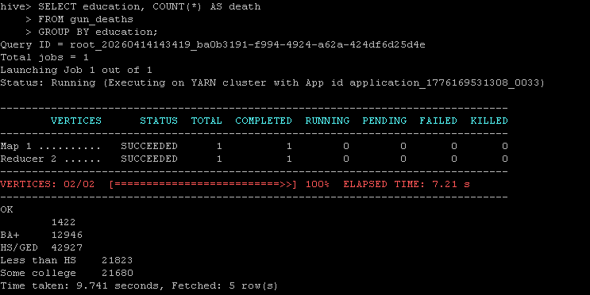
DATA PROCESSING WITH HIVE
Fig. 3: Query that finds the education level with the highest total gun deaths.
Fig. 4:Query that finds the total gun death counts for Suicide and Homicide
Figure 2 showed the first five rows of the table and confirmed that the dataset has been successfully loaded into the Hive table.
Figure 3 showed that the education level HS/GED had the highest total gun deaths.
Figure 4 showed that the total number of suicides was 63,175 and the total number of homicides was 35,176.
Figure 5 showed the total gun death count for each education level. The output revealed that the HS/GED had highest total gun deaths, followed by Less than HS and Some college. The gun deaths among BA+ were comparatively fewer. Few deaths with no education label appeared to be uncategorized.
Fig. 5: Query that finds the total gun death count for each education level

Slide 9
DATA VISUALIZATION
Steps Performed:
Zeppelin
Queries were performed on Apache Zeppelin to obtain the graphical representations.
“%jdbc” was used as interpreter prefix to execute queries for Hive databases.
Results presented using Line graphs, Pie charts and Bar charts.
The link between education levels and intent of deaths were visualized and examined in the data visualization phase.
Apache Zeppelin is an open-source web-based notebook tool for data visualization and data analysis [8] [10].
Apache Zeppelin provides notebook-style interface to run queries and visualize results [8].
It works smoothly with Big Data tools (Hive).
It helps in automatic generation of charts for analysis of the data.
It has interactive and user-friendly interface.
It allows iterative querying and refinement.
Why Zeppelin?
Hadoop cluster already includes Zeppelin and Hive integration.
Zeppelin supports iterative analysis whereas BI tools are more dashboard-focused [9].
BI platforms are designed for dashboarding and require data extraction. Zeppelin executes Hive queries directly on data stored in HDFS.
Tableau also does not directly operate on HDFS efficiently.

Slide 10
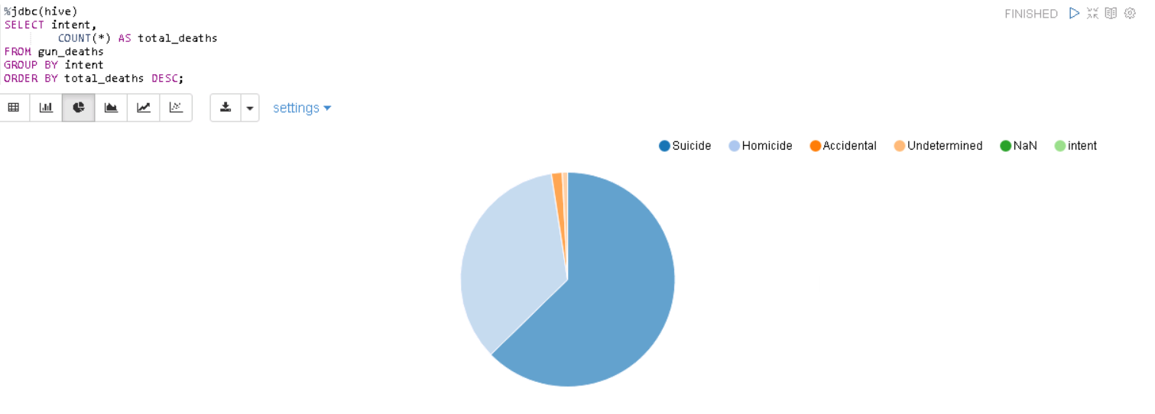
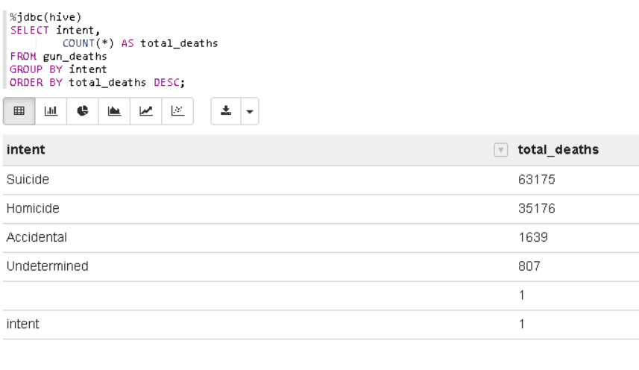
INSIGHTS FROM THE DATA
The relationship between gun deaths and education level was obtained using SQL queries. Following insights were obtained:
Fig. 6: Count Of Gun Deaths With Respect To Intent
Suicide accounts for the largest cause of gun deaths with 63,175.
Homicide is the second most common intent for gun deaths with 35,176.
Accidental and undetermined gun deaths are rare.
It was inferred that Suicide accounts for nearly two-thirds of all gun deaths.

Slide 11
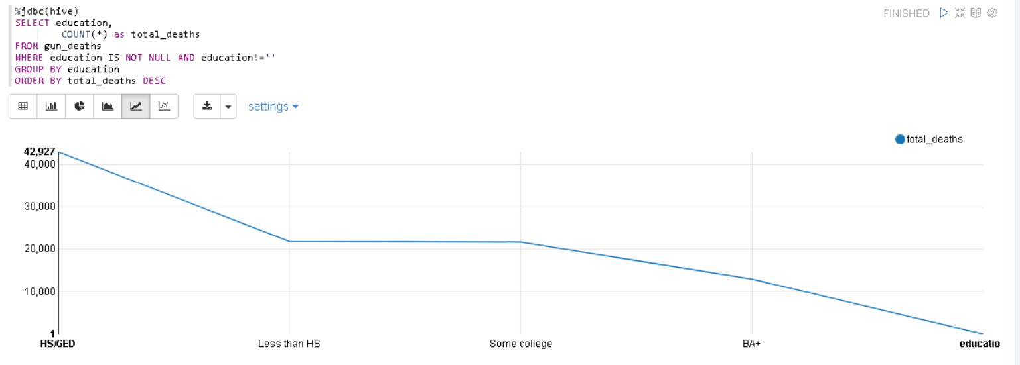
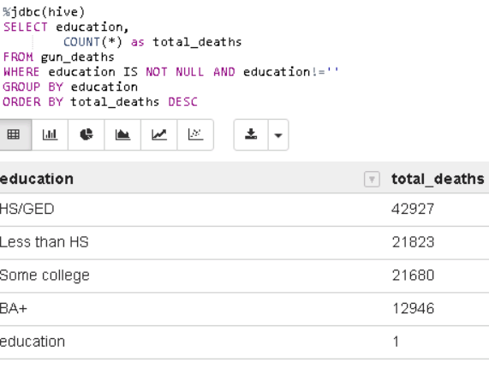
INSIGHTS FROM THE DATA
Fig. 7: Number Of Gun Deaths By Education Level Highest To Lowest
HS/GED has the highest total gun deaths, nearly double the second highest demographic. This may be due to higher firearm ownership and greater exposure to high-risk environments.
Less than HS and Some college are nearly identical with only 143 deaths apart. The small gap suggests that high school completion alone is not a clear dividing line.
BA+ has the lowest total gun deaths. This may be due to better employability and safer neighborhoods.
Those with an education level lower than BA+ appear to be at greater risk for gun-related deaths.
It was inferred that higher education level is associated with fewer total gun deaths.

Slide 12
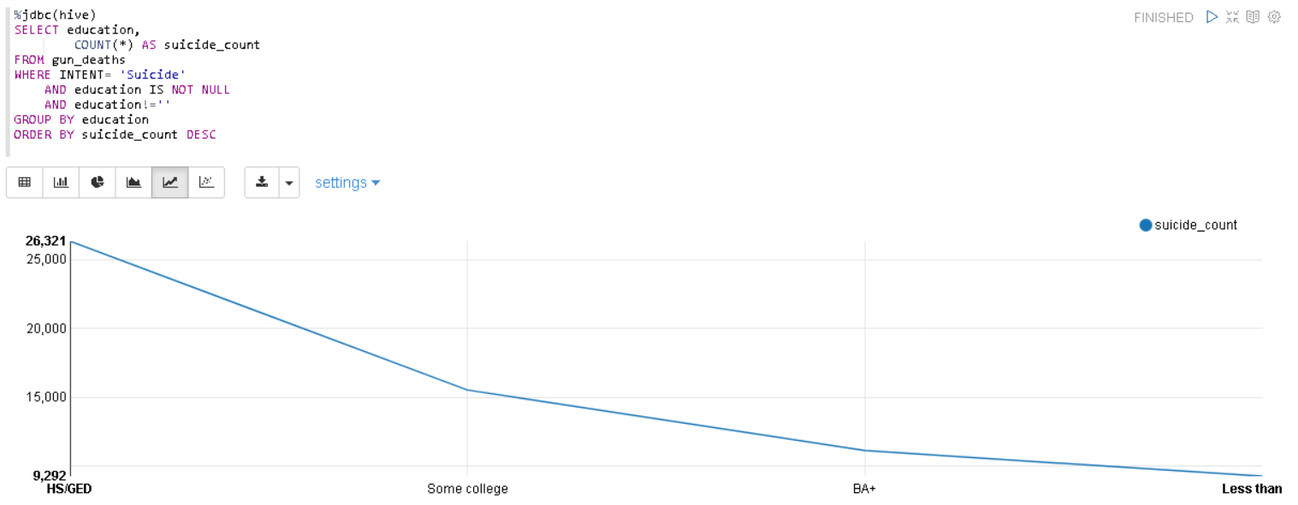
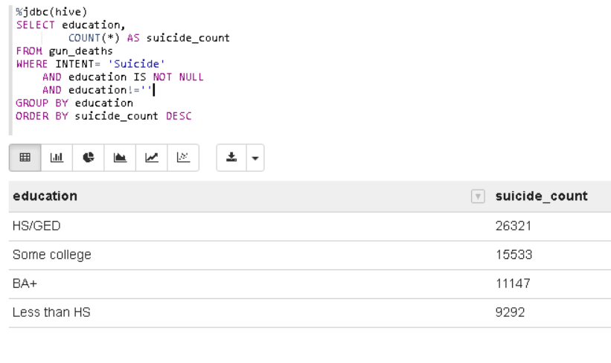
INSIGHTS FROM THE DATA
Fig. 8: Suicide Counts With Respect To Education Level
HS/GED has the highest suicide count by far, followed by Some college, then BA+.
Less than HS has the lowest suicide count.
Unlike total gun deaths, higher education does not mean fewer suicides.
Those with an education level BA+ are still susceptible to firearm deaths, mostly by suicide. This may be due to mental health issue that are not solely based on education level.
However, their total number of deaths by suicide is still much lower than the HS/GED education level.

Slide 13
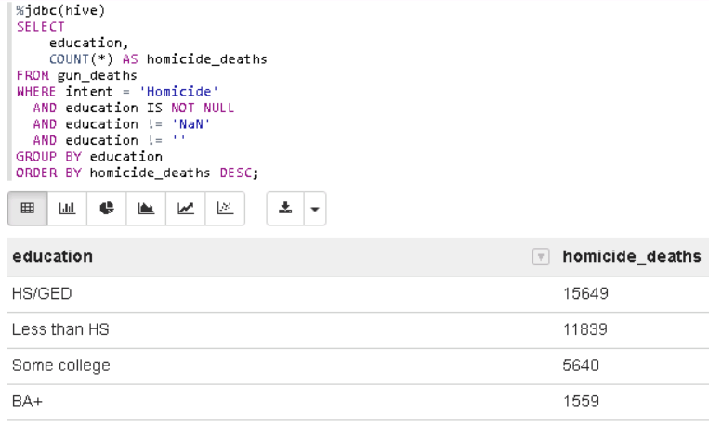
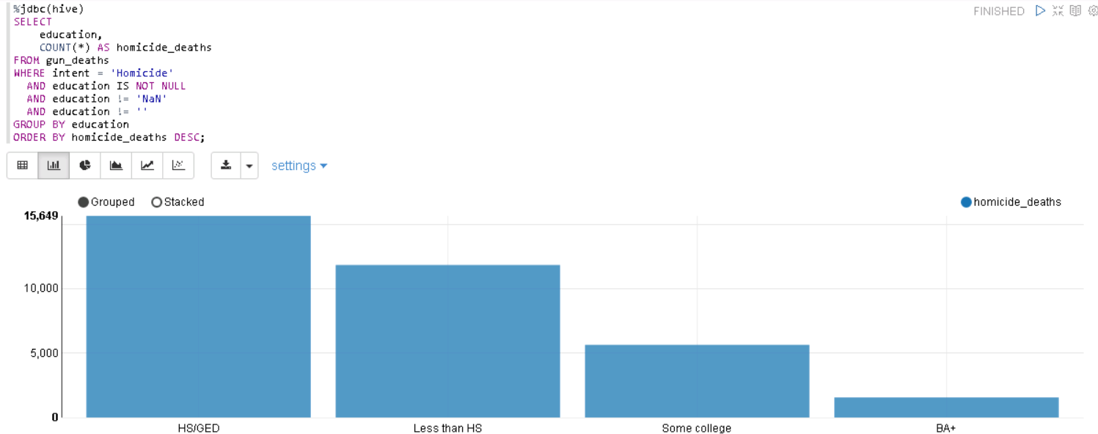
INSIGHTS FROM THE DATA
Fig. 9: Homicide Count With Respect To Education Level
HS/GED has the highest homicide count .
BA+ has 90% fewer homicides than HS/GED.
Clearly shown that higher education = fewer homicide deaths.
Less than HS is the only group where homicide exceeds suicide.
Education affects suicide and homicide differently: homicide drops sharply whereas suicide drops only modestly.
It can be inferred that higher education strongly protects against homicide but only weakly protects against suicide.

Slide 14
CONCLUDING REMARKS
There appears to be a significant link between education and gun deaths.
Lower levels of educational attainment are associated with higher gun death rates.
Individuals in the HS/GED group was found to have highest number of firearm deaths.
Gun deaths appeared most prevalent in suicide cases.
Homicide is the second most common cause of firearm deaths.
The analysis showed that higher-educated groups are more susceptible to firearm death related to suicide than homicide.
Homicide was more prevalent in lower-educated groups. It was fewer among the BA+ education level demographics.
The data lake architecture scaled effectively for 100798 records without performance issues.
It indicated that the chosen system was highly suitable for handling this dataset.
It also demonstrated that the solution can support larger datasets and future expansion.
Although the analysis showed important links, the education level categories may hide socioeconomic factors.
The dataset does not consider variables such as mental health history or economic conditions.
The data is limited and findings may not generalize to other populations or geographic regions.
In future, the data may be expanded to include additional years, states and more records to populate the dataset further.
The attributes such as gun ownership rates, mental health resources, employability and poverty rates may be added.
The queries may also be performed to investigate other relationships such as education and age, education and gender and death and location of death for clearer insights.

Slide 15
REFERENCES
B. Kalesan and S. Galea, "Patterns of gun deaths across US counties 1999-2013," Ann. Epidemiol., vol. 27, no. 5, pp. 302–307.e3, May 2017, doi: 10.1016/j.annepidem.2017.04.004. [1]
A. J. Dare et al., "Geospatial, racial, and educational variation in firearm mortality in the USA, Mexico, Brazil, and Colombia, 1990-2015: A comparative analysis of vital statistics data," Lancet Public Health, vol. 4, no. 6, pp. e281–e290, Jun. 2019, doi: 10.1016/S2468-2667(19)30018-0. [2]
P. Jha, interview by H. Singer, "Why young men die," Dalla Lana School of Public Health, UniversitySlide 9 of Toronto, May 22, 2019. [Online]. Available: https://www.dlsph.utoronto.ca/2019/05/22/why-young-men-die/. [3]
A. J. Kposowa, "Association of suicide rates, gun ownership, conservatism and individual suicide risk," Soc. Psychiatry Psychiatr. Epidemiol., vol. 48, no. 9, pp. 1467–1479, Sep. 2013, doi: 10.1007/s00127-013-0664-4. [4]
M. Ahmed, "Gun Deaths in America - CDC," Kaggle. 2023. [Online]. Available: https://www.kaggle.com/datasets/maso0dahmed/gun-deaths-in-america-cdc. [5]
Z. Cheng, Z. Luan, Y. Meng, Y. Xu, D. Qian, A. Roy, N. Zhang, and G. Guan, "ERMS: An Elastic Replication Management System for HDFS," in 2012 IEEE International Conference on Cluster Computing Workshops, 2012, pp. 32-38, doi: 10.1109/ClusterW.2012.25. [6]
K. Shvachko, H. Kuang, S. Radia, and R. Chansler, "The Hadoop Distributed File System," in Proc. 26th IEEE Symp. Mass Storage Syst. Technol. (MSST), Incline Village, NV, USA, May 2010, pp. 1–10, doi: 10.1109/MSST.2010.5496972. [7]
The Apache Software Foundation, "Apache Zeppelin," zeppelin.apache.org. [Online]. Available: https://zeppelin.apache.org/. [8]
Liu, F. C., Sun, Y., Sun, A. Y., & Xu, W. (2018). "Integrated HPC Scheduler Data Processing Workflow using Apache Zeppelin." IEEE International Conference on Big Data (Big Data 2018), pp. 4254-4260. IEEE.[9]
H. Ben Hamadou, T. B. Pedersen, and C. Thomsen, “The Danish National Energy Data Lake: Requirements, Technical Architecture, and Tool Selection,” in Proceedings of the 2020 IEEE International Conference on Big Data (Big Data), 2020, Art. no. 9378368, doi: 10.1109/BigData50022.2020.9378368. [10]

Slide 16
RECORDED DEMONSTRATION
Video Link

Slide 17
THANK YOU

