Slide 1

13 Steps to Writing a novel series
Emily Thompson

Slide 2
Build your central thread One character, relationship, mystery, or conflict.
Harry Potter is about “The Boy Who Lived” taking down the dark lord.
Supernatural is about two brothers, and how they relate.
Lost was about unraveling a mystery.
Star Wars is about a boy becoming a man.
LoTR is about what having an adventure will really do to you.
Twist was a person who felt incapable of love, becoming saturated with it.

Slide 3
Play with these ideas and get to know them.
Come up with more characters, settings, and conflicts that support your central thread.
If it’s about a person’s growth, poke at them in creative ways.
If it’s about a relationship, test it.
If it’s about a conflict or mystery, work out exactly what it is and work backwards.
I wrote most of the whole first book before I decided to make it a series.

Slide 4
Decide on a basic ending. Or, intentionally decide not to have one ever.
If you have an ending, it doesn’t have to be detailed when you start writing.
Harry Potter and Star Wars might have just been that they win in the end.
I knew I wanted Twist to be completely transformed into the best version of himself, and surrounded by love, friends, and family.
“No ending” will lead to an unsatisfying end, every time.
Supernatural isn’t built for an ending, and when it stops it’s going to just stop, but it’s fun for now.
Be sure to have an ending for a mystery! Don’t be like Lost. You’ll paint yourself into a corner.

Slide 5
Decide on a general length for the story you want to tell.
This can change, but come up with a ballpark number for books to start with.
Once you have a length decided on, you can start to build your arc(s).
It doesn’t matter what you chose, just chose something to shoot for.
Look at your own past projects to help you decide. Are you really long winded? Then go for a longer series and challenge yourself. Do you struggle to finish large projects? Then pick a lower number of books.

Slide 6
Design your central arc, based on the structure that best supports our central thread.
What will it take to get your story from the start to your ending?
Look at other stories that are like yours, and see what they did that worked or didn’t work. Copying is totally okay.
You can follow an act structure, or something else.
Look at that first book-ish amount that you wrote. Does it have a structure you can multiply?
Think of it like a fractal.
I based the entire series arc on the shape of the first book I wrote just because I liked it.

Slide 7
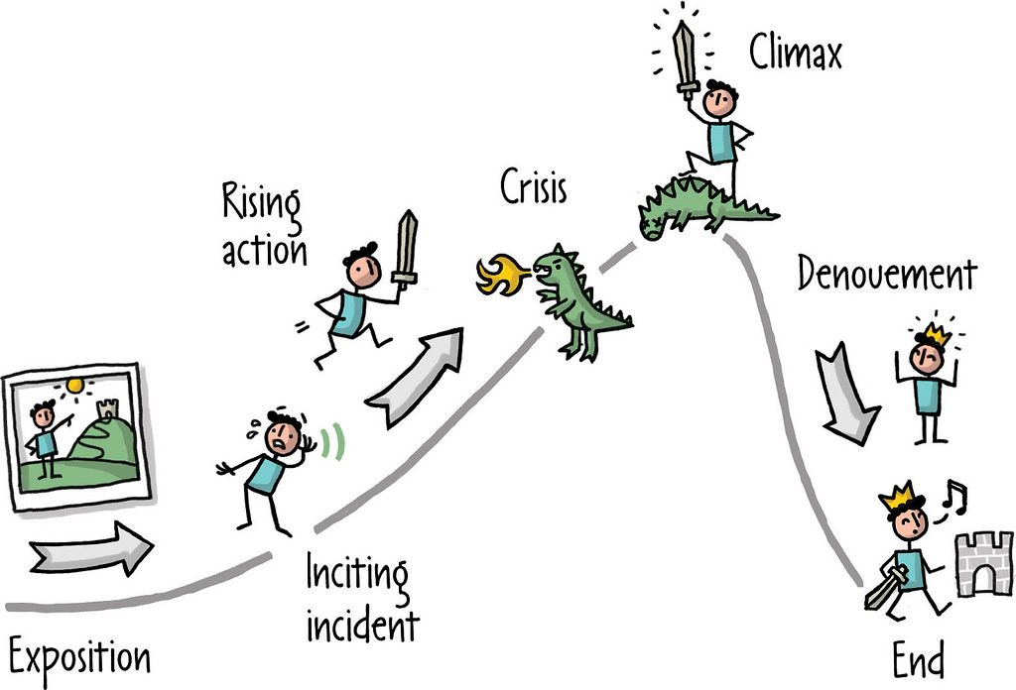

Slide 8
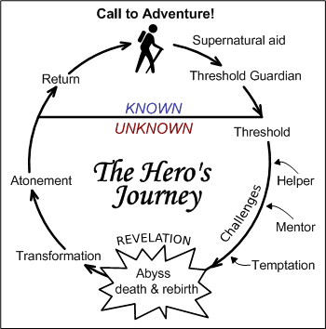

Slide 9
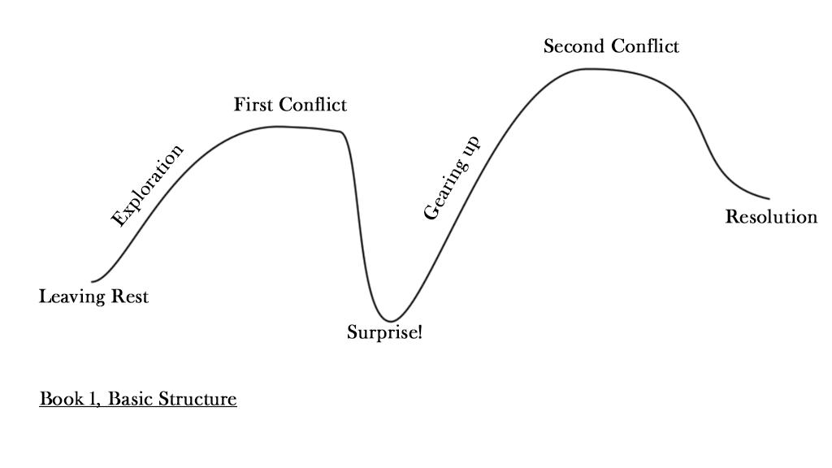

Slide 10
Once you have a central arc, add other ones on top of it and weaving through.
Give some or all of your secondary characters arcs of their own.
Try to fit the secondary arcs around the main one to strengthen it.
Someone else can take the spotlight for a bit, but never let the themes of the secondary arcs conflict directly with the themes of the main arc.
If possible, use these secondary arcs to explore similar ideas to the main one.
There can be many arcs running at the same time, and they can start and land at different times, anywhere in the series.

Slide 11
Secondary arc examples:
Han Solo isn’t going from boy to man, but he’s going from bad man to good man, right in front of Luke. His struggles and growth support Luke’s arc by being a good or bad example, and by giving Luke a reason to consider what makes a man good in the first place.
Aragon is already halfway through his personal arc when Frodo meets him in the beginning of the story. He’s already wrecked and damaged from his adventures, but he still has the hope to strive onward. He’s a warning for Frodo, that the character doesn’t see, but the reader does.

Slide 12
Secondary arc examples:
Jonas, the second main character, struggled with the fear of losing people he loved throughout the series. They had different personal journeys, and need to overcome different things, but his growth mirrored Twist’s and gave Twist reasons to consider things he otherwise never would have.
Vane began as an antagonist, designed to poke at Twist’s weaknesses. By book 4, however, Vane had grown as a character and in his relationship with Twist, and became an ally because he honestly cared about Jonas. His love for someone else changed him and made him stronger and more kind, showing Twist that anyone can be changed by love.

Slide 13
Step 7 Start Writing!
You’ve got your map, now follow it.

Slide 14
Sectioning and writing mechanics 1
Use your initial writing as a base, and maybe make what you already have into the first book in the series.
I recommend writing linearly, if possible. This way, most of the more organic parts of the story will flow naturally. But, it’s also okay to skip ahead and draft something if you need to, and then go back.

Slide 15
Sectioning and writing mechanics, Follow your map
Follow your map, and cut each book out of the arc.
If you have two books’ worth of time before you’ve scheduled a big twist in the story, then spend that time building the characters up and exploring minor aspects of the world that don’t affect the overall story.
Wait to ad characters until you need them to support the central arc.
If you have a long story, don’t be afraid to send characters off for a while if they aren’t needed.
If you’re planning a big event or twist, spend time pre-writing about it and thinking about it, so that you’ll have everything set for it both before and after in the series.

Slide 17
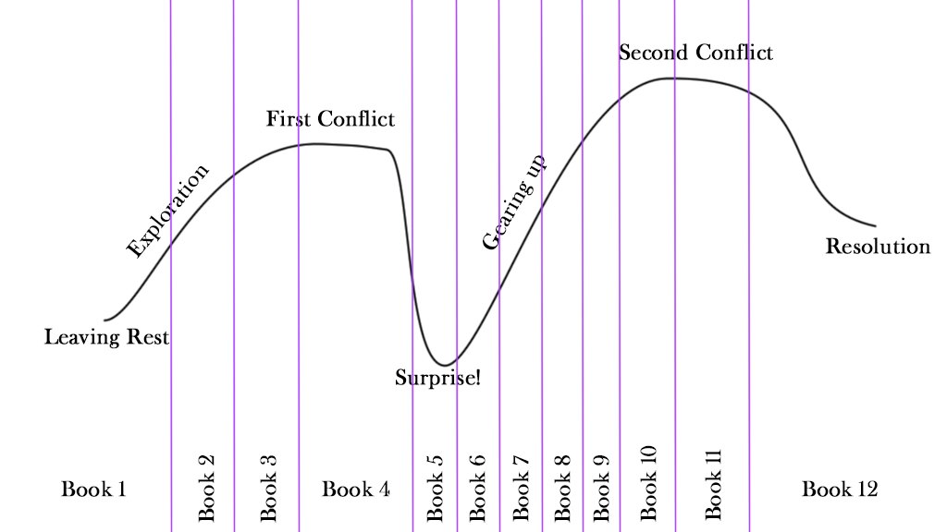

Slide 18
Exposition is a tricky beast, especially with a mystery
Plan for information to be revealed at plot points in your central arc. Until those moments arrive, try to either build up to them with clues, or intentionally hide them if you want to shock your reader.
It’s very important that you, as the writer, know exactly how everything works. Keep notes if you need to, so that you can stay consistent. Spend time deciding on details and look back at your central theme and arc to make sure it’s all supportive.
If you aren’t sure about a detail or how something works, you can always draft extra scenes or planned ones, just to work it out, but then go back and either fully re-write or edit out all of the extra information.

Slide 19
Exposition is a tricky beast, but expect your reader to understand.
General rule of thumb for modern writing is “show don’t tell.” Do you have a magic system or weird tech? Then show characters using it instead of explaining it. Does your society have unusual rules? Have characters react to it and plan around it, instead of talking about it.
If you must have exposition dumps, stuff it into a funny conversation, exciting scene, or make the information emotionally important to your characters so that the reader doesn’t feel like they are sitting in on a briefing.
When in doubt, don’t explain. Expect your reader to understand.

Slide 20
Trim your cast if needed.
In a series, you can keep adding new people as you go. But it’s usually best to have fewer, stronger characters than too many. Also, who can remember that many names?
To trim, look for similar characters. Are there any two characters that are very alike? Do you really need them both or can you combine them?
If you have a long series, it’s entirely fine to have people come and go, and maybe not even appear in entire books. If they are strong characters, your reader will remember them and all you’ll need is a quick, “oh, I haven’t seen you since…” line or two to remind them.

Slide 21
Watch your tone and general escalation.
For tone, frequently re-read previous parts of the series to make sure that everything sounds like part of the same story. If things don’t match because your writing voice is changing or your writing ability is improving, then go back and improve the beginning with light editing, and try not to be too clever at the end, so that the overall skill level and voice are consistent.
For escalation, follow your arcs closely and make sure that things aren’t getting too dangerous or exciting too quickly if that doesn’t match your plan. Or, if needs be, change your plan to match your organic style. Either way, make sure that you know where you’re going.

Slide 22
Be careful of the scale or your violence, death, and damage.
If you’re going to be killing people off, and you have big actiony ending planned, then make sure that you kill more named characters at the ending than in the middle of the series.
If the worst thing that will ever physically happen to your character in the entire series is that he’ll lose a finger, make that happen at the end and only give him cuts and bruises, sickness, or fatigue until then.
If you go too big too fast, you could end up with nowhere to go, or a very dark and uncomfortable story. But, of course, if that’s what you’re going for it’s fine. Just know your scale.

Slide 23
Re-assess when you’re about 3/4 of the way through the series.
Once you are starting to set things up for the ending, it’s time to make sure you like how things are working.
Do you still like your original arc structure, or have you come up with a better one? Have you invented an ending you like way better than the first one? Now is the time to make big changes.
If you make a change near the end, you’ll probably need to do at least some gentle re-writing elsewhere.
Once you’ve changed a few scenes or plot points in your previous writing, read on for a little longer to make sure that the tone and escalation, and the character relationships, haven’t been affected. If they have, smooth them out with a little more editing, until you can’t see the seems anymore.

Slide 24
Write your ending, and then re-read the whole series.
Once the whole thing is drafted and on paper, go back and start reading from Book 1, in order, all the way through at least once.
By now, you’ve grown as a writer, you know the story inside and out, and you’ll easily catch little things that need adjusting without even trying.
It’s also pretty fun to see it all again.

Slide 25
Q/A Emily Thompson, Author Clockwork Twist series. clockworktwist.com r/CWTwist
Thank you for your attention and your questions

