Slide 1
PL/SQL Instructions

Slide 2
Environment:
Add the following lines to the file of ~/.cshrc in bingsuns
if $?CLASSPATH then
setenv CLASSPATH {$CLASSPATH}:/opt/local/oracle/product/11.2.0/instantclient_11_2/ojdbc5.jar:/opt/local/oracle/product/11.2.0/instantclient_11_2/orai18n.jar
else
setenv CLASSPATH .:/opt/local/oracle/product/11.2.0/instantclient_11_2/ojdbc5.jar:/opt/local/oracle/product/11.2.0/instantclient_11_2/orai18n.jar
endif
Note: no newline after ‘setenv CLASSPATH’, it’s followed by a space.
After you saved the changes, use the following to activate the changes:
bingsuns% source .cshrc

Slide 3
Demo1:
Goal:
Insert a record into table of students.
Run demo program:
Before running this program, you should create a table named students first
This table will be used in the rest of programs
Please refer to demo1.sql for details
Run java program
bingsuns% javac mydemo1.java
bingsuns% java mydemo1
Note:
mydemo1 is a very simple program just for demo, so all the values(except sid) of student are hard coded.
You need to change the usr_id and password in all of demo programs to your own Oracle id and password

Slide 4
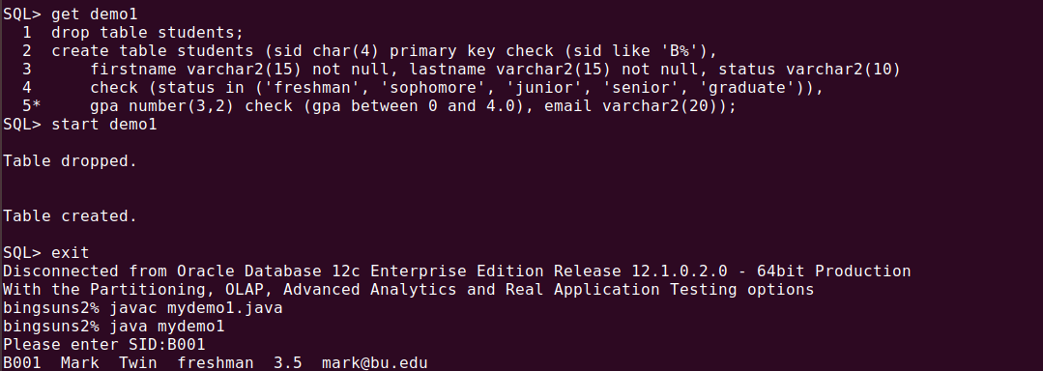
Demo1 output:

Slide 5
Demo2:
Goal:
Run a sql procedure from Java:
Get the status of students according to sid
Run demo program:
Before running this program, you should create a procedure named show_status
Please refer to demo2.sql for details
Run java program
bingsuns% javac mydemo2.java
bingsuns% java mydemo2

Slide 6
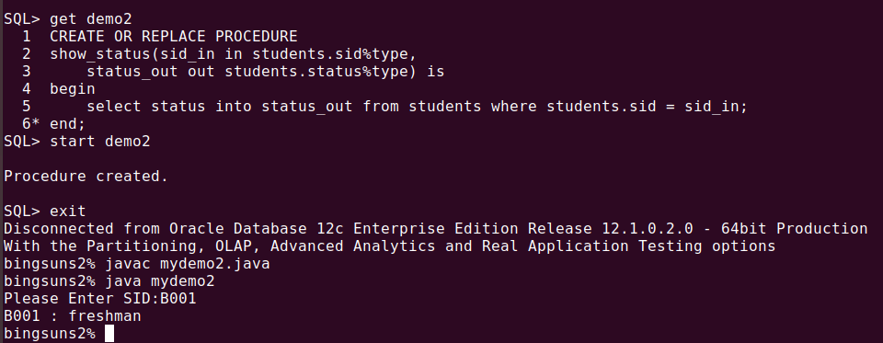
Demo2 output:

Slide 7
Demo3:
Goal:
Run a SQL function from Java
Get all of records in the tables of students.
Run demo program:
Before running this program, you should create a package named refcursor_jdbc1, and a function getstudents in the package
Please refer to demo3.sql for details
Run java program
bingsuns% javac mydemo3.java
bingsuns% java mydemo3

Slide 8
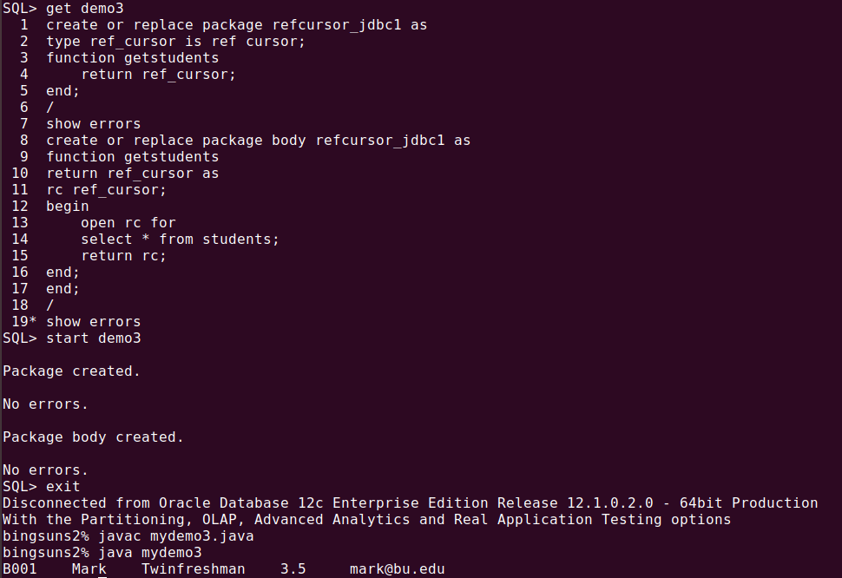
Demo3 output:

Slide 9
Demo4:
Goal:
Run a SQL function from Java
Get records of students whose gpa are larger than 3.0
Run demo program:
Before running this program, replace function of getstudents with a new one
Please refer to demo4.sql for details
Run java program
bingsuns% javac mydemo4.java
bingsuns% java mydemo4

Slide 10
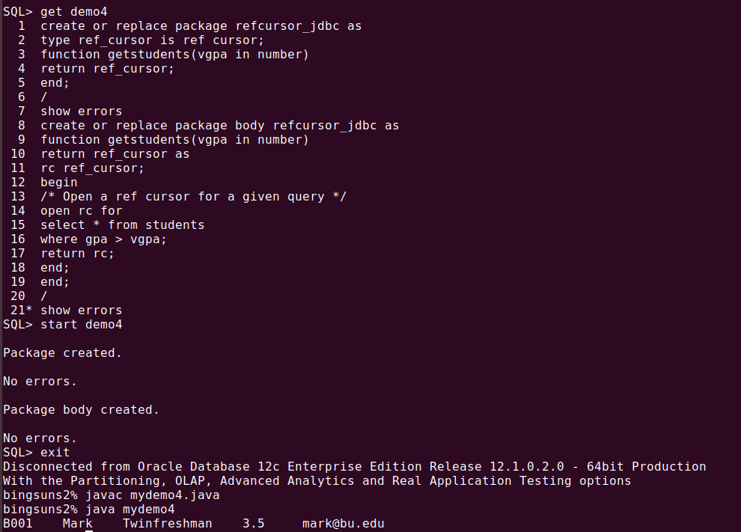
Demo4 output:

Slide 11
Thank you!

