Slide 1

Lovesick: The Father Who Never Stopped Chasing You
A Bible Study with Ervbo — Home Church
Ervbo • Bible Study
Notes:
Welcome the group. Set the tone: this is not a rules study but a love story that spans the entire Bible. Introduce the core sentence: the Bible's main message is a lovesick Father desperately looking for His children to bring them back home.

Slide 2
Lovesick
The ache you feel when someone you love is far away or a relationship is broken — you can't stop thinking about them, you keep the door open, you hope, you show up uninvited, you keep loving even when it isn't returned yet.
Notes:
Explain the roadmap: Eden, the Fall, the Promise, Tabernacle/Temple, Immanuel, New Jerusalem, and the closing verse. Emphasize that seeing the whole arc changes how we read Scripture.

Slide 3

Eden: Face-to-Face Closeness
● God walked with Adam and Eve in the cool of the day — a regular rhythm, not a one-time visit
● No priest, temple, altar, sacrifice, or veil between them
● God breathed life into Adam Himself and planted a garden just for them
● This is the blueprint: nearness, not distance — relationship, not just rules
Notes:
Contrast with the image of God as a distant, stern judge. In the beginning we see a Father walking with His kids. Everything else in the study is God trying to get back to this closeness.

Slide 4
“
And they heard the sound of the LORD God walking in the garden in the cool of the day, and the man and his wife hid themselves from the presence of the LORD God among the trees of the garden.
”
— Genesis 3:8
Notes:
Notice the tragic turn already present in this verse: the same God who walked with them is now the one they hide from. That hiding is the beginning of the distance the rest of Scripture works to undo.

Slide 5
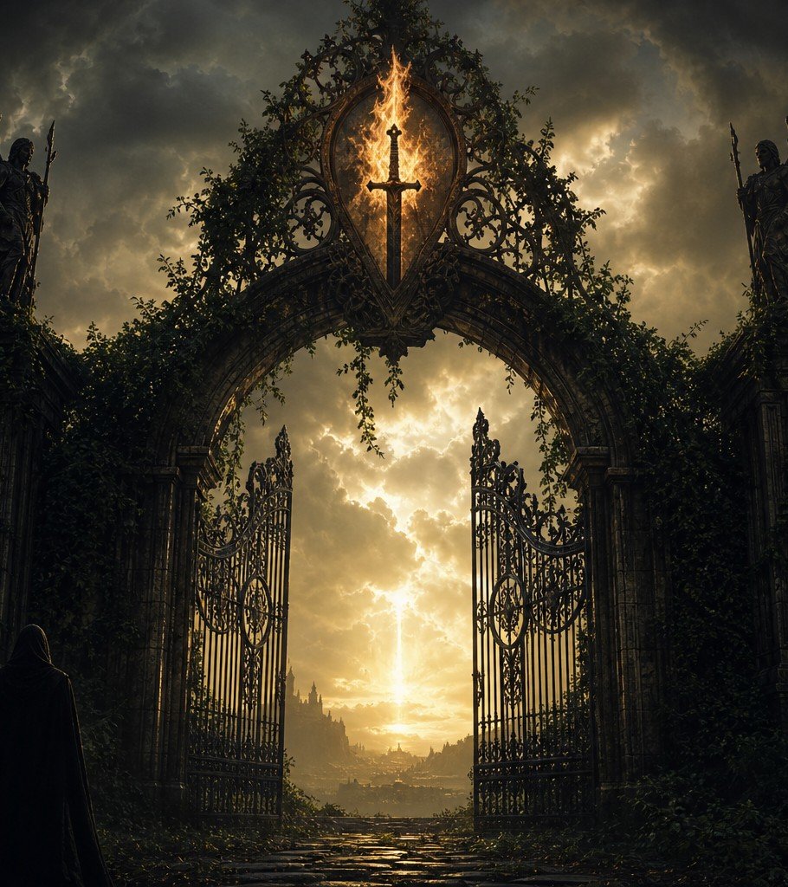
The Fall: The Barrier of Sin
● Adam and Eve hide from God — shame replaces intimacy
● They are sent out of the garden; cherubim and a flaming sword guard the way back
● This isn't God abandoning them out of anger alone — sin creates a real barrier
● Even in judgment, God clothes them Himself — love threading through the consequence
Notes:
Point out God's tenderness even in judgment: He makes garments of skin for Adam and Eve. The barrier is real, but the Father's care doesn't disappear.

Slide 6
“
And I will put enmity between you and the woman, and between your offspring and her offspring; he shall bruise your head, and you shall bruise his heel.
”
— Genesis 3:15
Notes:
Even while pronouncing judgment on the serpent, God is already promising a rescuer. This is the first gospel promise in the Bible — the Father already planning the way home before Adam and Eve even leave the garden.

Slide 7
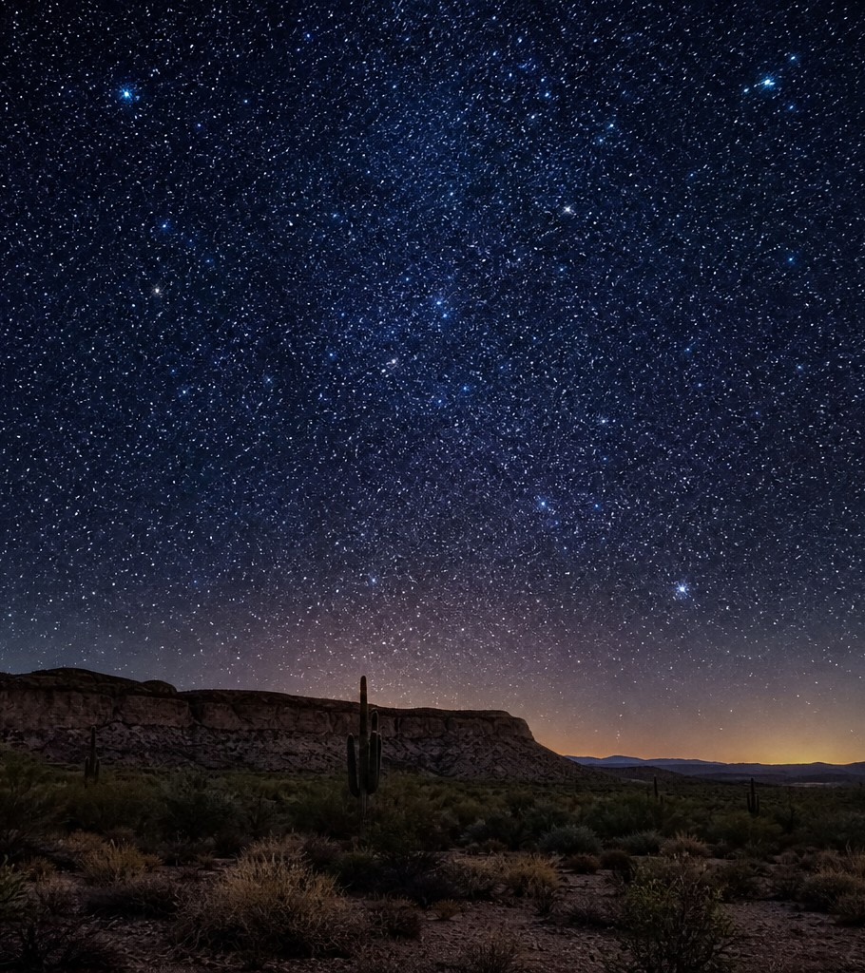
The Promise: A Father Who Keeps Pursuing
● God calls Abraham and makes a covenant: 'I will be your God, and you will be my people'
● This covenant language repeats again and again throughout Scripture
● Even after the Fall, God is already binding Himself back to His people
● The pursuit doesn't wait for humanity to get it together first
Notes:
Highlight Genesis 17:7 as the seed of the covenant refrain that echoes through Exodus, the prophets, and ultimately Revelation. God initiates every time.

Slide 8
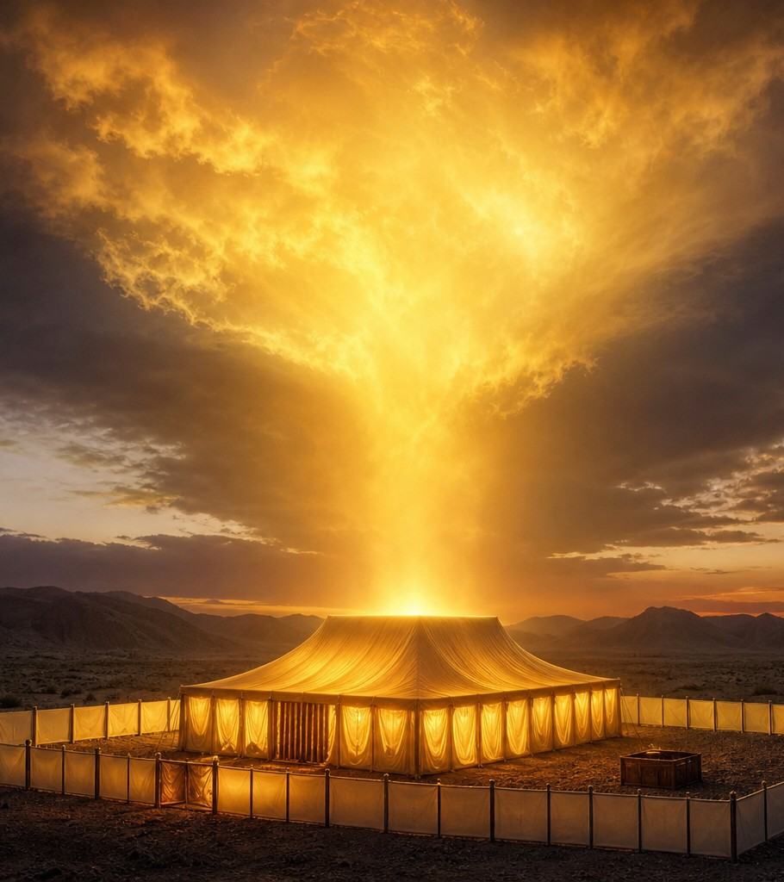
Tabernacle & Temple: Moving Closer
● God: 'Let them make me a sanctuary, that I may dwell among them' (Exodus 25:8)
● The Tabernacle, then the Temple — God's presence pitching a tent in the middle of the camp
● Still a veil, still a Holy of Holies — access was limited, but the direction is unmistakable
● God is moving toward His people, not waiting at a distance for them to arrive
Notes:
This is a major shift from Eden's open access, but it shows the trajectory of God drawing near again, step by step, era by era.

Slide 9
The Trajectory of a Pursuing Father
God walks with humanity face to face
God promises a rescuer and binds Himself in covenant
God becomes flesh — 'God with us' in the most personal way
Eden
The Promise
Immanuel
Genesis 2
Genesis 3:15 & 17
Matthew 1:23
Genesis 3
Exodus – Kings
Revelation 21
The Fall
Tabernacle & Temple
New Jerusalem
Sin creates distance; a barrier of shame and separation
God moves His dwelling into the camp of His people
God dwells with humanity forever; the garden is restored
Notes:
Use this slide to give the congregation the big-picture shape of the whole sermon so far: every era is another step in God's relentless pursuit of nearness.

Slide 10
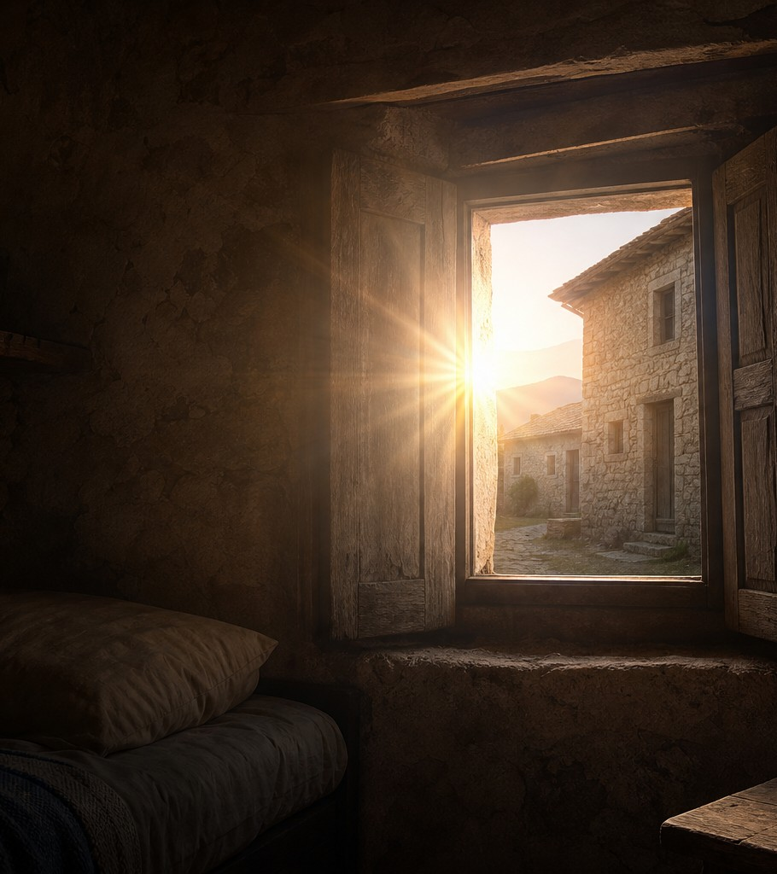
Immanuel: God With Us in the Flesh
● 'The Word became flesh and dwelt among us' (John 1:14)
● Literally: 'moved into the neighborhood' — God doesn't just visit, He moves in
● Jesus eats with sinners, touches the unclean, welcomes the outcast
● The distance from Eden is closing — God is now near enough to touch
Notes:
Emphasize the incarnation as the dramatic centerpiece of God's pursuit — no longer behind a veil, but walking among us in ordinary life.

Slide 11
“
And behold, the curtain of the temple was torn in two, from top to bottom. And the earth shook, and the rocks were split.
”
— Matthew 27:51
Notes:
The veil that separated humanity from the Holy of Holies is torn — from top to bottom, meaning God tore it, not man. The way is now open. This is the turning point of the whole story.

Slide 12
The Way Is Open — Now the Story Reaches Home
Notes:
Transition the congregation from the cross to the final restoration. The barrier is gone; now we look forward to what full restoration looks like.

Slide 13
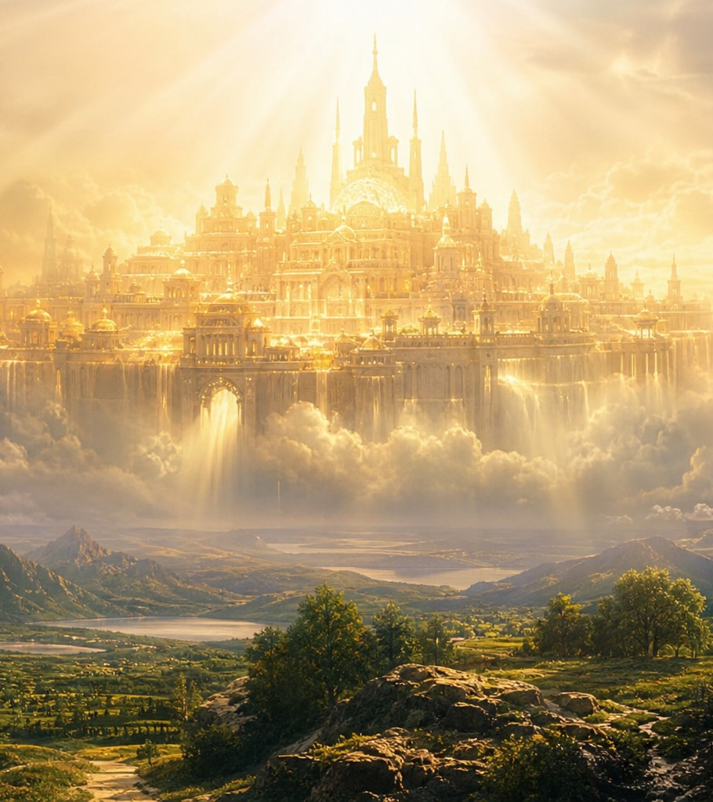
New Jerusalem: Home at Last
● 'Behold, the dwelling place of God is with man' (Revelation 21:3)
● No temple, no veil, no barrier — God's presence fills everything
● Every tear wiped away, death and mourning gone
● The story that began in a garden ends in a city where God lives with His people forever
Notes:
This is the full circle moment — Eden's intimacy restored and expanded into eternity. God's plan from the very beginning was always to be near us.

Slide 14
“
Through the middle of the street of the city; also, on either side of the river, the tree of life with its twelve kinds of fruit, yielding its fruit each month. The leaves of the tree were for the healing of the nations.
”
— Revelation 22:2
Notes:
Point out the beautiful bookend: Genesis begins with a tree in a garden and access lost; Revelation ends with a tree and access fully restored, bringing healing.

Slide 15
Eden Lost, Eden Restored
Genesis 3
Revelation 21-22
● Sin enters the world
● Access to God's presence lost
● Cherubim guard the way back
● Death enters as a consequence
● Sin and its curse are gone
● Access to God's presence fully restored
● The way is forever open
● Death is swallowed up in victory
Notes:
Use this side-by-side to crystallize the whole sermon's arc for the congregation — what was lost has been fully regained, and more.

Slide 16
“
For the Son of Man came to seek and to save the lost.
”
— Luke 19:10
Notes:
This single verse summarizes the entire sweep of Scripture — from Eden to the New Jerusalem — as one long rescue mission driven by love.

Slide 17
Walking Through the Open Door
1
2
3
Believe
Draw Near
Share
Trust that Christ has fully opened the way to God's presence for you
Approach God boldly and often in prayer, without fear or shame
Tell someone that the way to God is open through Jesus
Notes:
Challenge listeners to move from hearing the story to living it out this week — personally and in community.

Slide 18
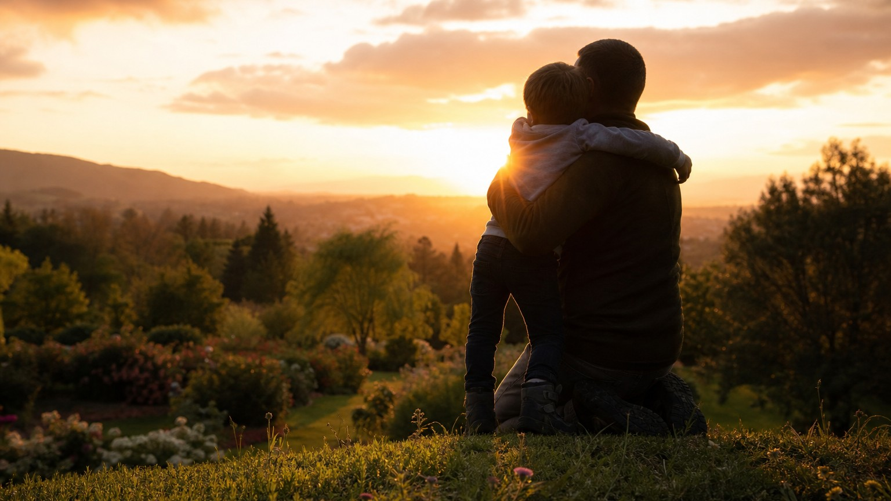
He Is Lovesick for You
● The Father has already torn down every barrier between you and Him
● The veil is torn, the door is open, the way is clear
● You are not too far gone, too broken, or too late
● Come home — He has been waiting for you all along
Notes:
End with warmth and invitation, not guilt. This is a love story, and the sermon closes by inviting people to respond to a Father who has already made every provision to welcome them home.

