Slide 1
History
of
Radix Sort

Slide 2
In computer science, radix sort is a non-comparative integer sorting algorithm that sorts data with integer keys by grouping keys by the individual digits which share the same significant position and value.
A positional notation is required, but because integers can represent strings of characters (e.g., names or dates) and specially formatted floating point numbers, radix sort is not limited to integers.
Radix sort dates back as far as 1887 to the work of Herman Hollerith on tabulating machines.

Slide 3
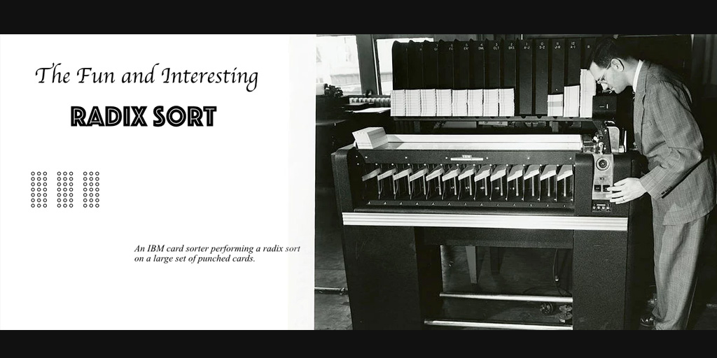

Slide 4
Most digital computers internally represent all of their data as electronic representations of binary numbers, so processing the digits of integer representations by groups of binary digit representations is most convenient.
Radix sorts can be implemented to start at either the most significant digit (MSD) or least significant digit (LSD).
For example, when sorting the number 1234 into a list, one could start with the 1 or the 4.

Slide 5
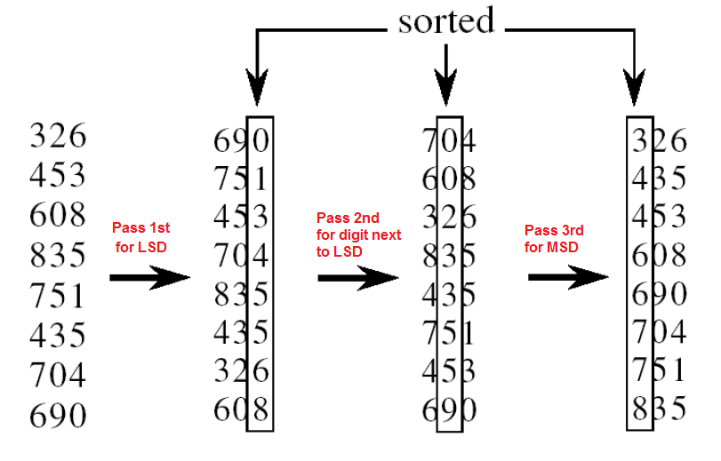

Slide 6
LSD radix sorts typically use the following sorting order: short keys come before longer keys, and then keys of the same length are sorted lexicographically.
This coincides with the normal order of integer representations, such as the sequence 1, 2, 3, 4, 5, 6, 7, 8, 9, 10, 11.

Slide 7
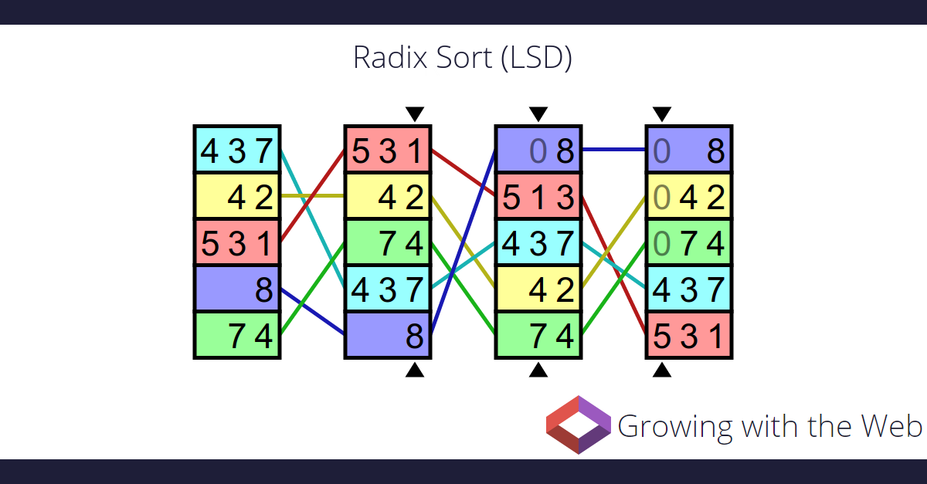

Slide 8
MSD radix sorts use lexicographic order, which is suitable for sorting strings, such as words, or fixed-length integer representations.
A sequence such as "b, c, d, e, f, g, h, i, j, ba" would be lexicographically sorted as "b, ba, c, d, e, f, g, h, i, j".
If lexicographic ordering is used to sort variable-length integer representations, then the representations of the numbers from 1 to 10 would be output as 1, 10, 2, 3, 4, 5, 6, 7, 8, 9, as if the shorter keys were left-justified and padded on the right with blank characters to make the shorter keys as long as the longest key for the purpose of determining sorted order.

Slide 9

67
45
25
7
3
32
21
98
56
110
0
1
2
3
4
5
6
7
8
9

Slide 10
110
21
32
3
45
25
56
67
7
98
0
1
2
3
4
5
6
7
8
9

Slide 11
3
7
110
21
25
32
45
56
67
98
0
1
2
3
4
5
6
7
8
9

Slide 12
PSEUDOCODE
1 Get the largest Significant Digit Position
2 Start from the Least Significant Digit 3 Iterate over the array and get the Significant Digit 4 Count its occurrence(how many times it appears) 5 Modify the array 6 Iterate over the array and position properly using the Digit in the counter 7 subtract the counter by 1 8 Go to the next Significant Digit

Slide 13
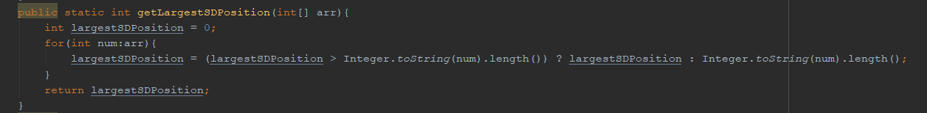

Slide 14
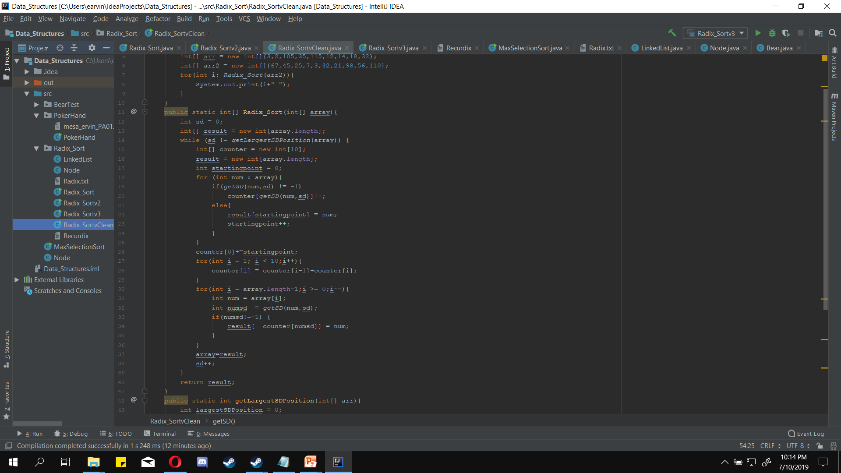

Slide 16
Array:
[67 , 45 , 25 , 7 , 3 , 32 , 21 , 98 , 56 ,110]
Counter:
[0 , 1 , 2 , 3 , 4 , 5 , 6 , 7 , 8 , 9] <- ID
[1 , 1 , 1 , 1 , 0 , 2 , 1 , 2 , 1 , 0] <- Count
[1 , 2 , 3 , 4 , 4 , 6 , 7 , 9 , 10 , 10] <- Modded

Slide 18
Array:
[67 , 45 , 25 , 7 , 3 , 32 , 21 , 98 , 56 ,110]
Modded Array:
[1 , 2 , 3 , 4 , 4 , 6 , 7 , 9 , 10 , 10]
Item: 110
Result: 0 in position 1-1
Resulting Array:
[110 , 0 , 0 , 0 , 0 , 0 , 0 , 0 , 0 , 0]

Slide 19
Array:
[67 , 45 , 25 , 7 , 3 , 32 , 21 , 98 , 56 ,110]
Modded Array:
[0 , 2 , 3 , 4 , 4 , 6 , 7 , 9 , 10 , 10]
Item: 56
Result: 6 in position 7-1
Resulting Array:
[110 , 0 , 0 , 0 , 0 , 0 , 56 , 0 , 0 , 0]

Slide 20
Array:
[67 , 45 , 25 , 7 , 3 , 32 , 21 , 98 , 56 ,110]
Modded Array:
[0 , 2 , 3 , 4 , 4 , 6 , 6 , 9 , 10 , 10]
Item: 98
Result: 8 in position 10-1
Resulting Array:
[110 , 0 , 0 , 0 , 0 , 0 , 56 , 0 , 0 , 98]

Slide 21
Array:
[67 , 45 , 25 , 7 , 3 , 32 , 21 , 98 , 56 ,110]
Modded Array:
[0 , 2 , 3 , 4 , 4 , 6 , 6 , 9 , 9 , 10]
Item: 21
Result: 1 in position 2-1
Resulting Array:
[110 , 21 , 0 , 0 , 0 , 0 , 56 , 0 , 0 , 98]

Slide 22
Array:
[67 , 45 , 25 , 7 , 3 , 32 , 21 , 98 , 56 ,110]
Modded Array:
[0 , 1 , 3 , 4 , 4 , 6 , 6 , 9 , 9 , 10]
Item: 32
Result: 2 in position 3-1
Resulting Array:
[110 , 21 , 32 , 0 , 0 , 0 , 56 , 0 , 0 , 98]

Slide 23
Array:
[67 , 45 , 25 , 7 , 3 , 32 , 21 , 98 , 56 ,110]
Modded Array:
[0 , 1 , 2 , 3, 4 , 6 , 6 , 9 , 9 , 10]
Item: 3
Result: 3 in position 4-1
Resulting Array:
[110 , 21 , 32 , 3, 0 , 0 , 56 , 0 , 0 , 98]

Slide 24
Array:
[67 , 45 , 25 , 7 , 3 , 32 , 21 , 98 , 56 ,110]
Modded Array:
[0 , 1 , 2 , 4 , 4 , 6 , 6 , 9 , 9 , 10]
Item: 7
Result: 7 in position 9-1
Resulting Array:
[110 , 21 , 32 , 3, 0 , 0 , 56 , 0 , 7 , 98]

Slide 25
Array:
[67 , 45 , 25 , 7 , 3 , 32 , 21 , 98 , 56 ,110]
Modded Array:
[0 , 1 , 2 , 4 , 4 , 6 , 6 , 8 , 9 , 10]
Item: 25
Result: 5 in position 6-1
Resulting Array:
[110 , 21 , 32 , 3, 0 , 25 , 56 , 0 , 7 , 98]

Slide 26
Array:
[67 , 45 , 25 , 7 , 3 , 32 , 21 , 98 , 56 ,110]
Modded Array:
[0 , 1 , 2 , 4 , 4 , 5, 6 , 8 , 9 , 10]
Item: 45
Result: 5 in position 5-1
Resulting Array:
[110 , 21 , 32 , 3, 45, 25 , 56 , 0 , 7 , 98]

Slide 27
Array:
[67 , 45 , 25 , 7 , 3 , 32 , 21 , 98 , 56 ,110]
Modded Array:
[0 , 1 , 2 , 4 , 4 , 4, 6 , 8 , 9 , 10]
Item: 67
Result: 7 in position 8-1
Resulting Array:
[110 , 21 , 32 , 3, 45, 25 , 56 , 67 , 7 , 98]

Slide 28
Array:
[67 , 45 , 25 , 7 , 3 , 32 , 21 , 98 , 56 ,110]
Modded Array:
[0 , 1 , 2 , 4 , 4 , 4, 6 , 7 , 9 , 10]
Resulting Array:
[110 , 21 , 32 , 3, 45, 25 , 56 , 67 , 7 , 98]

Slide 30
