Slide 1
Industrial Robotics
4 DOFs Robot
Bucci Simone
Monaco Thomas
Erwin Novicio

Slide 2
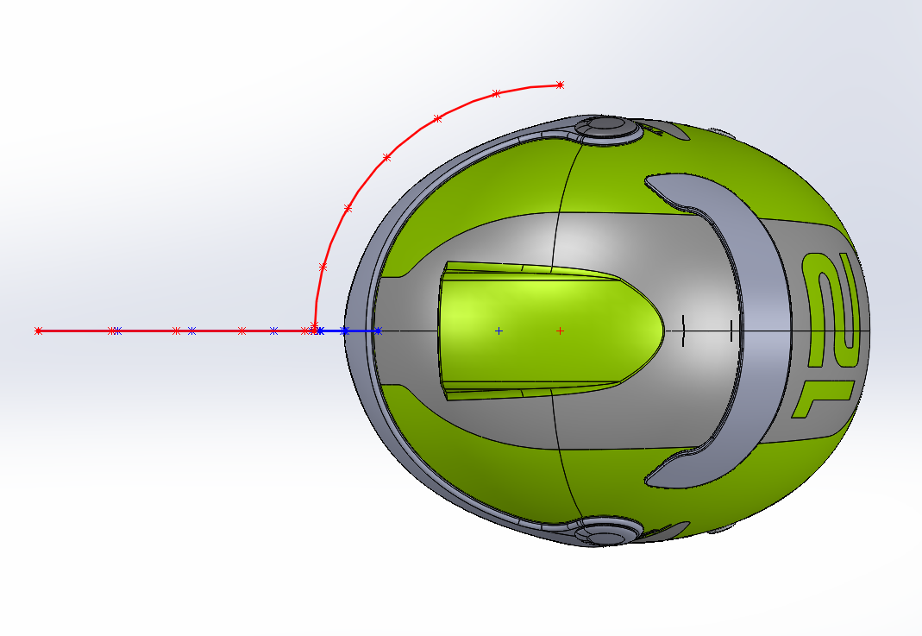
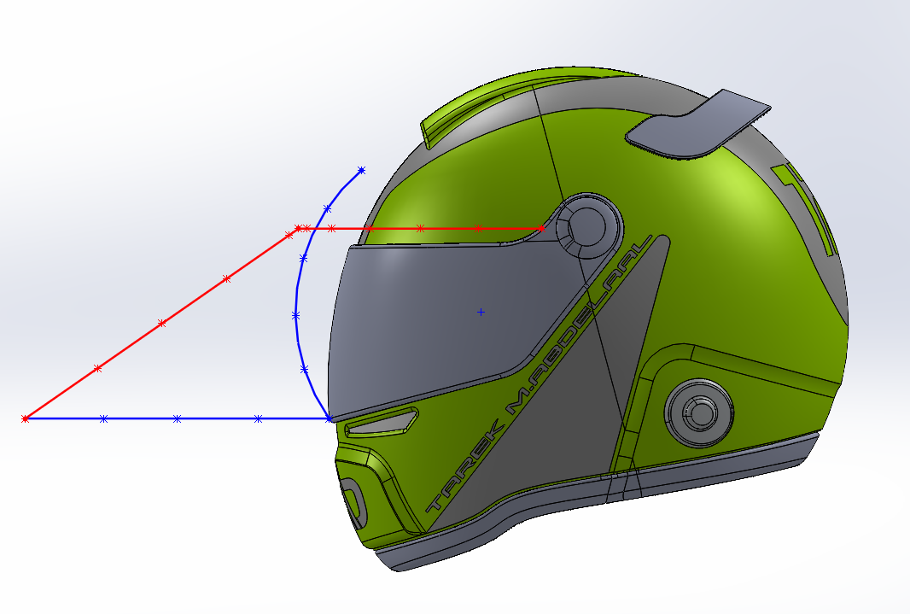
Introduction
The aim of this presentation is to describe the design process of a 4 DOFs robot characterized by:
Materials: arms made of ABS plastic, basement and shafts made of aluminum
General specifications:
The task that the robot has to accomplish is:
Robot specifications
Reach [mm]
870
Link length [mm] |  | Link mass [kg] | Joint angular range [deg]
Link 1 (L1) | 500 | 13.74 | Joint 1 | (-40°,40°)
Link 2 (L2) | 400 | 4.51 | Joint 2 | (-52°,232°)
Link 3 (L3) | 300 | 2.18 | Joint 3 | (-112°,112°)
Link 4 (L4) | 170 | 0.43 | Joint 4 | (-120°,120°)

Slide 3
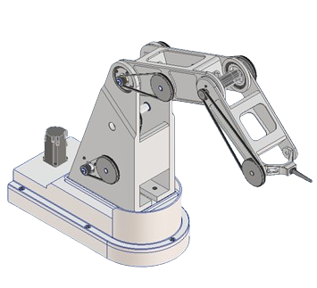
Introduction
Joint 2
Link 2
Joint 3
Link 3
Link 1
Joint 4
Link 4 - EE
Joint 1

Slide 4
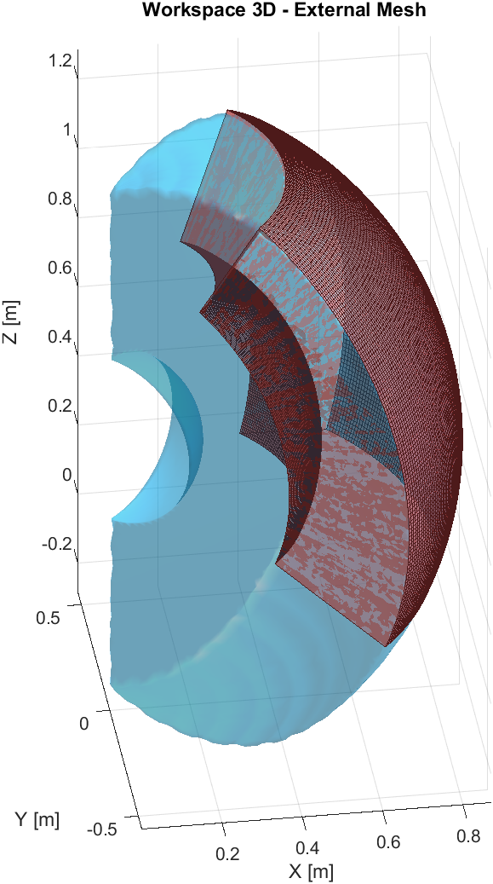
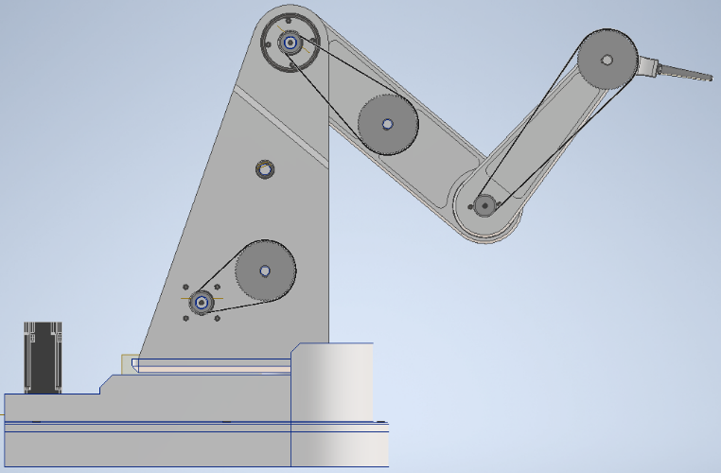
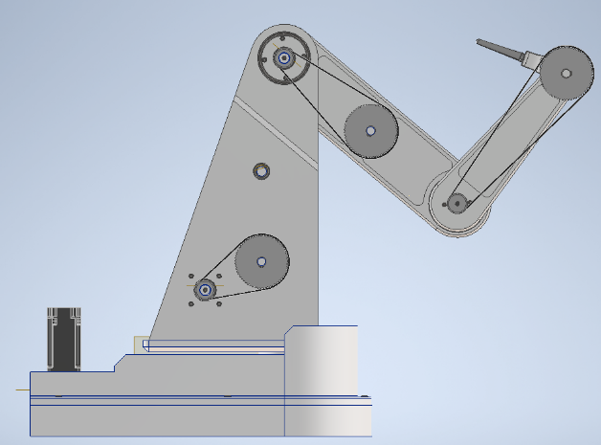
Introduction
Workspace:
Wanted configuration:
Effective
Configuration to be avoided:
Theoretical

Slide 5
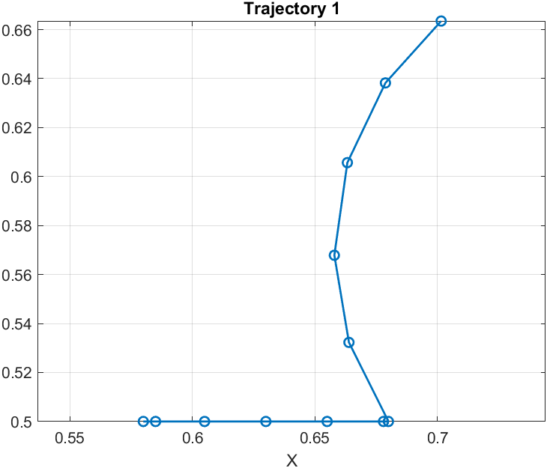
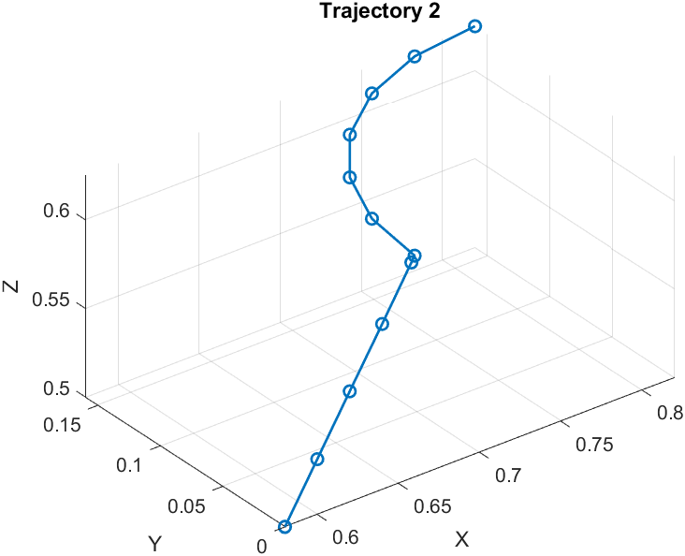
Trajectories Points Definition
First, discretize the two trajectories. Near heavy transitions in the trajectory we use more points. We also use two near points at the start and at the end of the second trajectory for the interpolation with quintic spline.

Slide 6
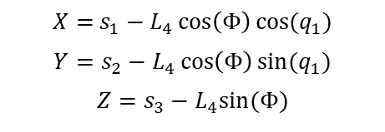
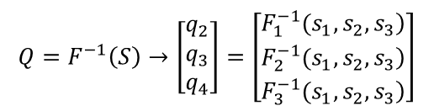
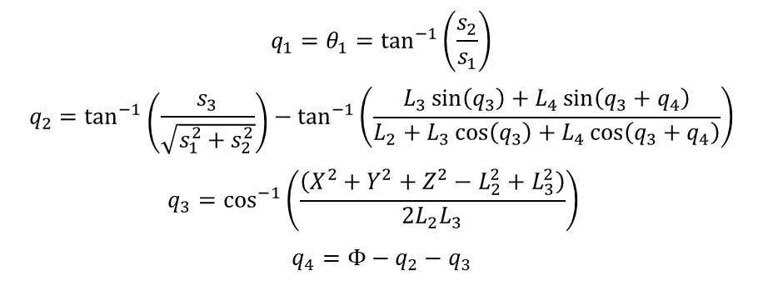
Inverse Kinematics
Mapping of the Working Space S variables onto the Joint Space variables Q
$$q_{1}=θ_{1}=\tan^{−1}\left(\frac{s_{2}}{s_{1}}\right)$$
$$q_{2}=\tan^{−1}\left(\frac{s_{3}}{\sqrt{s_{1}^{2}+s_{2}^{2}}}\right)−\tan^{−1}\left(\frac{{L_{3}\sin\left(q_{3}\right)+L}_{4}\sin\left(q_{3}+q_{4}\right)}{L_{2}+L_{3}\cos\left(q_{3}\right)+L_{4}\cos\left(q_{3}+q_{4}\right)}\right)$$
$$q_{3}=\cos^{−1}\left(\frac{\left(X^{2}+Y^{2}+Z^{2}−L_{2}^{2}+L_{3}^{2}\right)}{2L_{2}L_{3}}\right)$$
$$q_{4}=Φ−q_{2}−q_{3}$$
$$Q=F^{−1}\left(S\right)→\left[\begin{matrix}q_{2} \\ q_{3} \\ q_{4}\end{matrix}\right]=\left[\begin{matrix}\left.F_{1}^{−1}(s_{1},s_{2},s_{3}\right) \\ \left.F_{2}^{−1}(s_{1},s_{2},s_{3}\right) \\ \left.F_{3}^{−1}(s_{1},s_{2},s_{3}\right)\end{matrix}\right]$$
$X=$ $s_{1}−L_{4}\cos\left(Φ\right)cos⁡(q_{1})$
$$Y=s_{2}−L_{4}\cos\left(Φ\right)sin⁡(q_{1})$$
$$Z=s_{3}−L_{4}sin⁡(Φ)$$

Slide 7
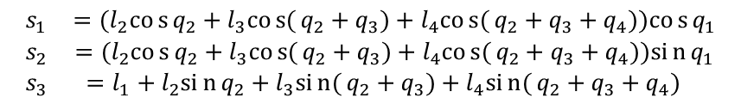
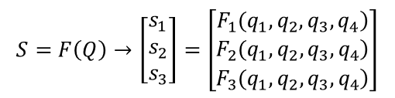
Direct Kinematics
Mapping of the Joint Space Q variables onto the Working Space variables S
$$S=F\left(Q\right)→\left[\begin{matrix}s_{1} \\ s_{2} \\ s_{3}\end{matrix}\right]=\left[\begin{matrix}\left.F_{1}(q_{1},q_{2},q_{3},q_{4}\right) \\ \left.F_{2}(q_{1},q_{2},q_{3},q_{4}\right) \\ \left.F_{3}(q_{1},q_{2},q_{3},q_{4}\right)\end{matrix}\right]$$
$$\begin{matrix}s_{1} & =(l_{2}cos{q_{2}}+l_{3}cos{(}q_{2}+q_{3})+l_{4}cos{(}q_{2}+q_{3}+q_{4}))cos{q_{1}} \\ s_{2} & =(l_{2}cos{q_{2}}+l_{3}cos{(}q_{2}+q_{3})+l_{4}cos{(}q_{2}+q_{3}+q_{4}))sin{q_{1}} \\ s_{3} & =l_{1}+l_{2}sin{q_{2}}+l_{3}sin{(}q_{2}+q_{3})+l_{4}sin{(}q_{2}+q_{3}+q_{4}) \end{matrix}$$

Slide 8
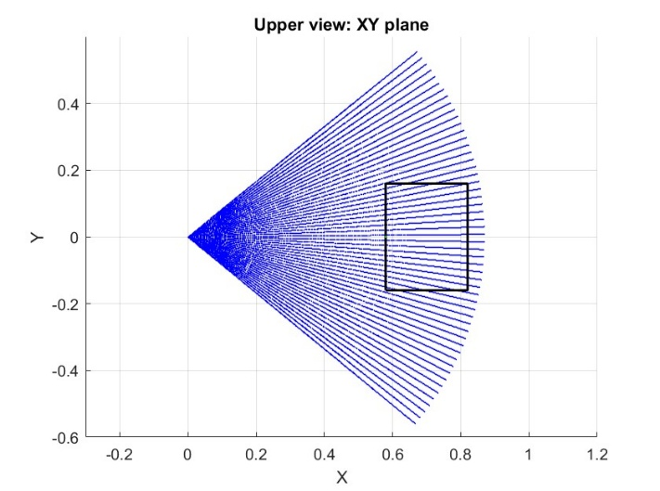
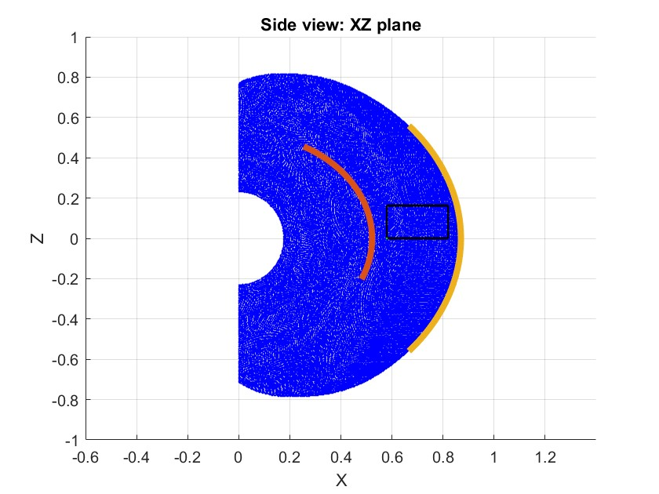
Workspace
Direct Kinematics
Montecarlo Method

Slide 9
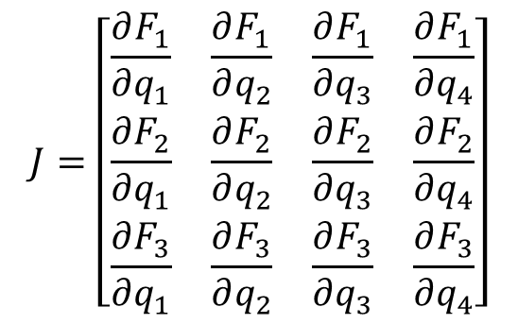
Jacobian matrix
The jacobian matrix$J∈ℝ^{3×4}$
Jacobian Matrix
$$J=\left[\begin{matrix}\frac{∂F_{1}}{∂q_{1}} & \frac{∂F_{1}}{∂q_{2}} & \frac{∂F_{1}}{∂q_{3}} & \frac{∂F_{1}}{∂q_{4}} \\ \frac{∂F_{2}}{∂q_{1}} & \frac{∂F_{2}}{∂q_{2}} & \frac{∂F_{2}}{∂q_{3}} & \frac{∂F_{2}}{∂q_{4}} \\ \frac{∂F_{3}}{∂q_{1}} & \frac{∂F_{3}}{∂q_{2}} & \frac{∂F_{3}}{∂q_{3}} & \frac{∂F_{3}}{∂q_{4}}\end{matrix}\right]$$
This matrix will be used in the quality assesments

Slide 10
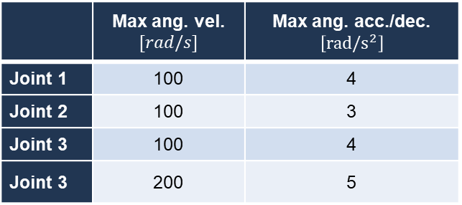
Motion Planning – Setting
Setting the accelerations/decelerations and velocities for each motor:
 | Max ang. vel. $[rad/s]$ | Max ang. acc./dec. $\left[rad/s^{2}\right]$
Joint 1 | 100 | 4
Joint 2 | 100 | 3
Joint 3 | 100 | 4
Joint 3 | 200 | 5
Synchronization of joints motion: the time to move between two consecutive points is set to the maximum of the four rise times.
We can now perform the motion planning.

Slide 11
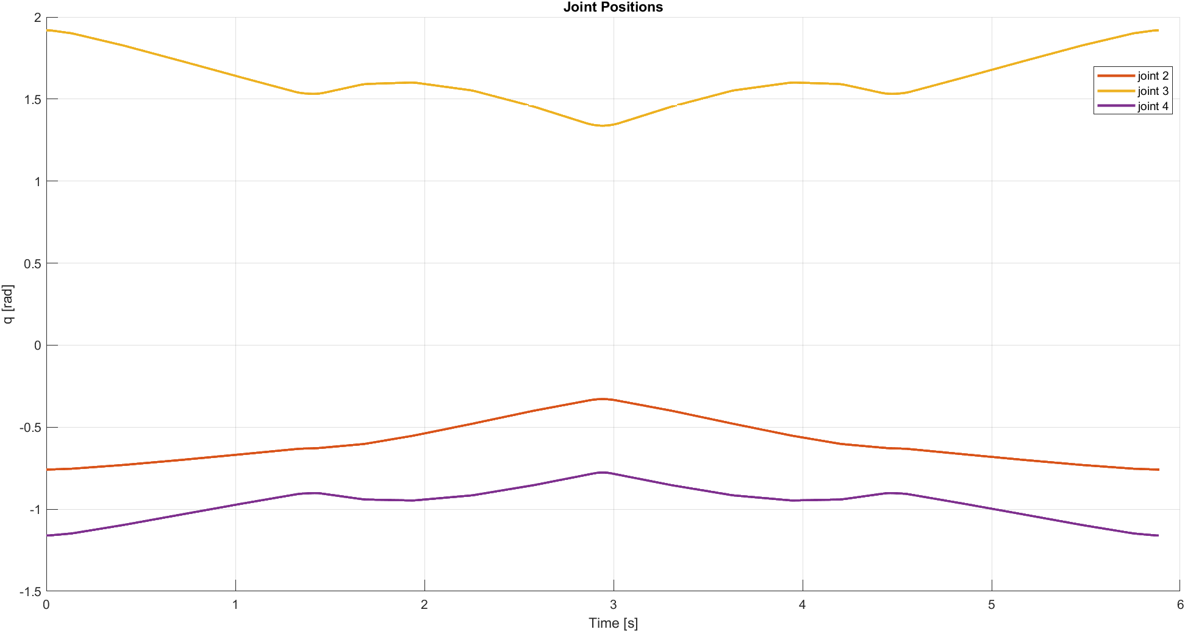
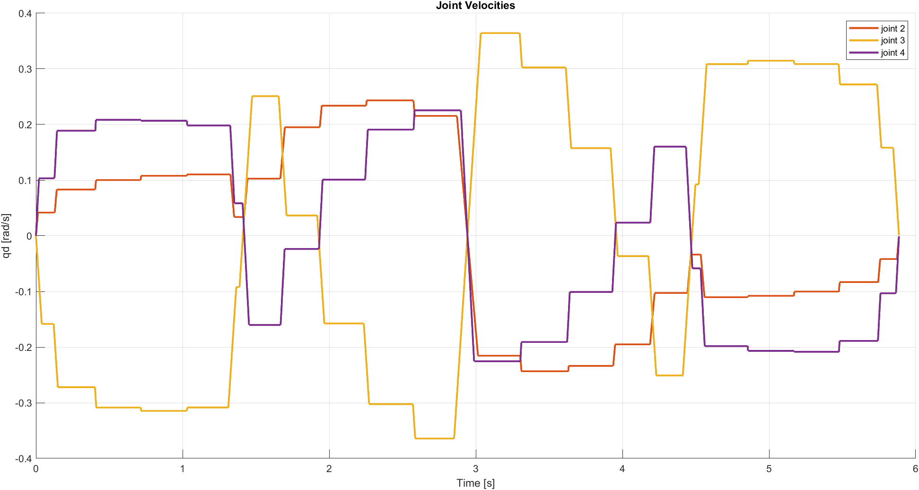
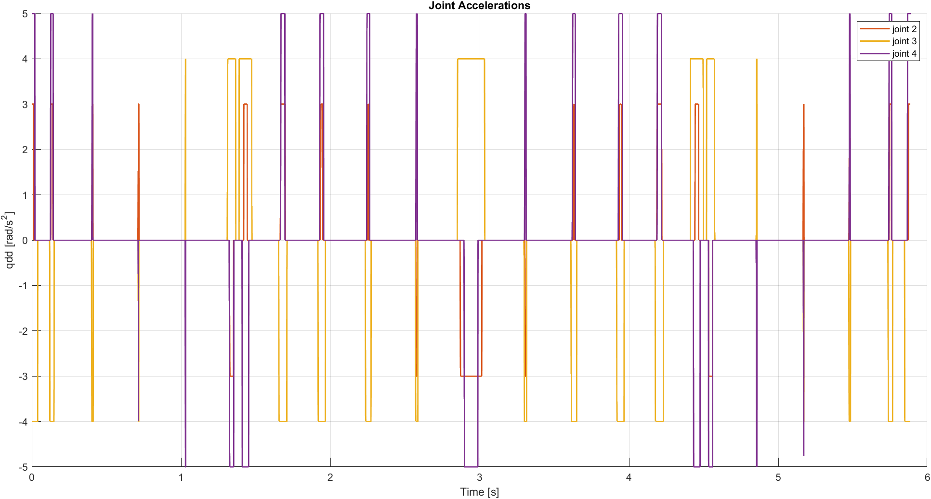
Motion Planning – Lines & Parabolas Method
For the first trajectory we use the Lines & Parabolas method:
Joint Position – Trajectory 1
Joint Velocity – Trajectory 1
Joint Acceleration – Trajectory 1
Time for the first task: 5.887 s

Slide 12
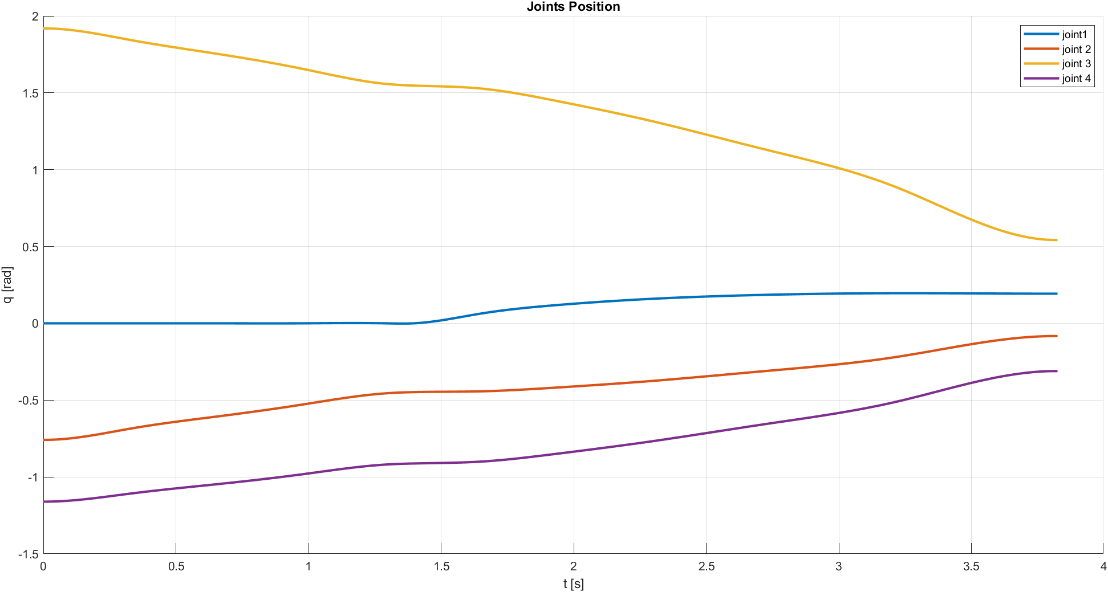
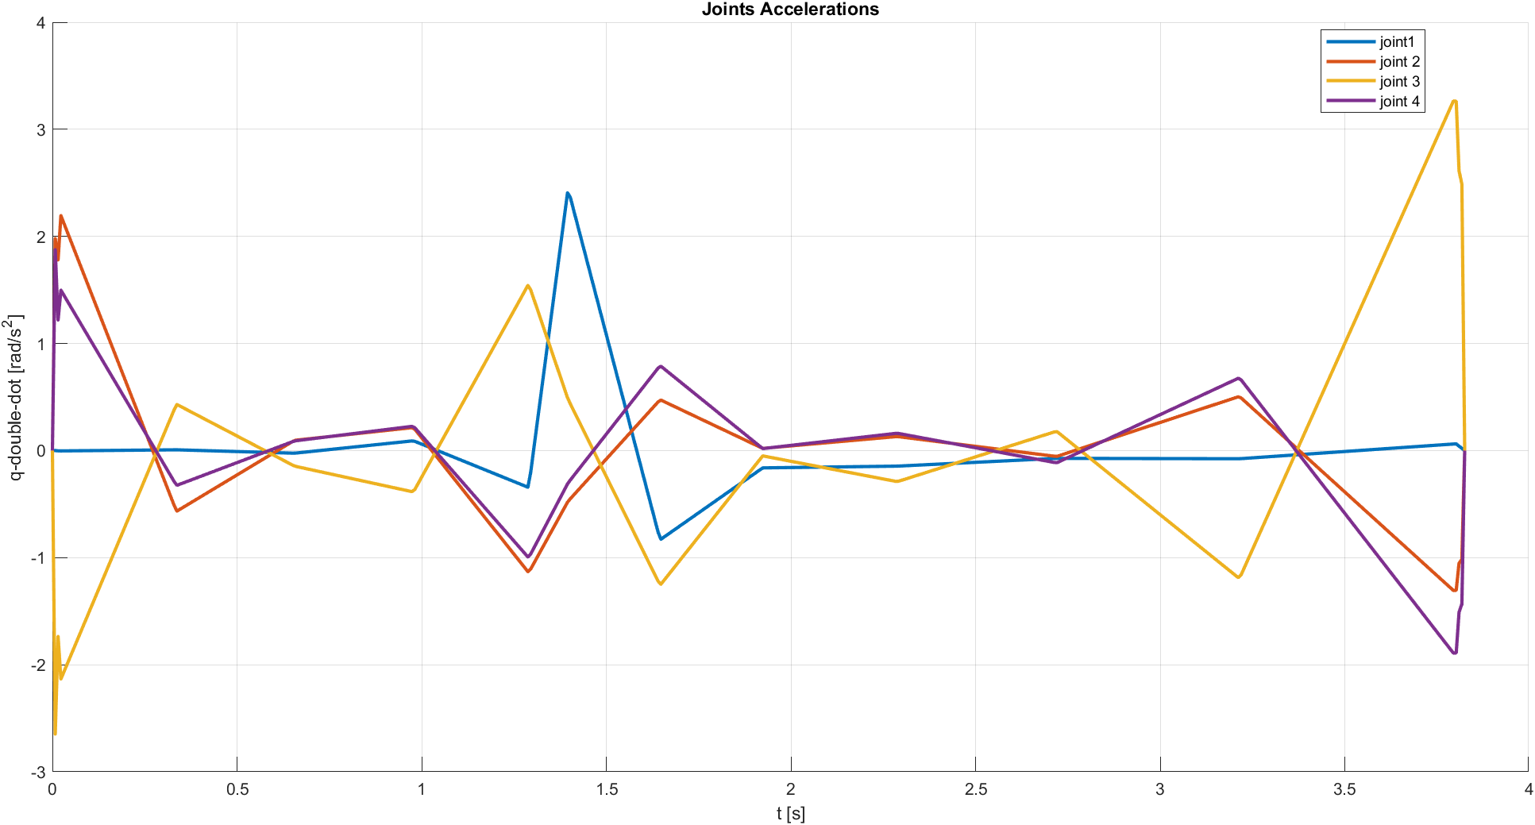
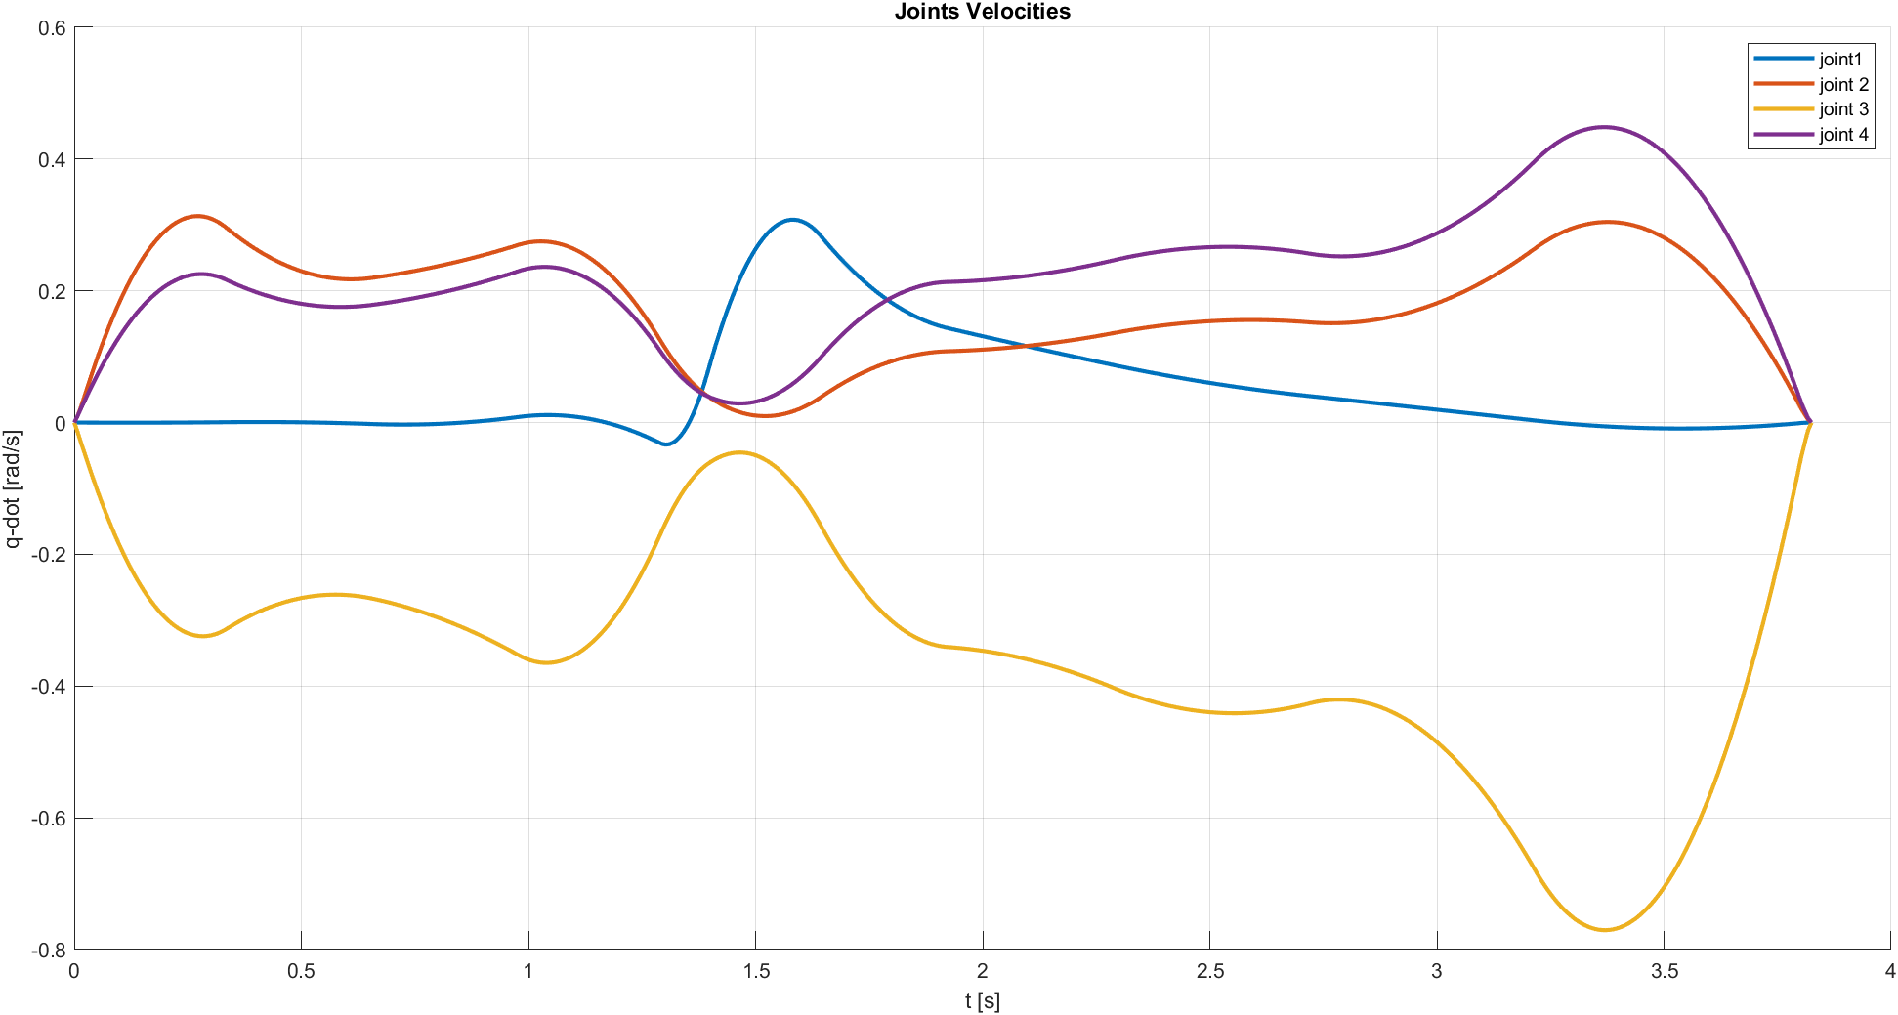
Motion Planning – Cubic Spline Method
For the second trajectory we use the Cubic Spline method:
Joint Position – Trajectory 2
Joint Velocity – Trajectory 2
Joint Acceleration – Trajectory 2
Time for the second task: 3.825 s

Slide 13
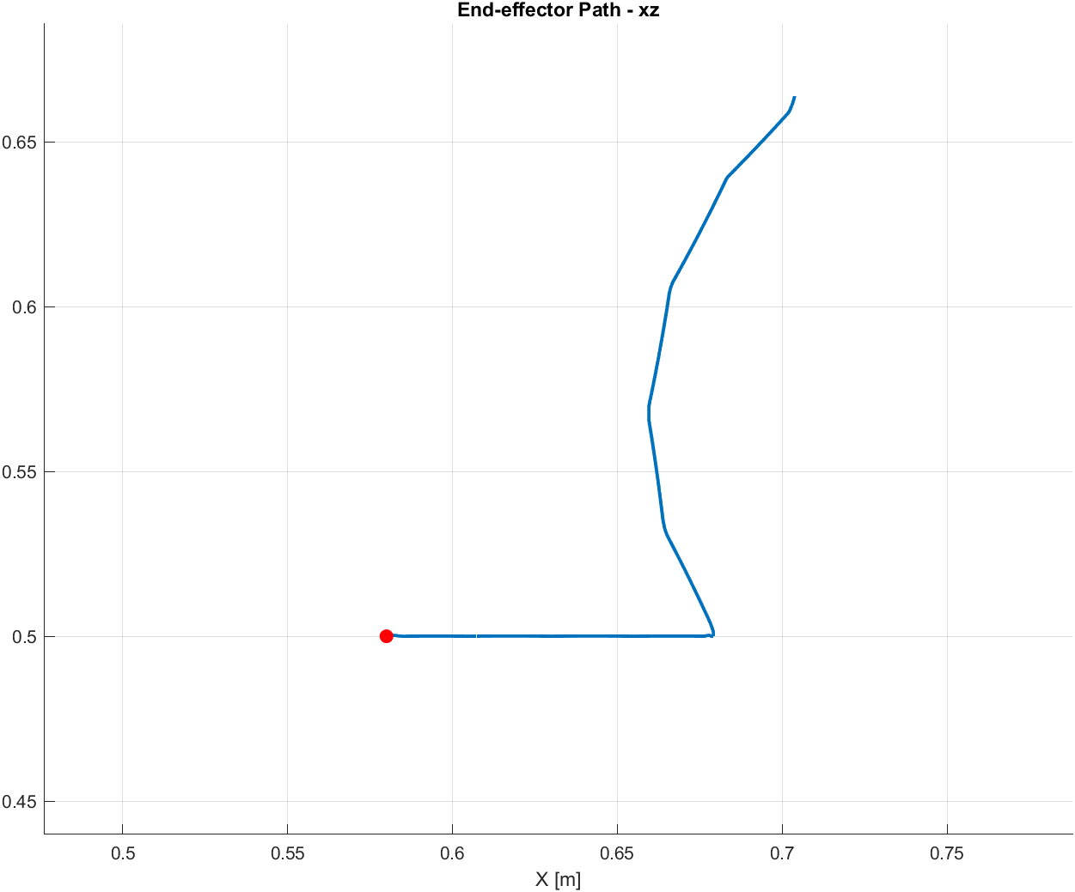
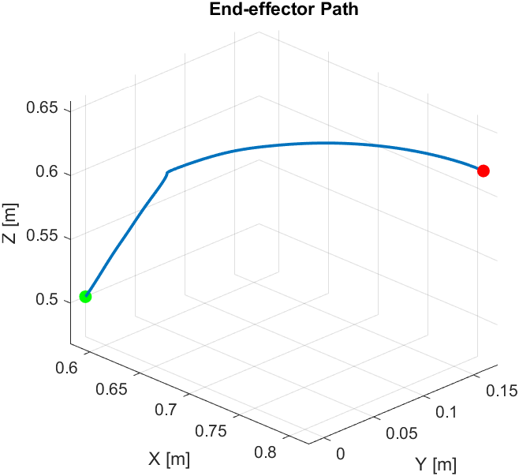
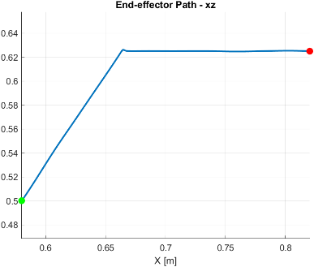
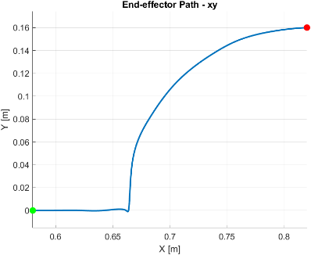
Check Motion Planning – Direct Kinematics
Trajectory 1
Trajectory 2

Slide 14
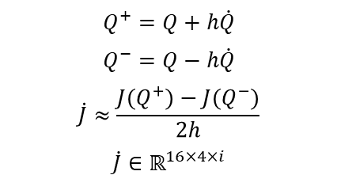
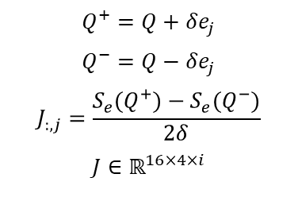

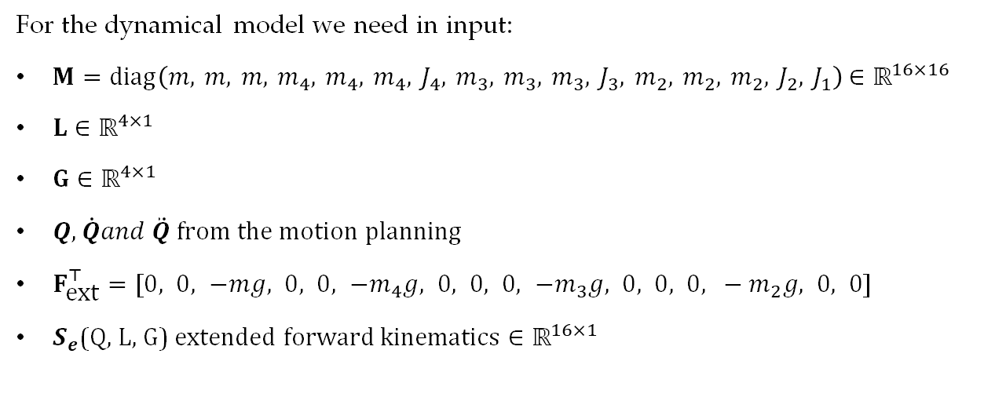
Dynamic Analysis - MATLAB
NUMERICAL
For the dynamical model we need in input:
$M=diag\left(m, m, m, m_{4}, m_{4}, m_{4}, J_{4}, m_{3}, m_{3}, m_{3}, J_{3}, m_{2}, m_{2}, m_{2}, J_{2}, J_{1}\right)$ $∈ℝ^{16×16}$
$L∈ℝ^{4×1}$
$G∈ℝ^{4×1}$
$Q, \dot{Q}and \ddot{Q}$ from the motion planning
$F_{\text{ext}}^{⊤}=[0, 0, −mg, 0, 0, −m_{4}g, 0, 0, 0, −m_{3}g, 0, 0, 0, −m_{2}g, 0, 0]$
$S_{e}$(Q, L, G) extended forward kinematics $∈ℝ^{16×1}$
Ext. Jacobian
$$Q^{+}=Q+δe_{j}$$
$$Q^{−}=Q−δe_{j}$$
$$J_{:,j}=\frac{S_{e}(Q^{+})−S_{e}(Q^{−})}{2δ}$$
$$J∈ℝ^{16×4×i}$$
Ext. Jacobian derivative
Now we can compute the torques of the joints:
$$Q^{+}=Q+h\dot{Q}$$
$$Q^{−}=Q−h\dot{Q}$$
$$\dot{J}≈\frac{J(Q^{+})−J(Q^{−})}{2h}$$
$$\dot{J}∈ℝ^{16×4×i}$$
$$\ddot{x}=\dot{J}(q,\dot{q}) \dot{q}+J(q) \ddot{q}$$
$$F_{\text{si}}=−M\ddot{x}$$
$$F_{s}=F_{\text{ext}}+F_{\text{si}}$$
$$τ=−J({q)}^{⊤}F_{s}$$

Slide 15
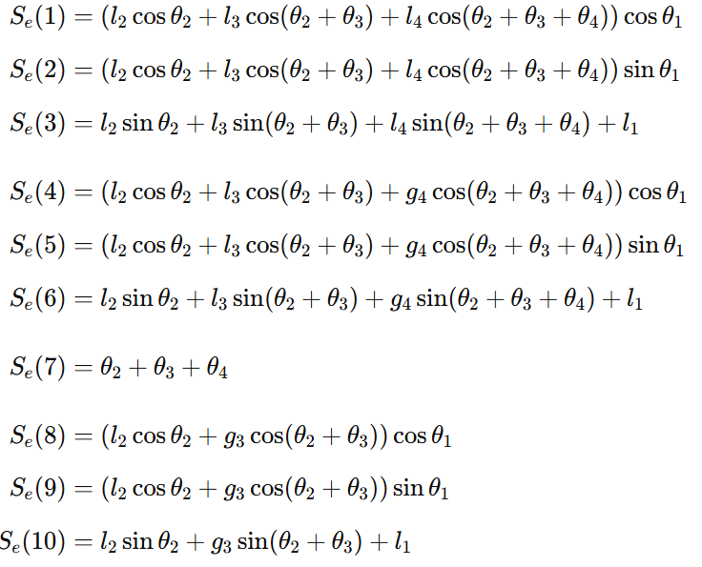
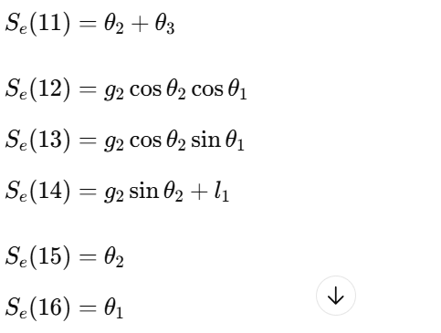
Dynamic Analysis - MATLAB
Extended forward kinematics:

Slide 16
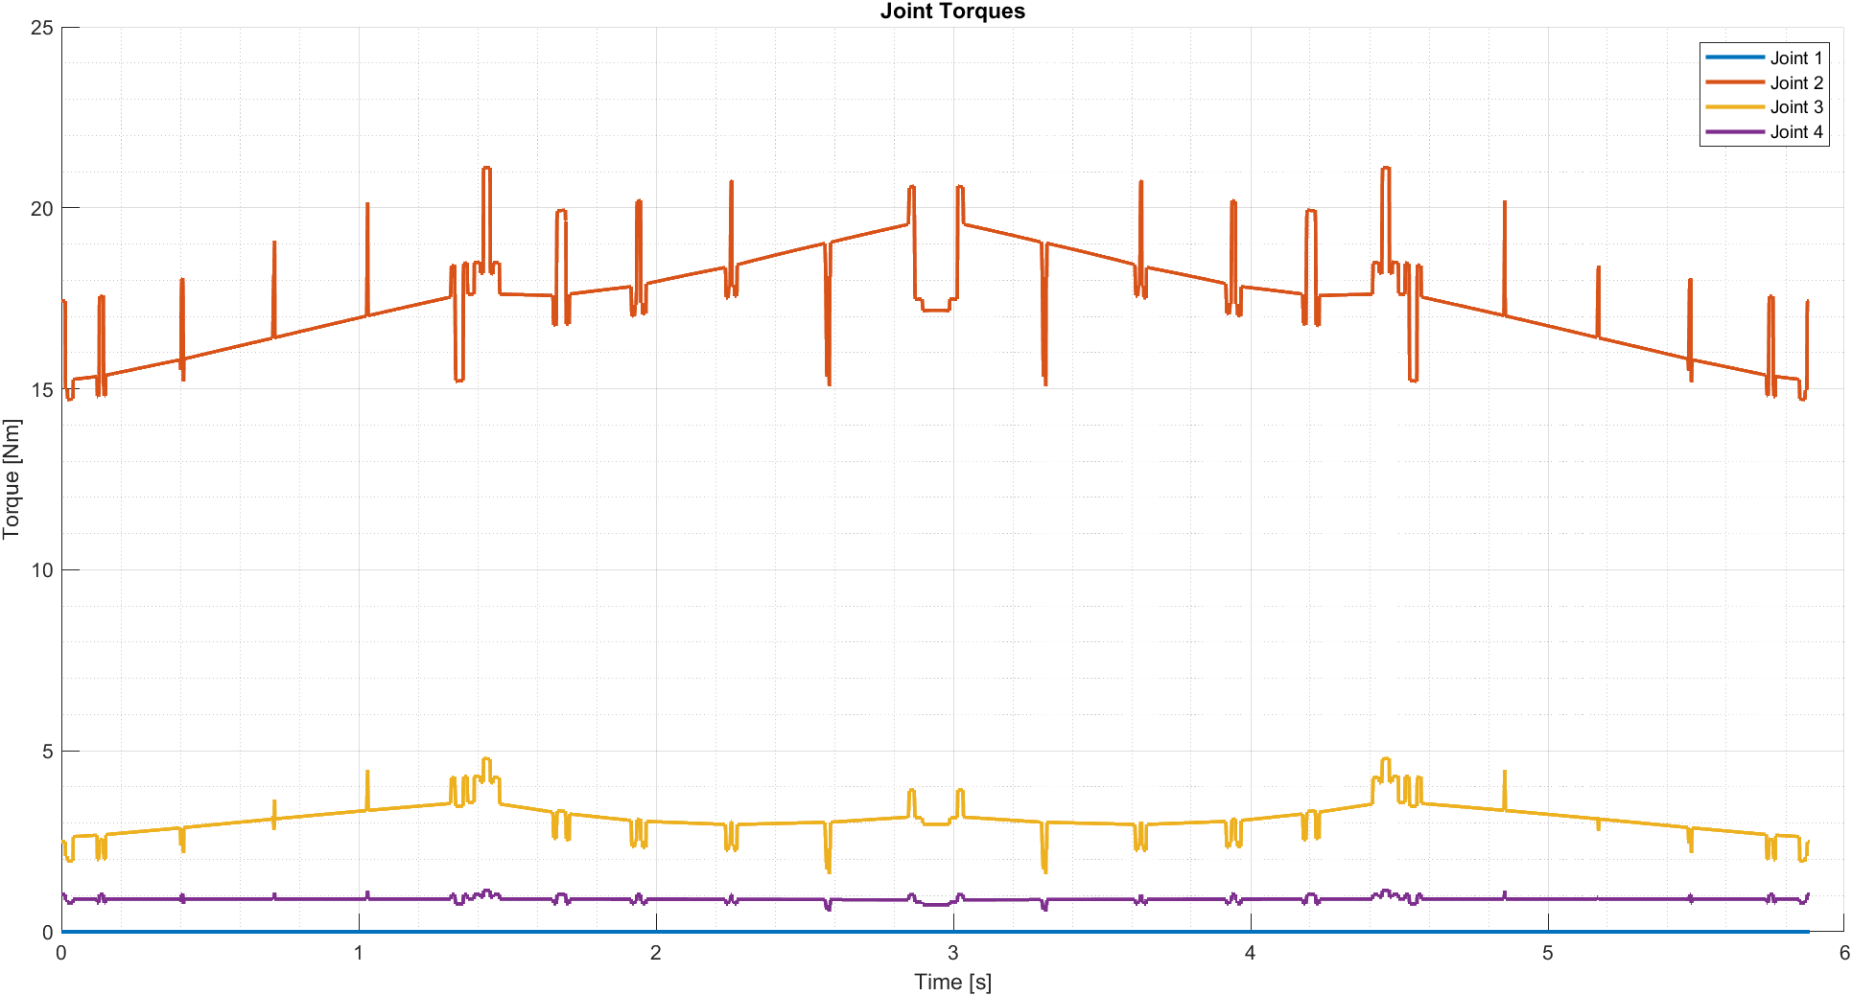
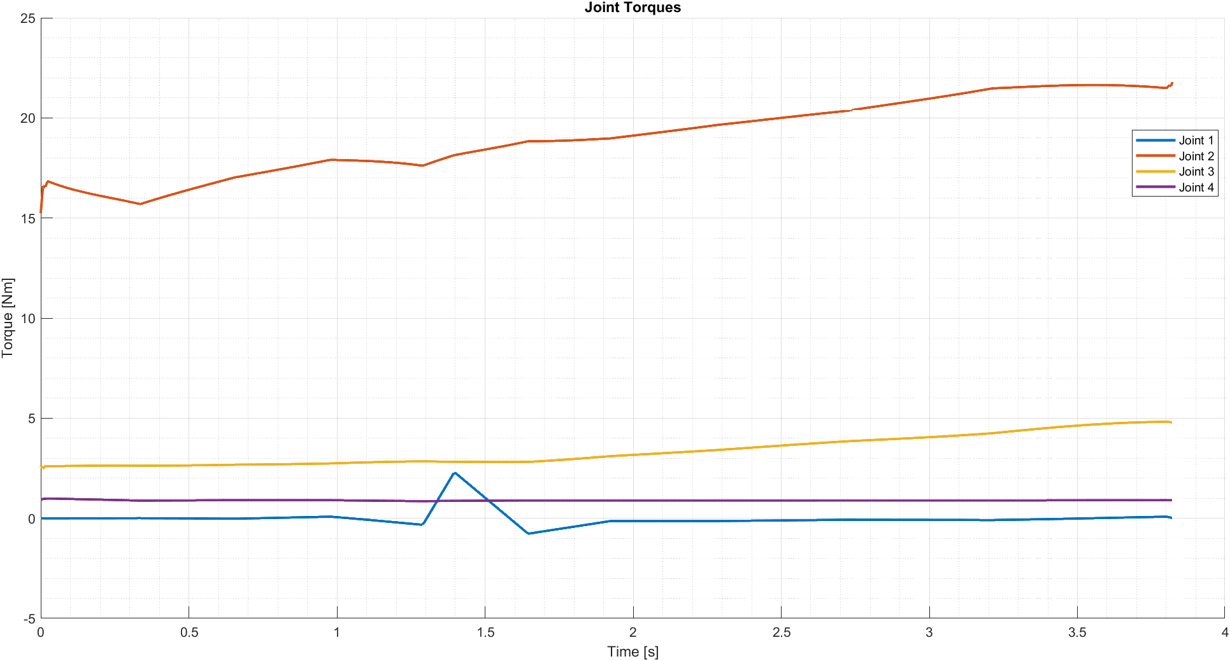
Dynamic Analysis - MATLAB
Trajectory 1
Trajectory 2

Slide 17
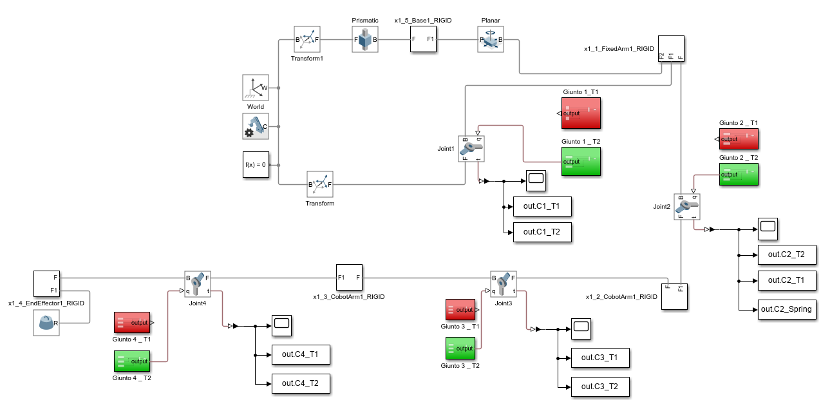
Dynamic Analysis - SIMSCAPE

Slide 18
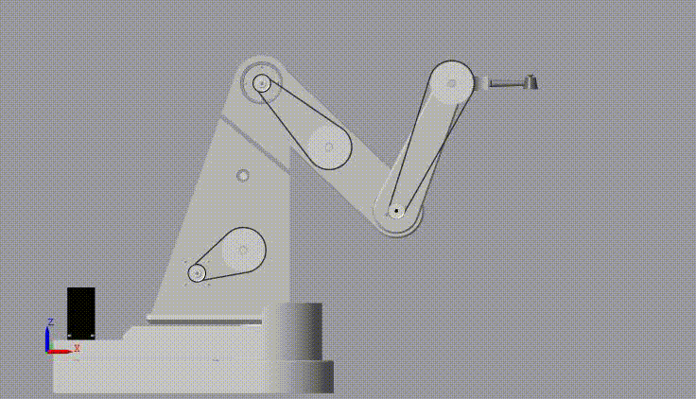
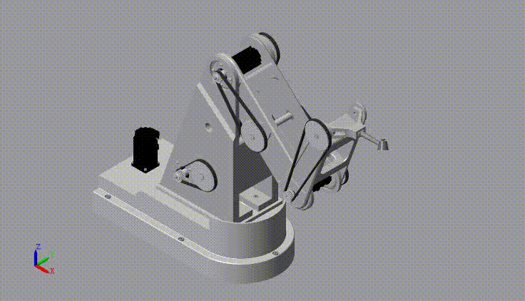
Dynamic Analysis - SIMSCAPE
Trajectory 1
Trajectory 2

Slide 19
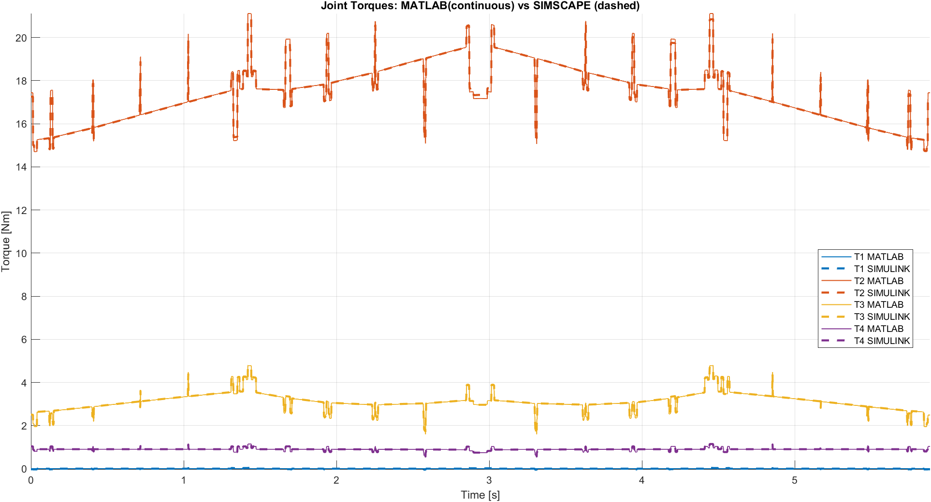
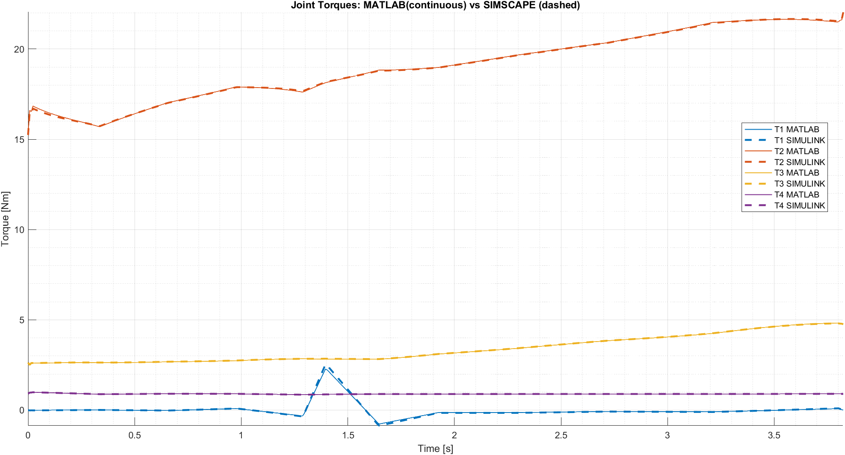
Dynamic Analysis - SIMSCAPE
These are the plots of the torques in output from Simscape (dashed lines) compared with the MATLAB ones (continues lines)
Trajectory 1
Trajectory 2

Slide 20
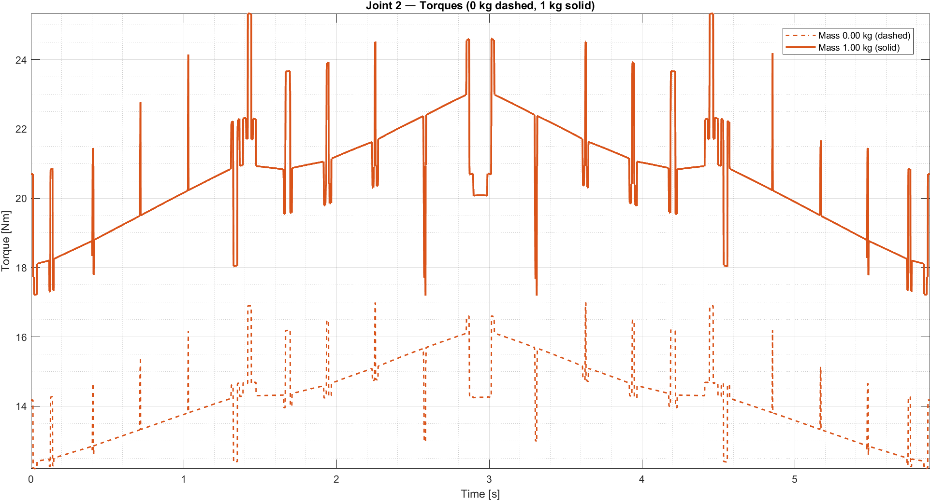
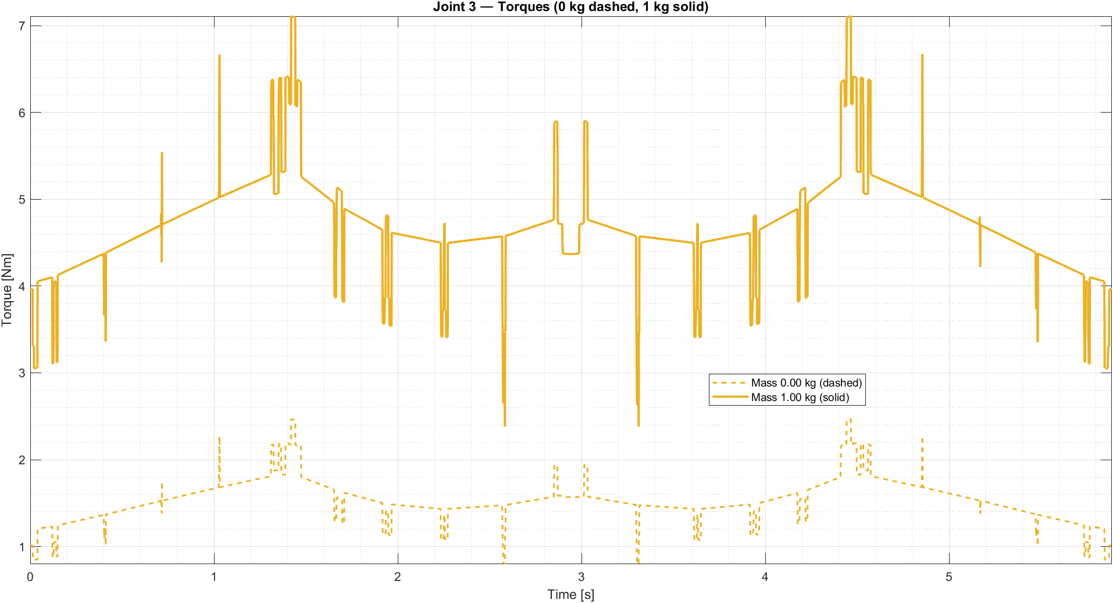
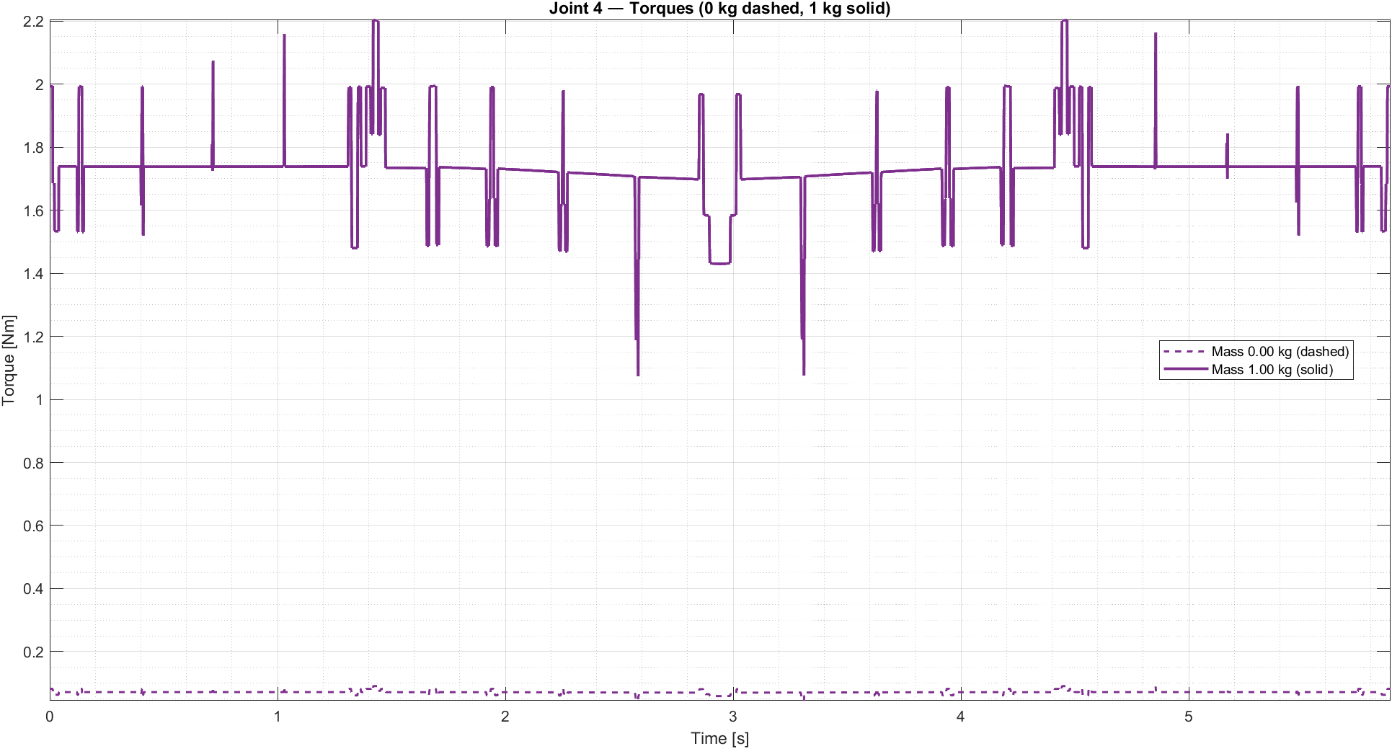
Dynamic Analysis - Different Payload
We perform the analysis with two different payload: 0 Kg and 1 Kg.
The dashed lines are 0 Kg, the continuous ones are 1 Kg
Trajectory 1

Slide 21
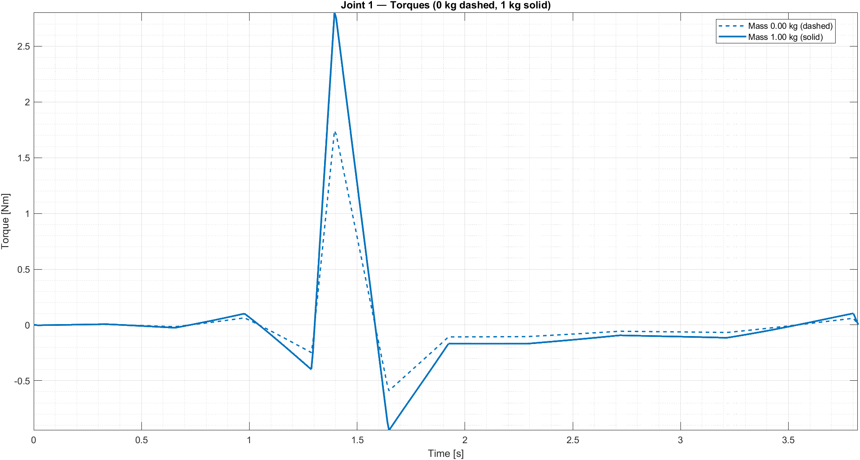
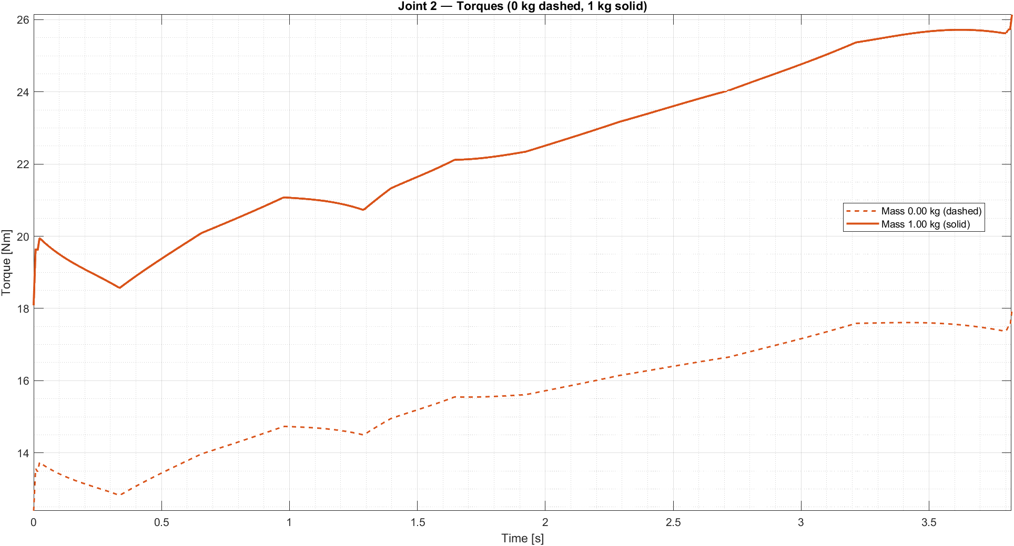
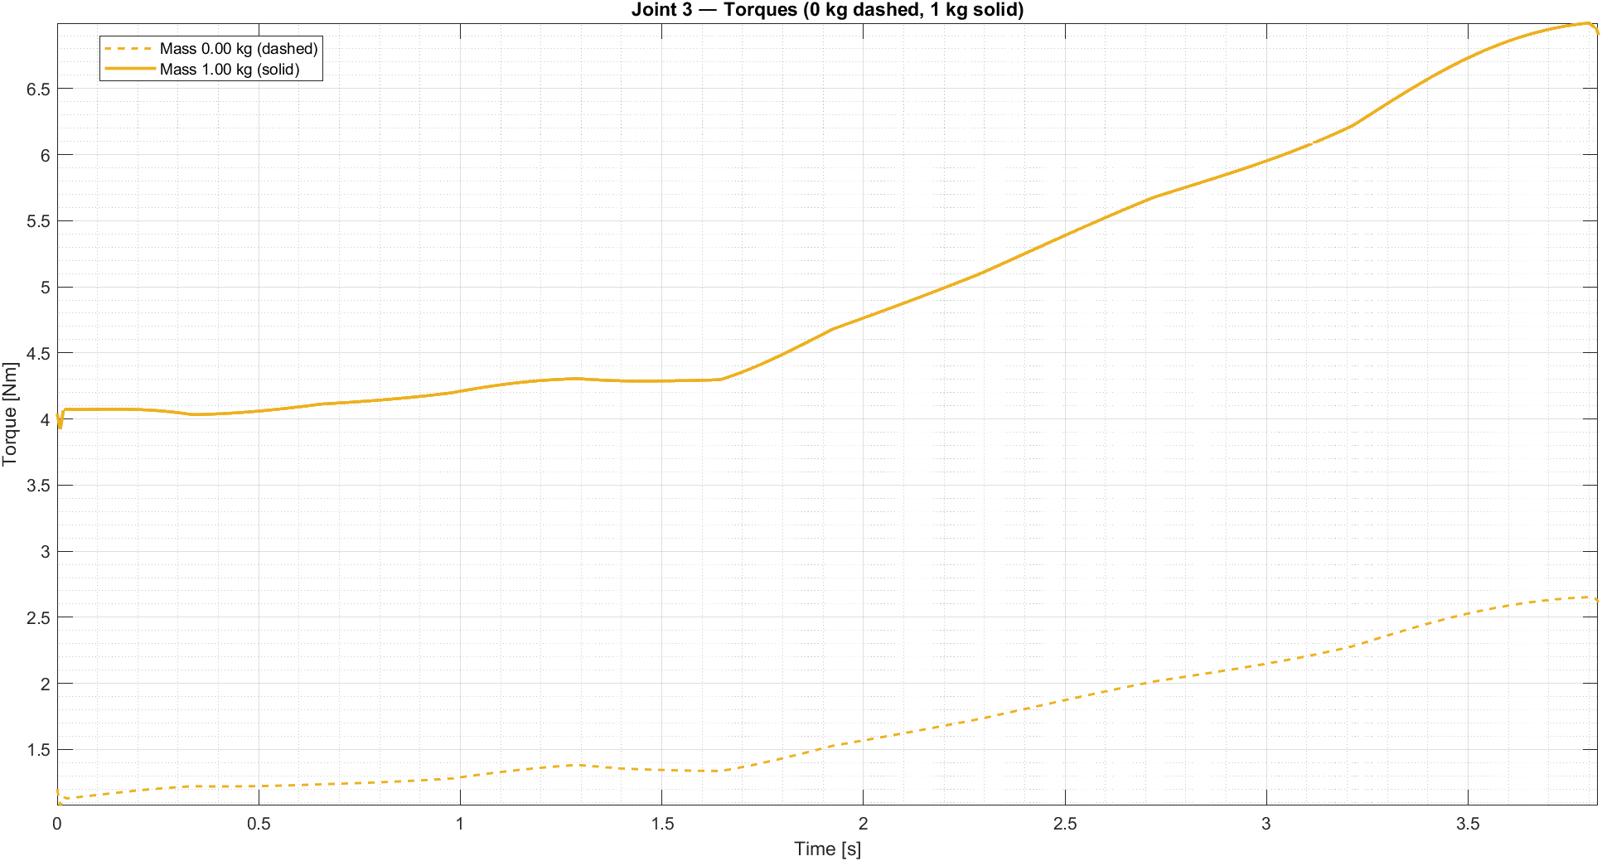
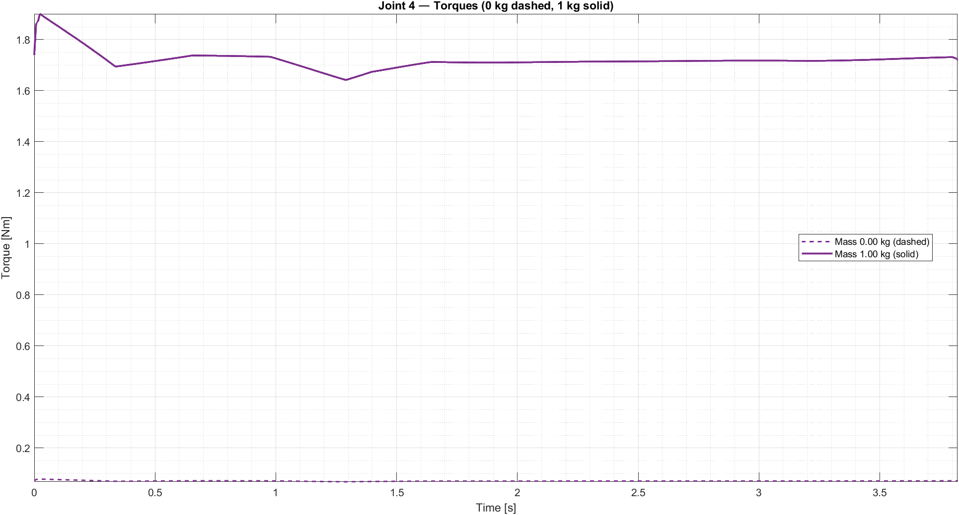
Dynamic Analysis - Different Payload
Trajectory 2

Slide 22



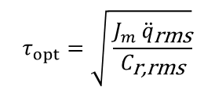


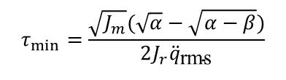

Motor and transmission sizing
For motors and transmissions sizing we need to define this parameters for each joint:
$$α=\frac{C_{n}^{2}}{J_{m}} β=4 J_{r} {\ddot{q}}_{\text{rms}}^{2}$$
$$τ_{opt}=\sqrt{ \frac{J_{m} {\ddot{q}}_{\text{rms}}}{C_{\text{r}\text{,}\text{rms}}}}$$
$$τ_{min}=\frac{\sqrt{J_{m}}(\sqrt{α}−\sqrt{α−β})}{2J_{r}{\ddot{q}}_{\text{rms}}}$$
$$τ_{max}=\frac{\sqrt{J_{m}}(\sqrt{α}+\sqrt{α−β})}{2J_{r}{\ddot{q}}_{\text{rms}}}$$
$$τ_{vel} =\frac{{\dot{q}}_{max}}{{\dot{q}}_{p,m,max⁡}}$$
For each joint, this conditions must be satisfied:
Nominal Torque condition
Maximum Torque condition
Transmission Ratio Limit
$$C_{m,n}>τ C_{\text{r}\text{,}\text{rms}\text{,}\text{max}}$$
$$C_{m,max⁡}>τ C_{max}$$
$τ_{max}>τ>τ_{vel}>τ_{min}$

Slide 23
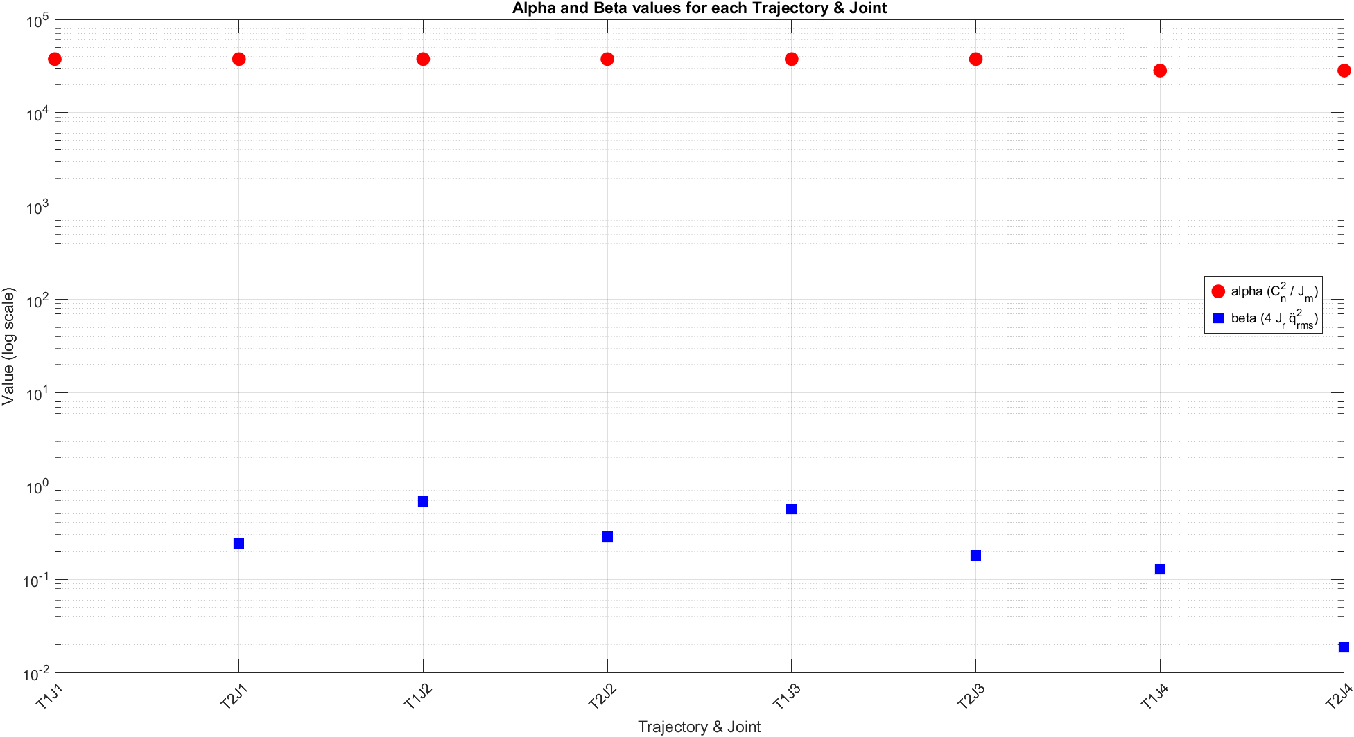
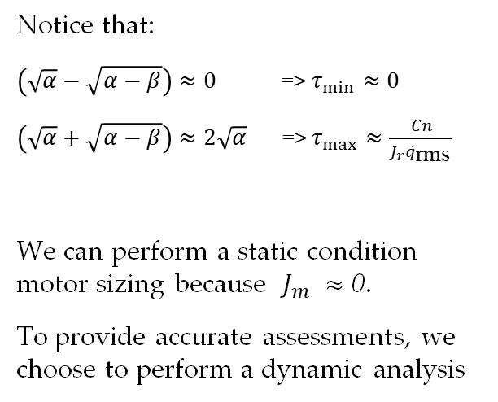
Motor and transmission sizing
Notice that:
$\left(\sqrt{α}−\sqrt{α−β}\right)≈0$ => $τ_{min}$ $≈0$
$\left(\sqrt{α}+\sqrt{α−β}\right)≈2\sqrt{α}$ => $τ_{max}$ $≈$ $\frac{ Cn}{J_{r}{\ddot{q}}_{\text{rms}}}$
We can perform a static condition motor sizing because $J_{m} ≈\text{0}$.
To provide accurate assessments, we choose to perform a dynamic analysis

Slide 24


Motor and transmission sizing
Joint 1
Motor: HG-KR23B, 200W
Transmission: τ1= 0.5
Joint 2
Motor: HG-KR23B, 200W
Transmission: τ2= 0.02
Condition 1: Cm, n=0.64>τ Cr, rms, max= 0.2208 > Passed
Condition 2: Cm, max=1.9>τ C max= 1.2628 > Passed
Condition 1: Cm, n=0.64>τ Cr, rms, max= 0.3983 > Passed
Condition 2: Cm, max=1.9>τ C max= 0.4602 > Passed

Slide 25


Motor and transmission sizing
Joint 3
Motor: HG-KR23B, 200W
Transmission: τ3= 0.11
Joint 4
Motor: HG-KR13B, 100W
Transmission: τ4= 0.33
Condition 1: Cm, n=0.64>τ Cr, rms, max= 0.3824 > Passed
Condition 2: Cm, max=1.9>τ C max= 0.5337 > Passed
Condition 1: Cm, n=0.32>τ Cr, rms, max= 0.1503 > Passed
Condition 2: Cm, max=0.95>τ C max= 0.1910 > Passed

Slide 26




Motor and transmission sizing – different payload
We just size the motors and transmissions for the worst case (payload: 1 Kg)
Condition 1: Cm, n=0.64>τ Cr, rms, max= 0.2671 > Passed
Condition 2: Cm, max=1.9>τ C max= 1.5283 > Passed
Condition 1: Cm, n=0.64>τ Cr, rms, max= 0.4703 > Passed
Condition 2: Cm, max=1.9>τ C max= 0.5455 > Passed
Condition 1: Cm, n=0.64>τ Cr, rms, max= 0.5694 > Passed
Condition 2: Cm, max=1.9>τ C max= 0.7815 > Passed
Condition 1: Cm, n=0.32>τ Cr, rms, max= 0.2887 > Passed
Condition 2: Cm, max=0.95>τ C max= 0.3669 > Passed

Slide 27





Possible improvement
Choosing a torsional spring of 0.6 Nm/deg could be helpful to reduce the $C_{\text{r}\text{,}\text{rms}}$ values for both the trajectories.
$$τ_{\text{opt}}=\sqrt{ \frac{J_{m} {\ddot{q}}_{\text{rms}}}{C_{\text{r}\text{,}\text{rms}}}}$$
 | With spring |  | Without Spring
 | Trajectory 1 | Trajectory 2 | Trajectory 1 | Trajectory 2
$C_{\text{r}\text{, }\text{rms}}$ [Nm] | 6.17 | 9.3 | 17.48 | 19.12
$$τ_{\text{opt}}$$ | 0.00120 | 0.00079 | 0.00071 | 0.00055

Slide 28




Quality of the robot
To evaluate the quality of the robot it has been decided to analyze the force and velocity ellipses with the corresponding conditioning index.
Kinetostatic duality
$$\left\{\begin{aligned}F_{q}=−J^{T}F_{s} \\ \dot{S}=J\dot{Q}\end{aligned}\right.$$
Joint velocities and forces of constant norm
$$\left\{\begin{aligned}{\dot{Q}}^{T}\dot{Q}=1 \\ {F_{q}^{T}F}_{q}=1\end{aligned}\right.$$
$$\left\{\begin{aligned}&{\dot{S}}^{T}{\left({JJ}^{T}\right)}^{−1}\dot{S}=1 \\ &F_{S}^{T}\left({JJ}^{T}\right)F_{s}=1\end{aligned}\right.$$
Manipulability matrix: $M={JJ}^{T}$
$$σ_{i}=\sqrt{λ\left(JJ^{T}\right)}$$
Representative of the semiaxis of the ellipsoids, can also be evaluated directly as the eigenvalues of the Jacobian.

Slide 29




Quality of the robot
Trajectory 1
Trajectory 2

Slide 30




Quality of the robot
The index that permit to correctly estimate the quality of the robot is the inverse of the conditioning index:
$$Ci=\frac{σ_{min}}{σ_{max}}$$
$$Ci∈[0,1]$$
Trajectory 1
Trajectory 2

Slide 31

3D Model

Slide 32

3D Model

Slide 33


3D MODEL - ASSEMBLY

Slide 34


3D MODEL - ASSEMBLY

Slide 35



3D MODEL - ASSEMBLY

Slide 36

3D MODEL – BEARINGS CONFIGURATIONS
The shaft at the base (the one related to the first rotation) employs a pair of back-to-back angular-contact ball bearings. This configuration sustain both radial and axial loads.

Slide 37


3D MODEL – BEARINGS CONFIGURATIONS
Deep-groove radial ball bearings are used in pair for shafts and joints. Although angular-contact bearings would be preferred, we choose this configuration both for simplicity and because the axial loads are negligible.

Slide 38

3D MODEL – BEARINGS CONFIGURATIONS

Slide 39


PULLEYS
In a first attempt the idea was to fix the pulleys using keys (linguette). However, keys perform poorly under frequent reversal of rotation and can increase backlash. So, at the end we choose clamped or friction mounts solutions.

Slide 40








TRANSMISSION RATIOS
Joint 1
Joint 2
Joint 3
Joint 4
Motor3
1:3
Motor1
Motor4
1:4
1:4
1:3
1:2
1:3
Motor2
1:3
${\text{τ}}_{1}$= 0.5
${\text{τ}}_{2}$= 0.02
${\text{τ}}_{3}$= 0.11
${\text{τ}}_{4}$= 0.33

Slide 41


SOLUTION TO AVOID THREAD
Threading directly into plastic is not recommended, as the thread is prone to rapid wear

Slide 42

Epson: 6-axis robot arm
Characteristics
N. of joints | 6
Max. reach | 900 mm
Max. payload | 4 kg
Epson C4-A9012

Slide 43
Epson: Teaching Points
P11
Teaching Points
Geometry | Trajectory 1 | Trajectory 2
Linear | P0, P1, P2, P3, P4, P5 | P12, P13, P14, P15, P16, P17
Circular | P6, P7, P8, P9, P10, P11 | P18, P19, P20, P21, P22, P23, P24, P25
P0
P25
Trajectory points used for the motion path planning
P12

Slide 44







Epson: TCP speed and acceleration setting
Average Joint Position
$$\overline{q_{i}}=\frac{1}{N}\sum_{k=1}^{N}{q_{k}} i=1,2,3,4$$
Average Joint Speed
Average Joint Speed Vector
$${\left\|\overline{\dot{S}}\right\|}_{2}=\sqrt{{\overline{{\dot{S}}_{x}}}^{2}+{\overline{{\dot{S}}_{y}}}^{2}+{\overline{{\dot{S}}_{z}}}^{2}}$$
Average Joint Velocity
$$\overline{\dot{S}}=J_{m}\overline{Q}$$
$$\overline{{\dot{q}}_{i}}=\frac{1}{t_{f}−t_{0}}\int_{t_{0}}^{t_{f}}{\left|\dot{q}\right|dt }=\frac{1}{T}\int_{t_{0}}^{t_{f}}{\left|\dot{q}\right|dt } i=1,2,3,4$$
Average Joint Acceleration Vector
Average Joint Acceleration
$$\overline{\ddot{S}}={\dot{J}}_{m}\overline{\dot{Q}}+J_{m}\overline{\ddot{Q}}$$
$${\left\|\overline{\ddot{S}}\right\|}_{2}=\sqrt{{\overline{{\ddot{S}}_{x}}}^{2}+{\overline{{\ddot{S}}_{y}}}^{2}+{\overline{{\ddot{S}}_{z}}}^{2}}$$
Average Joint Acceleration
$$\overline{{\ddot{q}}_{i}}=\frac{1}{t_{f}−t_{0}}\int_{t_{0}}^{t_{f}}{\left|\ddot{q}\right|dt }=\frac{1}{T}\int_{t_{0}}^{t_{f}}{\left|\ddot{q}\right|dt } i=1,2,3,4$$

Slide 45



Epson: Motion Programming
Data logger function
Trajectory 1 motion code
Trajectory 2 motion code

Slide 46


Epson: Motion path simulation
Simulation of the Trajectory 1
Completion Time: 6.6450 s
Simulation of the Trajectory 2
Completion Time: 4.7670 s

Slide 47


Epson: TCP Position – Trajectory 1
Trajectory 1 Motion Path
TCP position trend – Trajectory 1

Slide 48


Epson: TCP Position – Trajectory 2
Motion Path of the Trajectory 2
TCP position trend – Trajectory 2

Slide 49


Epson: TCP Speed
TCP speed trend – Trajectory 1
TCP speed trend – Trajectory 2

Slide 50


Epson: TCP Acceleration
TCP acceleration trend – Trajectory 1
TCP acceleration trend – Trajectory 2

Slide 51


Epson: Joint Position
Joint position trend – Trajectory 1
Joint position trend – Trajectory 2

Slide 52


Epson: Joint Velocity
Joint velocity trend – Trajectory 1
Joint velocity trend – Trajectory 2

Slide 53


Epson: Joint Acceleration
Joint acceleration trend – Trajectory 1
Joint acceleration trend – Trajectory 2

