Slide 1
Tuscany Now Walking Tours
Erica Esinam Gelly
Notes:
This file created specifically for Mark Mensah

Slide 2
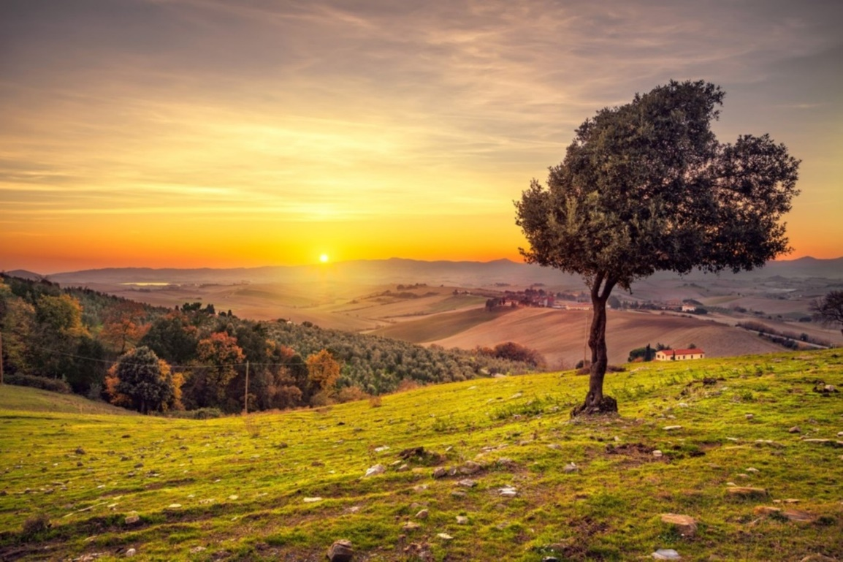
All About Tuscany Now
Family-Owned Company for 20 years
Unique Itineraries
Local Tour Guides
Boutique Hotels
Fabulous Meals
Cooking Classes

Slide 3

Small Is Good!
All groups contain between four and twelve travelers
Personalized itineraries to suit each group’s interests
Contact with locals—farm stays, cooking classes, art tours
Fun!

Slide 4
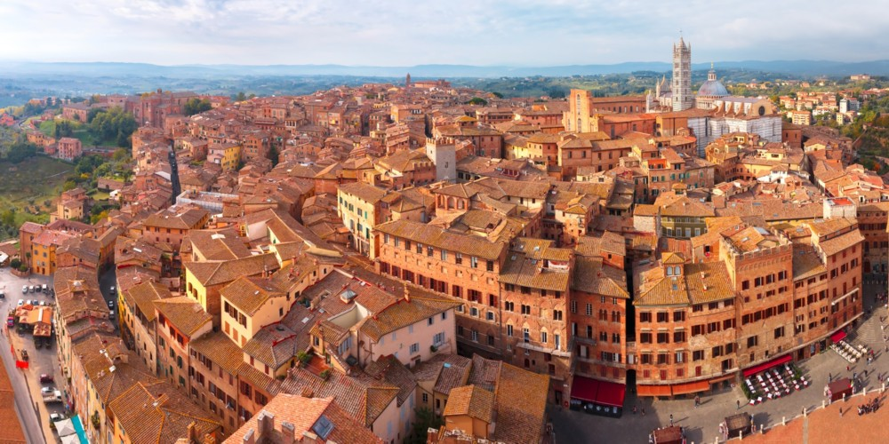
Location
Tuscany Now operates out of Siena in Tuscany. All tours depart from and return to Siena.
Stay a few days in this fabulous medieval city with its wonderful art and famous Campo.
Fabulous Siena!

Slide 5
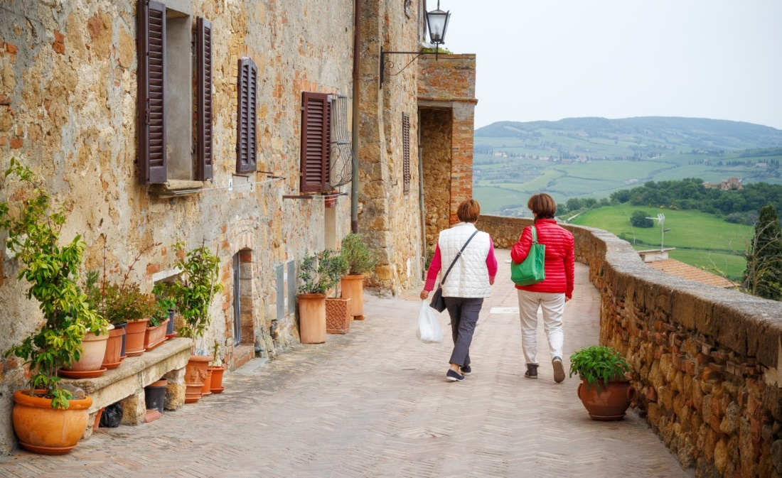
Our Most Popular Walks
Tuscany Sampler™
Siena to San Gimignano
Siena to Montalcino
Siena to Pienza
Siena to Val d’Orcia

Slide 6
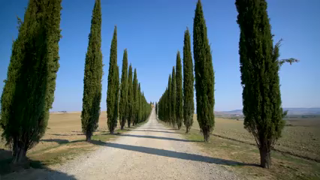
Bella Toscana!

Slide 7
Tour Schedule
May | June | July
May 5 | June 4 | July 2
May 15 | June 12 | July 17
May 26 | June 24 | July 28

Slide 8
Tuscany Sampler Itinerary
Day | Activities | Accommodation
1 | Chianti walk, olive oil experience, cooking class | Hotel Flora, Siena
2 | San Gimignano walk, farmhouse lunch | Hotel Ciara, San Gimignano
3 | Walk near Monte Amiata, farmhouse cooking class | Hotel Celeste, Montalcino
4 | Bagno Vignoni and San Quirico | Hotel d’Orcia, Pienza
5 | Monticchiello walk, cheese-making farm | Hotel d’Orcia, Pienza
6 | Walk near Montepulciano, farewell dinner | Hotel Flora, Siena

Slide 9

Book a Tour with Tuscany Now!
US Office: (216) 555-0163
Siena Office: (39) 555-701-016
www.tuscanynow.cengage.com

