Slide 1
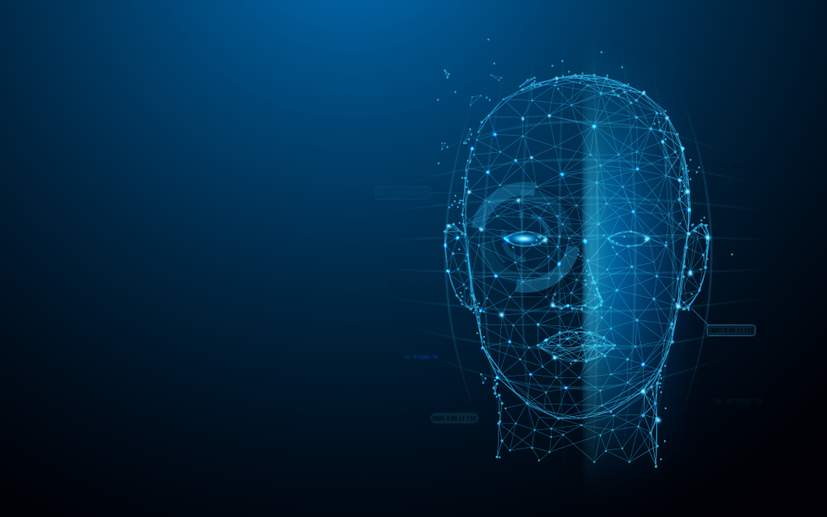
Smart ATTENDENCE SYSTEM USING OPENCV BASED ON FACE RECOGNITION
PRESENTED by: Yogender Kumar
Roll NO. 17/NR/UT/CS023
CLASS: B.TECH(CSE)

Slide 2
ABSTRACT
This presentation describes an overview and the outcome of work done on this project during the training of bachelor of computer science. I had made the project on FACE RECOGNITION BASED ATTENDANCE SYSTEM. In this project, I have used python language, OPENCV, and Numpy.
Face recognition being A biometric technique implies determination if the image of the face of any particular person matches any of the face images that are stored in A database. This difficulty is tough to resolve automatically because of the changes that several factors, like facial expression, aging and even lighting can affect the image.
The expected system engages the face recognition approach for the automating the attendance procedure of students or employees without their involvement. A web cam is used for capturing the images of students or employees.
The aim of this project is to develop the faces in the captured images are detected and compared with the images in database and the attendance is marked

Slide 3
Index
INTRODUCTION
AIMS AND OBJECTIVE
IMPLEMENTATION
HOW THE SYSTEM WORKS
SOFTWARE REQUIREMENT
RESULT ANALYSIS
CONCLUSION
FUTURE SCOPE
REFERENCES

Slide 4
Introduction
As we are making a system which can recognize face and match with its own database. It will make the attendance system more authentic.
Our primary goal is to help the lecturers, improve and organize the process of track and manage student attendance and absenteeism.
Attendance maintenance is a significant function in all the institutions to monitor the performance of the students.
A facial recognition system is computerized biometric software which is suited for determining or validating a person by performing comparison on patterns based on their facial appearances

Slide 5
Aims and Objectives
Improve and organize the process of track and manage student attendance and absenteeism.
Additionally, we seek to:
provides a valuable attendance service for both teachers and students.
Reduce manual process errors by provide automated and a reliable attendance system uses face recognition technology.
Increase privacy and security which student cannot presenting himself or his friend while they are not.
Produce monthly reports for lecturers.
Flexibility, lecture’s capability of editing attendance records.
Calculate absenteeism percentage and send reminder messages to students.

Slide 6
IMplementation
A. Data Acquisition
i. Image acquisition:
Image is acquire using a high definition camera which is placed in the classroom. This image is given as an input to the system.
ii. Dataset Creation:
Dataset of students is created before the recognition process. Dataset was created only to train this system. We have created a dataset of 5 students which involves their name, roll number, department and images of student in different poses and variations. For better accuracy minimum 15 images of each students should be captured. Whenever we register student’s data and images in our system to create dataset, deep learning applies to each face to compute 128-d facial features and store in student face data file to recall that face in recognition process. This process is applies to each image taken during registration.
iii. Storing:
We have used JSON to store the student’s data.

Slide 7
iv. JavaScript Object Notation (JSON):
To represent a structured data based on JavaScript object syntax, a standard text based format is introduced. JSON is used for transmitting data in web application. It is a perfect solution for storing temporary data that’s consumed by the entity that’s creates the data. JSON can store data in String, Number, Object, Array, Boolean, Null form which means it has limitation of storing data in functions, dates and undefined data form. If you are trying to store or exchange data in functions or dates than JSON is not right choice for you.
B. Face recognition process
Camera
Compute 128-d face embedding via deep metric learning
Compare 128-d vector to known dataset
Frame/Image
Detect Faces (HOG Method)
Recognize face
Attendance Marking
Excel sheet generated

Slide 8
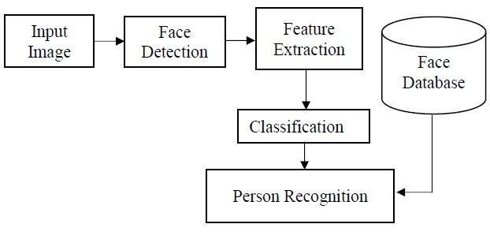
BLOCK DIAGRAM

Slide 9
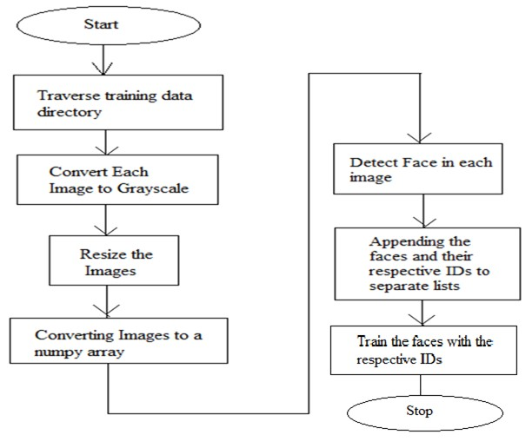
FLOW CHART USED FOR TRAINING PROCESS

Slide 10
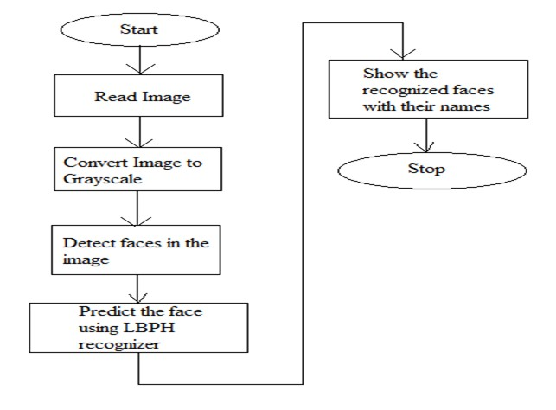
Flow-chart of the methodology used for Face Detection and Recognition

Slide 11
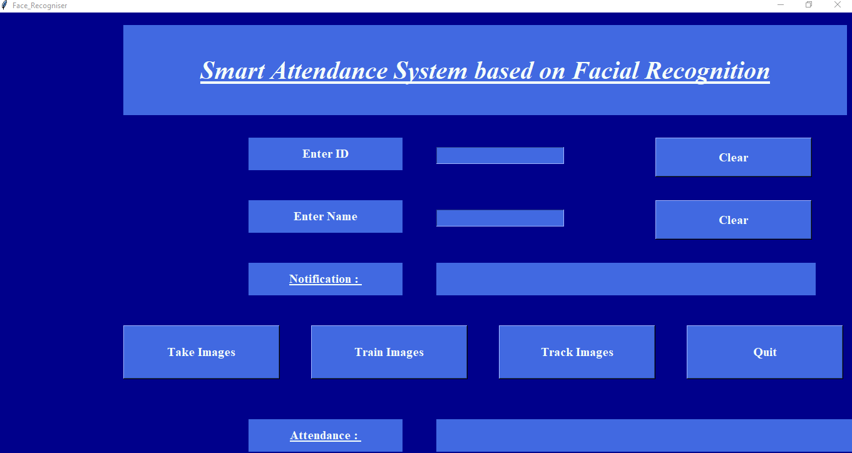
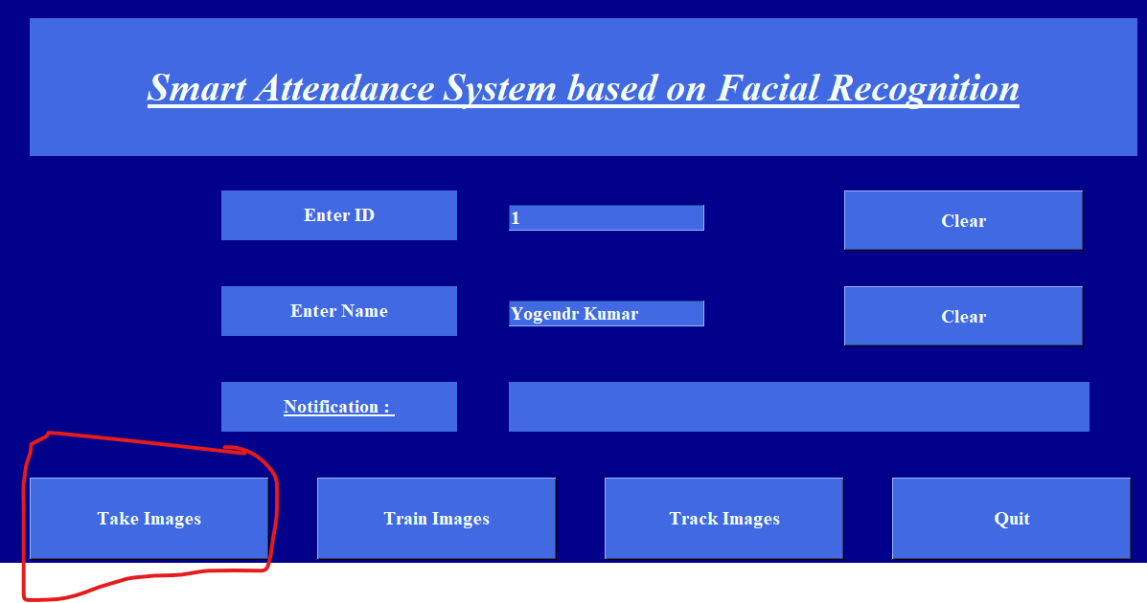
How the system works?
This system works accordingly with a series of step explained below:
DATA COLLECTION:
Fig1.interact with graphic user interface
Fig2. Entering the detail and then student will click on take image

Slide 12
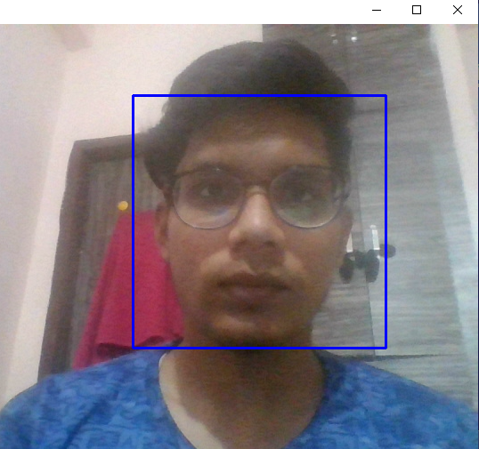
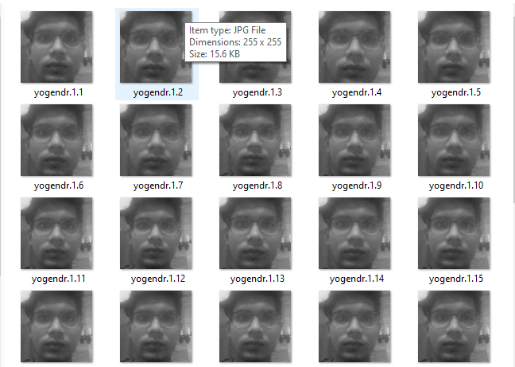

Fig3. Taking images for dataset
Fig5. Here is our Dataset Sample
Fig4. After taking images system responds

Slide 13
2. IMAGE TRAINED
The student has to click on the TRAIN IMAGE button which will link his details, face features to the LBPHrecognizer to ease further face recognition, the recognizer will save the face features in the trainner.yml and "IMAGE TRAINED" will be printed on the GUI notification board after a successful linkage
Fig6. after clicking on train images system respond
2. Face Tracking
The student has to click on the TRACK IMAGE button to allow the face recognizer to track his face through a video stream, when the system successfully recognize the student face, his details will show and "ATTENDANCE UPDATED" will be printed out otherwise , the ID will be Unknown and "ID UNKOWN, ATTENDANCE NOT UPDATED" will be printed out. Simultaneously, a csv file AttendanceFile.csv' will be updated with the ID,NAME of the student and DATE And TIME at which his face has recognized. the Unknown face captured will be store in the Unknown Images folder.

Slide 14
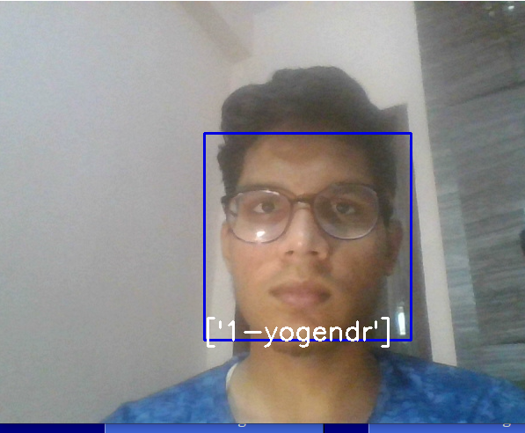


Fig7. System Recognizing the face
Fig8. attendance marked
Fig9. CSV file generated and marked the attendance

Slide 15
Software Requirement
The following software components were used in developing the system: -
Operating System-Windows 10
Programming language-Python
Editor – Pycharm, visual studio
Running Platform
The following software components are required in running the system: -
Operating System- Windows 2000/XP/7/8/10
Editor– Idle, pycharm
Programming language- Python

Slide 16
Advantages
The system stores the faces that are detected and automatically marks attendance.
Ease of use is manipulate and recognize the faces in real time using. Multiple face detection. Multipurpose software Can be used in different places.
DISADVANTAGES
The accuracy of the system is not 100%. It can only detect face from a limited distance.

Slide 17
Result Analysis
The interface for the Smart Attendance System has been created. Using the interface the images of the individual students is being recorded and stored in the training dataset. Simultaneously their information is stored in the database i.e. excel sheet. Finally the images of the students is being tracked and recognized.
Fig 4. The different folders have been created.
Fig 5. The interface for the Face Recognition Based Attendance System in which the Id and Name of the respective students are stored.
Fig 6. The images are stored in a folder named Training Images.
Fig 7. The excel sheet for the student details is created.
Fig 8. The names of the students have been stored in the Student Details excel sheet.
Fig 9. The images of the students are trained.
Fig 10. After tracking the images are attendance of the students is marked.
Fig 11. The excel sheet for attendance of the students is created.
Fig 12. The students attendance record is stored in the excel sheet

Slide 18
Conclusion
Smart attendance management system is designed to solve the issues of existing manual systems. We have used face recognition concept to mark the attendance of student and make the system better. The system performs satisfactory in different poses and variations. In future this system need be improved because these systems sometimes fails to recognize students from some distance, also we have some processing limitation, working with a system of high processing may result even better performance of this system.
This paper features the most productive Open CV face recognition method accessible for Attendance Management. The system has been implemented using the LBPH algorithm. LBPH excels other algorithms by confidence factor of 2-5 and has least noise interference. The implementation of the Smart Attendance System portrays the existence of an agreement between the appropriate recognition rate and the threshold value. Therefore LBPH is the most authentic and competent face recognition algorithm found in Open CV for the identification of the students in an educational institute and marking their attendance adequately by averting proxies

Slide 19
Future Scope
It can also be deployed vaults and lockers in banks for access control verification and identification of authentic users.
In all government and private offices this system can be deployed for identification, verification and attendance.
To identify and verify terrorists at airports, railway stations and malls the face recognition technology will be the best choice in India as compared with other biometric technologies since other technologies cannot be helpful in crowdy places.
In defense ministry and all other important places the face technology can be deployed for better security.
It can also be deployed in police station to identify and verify the criminals.

Slide 20
REFERENCES
1) Smart Attendance System using Computer Vision and Machine Learning Dipti Kumbhar#1 , Prof. Dr. Y. S. Angal*2 # Department of Electronics and Telecommunication, BSIOTR, Wagholi, Pune,
2) Face Recognition based Attendance Management System using Machine Learning Anushka Waingankar1, Akash Upadhyay2, Ruchi Shap, Nevil Pooniwala4, Prashant Kasambe5
3) Face Recognition Based Student Attendance System with OpenCV CH. VINOD KUMAR1 , DR. K. RAJA KUMAR2 1 PG Scholar, Dept of CS& SE, Andhra University, Vishakhapatnam, AP, India. 2Assistant Professor, Dept of CS& SE, Andhra University, Vishakhapatnam, AP, India.
https://www.superdatascience.com/blogs/opencv-face-recognition
https://towardsdatascience.com/face-recognition-how-lbph-works- 90ec258c3d6b
https://www.pyimagesearch.com/2018/09/24/opencv-face- recognition/
http://www.ijsrp.org/research-paper-0218/ijsrp-p7433.pdf
https://iopscience.iop.org/article/10.1088/1757- 899X/263/4/042095/pdf

Slide 21

Thanks!
Thanks!

