Slide 1

Predictive Modeling for Travel Insurance Coverage: Machine Learning Classification Approach
Erza Anandhika Valerian Vacquier
Purwadhika
JCDSOL13

Slide 2
Introduction
Context
Problem Statement & Objectives
Travel insurance is a type of insurance that provides protection when someone travels, both domestically and internationally. Some countries, such as in Europe and America, even require tourists to have travel insurance. The amount of this insurance premium depends on the desired coverage, duration of the trip, and purpose of the trip.
The company needs a model to predict which policyholders are likely to file a claim. With goals of 1. Increase prediction accuracy; 2. Optimize risk assessment; 3. Reduce financial losses from unexpected claims; 4. Enhance customer satisfaction and trust with more targeted offerings.

Slide 3
Strategy Goals
Increase the accuracy of travel insurance claim predictions.
Increase customer satisfaction and trust through more targeted offers.
Minimize potential financial losses due to unexpected claims.
Optimize the risk assessment and premium determination process.

Slide 4
Strategy Action Plan
Data Understanding
Conclusion & Recommendation
Project Objectives
Machine Learning and Model Summary for Business Implication
Historical data of policyholders, outliers and duplicates data.
Features include destination, insurance product type, trip duration, etc.
Determined the best approach to analyze travel insurance claim
3 / 2 / 2015
Exploratory Data Analysis (EDA)
Machine Learning Solution
Understand data distribution, relationships, and patterns.
Identify the best-performing model based on benchmark results for the business

Slide 5
Data Understanding

Slide 6
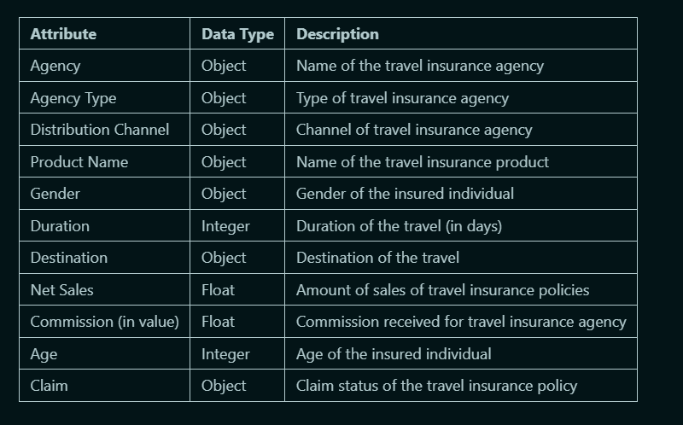
Dataset contains 10 Feature with
4 Numerical and 6 Categorical

Slide 7
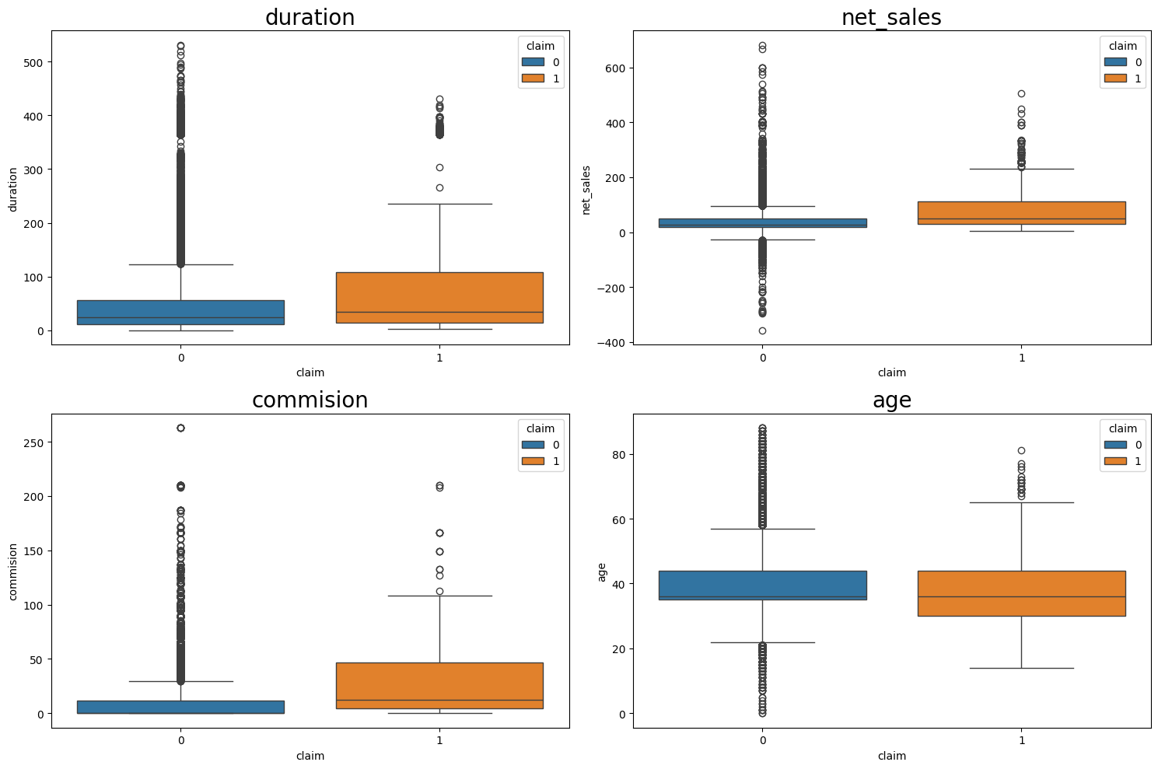
The dataset consists of 38,886 records. Outlier analysis revealed that there are numbers of outliers in columns.
In the "duration" column, there are 3,407 outliers, accounting for approximately 8.76% of the data. The "net_sales" column has 3,525 outliers, making up about 9.06% of the total data. The "commision" column contains 3,929 outliers, representing roughly 10.10% of the dataset. Lastly, the "age" column has 2,321 outliers, which is about 5.97% of the data. In total, these outliers contribute to various degrees of deviation in their respective columns, potentially affecting the overall analysis and model performance.
Domain of Knowledge Handling Outliers:
- Drop duration above 18 month
- Drop age above 100 years

Slide 8
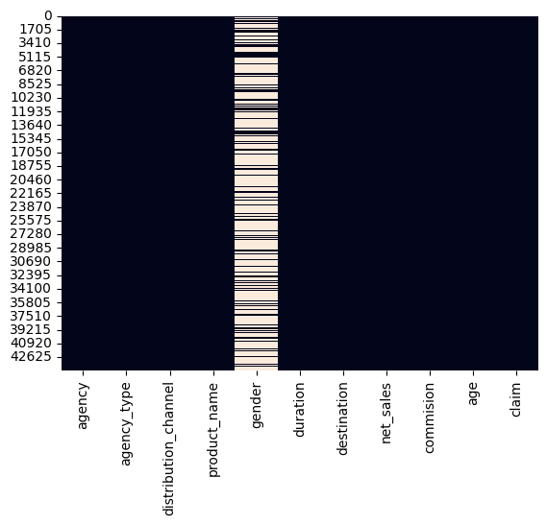
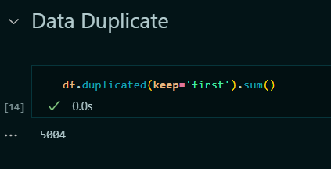
Data Cleaning process revealed there are missing values and data duplicates
During the data cleaning process, 71% of the entries in the gender feature were missing, prompting their removal from the dataset. Additionally, 5004 duplicate records were identified out of the total 38886 entries and were consequently dropped to ensure data integrity and accuracy for subsequent analyses or modeling.

Slide 9
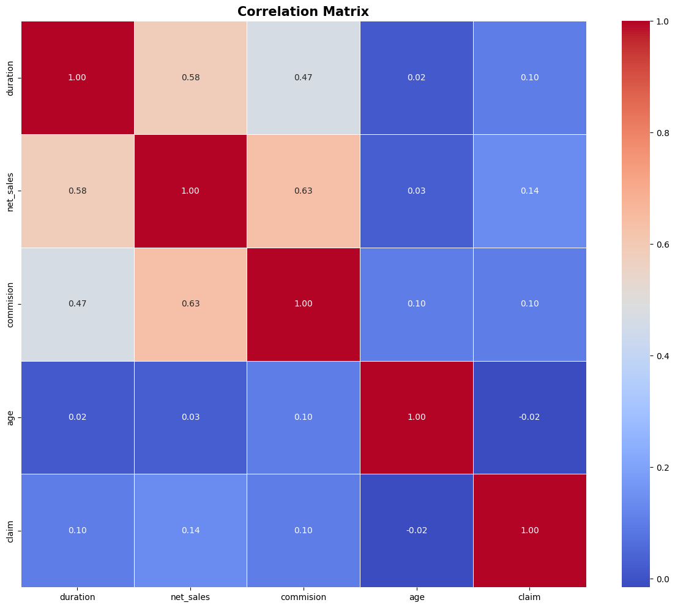
The correlation matrix reveals interesting insights about the relationships between different features in the dataset.
There's a strong positive correlation between the duration and net sales (0.582), indicating that longer durations tend to coincide with higher net sales. Similarly, the correlation between net sales and commission is also notable (0.632), suggesting that higher net sales are associated with higher commissions. However, the correlation between age and other features is relatively weak, with coefficients close to zero. Surprisingly, there's only a slight positive correlation between age and commission (0.102), implying that age has limited influence on commission amounts. Additionally, the correlation between age and claims is negative (-0.015), indicating a very weak inverse relationship between age and claims. This correlation matrix provides valuable insights for understanding the interplay between different variables in the dataset, which can inform further analysis and decision-making processes.

Slide 10
Exploratory Data Analysis

Slide 11
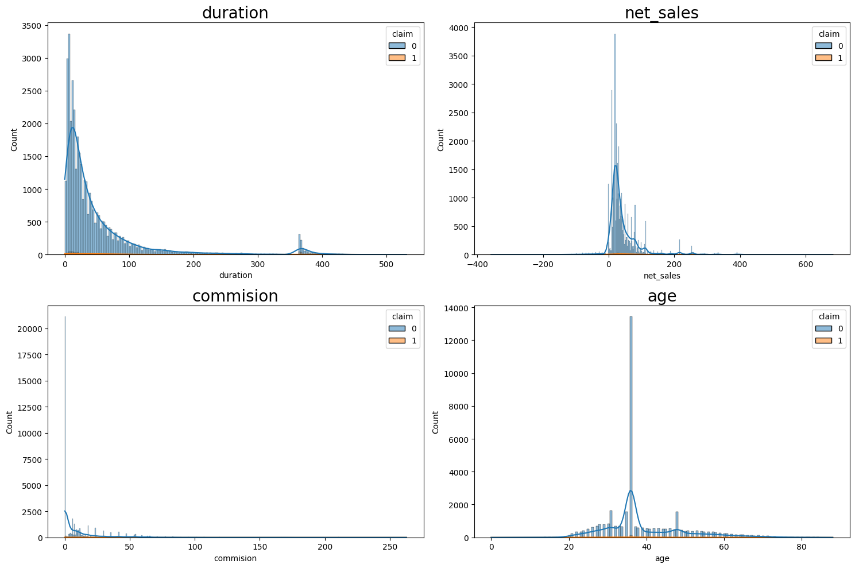
All Numeric Feature Has Skewed Distribution
Right Skew
Right Skew
Right Skew
Slighlty
Right Skew

Slide 12
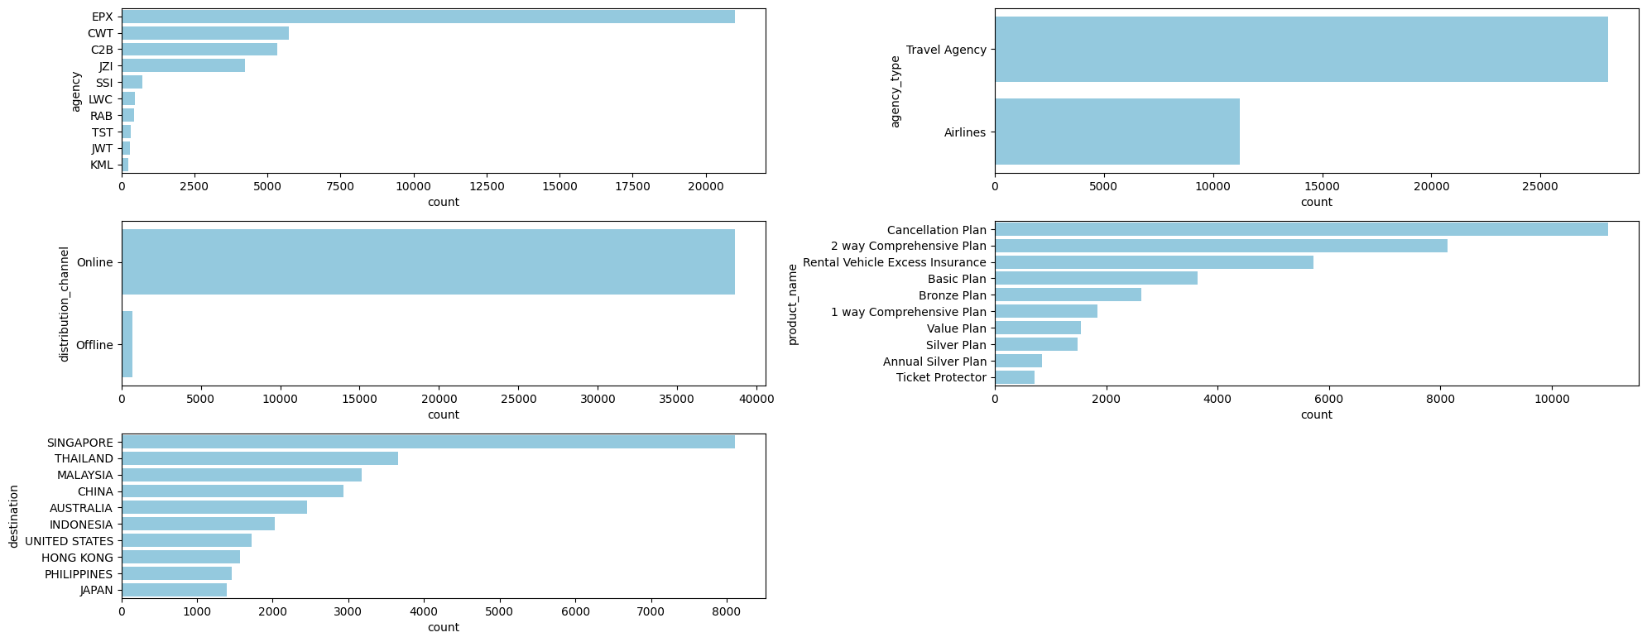
..categoric data showing Consistency, Frequency Discrepancy between the #1 and other values quite high

Slide 13
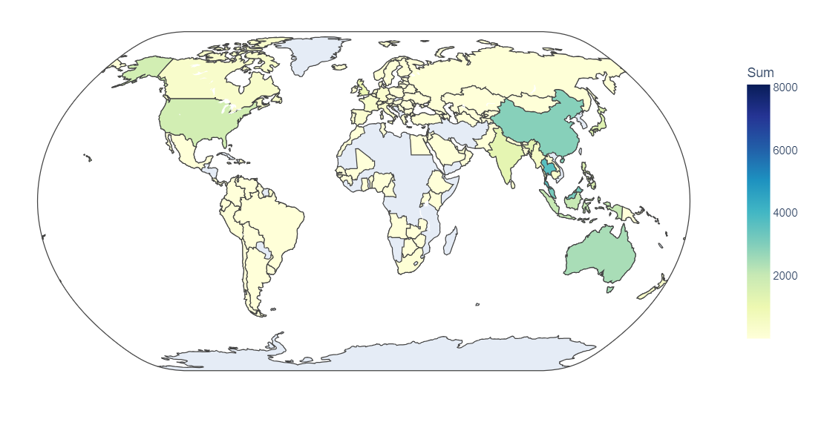
This distribution suggests that a significant portion of the insurance company’s customers travel to South-East Asia (SEA).
Understanding the popularity of these destinations is essential for several reasons. Firstly, it helps the company recognize patterns in travel behavior and preferences. Secondly, it provides insights into where most claims might originate, given the higher volume of travelers to these destinations.

Slide 14
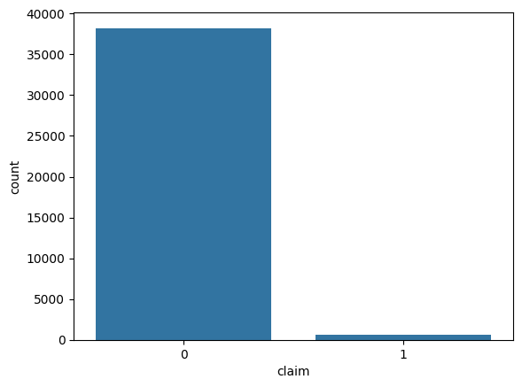
Distribution revealed significant imbalanced in target variable
The analysis revealed a significant imbalance between policyholders who filed a claim (1) and those who did not file a claim (0). Specifically, out of the total records, 38,220 policyholders did not file a claim, while only 666 policyholders did file a claim.
This imbalance indicates that the occurrence of claims is relatively rare compared to the total number of policyholders. Such an imbalance is crucial for our modeling process because it can impact the performance and evaluation of predictive models. Models trained on imbalanced data might become biased towards predicting the majority class (no claim filed), thereby reducing their effectiveness in correctly identifying the minority class (claim filed).

Slide 15
Only One Variables Showing Insignificant
 | Data Types | P-value | Corr | method | Result
Net_sales | Numeric | 2.976e-73 | 0.0911 | Spearman | Significant
Commision | Numeric | 8.433e-86 | 0.0988 | Spearman | Significant
Duration | Numeric | 8.929e-17 | 0.0419 | Spearman | Significant
Age | Numeric | 9.165e-08 | -0.0269 | Spearman | Significant
Agency | Category | 1.99e-280 |  | Chi-square | Significant
Agency Type | Category | 4.58e-101 |  | Chi-square | Significant
Distribution Channel | Category | 0.409 |  | Chi-square | Not Significant
Product Name | Category | 0.0 |  | Chi-square | Significant
Destination | Category | 6.11e-88 |  | Chi-square | Significant
Based on the correlation results, only the "distribution channel" variable does not show a statistically significant relationship with the 'claim' variable in the dataset (p value > 0.05). All other variables showed statistically significant relationships (p value < 0.05). Therefore, as a feature engineering method, the "goal" column should be removed because it is less statistically relevant.
…Only age feature that is significant but has negative correlation

Slide 16
applied various encoding and scaling techniques to ensure that our model can effectively interpret and process the different types of data.
Binary
One Hot Encoding
Binary Encoding is chosen for these categorical variables because they have a high cardinality, meaning they have many unique values. For example, agency, product_name, and destination can each have numerous different entries.
B
E
One-Hot Encoding is used for agency_type because this variable has a low cardinality with only a few unique categories. One-Hot Encoding creates binary columns for each category
Robust Scaler
Passthrough
Robust Scaler is applied to these numerical features to normalize the data. Unlike standard scaling methods that can be affected by outliers, Robust Scaler uses the median and interquartile range (IQR) for scaling, making it more robust to outliers. This is particularly important for features like duration, net_sales, commission, and age
Reason: The remainder='passthrough' parameter is used to leave any remaining features that are not explicitly transformed as they are. This approach ensures that all relevant features are included in the model without unnecessary transformations
S
T

Slide 17
Machine Learning Solution

Slide 18
Confusion Matrix
Actual Class
positive
negative
- True Negative: Customers who did not submit a claim and should not receive a claim payment.
- False Negative: Customers who did not submit a claim but should be entitled to receive claim payment.
- False Positive: Customers who submit claims but should not be entitled to receive claim payments.
- True Positive: Customers who submit claims and should be entitled to receive claim payments.
False Positive Consequences, the model will identify some customers who are actually ineligible to receive claims as eligible to receive claim payments.
False Negative Consequences: The model fails to identify some customers who are actually eligible to receive claim payments as ineligible.
True
Positive
False Positive
positive
Predicted Class
False Negative
True Negative
negative

Slide 19
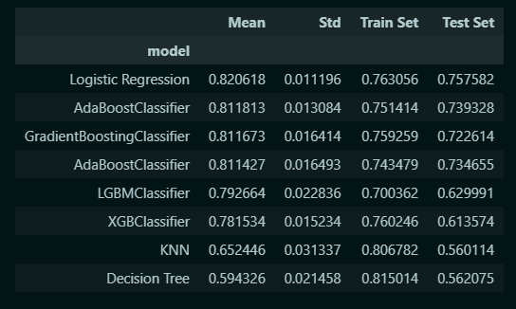
Model Benchmarking, Logistic Regression showing the best model
After evaluating various models, Logistic Regression emerged as the top performer with a mean accuracy of 82.06% and a standard deviation of 1.12%. This model achieved a training set accuracy of 76.31% and a test set accuracy of 75.76%, demonstrating a good balance between bias and variance. Other models such as Ada Boost Classifier and Gradient Boosting Classifier showed competitive performance but did not surpass Logistic Regression in terms of both mean accuracy and test set performance. Therefore, Logistic Regression is recommended as the best model for predicting travel insurance claims, balancing accuracy and generalization capability effectively.

Slide 20
Modelling pipeline designed to enhance the performance model classifier for predicting travel insurance claims
Encoding is utilized to apply specific preprocessing techniques to different types of data: Binary Encoding, One-Hot Encoding, and Robust Scaling to handle outliers. To address class imbalance, the SMOTE (Synthetic Minority Over-sampling Technique) method is applied before the final classification step. This comprehensive preprocessing and modeling approach ensures that the Logistic Regression model receives well-processed and balanced data, thereby improving its predictive accuracy and reliability in identifying travel insurance claims.
Encoding
Logistic Regression
Model
Pipeline
Robust Scaler
Resampling
SMOTE()

Slide 21
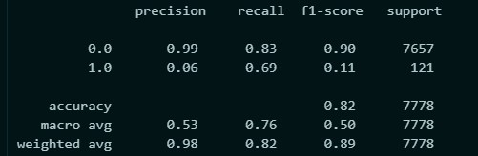
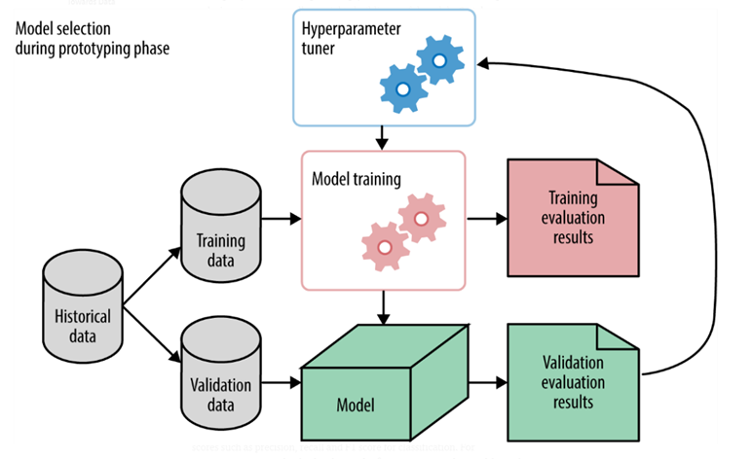
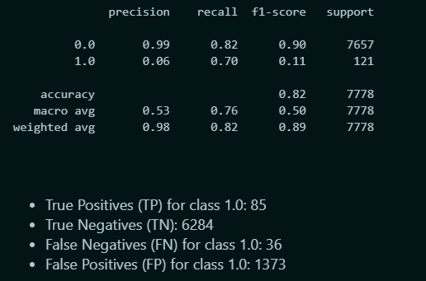
Model before tuning and after tuning
Before Tuning
After Tuning
Following the tuning process, it appears that the model's performance did not exhibit significant improvements. This suggests that the grid search procedure failed to identify parameter configurations that significantly outperformed those discovered through random search. Notably, the only discernible change occurred in the recall metric for the minority class (1.0), which experienced a marginal increase from 0.69 to 0.70. This outcome implies that while the grid search approach did not yield substantial enhancements overall, it did lead to a slight improvement in correctly identifying instances of the minority class, albeit modestly.

Slide 22
Final Model Result
- True Positives (TP) for class 1.0: 85
- True Negatives (TN): 6284
- False Negatives (FN) for class 1.0: 36
- False Positives (FP) for class 1.0: 1373
False Positive Consequences, the model will identify some customers who are actually ineligible to receive claims as eligible to receive claim payments. This can have an impact on the company's operational costs because it pays inappropriate claims, it can also increase the company's financial risk due to the increasing number of invalid claims.
False Negative Consequences: The model fails to identify some customers who are actually eligible to receive claim payments as ineligible. This can result in customer dissatisfaction, as well as possibly reducing customer trust in the insurance company. Additionally, financially, this can also mean lost premium revenue that would otherwise be paid by customers who actually qualify.

Slide 23
Business Impact Estimation
Assumptions:
- Cost of falsely predicting a policyholder as not filing a claim (False Positive, FP): Rp 14,000,000 (unnecessary claim payment costs).
- Benefit of correctly predicting a policyholder as not filing a claim (True Positive, TP): Rp 7,000,000 (lost income per undetected claim).
let's say the total number of predictions made by the model for class 0 is 7657. This means out of these 7657 predictions, 99% (or 7580) are true positive predictions (correctly predicted not to file a claim), and the remaining 1% (or 77) are false positive predictions (incorrectly predicted not to file a claim).
Given:
- True Positives (TP) = 7580
- False Positives (FP) = 77
- Benefit per TP = IDR 7,000,000
- Cost per FP = IDR 14,000,000
Net Business Impact = (TP * Benefit per TP) - (FP * Cost per FP)
Substituting the values:
Net Business Impact = (7580 * Rp 7,000,000) - (77 * Rp 14,000,000)
= (Rp 53,060,000,000) - (Rp 1,078,000,000)
= Rp 51,982,000,000
So, based on these assumptions, the model's strong performance in identifying policyholders who will not file a claim (class 0) leads to a net business impact of IDR Rp 51,982,000,000.

Slide 24
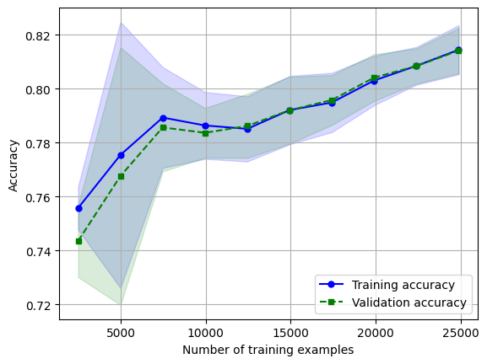
The learning curve illustrates the accuracy of both the training and validation datasets for our predictive model.
The close alignment between training and validation accuracy, especially as the number of training examples increases, indicates that the model is generalizing well to new, unseen data. This is crucial for ensuring that the model performs reliably in real-world scenarios where it will encounter data that was not part of the training set.
the training accuracy stabilizes and gradually improves, reaching approximately 82% at 25,000 examples.
between 3,000 and 5,000, instability or model adjustments during early training stages.

Slide 25
Conclusion & Recommendation

Slide 26
S
W
Strengths
Weaknesses
High Precision for 'No' Claims
The model exhibits strong performance in identifying policyholders who will not file a claim (class 0), with a precision of 99%. This high precision indicates that the model is highly effective in avoiding false claims (incorrectly predicting no claim as a claim), which can save on operational costs and ensure efficient resource allocation.
Low Precision for 'Yes' Claims
The model struggles significantly in detecting actual claims (class 1), with a very low precision of 6%. This means a high rate of false positives (incorrectly predicting a claim when there is none), which can lead to unnecessary expenses and misallocation of resources.
Missed Claims
The model's recall for actual claims is 70%, meaning it fails to detect 30% of true claims. These missed claims can result in customer dissatisfaction and potential financial losses due to legitimate claims not being identified.

Slide 27
5 Strategic Recommendation to Improve the Model's Performance
Enhanced Feature Engineering
Explore Other Algorithm Tuning and Experimentation
Implementation of Ensemble Methods
Increase the size and diversity of the training dataset
Advanced Sampling Techniques
Include new relevant features derived from existing data
Enhance the model’s learning capabilities and generalization by providing more comprehensive and representative training examples.
Apply advanced sampling methods such as hybrid approaches to address the class imbalance.
Fine-tune the current Logistic Regression model’s hyperparameters and experiment with alternative algorithms
Develop and deploy ensemble methods such as bagging, boosting or stacking multiple models

Slide 28
Thank you

