Slide 1

WIT BATCH-II
RTL Design of I2C master using Verilog
Bridging Digital Worlds: A Precise I2C Master Design with Verilog RTL
Supervised by: | Compiled by:
Ravi Chandra Sir | Shravani Mamidwar, IIT(BHU) Varanasi Bandlamudi Manogna, R.V.R& J.C College of Engineering Sanjana Tomar, Banasthali Vidhyapith Arvapally Saichandana, NIT RAIPUR

Slide 2
INTRODUCTION TO I2C MASTER
The I2C Master is a crucial component in I2C communication systems, responsible for controlling data flow and synchronizing communication with one or multiple I2C slave devices. As the central controller, the I2C Master initiates and manages data transactions on the I2C bus, a widely-used protocol for low-speed, short-distance data communication. This design is particularly useful in embedded systems, where the master typically manages data exchange with peripherals like sensors, memory modules, and displays.
I2C uses two bidirectional lines for communication:
1.SDA (Serial Data Line): Transmits the actual data between devices.
2.SCL (Serial Clock Line): Carries the clock signal, generated by the master device, to synchronize data transfer across all devices on the bus.
Role of I2C Master in Communication:
The I2C Master initiates and controls communication, generating start and stop conditions to mark each data transaction.
It synchronizes data transfer by providing a clock (SCL) for timing, which ensures organized data exchange on the I2C bus.

Slide 3
The I2C protocol follows a straightforward communication process managed by the master:
Communication Process:
Start Condition : Initiated when SDA goes low while SCL is high, signaling the beginning of a data transfer.
Data Transfer: Data is sent as a series of bits, synchronized with the clock signal on SCL. Each byte of data is followed by an acknowledgment (ACK) or no-acknowledgment (NACK) bit, indicating successful reception.
Stop Condition: The transaction ends when SDA goes high while SCL remains high, signaling the bus is released for other operations.
Applications of I2C Master :
Sensor Networks: Used in IoT and embedded systems, the I2C Master communicates with various sensors (e.g., temperature, pressure, humidity) for data collection and monitoring.
EEPROM and Memory Access: The master controls communication with EEPROMs and other memory devices for storing and retrieving data, such as configuration settings or logged data in microcontroller-based systems.
Real-Time Clock (RTC) Modules: Accesses time and date information from RTC modules for applications that need accurate timekeeping, like scheduling, logging, or alarms.
Display Control: Interfaces with LCD or OLED displays, allowing microcontrollers to show information while using minimal pins, useful in handheld and embedded devices

Slide 4
PROJECT OVERVIEW
The goal of this project is to design and implement an I2C Master Controller using Verilog at the RTL (Register Transfer Level). This I2C Master will facilitate communication between a central processing unit (CPU) or microcontroller and various slave devices such as sensors, memory modules, and display controllers. As the master device on the I2C bus, this controller will generate the necessary clock signals and manage the data flow between itself and multiple connected I2C slave devices
Objectives:
Protocol Compliance: The design must fully comply with the I2C standard, supporting key operations like start, stop, read, write, and ACK/NACK detection.
Efficient Data Transfer: Enable reliable data exchange with minimal errors by ensuring precise clock timing and data synchronization.
Modularity and Scalability: Design the I2C Master to be modular, allowing for easy integration into larger systems and expansion to support additional slave devices.
FPGA/ASIC Compatibility: The RTL design in Verilog allows the controller to be synthesized on FPGA or ASIC, making it suitable for real-world applications
By implementing the I2C protocol at the RTL level, this project explores the practical aspects of digital design, from timing considerations to state machine management, providing a hands-on understanding of I2C communication fundamentals in embedded systems.

Slide 5
I2C PROTOCOL BASICS
The I2C (Inter-Integrated Circuit) protocol is a synchronous, serial communication protocol designed for low-speed, short-distance communication between devices on the same PCB. Developed by Philips, it is widely used due to its simplicity and flexibility in connecting multiple devices with only two communication lines.
Communication lines:
1.SDA (Serial Data Line): Transmits data bidirectionally between master and slave devices.
2.SCL (Serial Clock Line): The master device generates this clock signal to synchronize data transmission.
Key Features:
Multi-Master, Multi-Slave Architecture: I2C can support multiple master and slave devices on a single bus, though only one master actively controls the bus at a time.
Addressing: Each device has a unique address (usually 7-bit, though 10-bit addressing is supported), allowing the master to communicate selectively with specific slave devices.
Data Transfer and Acknowledgment: Data is transmitted in 8-bit bytes, and each byte is followed by an acknowledgment (ACK) or no-acknowledgment (NACK) bit to indicate successful reception or error.
Protocol Phases:
Start Condition: SDA goes low while SCL is high, signaling the beginning of communication.
Data Transfer: Data bits are transferred on SDA, synchronized by the clock on SCL.
Stop Condition: SDA goes high while SCL is high, marking the end of the communication.

Slide 6
FUNCTIONAL REQUIREMENTS
To design a reliable and efficient I2C Master Controller, several key functional requirements must be met to ensure accurate and seamless communication with I2C slave devices.
1.Start and Stop Conditions: The I2C Master must generate precise start and stop signals, which are critical for initiating and terminating communication. These signals mark the beginning and end of a data transfer session on the I2C bus.
2.Clock Generation: The master must generate an accurate and stable clock signal (SCL) to synchronize data transfers. This clock must be adjustable to meet the standard I2C speeds (100 kbps to 3.4 Mbps) and compatible with various I2C slave devices.
3.Data Read/Write Operations: The I2C Master should support both reading from and writing to slave devices, sending data over the SDA line in 8-bit bytes. Each transaction must be followed by an acknowledgment (ACK/NACK) from the slave to verify successful data transmission.
4.Addressing and Selection of Slave Devices: The I2C Master must handle the addressing of slave devices on the bus, sending unique 7-bit or 10-bit addresses to initiate communication with specific slaves.
5.Error Detection and Handling: The controller should monitor for ACK/NACK responses after each byte to identify errors. In the case of a missing acknowledgment, it should attempt error-handling procedures to maintain reliable communication.

Slide 7
RTL DESIGN OF I2C MASTER
Importance Of RTL Design:
The RTL (Register Transfer Level) approach is crucial in designing digital circuits as it allows designers to model complex hardware behaviors while focusing on data flow and timing. In the case of an I2C Master, RTL design enables a structured and modular approach to implementing each aspect of the I2C protocol, ensuring reliable communication between the master and various slave devices on the bus.
Main Modules in I2C Master:
1.Clock Generation: This module generates the SCL clock signal by dividing the main system clock, allowing control over the I2C speed. The clock frequency is adjustable, making it compatible with standard I2C speeds.
2.Control Unit: The heart of the I2C Master, the Control Unit is modeled as a Finite State Machine (FSM) that manages protocol stages—START, READ, WRITE, ACK/NACK, and STOP. It handles timing and signal generation, ensuring compliance with I2C protocol requirements.
3.Data Shift Register: The Shift Register is responsible for serializing and deserializing data, converting parallel data to serial format for SDA line transmission. It supports both data read and write operations with bitwise control.
Verilog Modeling:
Verilog was used to model each module at the RTL level, defining how data moves between registers and the logic of the control signals. The Clock Generation module was created using clock division techniques, while the Control Unit FSM was coded to manage protocol sequences. The Shift Register was built using shift operations to enable bitwise data flow on the SDA line. This Verilog-based RTL design provides a flexible, synthesizable I2C Master suitable for real-world embedded applications.

Slide 8
MODULE BREAKDOWN
A breakdown of each module related to a communication protocol (like I2C):
1. Clock Generator:
Generates the Serial Clock Line (SCL).
SCL synchronizes data transfer between master and slave devices.
Clock frequency is derived from the system clock for consistent timing.
2. Control Logic:
Manages start and stop conditions for data transmission.
Handles acknowledgment (ACK) and not-acknowledgment (NACK) signals.
Ensures correct sequence of operations during communication.
3. Data Shift Register:
Serializes parallel data from the microcontroller for transmission.
Deserializes incoming data for processing by the microcontroller.

Slide 9
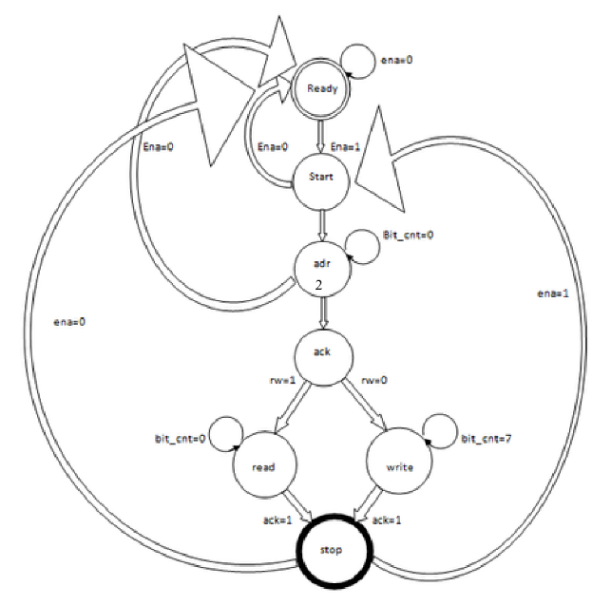
FSM
1.Ready State (Idle):
Bus inactive (SCL/SDA high) & Waits for enable signal
2. Start state :
Initiates communication
SDA goes low while SCL high
3.Address State:
Transmits slave address serially & Counts bits sent
4.Acknowledge State:
Receives slave acknowledgment
Checks R/W bit direction
5.Write state:
Master sends 8-bit data & Receives slave acknowledgment
6.Read state :
Master reads 8-bit data
Sends acknowledgment
7.Stop :
Ends transmission
Returns to Ready if enable low
Finite State Machine for Design of Single
Master

Slide 10
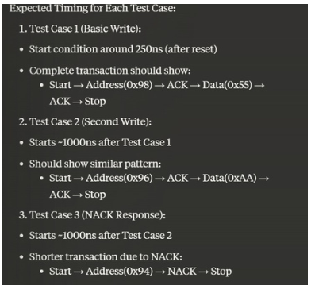
SIMULATION AND VERIFICATION
The I2C single master has been designed in Verilog and simulated in simulator tool EDA playground, which is used to verify the design functioning. This design works for both read and write cycle.
Prerequisites :
Eda Playground for simulation
Xilinx 14.1 or later for synthesis (if FPGA implementation
is intended)
Steps to Run :
Simulation: Use I2C_tb.v in Eda playground to verify the design.
Synthesis (Optional): Load I2C_Master_Dut.v into Xilinx
for synthesis on FPGA.
These are some of the test cases verified using the I2C Master :
Read write operation
Second write
Nack response

Slide 11
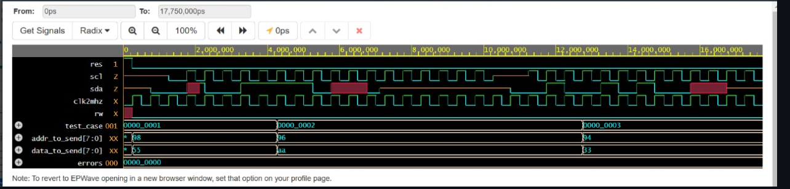
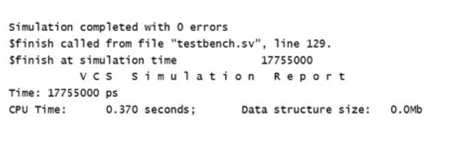
RESULTS AND OBSERVATIONS
Simulations in Eda Playground validate the design's functionality across various scenarios, confirming that the master accurately initiates, transfers, and terminates communication as per the I2C protocol.

Slide 12
CONCLUSION AND FUTURE SCOPE
The I2C Master project successfully established reliable communication between master and slave devices, proving its effectiveness for embedded applications.
Future Improvements:
Multi-Master Support: Enable multiple masters on the same bus for enhanced flexibility.
Enhanced Error-Handling: Add features to manage bus errors and improve reliability.
Applications:
Ideal for embedded systems needing sensor integration, display control, or memory access, such as IoT devices, environmental monitors, and robotics.

Slide 13
CHALLENGES FACED
1.Timing Issues:
Challenge: Ensuring precise timing to meet I2C protocol requirements, especially for setup and hold times on SDA and SCL lines.
Solution: Applied constraints in the synthesis tool and used timing analysis to verify all paths. Adjusted clock signal propagation to ensure compliance with I2C timing specifications.
2.Clock Synchronization:
Challenge: Managing clock synchronization between the FPGA’s internal clock and the slower I2C clock, especially for multi-speed I2C communication.
Solution: Implemented a clock divider to generate the appropriate I2C clock frequency. Ensured proper sampling edges for reliable data transfers.

Slide 14
REFERENCES
[1] Samir Palnitkar ―Verilog HDL A guide to Digital
Design and Synthesis‖ SunSoft Press,1996
[2] Stuart Sutherland ―Verilog HDL Quick Reference
Guide‖ IEEE Std 1364-2001
[3] M.Morris Mano ―Digital Design‖ EBSCO publishing.
Inc, 2002
[4] Philips Semiconductor ―I2C Bus Specification‖, April
1995
Thank you

