Slide 1
photoStockage
A platform for free photo sharing and community engagement
Sotirios NATSIOS
February 22, 2025

Slide 2
Introduction
Self introduction:
Name
Background
Role in the project

Slide 3
Project Overview
What is photoStockage:
A platform for free photo sharing
Encourages community engagement
Core functionalities:
User registration
Photo sharing (upload / download)
Liking and saving photos
Searching and filtering
Target audience:
Photographers
Content creators
Graphic designers
Web developers
Marketing professionals
Students and educators

Slide 4
Technical Specifications
Platform:
Platform-agnostic
Responsive design
Technology stack:
Frontend: Next.js
Backend: Node.js with Express.js
Database: PostgreSQL

Slide 5
Backend Architecture
MVC-like architecture:
Models
Controllers
Routes
API endpoints
Security measures:
Authentication and authorization (with jwt management)
Input sanitization
Rate limiting

Slide 6
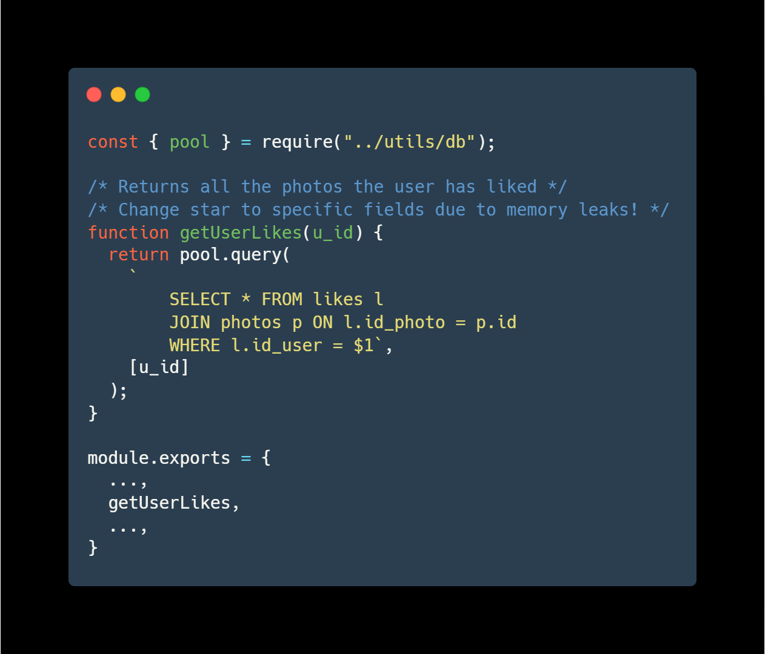
Backend Code Examples
Model example
Imports
Functions
Exports

Slide 7
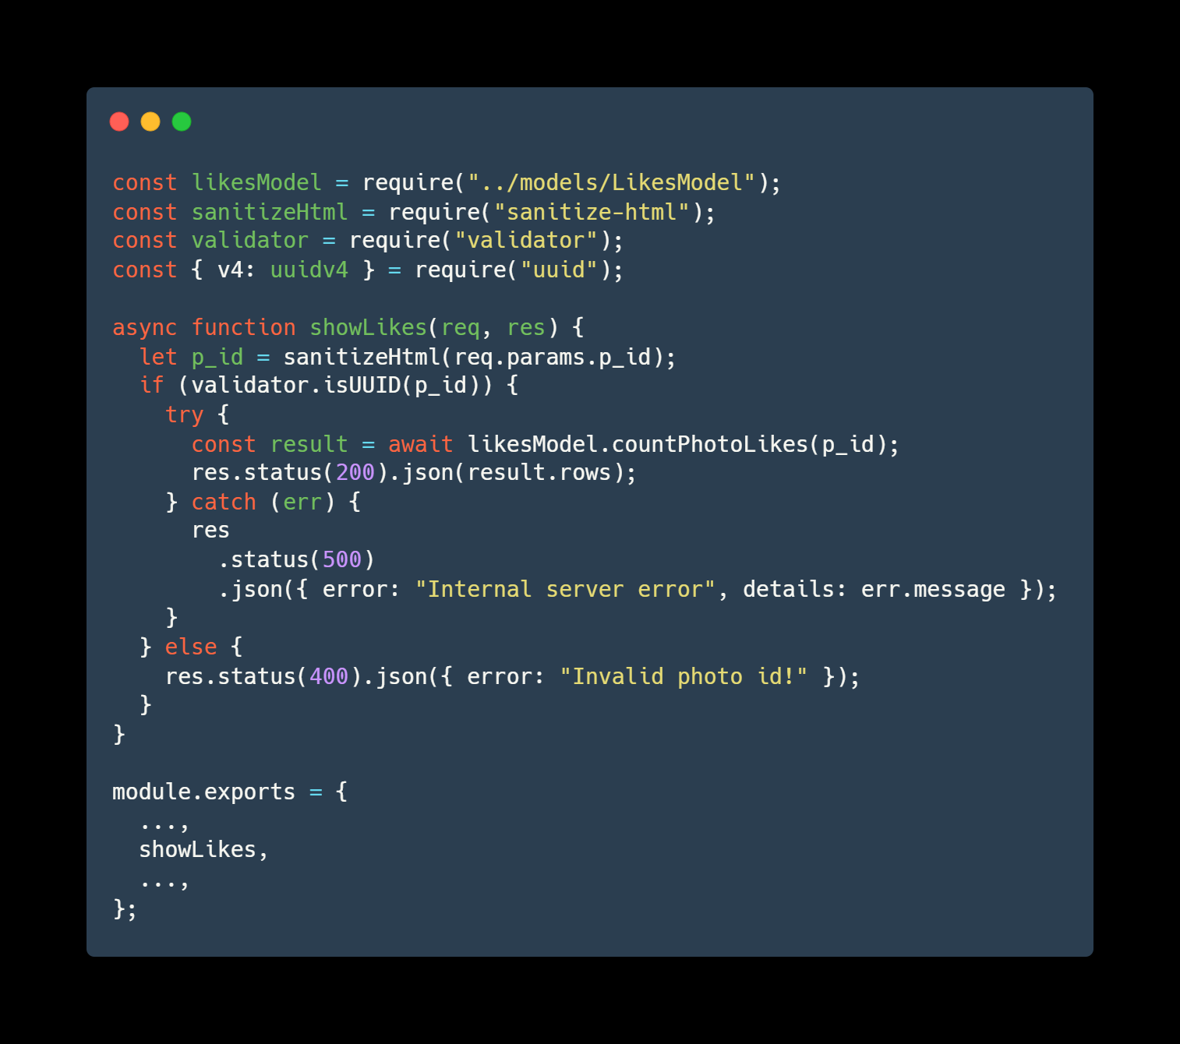
Backend Code Examples
Controller example
Imports
Functions
Exports

Slide 8
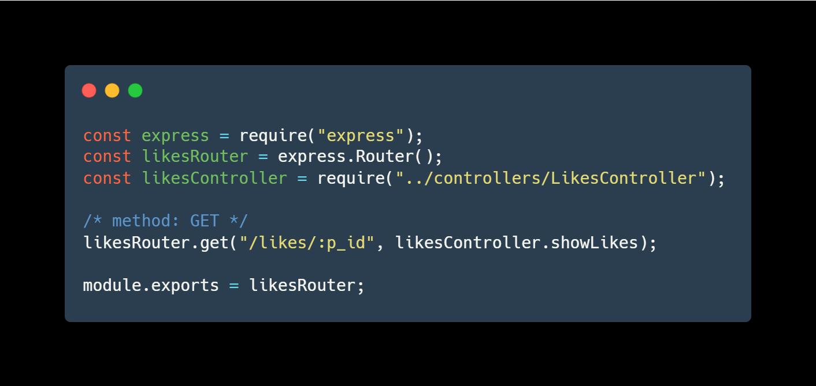
Backend Code Examples
Routes example
Imports
Routing
Exports

Slide 9
Frontend Architecture
Component-based architecture
Reusable UI elements
State management
API integration
Responsive Design:
Mobile-first approach (tailwind)

Slide 10
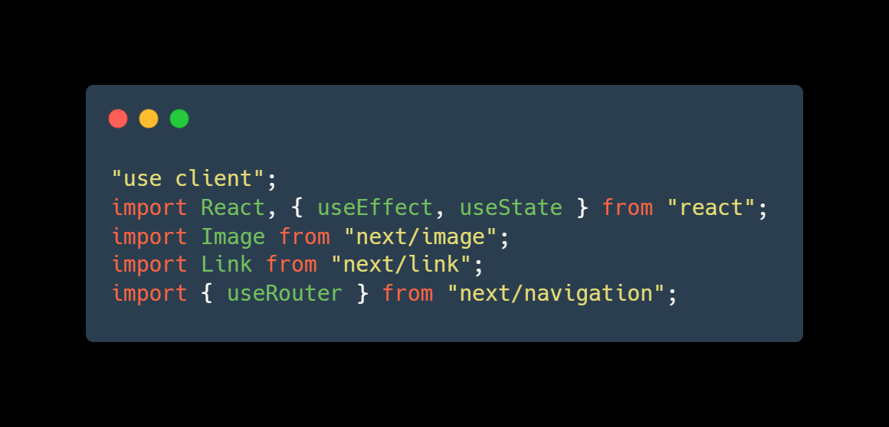
Frontend Code Examples
Hero component 1/3
Imports
Export of component
Render

Slide 11
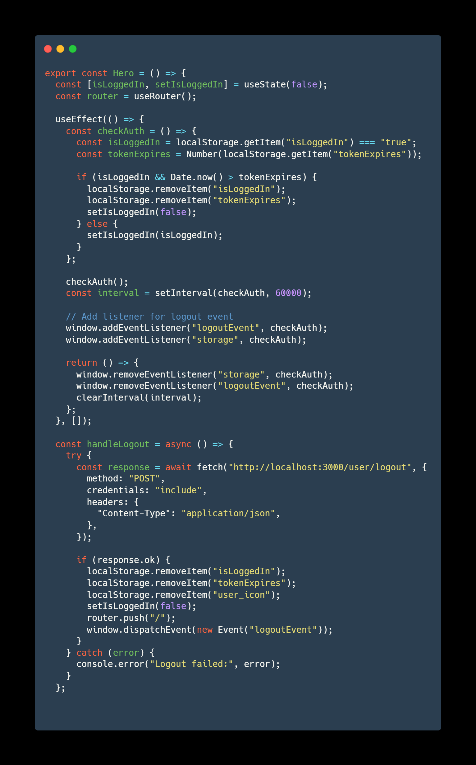
Frontend Code Examples
Hero component 2/3
Imports
Export of component
Render

Slide 12
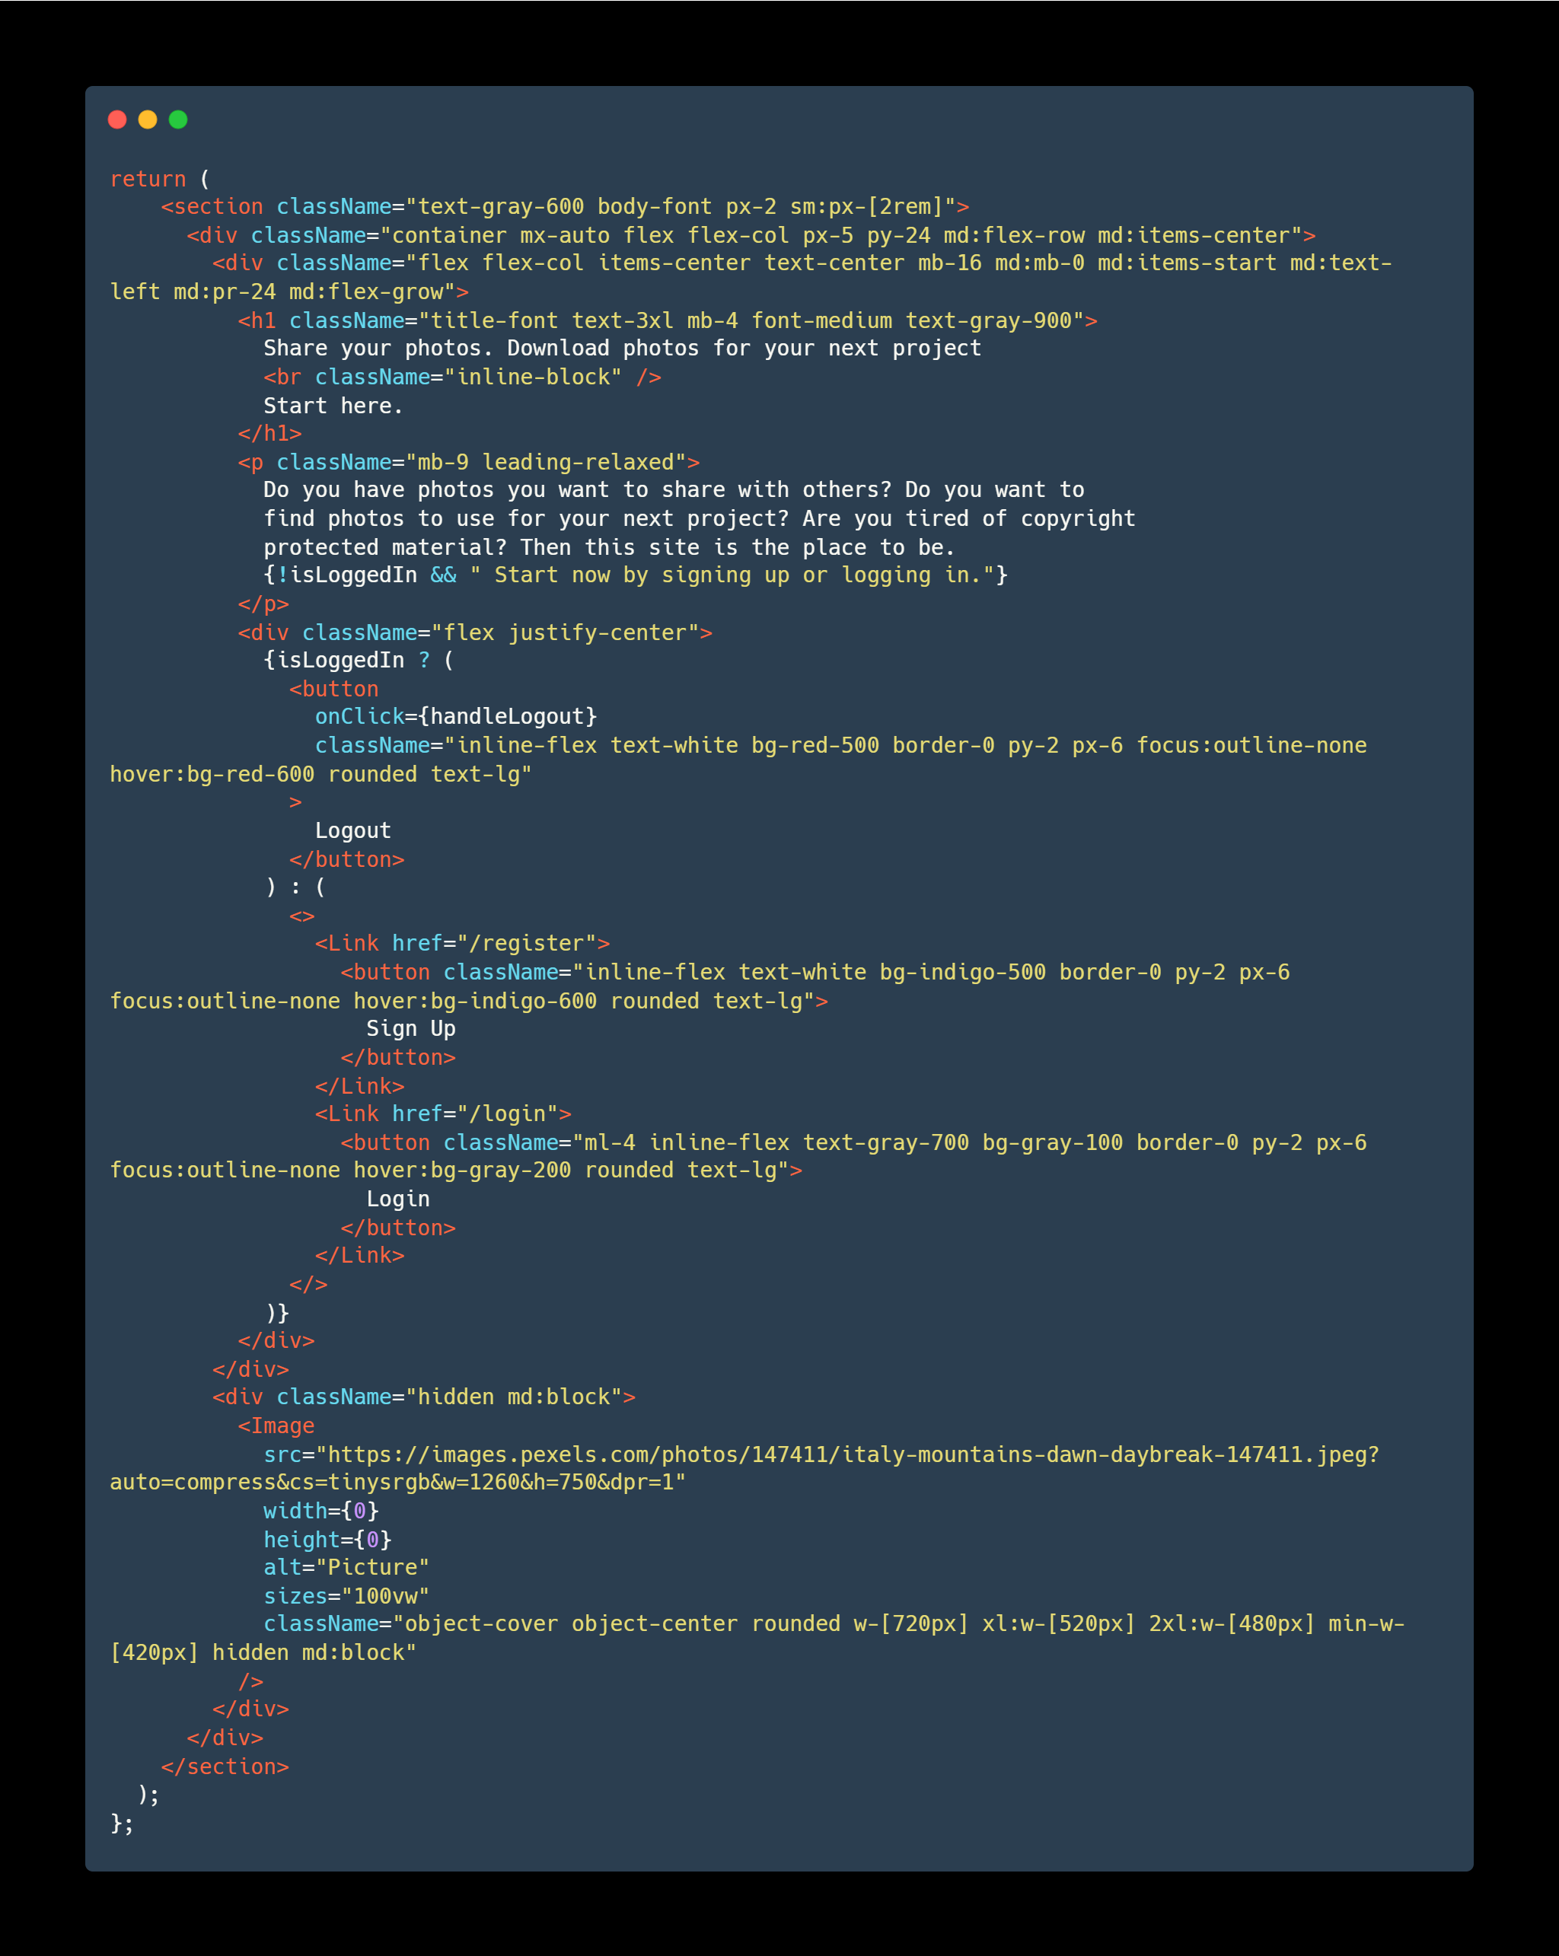
Frontend Code Examples
Hero component 3/3
Imports
Export of component
Render

Slide 13
Data Management
Data models:
Tables of users, photos, likes, categories, photos_categories, comments, downloads
Data storage:
Use of PostgreSQL (local)
Use of MySQL (hosted for demo)
Hosted on Namecheap and Vercel

Slide 14
Testing & Quality Assurance
Testing strategy:
Unit testing
Backend and Frontend tests

Slide 15
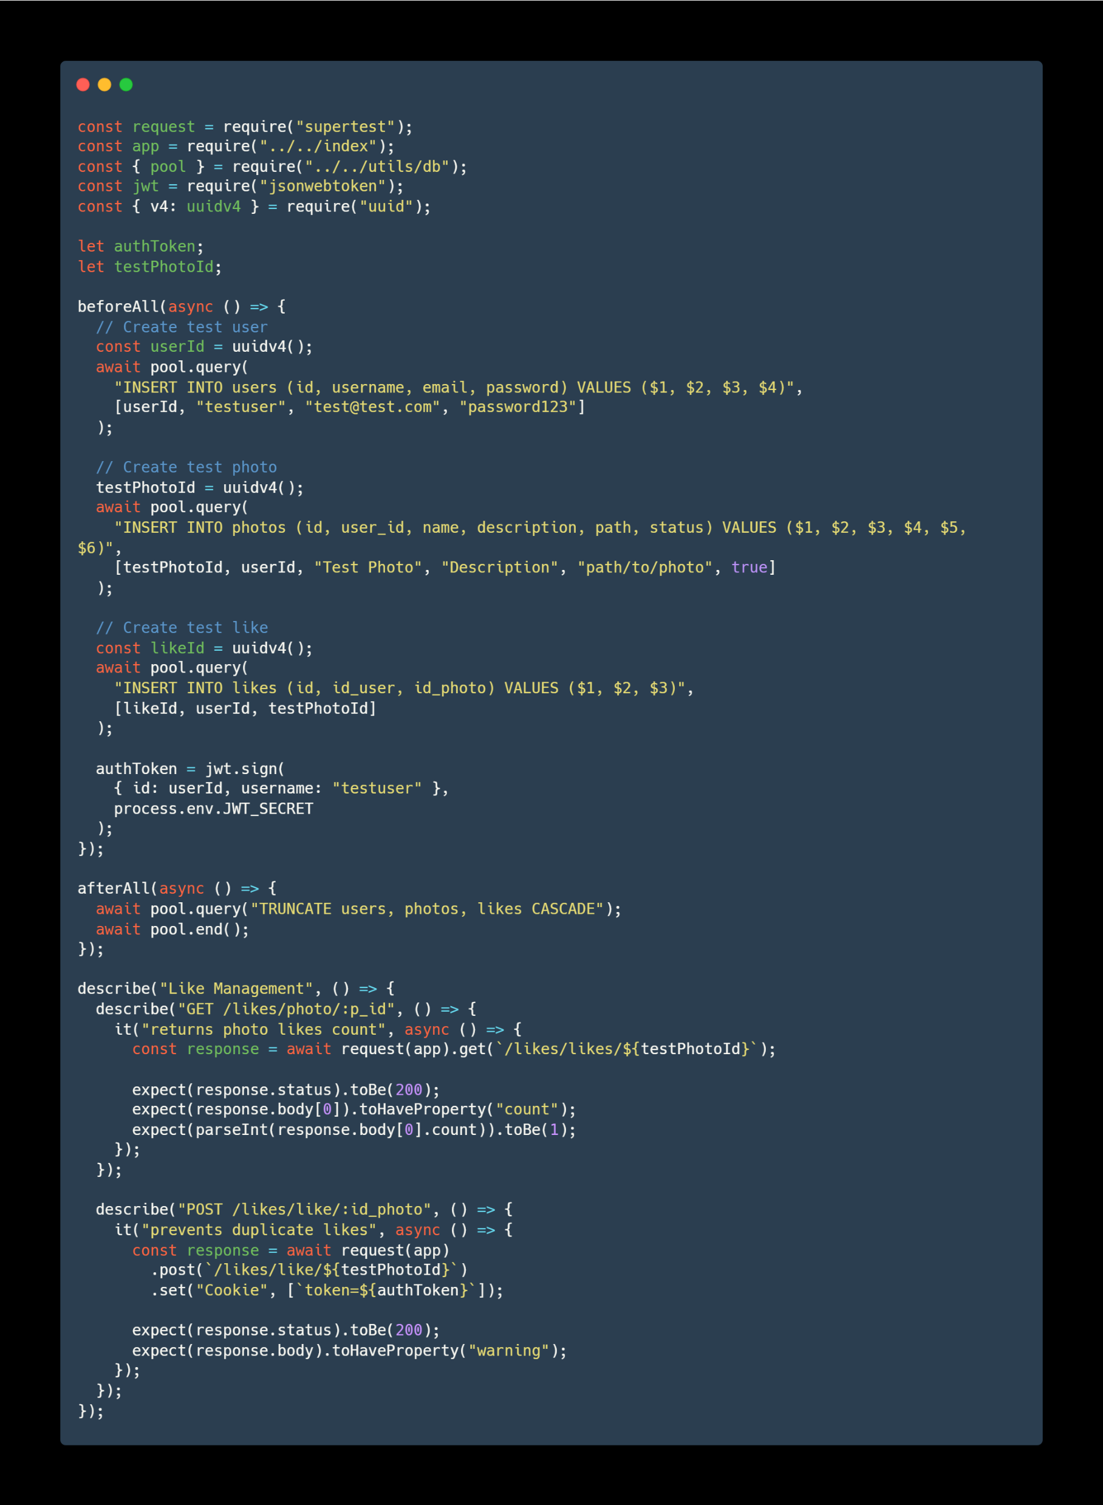
Testing & Quality Assurance Code Examples
Imports
Preparation
Expectation

Slide 16
Challenges & Solutions
Technical challenges:
Prototyping with Adobe XD
Reconversion of style for mobile-first design
Management of JWT
Solutions:
Watched tutorials and sought guidance from forums
Re-read styles and re-imagined them as mobile-first
Learned from training projects for JWT and cookie management

Slide 17
Project Timeline & Milestones
Phases:
Specification document (May 2024)
UML diagrams and visual definitions (June-July 2024)
Backend development (August-September 2024)
Fronted development (September-December 2024)
Finalization (February 2025)

Slide 18
Legal & Compliance
Intellectual property:
Licensed under the MIT license
Open-source
Compliance:
DGPR and European laws
Terms and conditions

Slide 19
Conclusion & Approval
Summary:
Recap of key points
Importance of the project
Additional considerations:
Documentation
Future improvements

Slide 20
Q&A
Follow-up questions
General questions

Slide 21
Thank you for your time

