Slide 1
Overview
Arduino
MIDI
Arduino as MIDI Controller
Sources

Slide 2
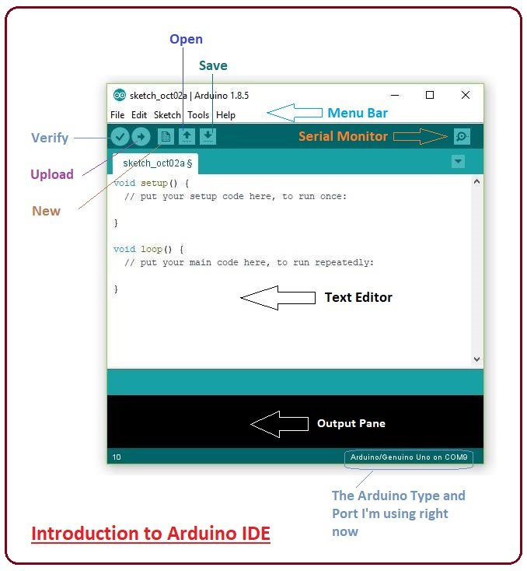
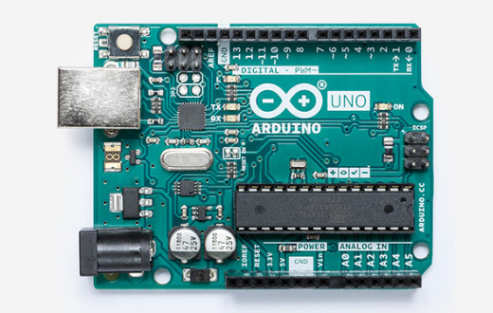
1. Arduino
Arduino =
+
(Hardware: Mikrokontroller + Board)
(Software: IDE + Programming Lang.)

Slide 3
1. Arduino - Hardware
e.g.: PC, MIDI, ...
UART (Serial over USB)
e.g.:
Sensors,
Triggers,
Switches
...
Digital Pins
Analog Pins
e.g.:
Sensors,
Potentiom.,
...
Digital Pins
e.g.:
Motors
Servos
Lamp
...

Slide 4
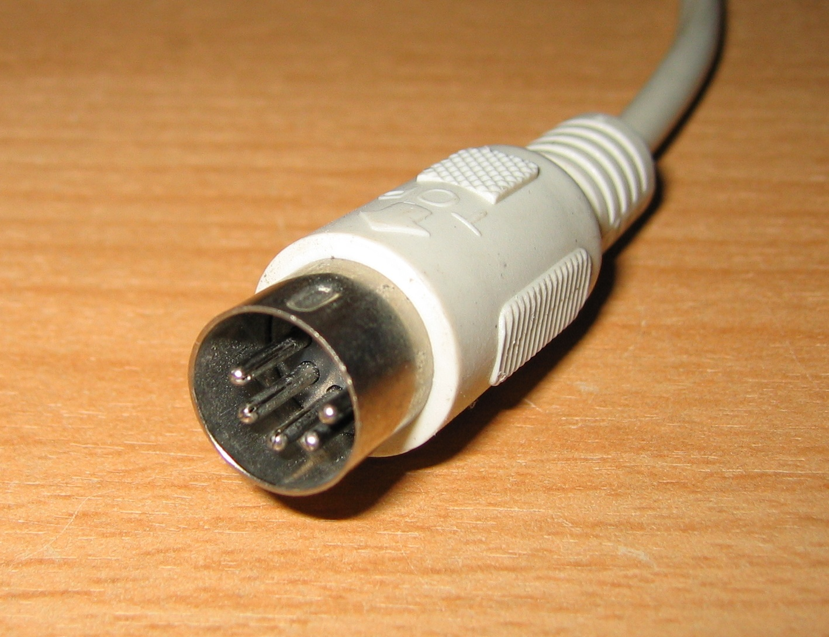
2. MIDI (Musical Instrument Digital Interface)
Hardware:
  UART (Universal Asynchronous Receiver Transmitter): „serial communication“
  5V
  31250 bit/sec: 1 bit takes 32us (=0.000032s)
  Unidirectional: a single cable only transmitts data in one direction
  5pin DIN connectors

Slide 5
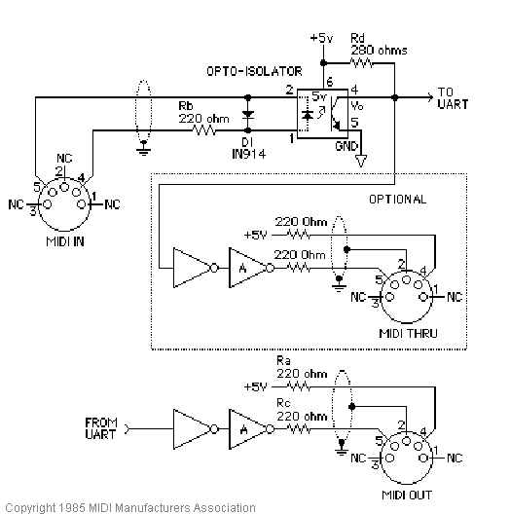
2. MIDI Wiring
Sender, e.g. Keyboard
Receiver, e.g. Synthesizer

Slide 6
2. MIDI Protocol
MIDI Message = status byte + 2 data bytes
Details:
 | Byte 0 (status) | Byte 1 (data) | Byte 2 (data)
Notes: | Starts with 1, so values are in 80₁₆...FF₁₆ | Starts with 0, values in 0₁₆...7F₁₆ | Starts with 0, values in 0₁₆...7F₁₆
Note Off: | 8n₁₆ (n: channel from 0..15) | kk (pitch) | vv (velocity)
Note On: | 9n₁₆ (n: channerl from 0..15) | kk (pitch) | vv (velocity)
... | ... | ... | ...

Slide 7
2. MIDI Protocol - Example
...,10010000₂, 00111100₂, 01111111₂, ...
= 9₁₆
(note on)
(chan. 0)
= 3C₁₆
= 60₁₀
(Middle c)
= 7F₁₆
= 127₁₀
(max. vel.)
Starts with 1
→ status byte

Slide 8
3. Arduino as MIDI Controller
Hardware Components:
  Arduino Mega 2560 (lots of IO interfaces compared to Arduino Uno)
  Box
  Potentiometers, Triggers, Switches
  Drill, Solder Iron, ...
Software:
  USBMidiKliK: USB Firmware to turn Arduino into a MIDI-over-USB device
  Own code

Slide 9
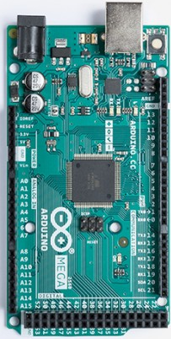
3. Arduino as MIDI Controller - Concept
PC
Via MIDI over USB (using USBMidiKliK)
UART 0
Digital Pins
Triggers,
Switches
Analog Pins
Potentiometers
(optional: foot pedals)
UART 1
Additional MIDI devices via DIN-5

Slide 10
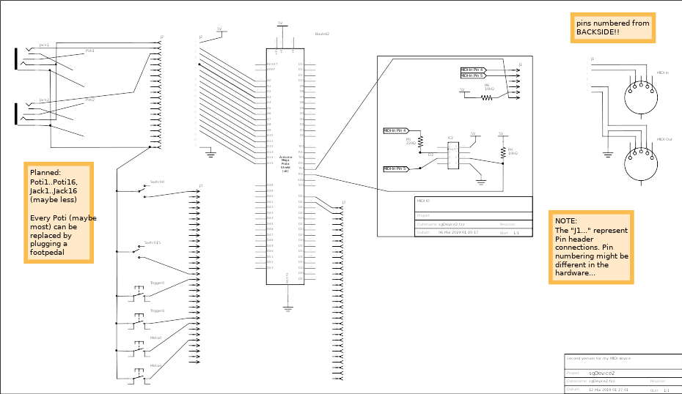
3. Arduino as MIDI Controller - Wiring

Slide 11
3. sgDevice 2 – Live Demo
LIVE DEMO

Slide 12
4. Sources
Sources:
  Arduino Webpage: https://www.arduino.cc
  Wikipedia on MIDI: https://de.wikipedia.org/wiki/Musical_Instrument_Digital_Interface
  Microcontroller.net on MIDI:https://www.mikrocontroller.net/articles/MIDI
  Project repository of my project: https://github.com/EsGeh/sgDevice
  UART Firmware (turn Arduino into a MIDI device): https://github.com/TheKikGen/USBMidiKliK
Image sources:
  https://store.arduino.cc/arduino-uno-rev3
  https://www.theengineeringprojects.com/2018/10/introduction-to-arduino-ide.html
  https://de.wikipedia.org/wiki/DIN-Steckverbinder
  https://www.midi.org/specifications/item/midi-din-electrical-specification

