Slide 1
July, 2024

Slide 2


CVAE Architecture
Decoder
Encoder
One-Hot Encoded
Sequences
Input Layer
Latent
Space
z
Input Layer (latent)
Bi-LSTM
Fully Connected (Lin)
Condition
Fully Connected (Lin)
Bi-LSTM
Condition
$$µ_{z}$$
$$σ_{z}$$
Fully Connected (Lin)
Reshape
Decoded
Sequences
Here condition is spectra

Slide 3
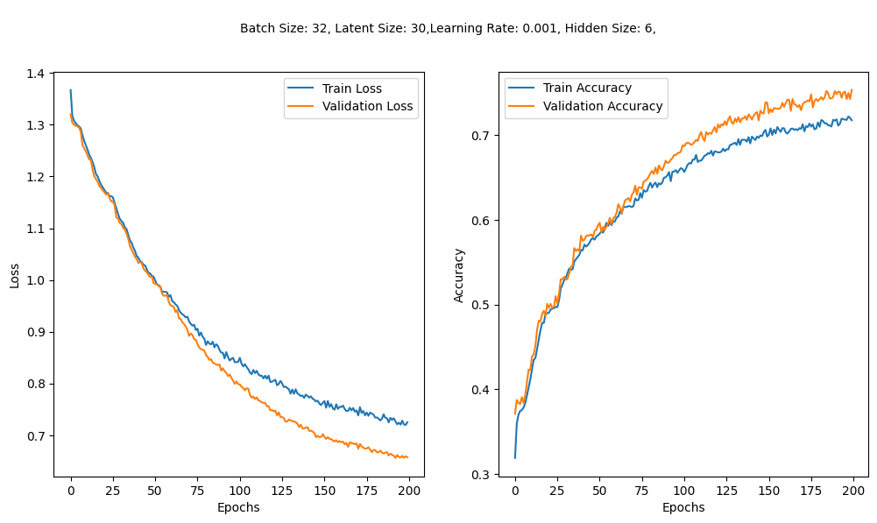
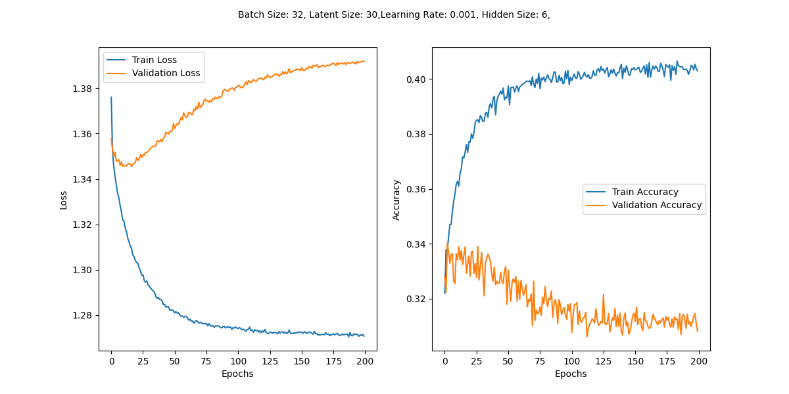
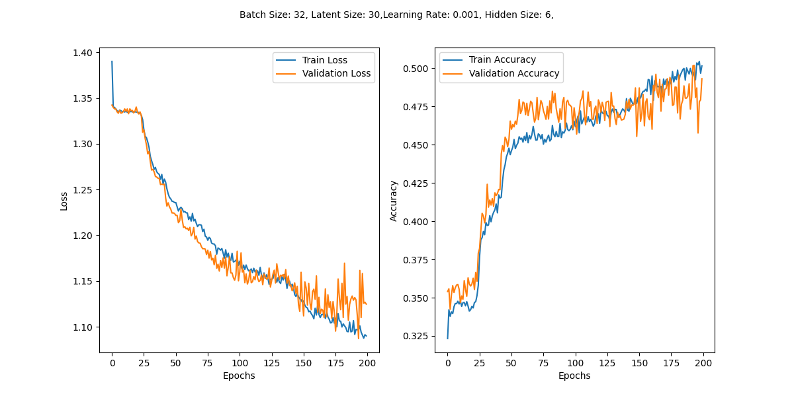
Tested the effect of different condition values on the performance of CVAE
1
2
Plot 1: CVAE trained with spectra as the condition.
Plot 2: CVAE trained with random values as the condition.
Plot 3: CVAE trained with condition where all values are set to one
The hyperparameters were kept the same across all tests; only the conditions were varied.
Results:
Using the original spectra as conditions led to a stable model.
The use of spectra as conditions appears to be effective in training the CVAE.
3

Slide 4
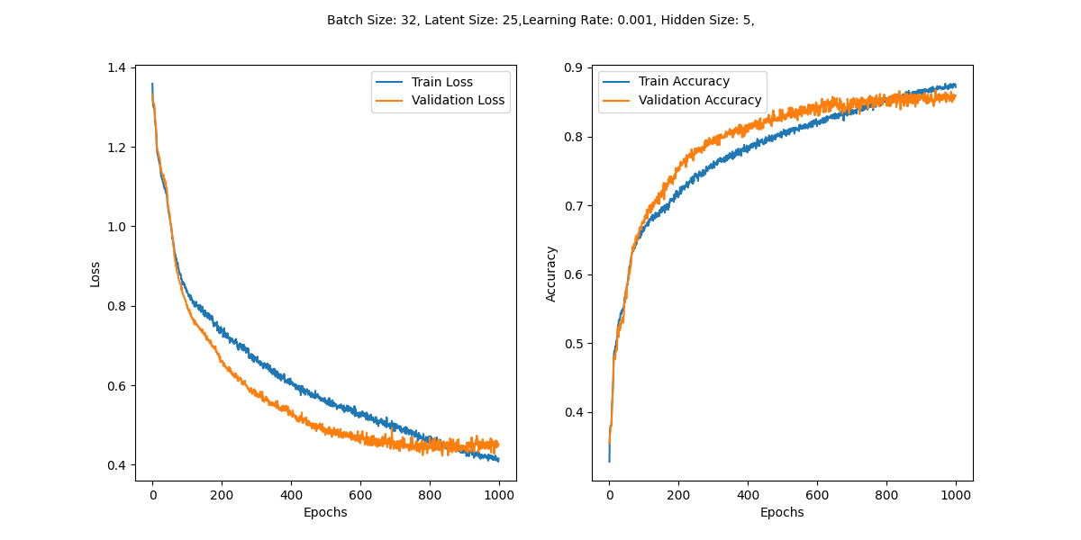
Best model so far
The reason that validation accuracy is higher than train accuracy is because dropout is used during training but not during evaluation. Dropout helps prevent overfitting by turning off some neurons randomly, which makes training tougher. When evaluating, dropout is off, so the model performs better on validation data.
Dropout helps the model generalize well but makes training accuracy lower. Without dropout, training accuracy is similar to validation accuracy.

Slide 5
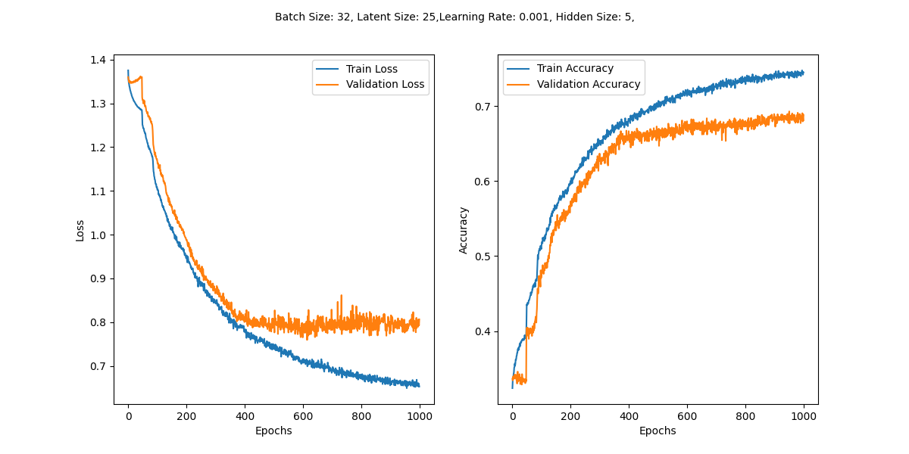
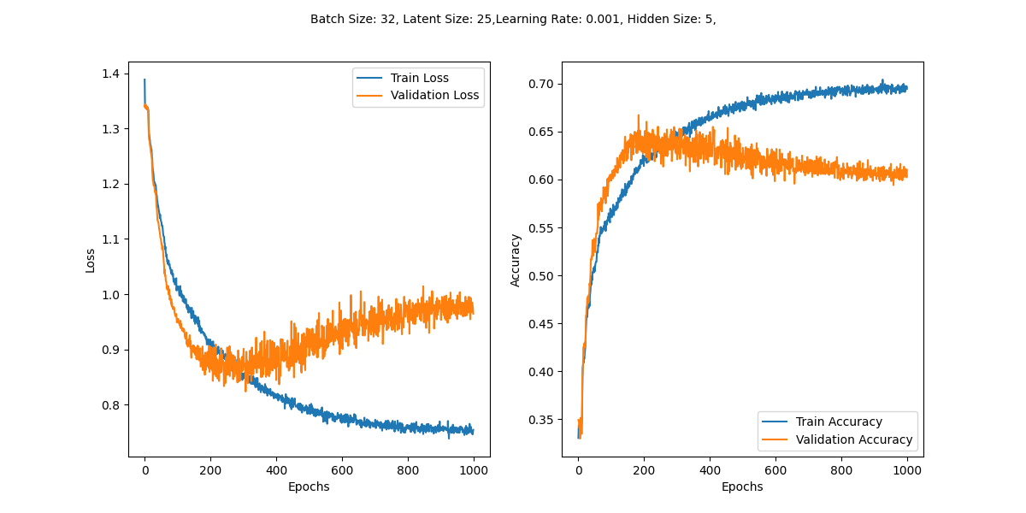
Best model so far
Again tested with both random condition and condition where all values are set to one
Condition: Random
Condition = 1

Slide 6
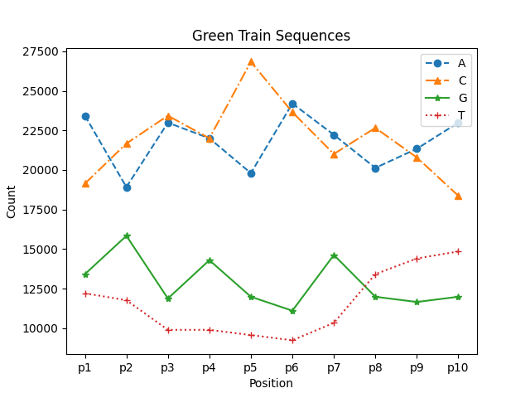
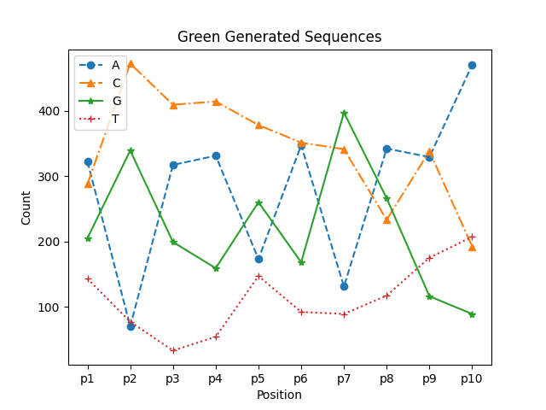
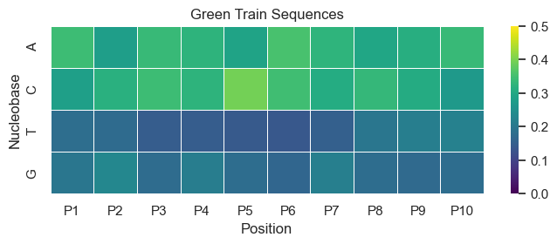
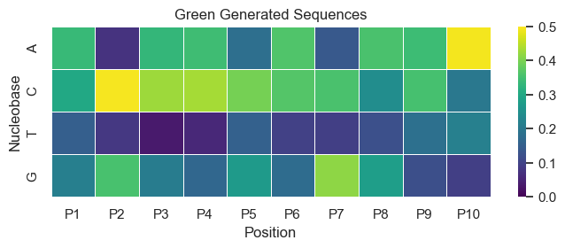
Green Sequences
heatmap show normalized frequencies of bases across 10positions, each position is normalized by calculating the total count of all bases at that position. after that frequency of each base is divided by this total count.
I only considered peak 1; I didn’t want to make it complicated for now. But in the future, we can decide how to group sequences, e.g., by considering the brightest peak.

Slide 7
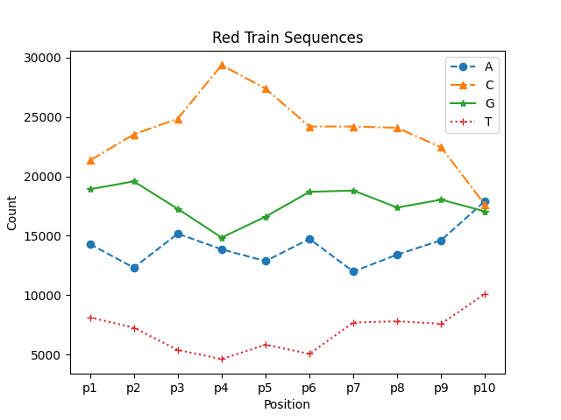
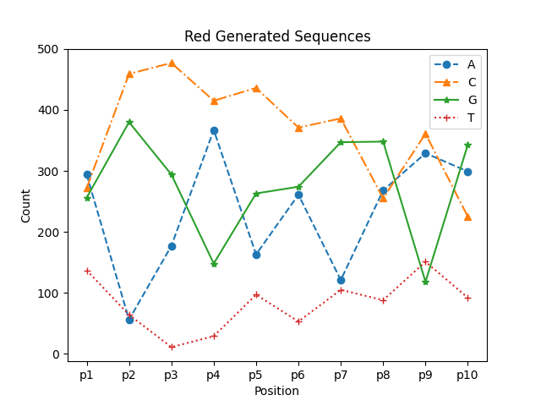
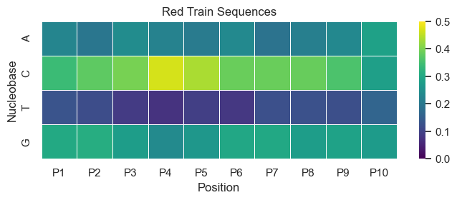
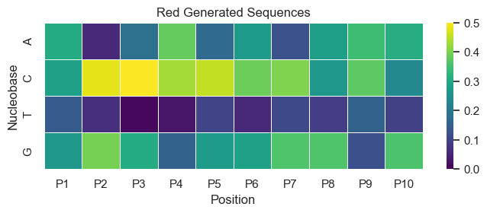
Red Sequences

Slide 8
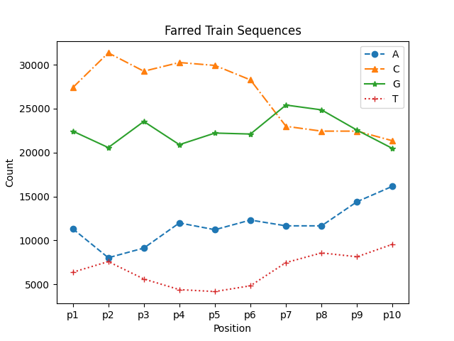
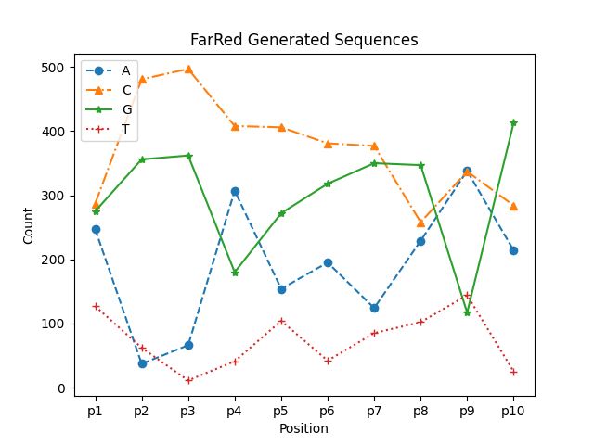
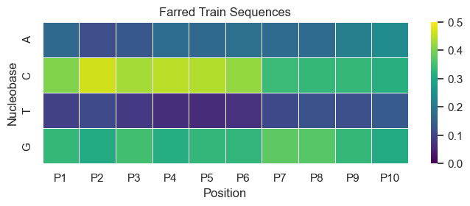
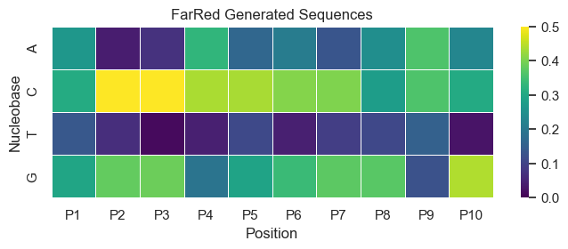
FarRed

Slide 9
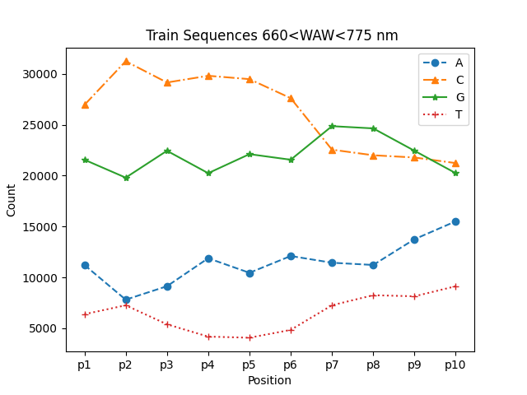
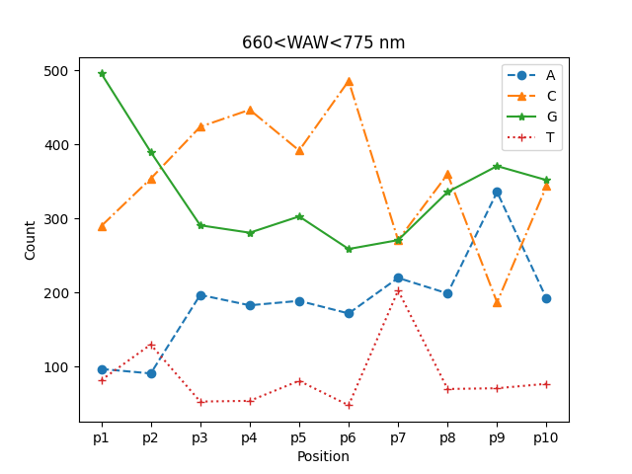
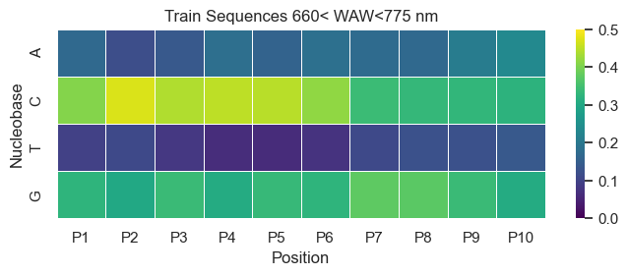
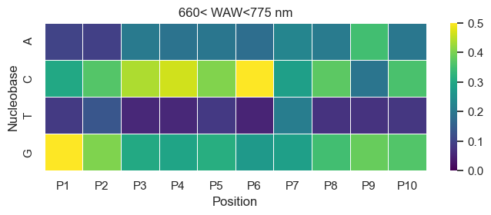
660 < WAV< 775 nm

Slide 10
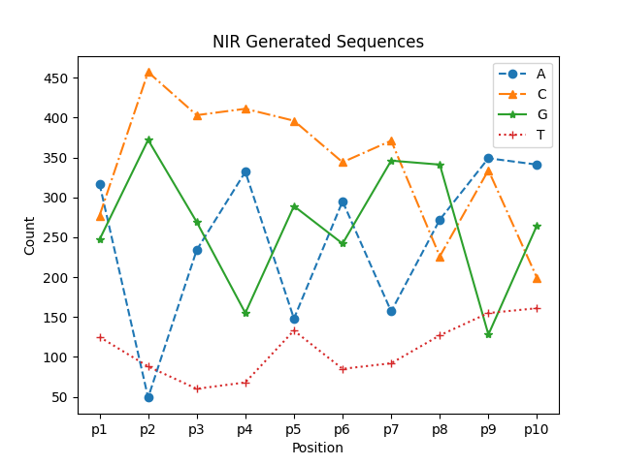
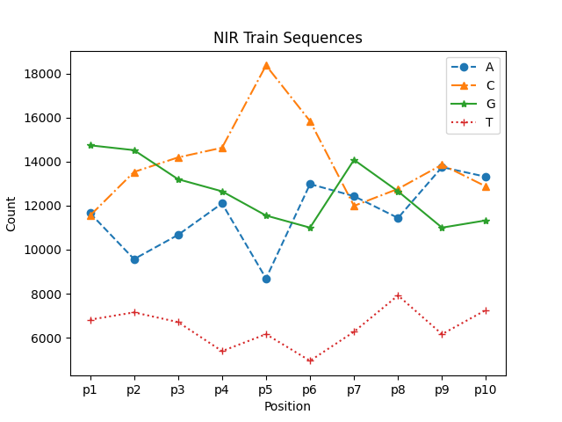
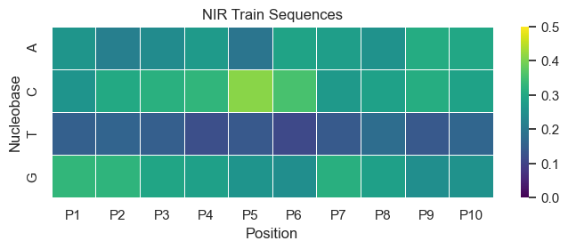
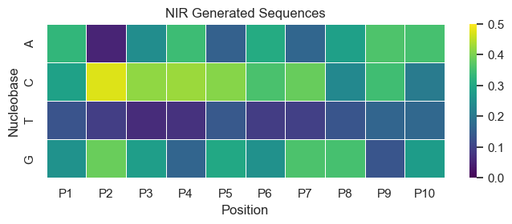
NIR Sequences

Slide 11
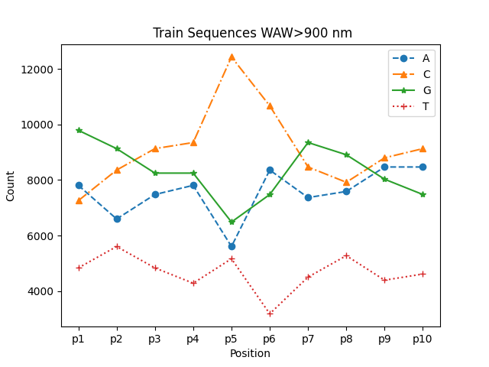
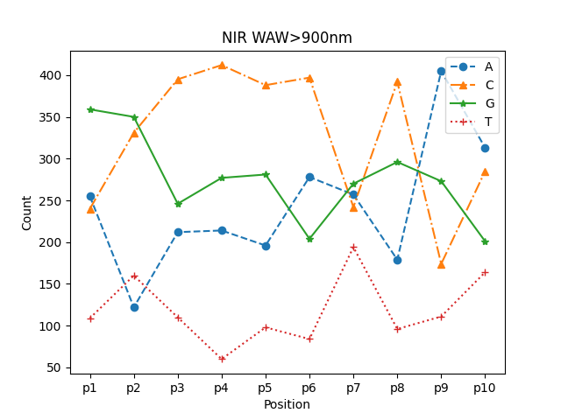
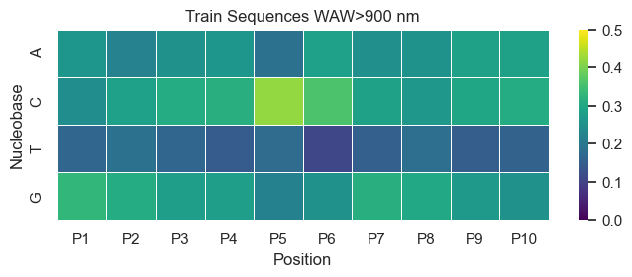
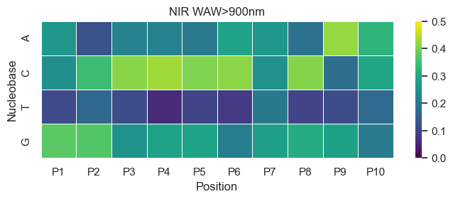
WAV>900 nm

Slide 12


CVAE & Mutual information
Decoder
Encoder
One-Hot Encoded
Sequences
Input Layer
Latent
Space
Input Layer (latent)
Bi-LSTM
Fully Connected (Lin)
Condition
Code
c
Fully Connected (Lin)
Bi-LSTM
Condition
$$µ_{z}$$
$$σ_{z}$$
Variable
z
Fully Connected (Lin)
Decoded
Sequences
Reshape
Condition: spectra
c: continuous latent code (input-independent)
z: latent representation of input

Slide 13
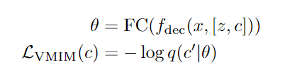
Auxiliary Network
The auxiliary network 𝑞(𝑐∣𝑥) crucially approximates the posterior distribution 𝑝(𝑐∣𝑥′) essential for the VMIM loss.
The VMIM loss guarantees that the latent codes c are informative and not ignored, enhancing variability and generative diversity.
where θ is the output of a fully connected layer(auxiliary network)
During backpropagation, the gradients from the VMIM loss term flow through the auxiliary network. This gradient flow implicitly trains the auxiliary network, improving its ability to predict the latent codes accurately.
No need for additional explicit loss (e.g., MAE), simplifying training.

Slide 14
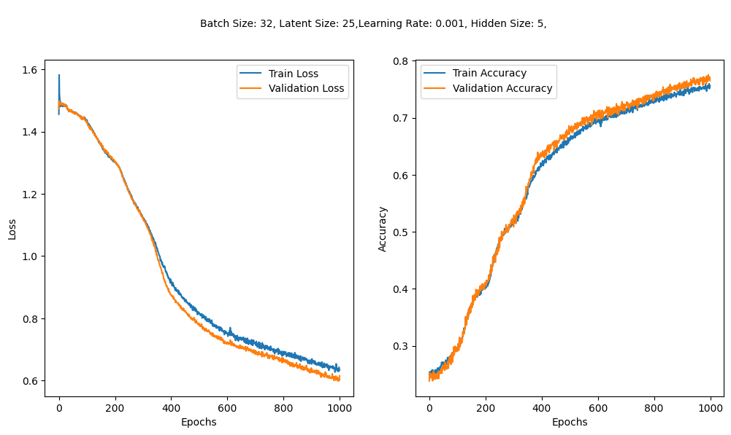
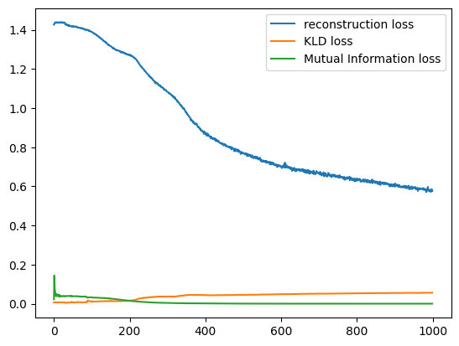
Preliminary result
Lambda: 0.002
Beta: 0.007

