Slide 1
July, 2024

Slide 2


CVAE Architecture
Decoder
Encoder
One-Hot Encoded
Sequences
Input Layer
Latent
Space
z
Input Layer (latent)
Bi-LSTM
Fully Connected (Lin)
Condition
Fully Connected (Lin)
Bi-LSTM
Condition
$$µ_{z}$$
$$σ_{z}$$
Fully Connected (Lin)
Reshape
Decoded
Sequences
Here condition is spectra

Slide 3
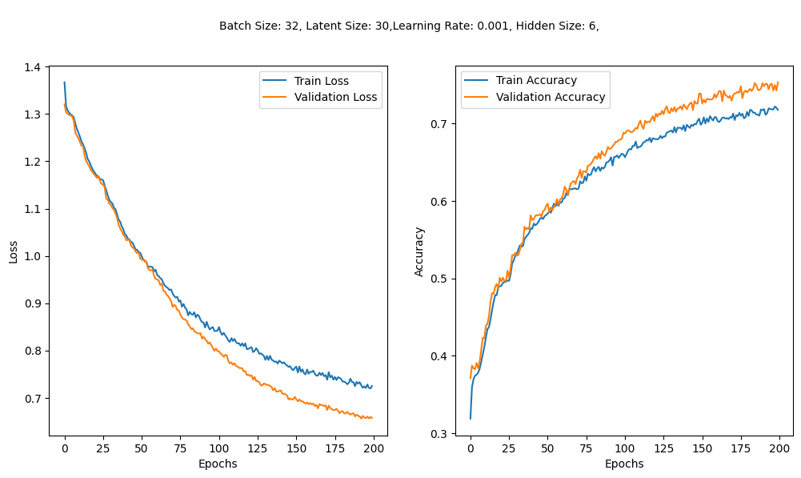
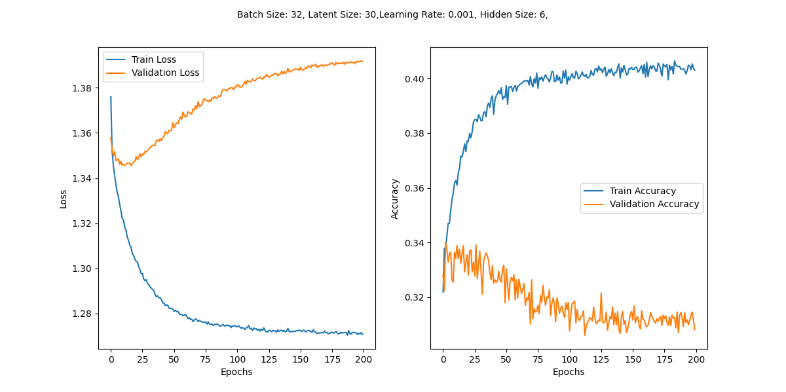
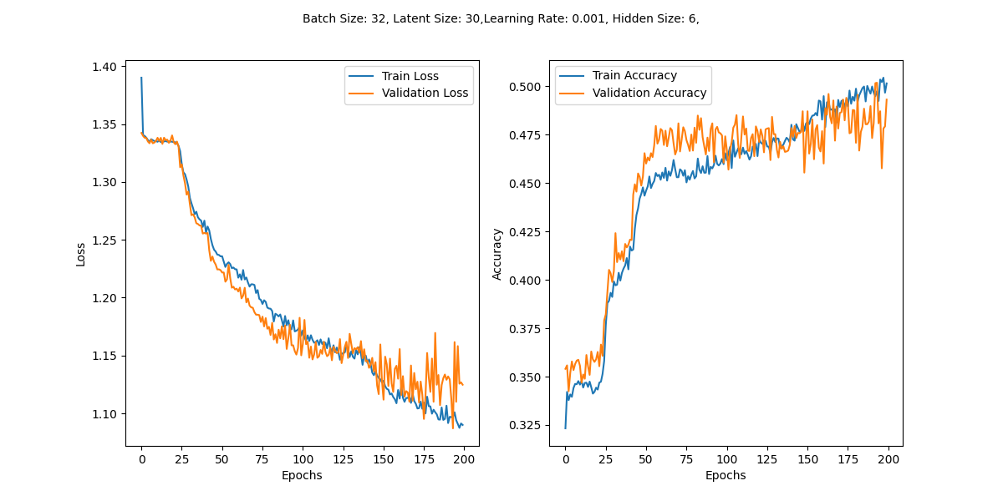
Tested the effect of different condition values on the performance of CVAE
1
2
Plot 1: CVAE trained with spectra as the condition.
Plot 2: CVAE trained with random values as the condition.
Plot 3: CVAE trained with condition where all values are set to one
The hyperparameters were kept the same across all tests; only the conditions were varied.
Results:
Using the original spectra as conditions led to a stable model.
The use of spectra as conditions appears to be effective in training the CVAE.
3

Slide 4
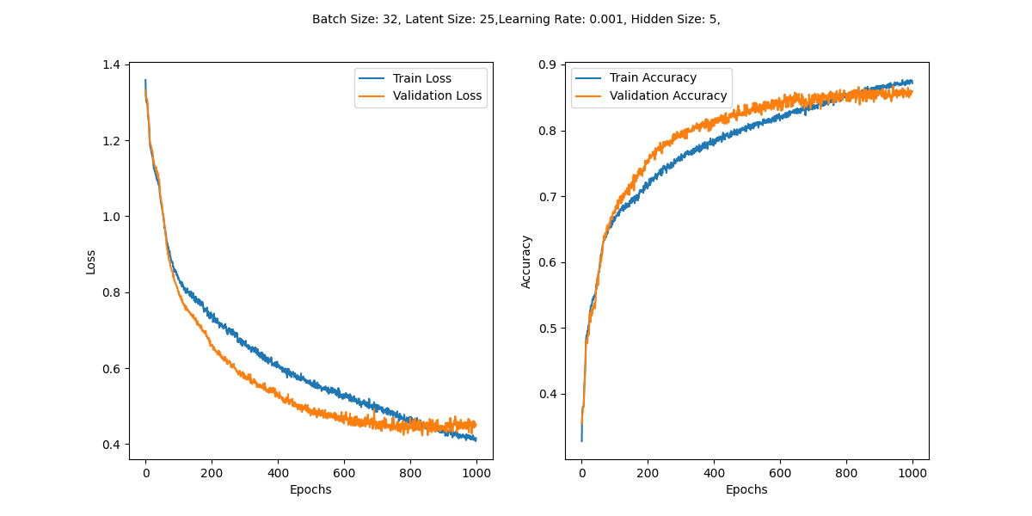
Best model so far
The reason that validation accuracy is higher than train accuracy is because dropout is used during training but not during evaluation. Dropout helps prevent overfitting by turning off some neurons randomly, which makes training tougher. When evaluating, dropout is off, so the model performs better on validation data.
Dropout helps the model generalize well but makes training accuracy lower. Without dropout, training accuracy is similar to validation accuracy.

Slide 5
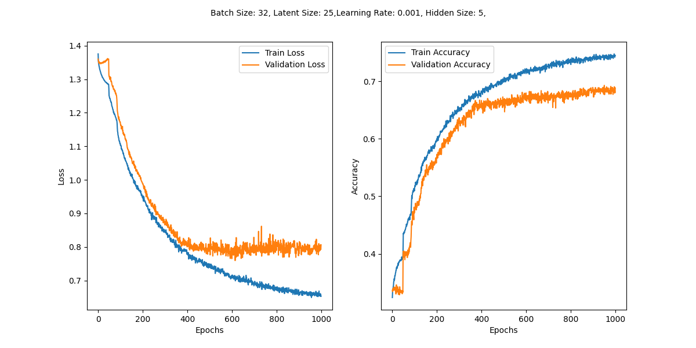
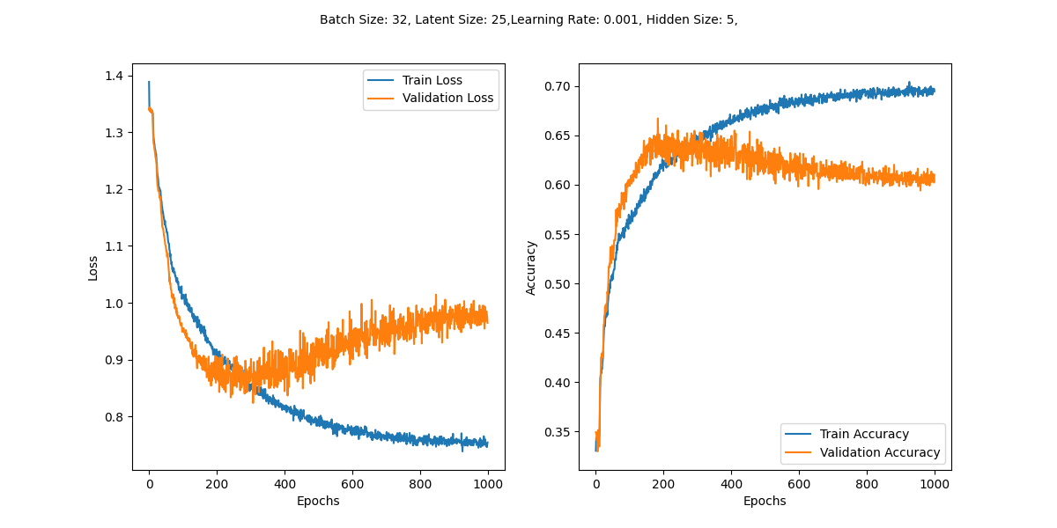
Best model so far
Again tested with both random condition and condition where all values are set to one
Condition: Random
Condition = 1

Slide 6
Sampling
For each class (green, red, farred) the data is filtered to include only sequences corresponding to specific wavelength ranges.
Within each class, only the first peak of the spectrum is considered (for now just for simplicity, we can then decide which peak is more logical or select the brightest peak)
To generate sequences for a specific class (e.g., green), a random subset of the spectra from this class is selected.
This subset is then combined with the latent vector z from a standard normal distribution and used by the CVAE decoder to generate the desired DNA sequences.

Slide 7
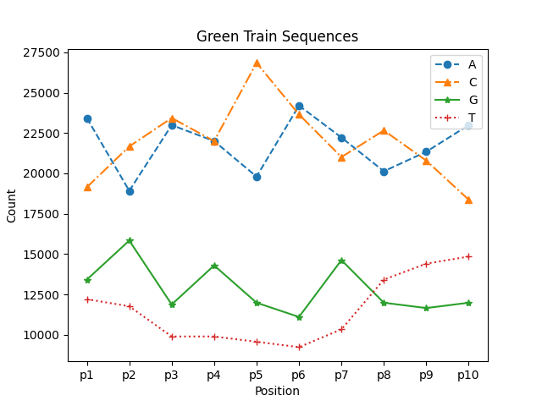
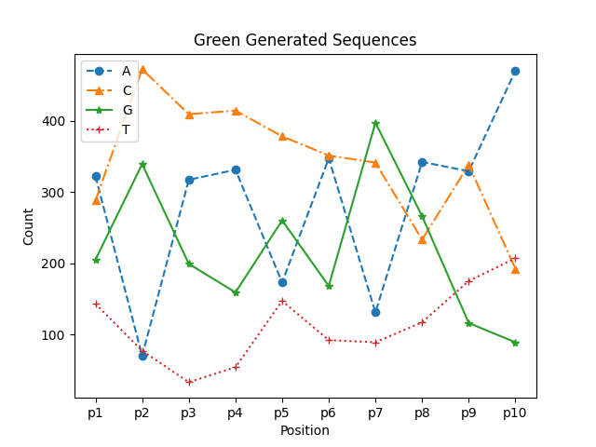
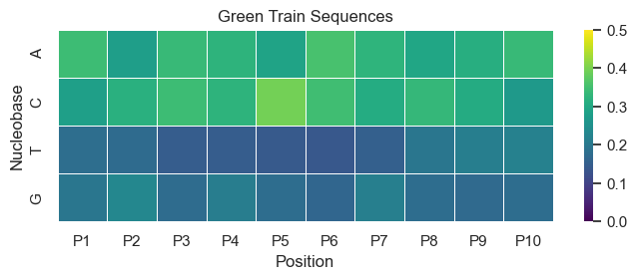
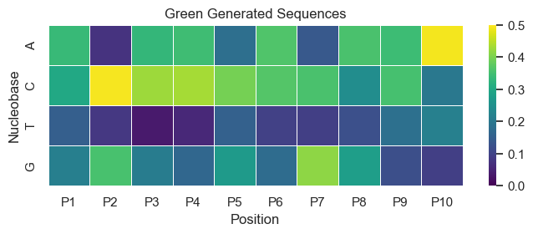
Green Sequences
heatmap show normalized frequencies of bases across 10positions, each position is normalized by calculating the total count of all bases at that position. after that frequency of each base is divided by this total count.

Slide 8
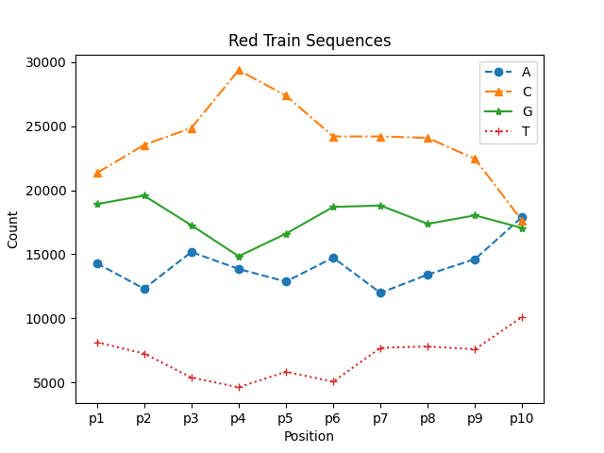
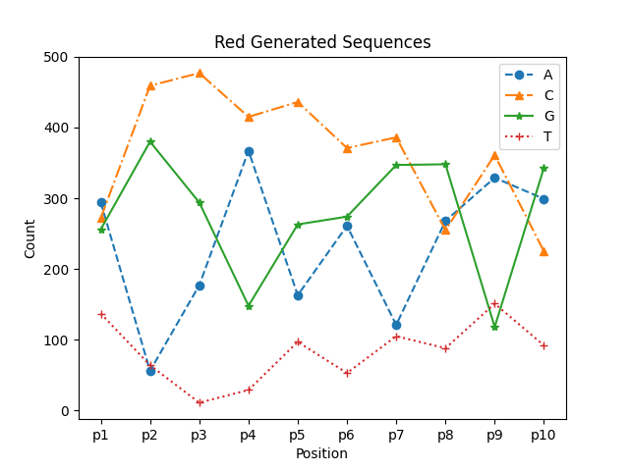
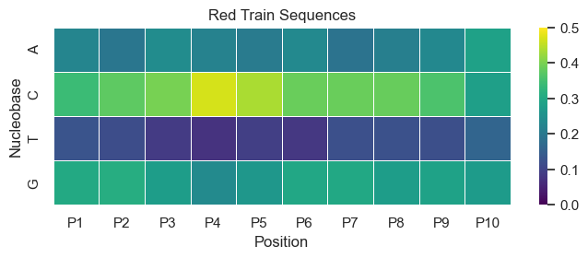
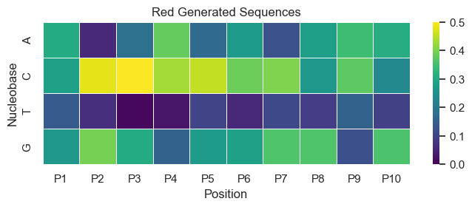
Red Sequences

Slide 9
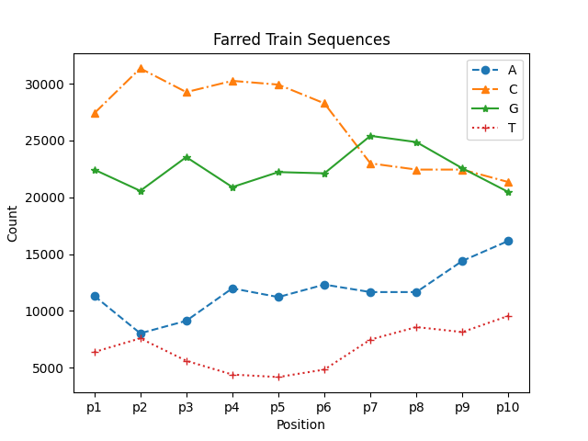
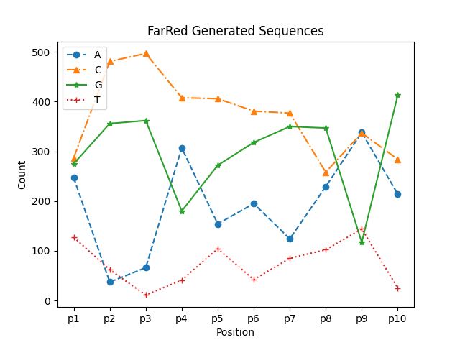
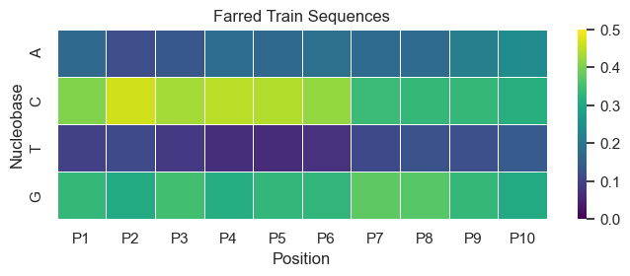
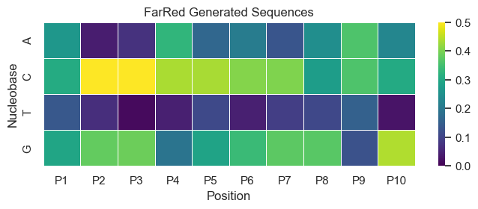
FarRed (660<WAV<800 nm)

Slide 10
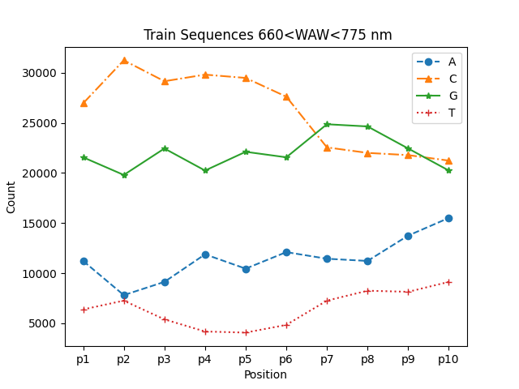
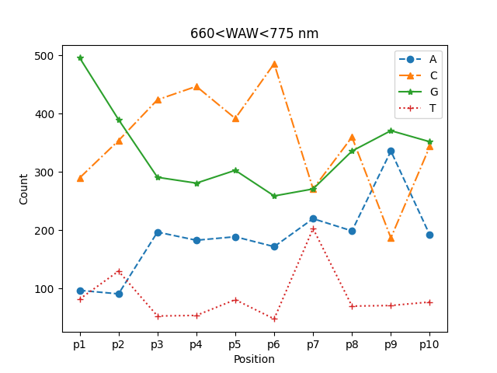
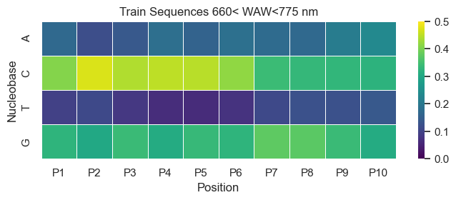
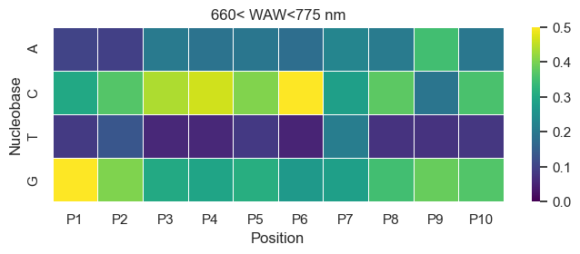
660 < WAV< 775 nm

Slide 11
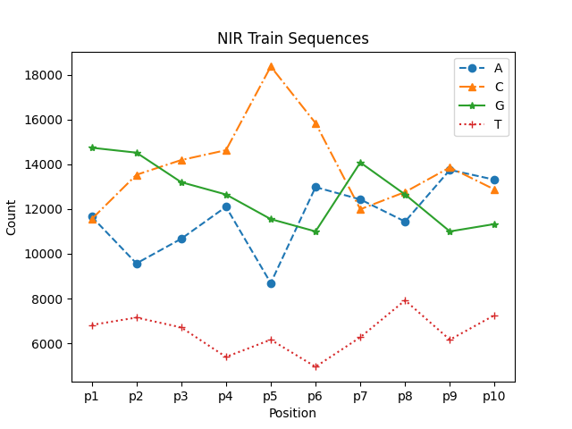
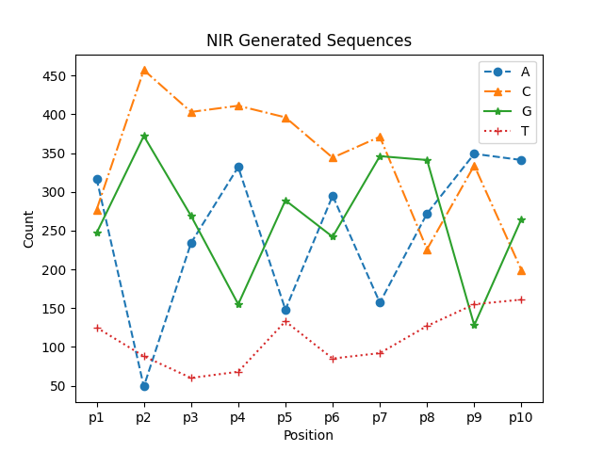
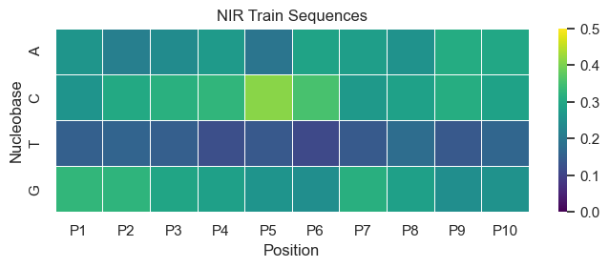
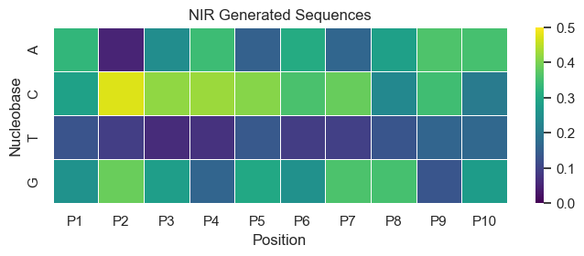
NIR Sequences (WAV > 800nm)

Slide 12
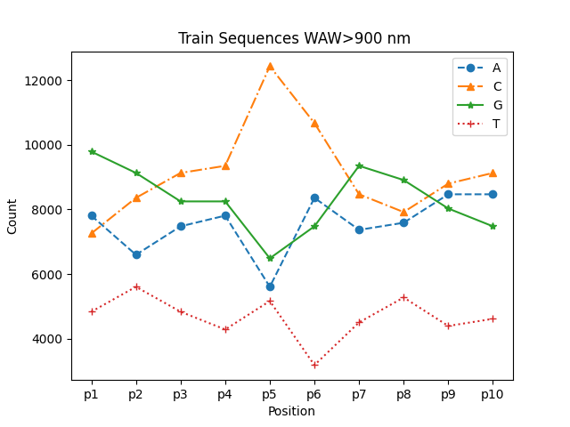
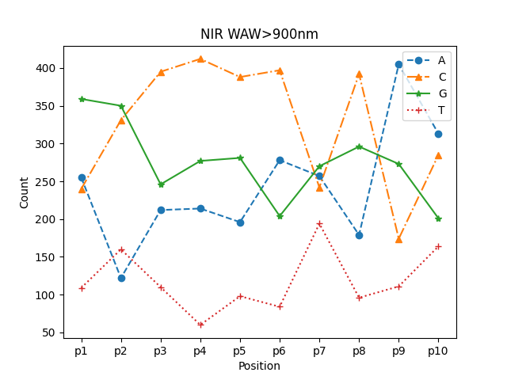
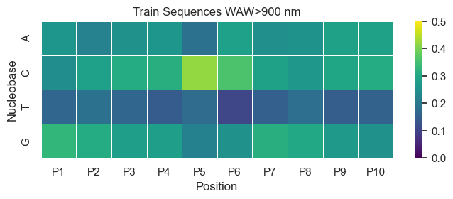
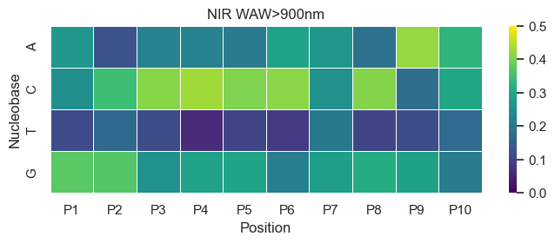
WAV>900 nm

Slide 13


CVAE & Mutual information
Decoder
Encoder
One-Hot Encoded
Sequences
Input Layer
Latent
Space
Input Layer (latent)
Bi-LSTM
Fully Connected (Lin)
Condition
Code
c
Fully Connected (Lin)
Bi-LSTM
Condition
$$µ_{z}$$
$$σ_{z}$$
Variable
z
Fully Connected (Lin)
Decoded
Sequences
Reshape
Condition: spectra
c: continuous latent code (input-independent)
z: latent representation of input

Slide 14
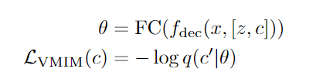
Auxiliary Network
The auxiliary network 𝑞(𝑐∣𝑥) approximates the posterior distribution 𝑝(𝑐∣𝑥′) for the VMIM loss.
The VMIM loss guarantees that the latent codes c are informative and not ignored.
where θ is the output of a fully connected layer(auxiliary network) which predicts the latent codes c from the generated data 𝑥′
During backpropagation, gradients are computed for all parameters that influence the overall loss function. This includes the parameters of the auxiliary network since the VMIM loss directly involves the predictions made by this network,so its gradients are w.r.t the parameters of this network.
These gradients flow through the auxiliary network, implicitly training it. This means that the parameters of the auxiliary network are updated to optimize the VMIM loss, improving its ability to predict the latent codes c accurately.
No need for additional explicit loss (e.g., MAE), simplifying training.

Slide 15
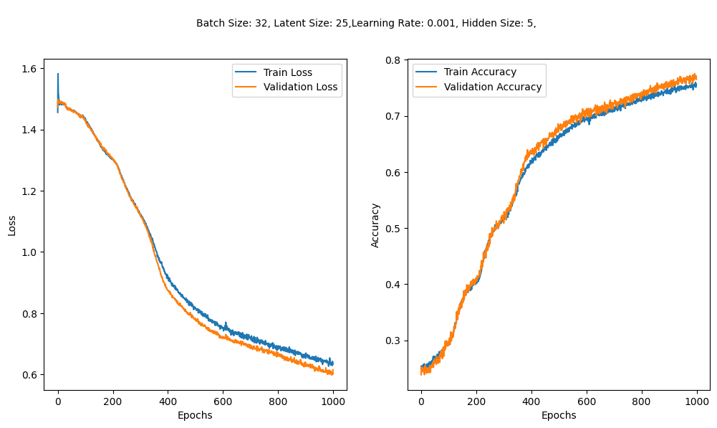
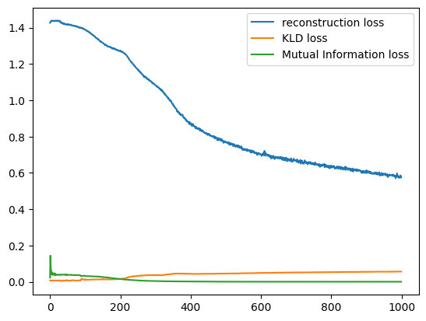
Preliminary result
Lambda: 0.002
Beta: 0.007

