Slide 1
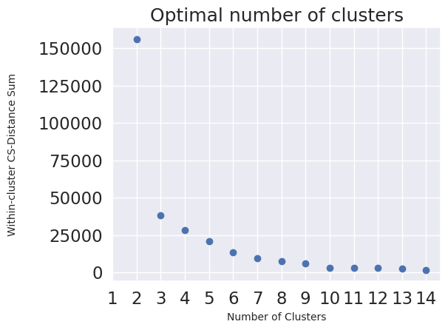
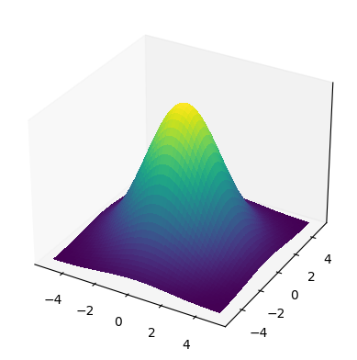




D_{cs} = S(i) - S(j)
Pair-wise
Distance
Similarity
Optimal Number of Clusters
Gaussian Kernel
Spectral Clustering
n×n
n×n
Across-Cluster Distance
D_{z} = Z(i) - Z (j)
Cauchy–Schwarz Distance Function
Align
Pair-wise
Distance
Across-Cluster Distance
Correlation (Geometry Preserving)
n×n
6×6
6×6
Spectra
Training
Sequences
Latent Space
Designed
Sequences
Euclidean Distance Function
Training Data Distribution in Joint Space
AACACGAGAT
GGACCGGACC
GAGGTCGTCA
CCCCGAAGTT
.
.
.
GGGGCCCGGT
AAAAGATGTT
AACCCCTCCA
CCTGGGGGGT
AAACCGGAGC
AGCCGAAGTT
.
.
.
CAACGGGTCG
CCTGGGGGGT
AAACCGGAGC
AGCCGAAGTT
.
.
.
CAACGGGTCG
Encoder
Decoder
Encoder
$$µ$$
$$µ$$
Rank
$$σ$$
$$σ$$
Sample
n : Number of instances
6 : Number of clusters
Wet Lab Validation

