Slide 1
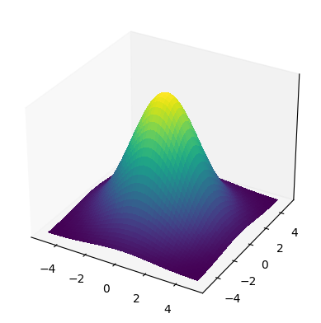




Model architecture and data flow overview
D_{cs} = S(i) - S(j)
D_{z} = Z(i) - Z (j)
Pair-wise
Distance
Align
Pair-wise
Distance
Cauchy–Schwarz Distance Function
n×n
n×n
Euclidean Distance Function
Spectra
Training
Sequences
Latent Space
Training Data Distribution in Joint Space
Designed
Sequences
AACACGAGAT
GGACCGGACC
GAGGTCGTCA
CCCCGAAGTT
.
.
.
GGGGCCCGGT
AAAAGATGTT
AACCCCTCCA
CCTGGGGGGT
AAACCGGAGC
AGCCGAAGTT
.
.
.
CAACGGGTCG
CCTGGGGGGT
AAACCGGAGC
AGCCGAAGTT
.
.
.
CAACGGGTCG
Encoder
Decoder
Encoder
$$µ$$
$$µ$$
Rank
$$σ$$
$$σ$$
Sample
Wet Lab Validation

Slide 2
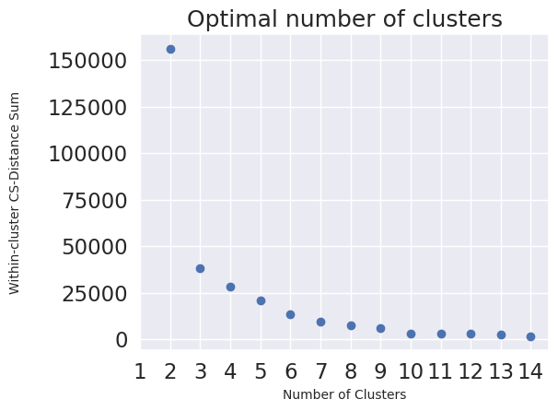
Evaluation
D_{cs} = S(i) - S(j)
Pair-wise
Distance
Gaussian Kernel
Similarity
Spectral Clustering
Optimal Number of Clusters
n×n
n×n
Across-Cluster Distance
D_{z} = Z(i) - Z (j)
Pair-wise
Distance
Across-Cluster Distance
Correlation (Geometry Preserving)
6×6
6×6
n×n

Slide 3
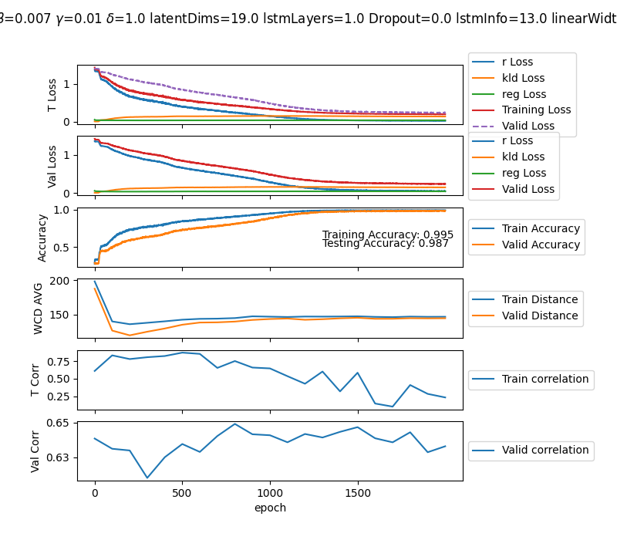
Gamma= 0.01
Latent dimension= 19
The model cannot maintain the balance between r-loss and reg-loss.
Using a small gamma value, close to 0, leads to good accuracy.
However, because the impact of regularization is very low, the correlation drops as the accuracy reaches a higher value

Slide 4
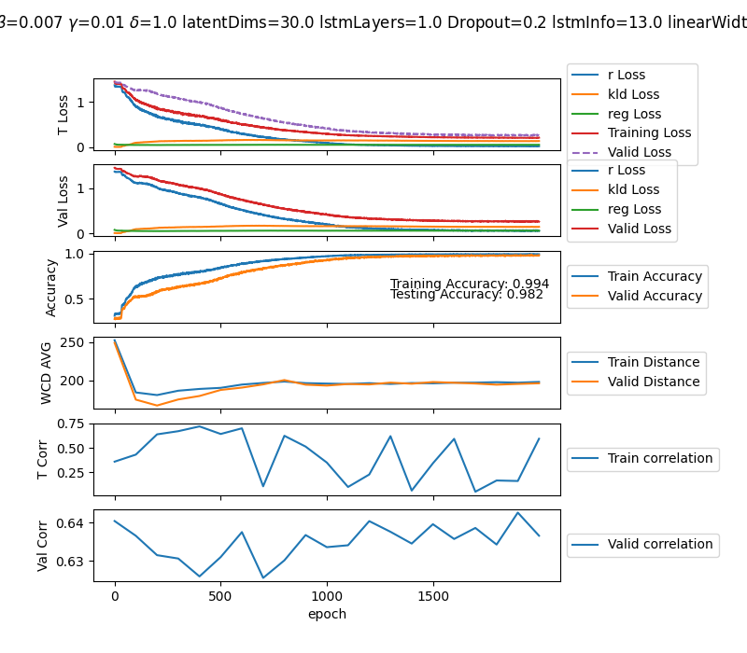
Gamma= 0.01
Latent dimension=30

Slide 5
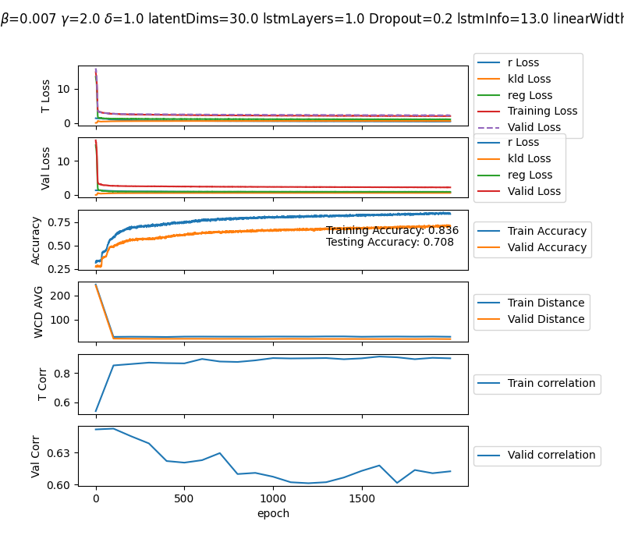
Gamma= 2
Latent dimension=30

