Slide 1

Inkscape
Founder : Nathan Hurst

Slide 2
Inkscape is a free and open-source vector graphics editor.
It can be used to create or edit vector graphics such as illustrations, diagrams, line arts, charts, logos and complex paintings.
It is available in 90 languages.
It’s primary format is Scalable Vector Graphics (SVG) version 1.1

Slide 3
Operating Systems
FreeBSD
Linux
macOS
Windows

Slide 4
Initial release date : November 2 2003 (0.91 version)
Preview release : March 11 2018 (0.92.3 version)
The latest version of Inkscape is available for Ubuntu, OpenSUSE, Microsoft Windows and macOS platforms.

Slide 5
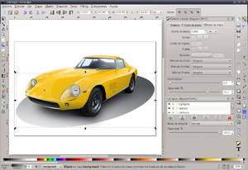
Inkscape 0.91

Slide 6

Licensing model :

