Slide 1
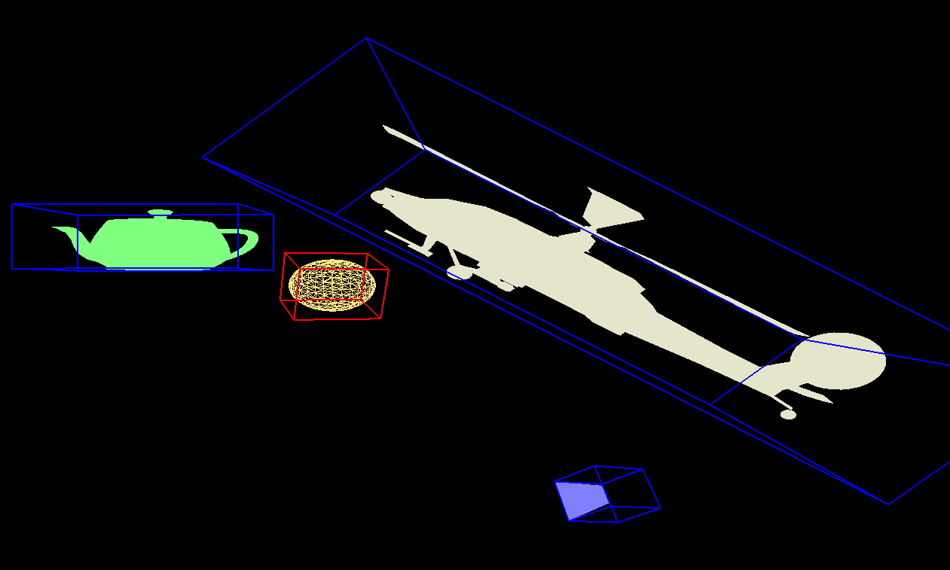
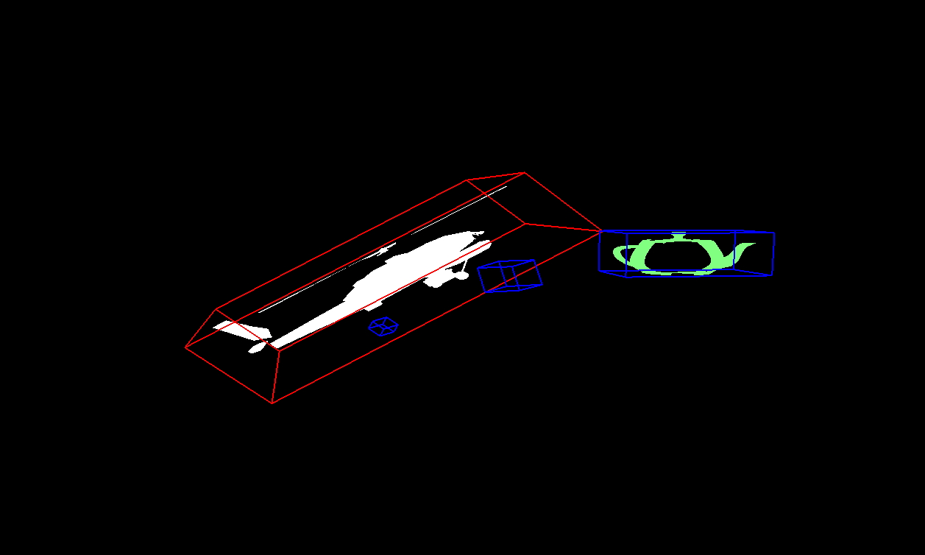
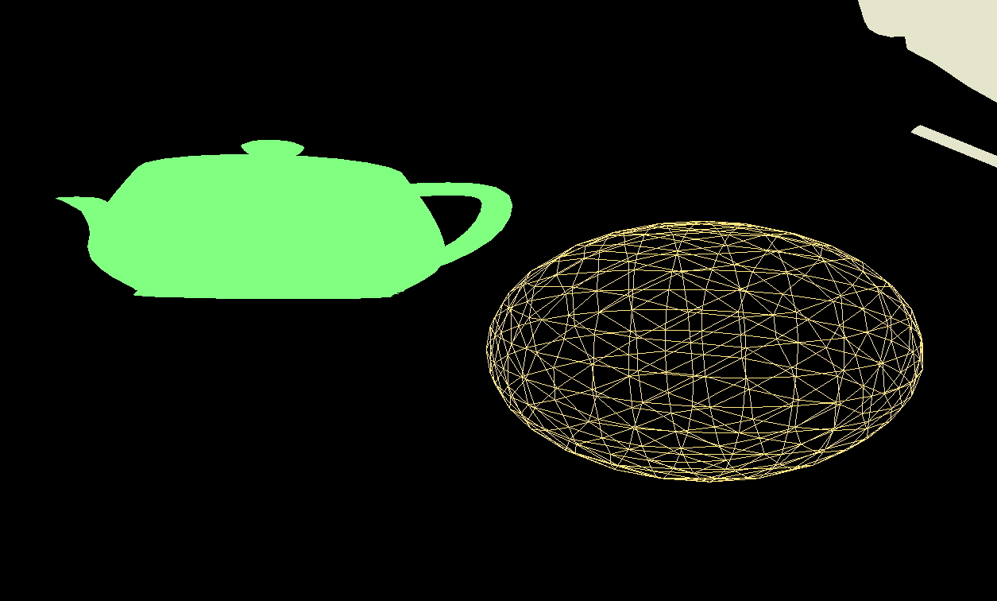
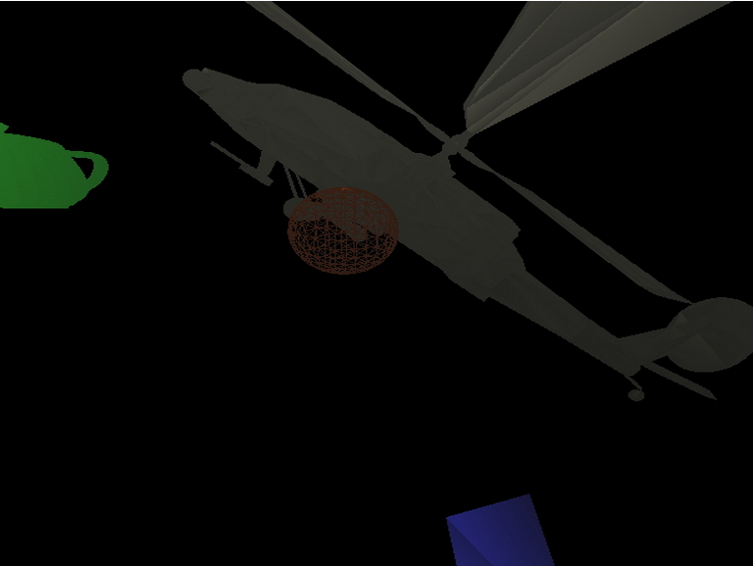
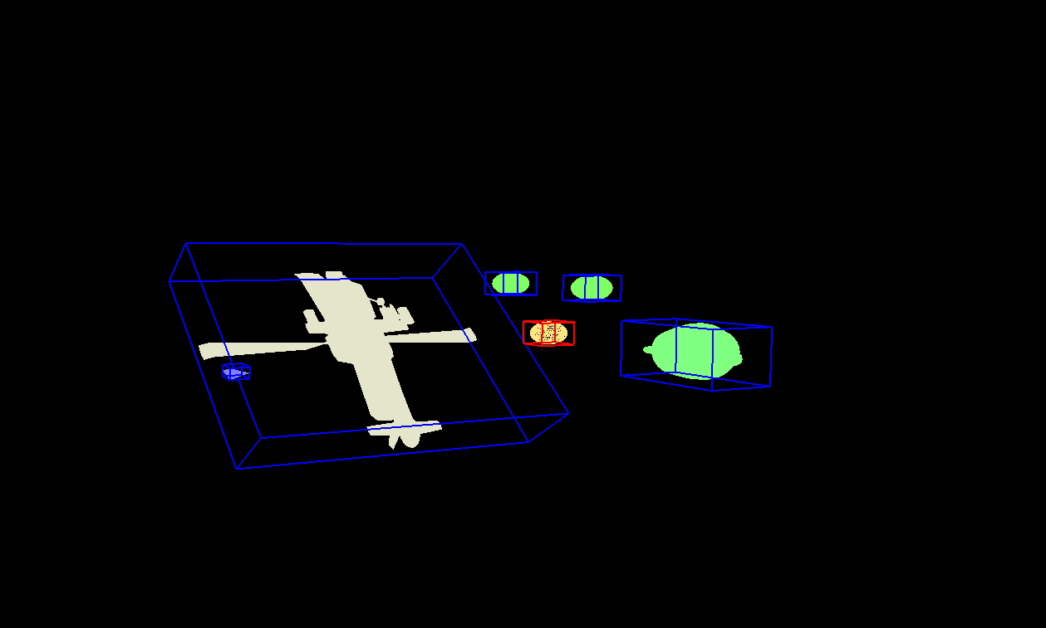
An Accessible, Extensible API Layered over OpenGL
Jon Neel
EECS 466
Fall 2013
Abstract
OpenGL can be a complex and difficult-to-understand framework for implementing code that deals with graphics. The graphics pipeline, although intuitive after much use, can seem insurmountable to the uninitiated. The goal of this project was to create a more intuitive and easy-to-use API layered on top of OpenGL that abstracts out the more difficult parts of OpenGL itself, while giving me an opportunity to craft a well-designed framework with custom implementations of the concepts covered in class.
The focus of this project is creating an extensible basis for a framework that can be easily added on to. There are several concepts tied together in one cohesive whole. The first of which is the streamlining and unifying of the different coordinate frames in the graphics pipeline. The second is the implementation of a concrete camera class, each instance of which has a defined state that can be recovered at any given time and can be used in conjunction with any number of other cameras in the scene. Tangentially, each camera instance can have custom clipping boundaries and can have its projection mode toggled between orthographic and perspective. The third is the ability to configure scenes such that they can be swapped out for any number of other scenes on the fly. A fourth task was to allow for quick and easy configuration and swapping of illumination, shading, and texturing of objects in the scene via GLSL integration.
Background and Motivations
OpenGL makes it difficult to move between coordinate frames. OpenGL inextricably ties the model matrix and the view matrix together, and to manipulate these matrices independent of one another, it is up to the developer to manage the matrix representations of the coordinate systems he or she is using at any given time. This API lets the developer work exclusively in the world coordinate frame, while making it easy to manipulate model, view, or projection matrices directly for any class instance that uses one. Class instances that exist within these different frames keep track of the matrices unique to them, and allow the developer to jump freely between manipulation of these different frames without the need to manage them at the lower-level OpenGL layer. This makes it quick and easy to manipulate scores of different models, cameras, and scenes on the fly.
Once a user has defined their scenes, the are free to add any number of Cameras to those scenes, and manipulate Scene, Mesh, Light, and Camera properties at will. They can very easily move between different views of the same scene, or different scenes altogether. They can define their own rendering loops, or let the configuration files dictate necessary properties and allow the API to handle default rendering behavior for any Mesh or Light. They still need to define their own OpenGL functions for displaying, handling user input, and resizing, but can reduce what would other wise be hundreds of lines of code with complex maintenance requirements to a few method calls without dealing with the hassles inherent to managing such intricate structures and routines.
Finally, the user can choose to enable GLSL support in order to take advantage of the power and versatility of vertex and fragment shaders. The user loads his or her shaders into a ShaderHelper, which tracks them along with the GLSL program. The user then defines a callback function to hand off any variables or attributes the shaders require from the program. Once those two tasks are done, the API can automatically render everything for the user using the default rendering methods, or the user can code their own implementations.
Scene 2 - Camera 1: View of a scene fit to screen with various local transformations performed on a teapot, helicopter, pyramid, and sphere (selected; rendered with GL_LINES).
Scene 2 - Camera 2: Same scene with a very narrow clipping distance between near plane and far plane with the helicopter selected.
Scene 2 - Camera 3: Closeup view without bounding boxes shown.
Approaches and Applications
Very little is required of a developer to make use of this framework. They are responsible for creating configuration files for scenes that define the lights and meshes present in the scene, and properties thereof.
Scene 2 - Camera 2: Midrange view of the scene rendered using the GLSL integration with simple Phong illumination and Gouraud Shading.
Scene 3 - Camera 3: Far off view of the whole scene with no clipping.

